Slide 1
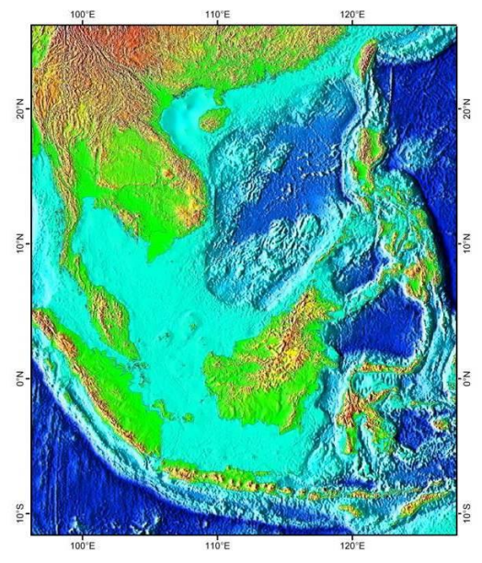
Implementing the Strategic Action Programme for the South China Sea and Gulf of Thailand (SCS-SAP)
by
Anders Poulsen
Project Manager, SCS-SAP

Slide 2



The South China Sea SAP Project
Six countries: Cambodia, China, Indonesia, Philippines, Thailand and Vietnam
Duration: 2018 – 2024 2026
Funding: 15 mill USD, GEF International Waters Programme
Implementing and Executing agencies: UNEP and UNOPS
Based on Transboundary Diagnostic Analysis (TDA) from 2000 and Strategic Action Programme (SAP) from 2008

Slide 3
The SCS-SAP Project:
Component 1.
Reducing habitat degradation and loss via national and local reforms to achieve Strategic Action Programme targets for coastal habitat management in the South China Sea
Component 2.
Strengthening knowledge-based action planning for the management of coastal habitats and land-based pollution to reduce environmental degradation of the South China Sea
Component 3.
Facilitating regional and national level integration and cooperation for implementation of the South China Sea Strategic Action Programme

Slide 4
The SCS-SAP Project:
Component 2: Strengthening knowledge-based action planning for the management of coastal habitats and land-based pollution to reduce environmental degradation of the South China Sea
Outcome 2.1: Enhanced information-base for coastal habitat management, monitoring and action planning
Outcome 2.2: Effective integration of regional science in the management of land-based pollution
Outcome 2.3: Strengthened and harmonized national policies and laws, and supporting financial mechanism, for the management of habitats and land-based sources of pollution
Outcome 2.4: Updated Total Economic Values of coastal habitats for use in development planning and decision-making and blue economy
Outcome 2.5: Regionally appropriate tools and mechanisms to guide the development of sustainable management systems for coastal habitats and land-based pollution
Outcome 2.6: Updated and Ministerially adopted Transboundary Diagnostic Analysis and Strategic Action Programme, including prioritization of national management actions to address climate variability and change

Slide 5
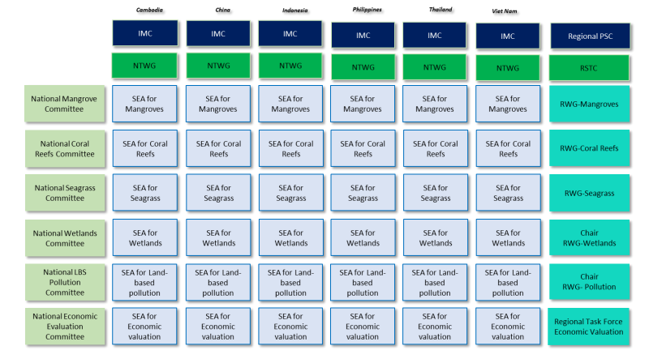
SCS-SAP Structure:

Slide 6
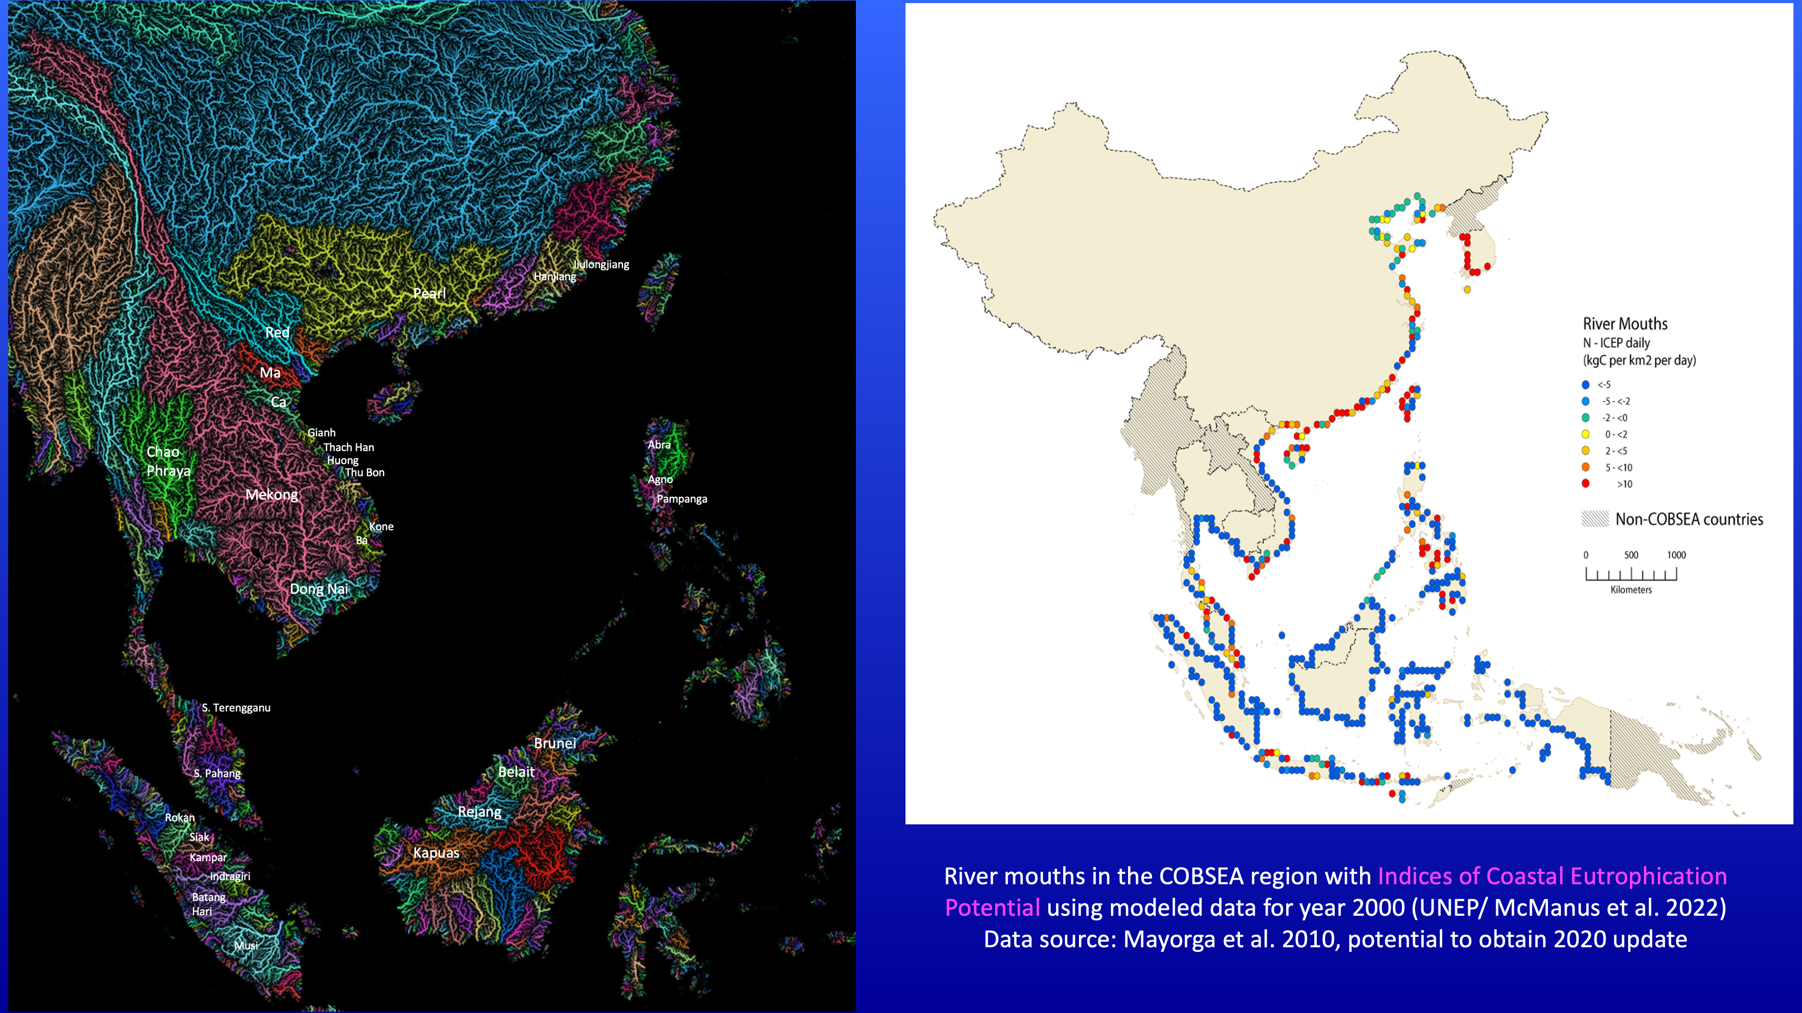
Science for TDAs

