Slide 1
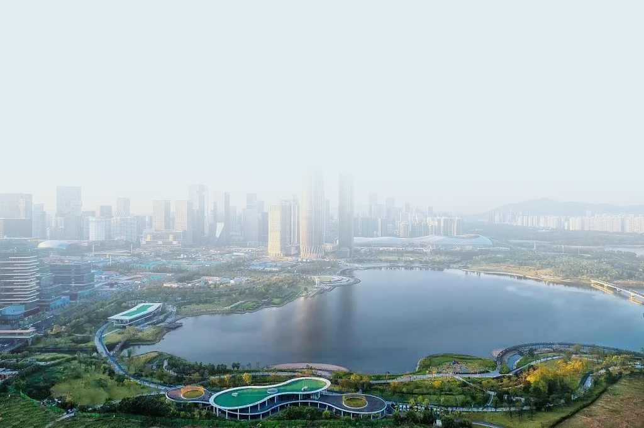






Implementing the Strategic Action Programme for the South China Sea and Gulf of Thailand (SCS SAP) Project
The Second Meeting of the Regional Working Group on
Land-Based Pollution
11-12 November 2024
Shenzhen, China

Slide 2
Implementing the Strategic Action Programme for the South China Sea and Gulf of Thailand (SCS SAP) Project
BREAK
10:15 - 10:30

Slide 3
Implementing the Strategic Action Programme for the South China Sea and Gulf of Thailand (SCS SAP) Project
LUNCH
12:00 - 13:30

Slide 4
Implementing the Strategic Action Programme for the South China Sea and Gulf of Thailand (SCS SAP) Project
RECEPTION DINNER
18:00 - 20:00

