Slide 1
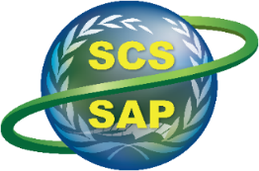
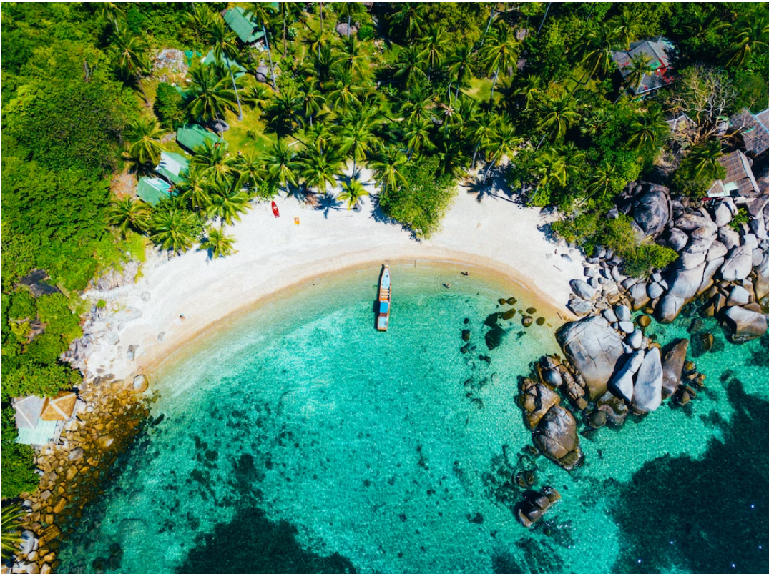
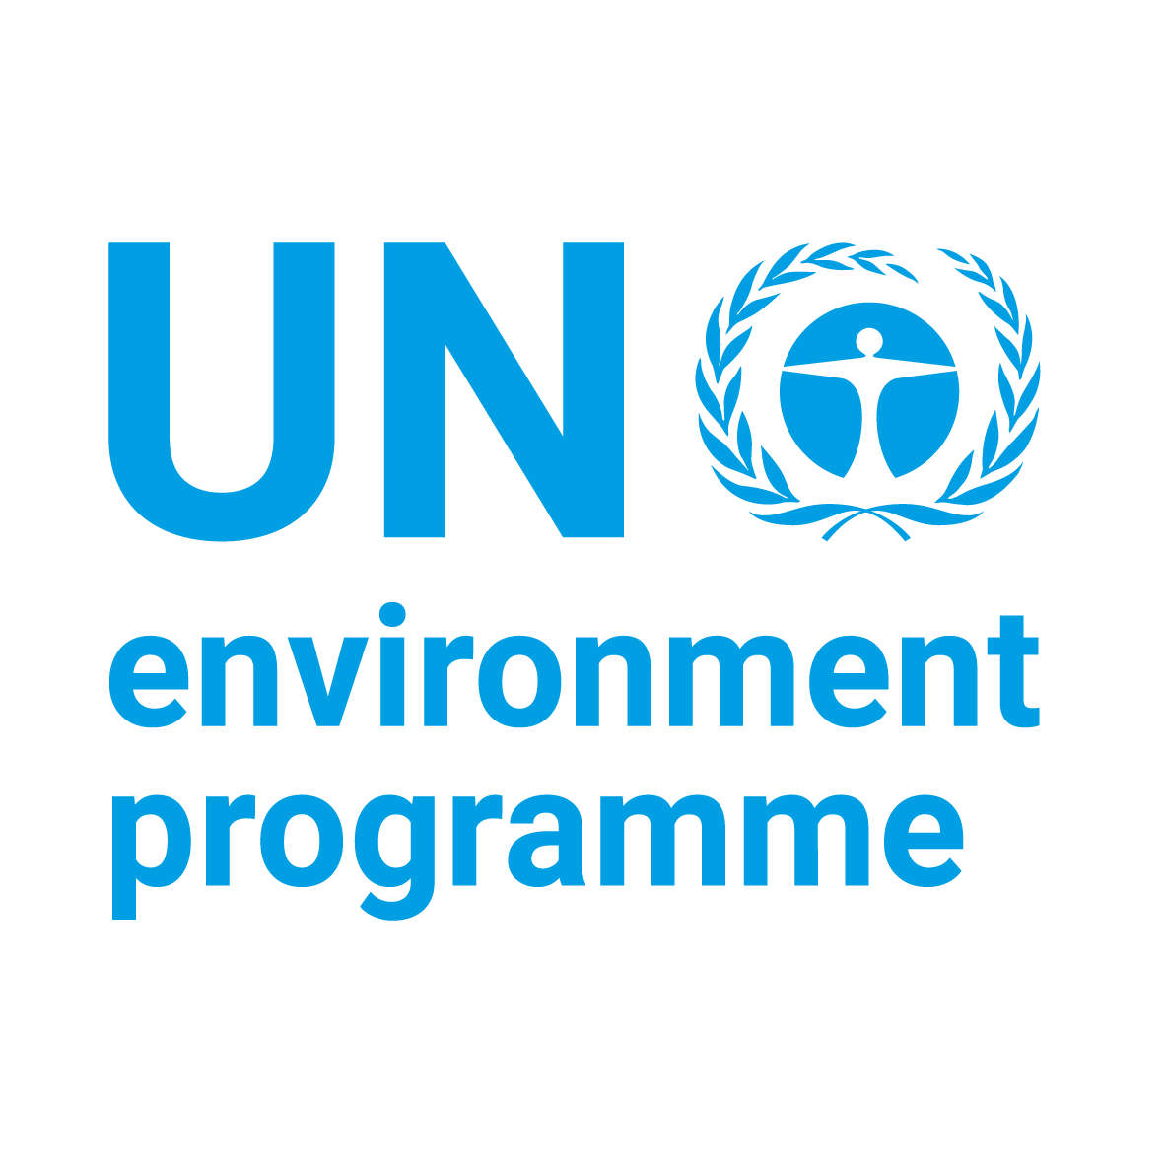


Implementing the Strategic Action Programme for the South China Sea and Gulf of Thailand (SCS SAP) Project
Second Meeting of the Regional Working Group on Land-Based Pollution (RWG-LBP)
11-12 November 2024, Shenzhen, China
Status of Preparation and Implementation of
Land-Based Pollution Activities
PHILIPPINES
Name of LBP Focal Point: TBD
Organization: SCPW (pending signing of GSA)

Slide 2
Implementing the Strategic Action Programme for the South China Sea and Gulf of Thailand (SCS SAP) Project
Updates on LbP-related activities & achievements for 2023-2024 (following the 1st RWG-LbP meeting)
PHILIPPINES
Name of LBP Focal Point: TBD
Organization: SCPW (pending signing of GSA)

Slide 3
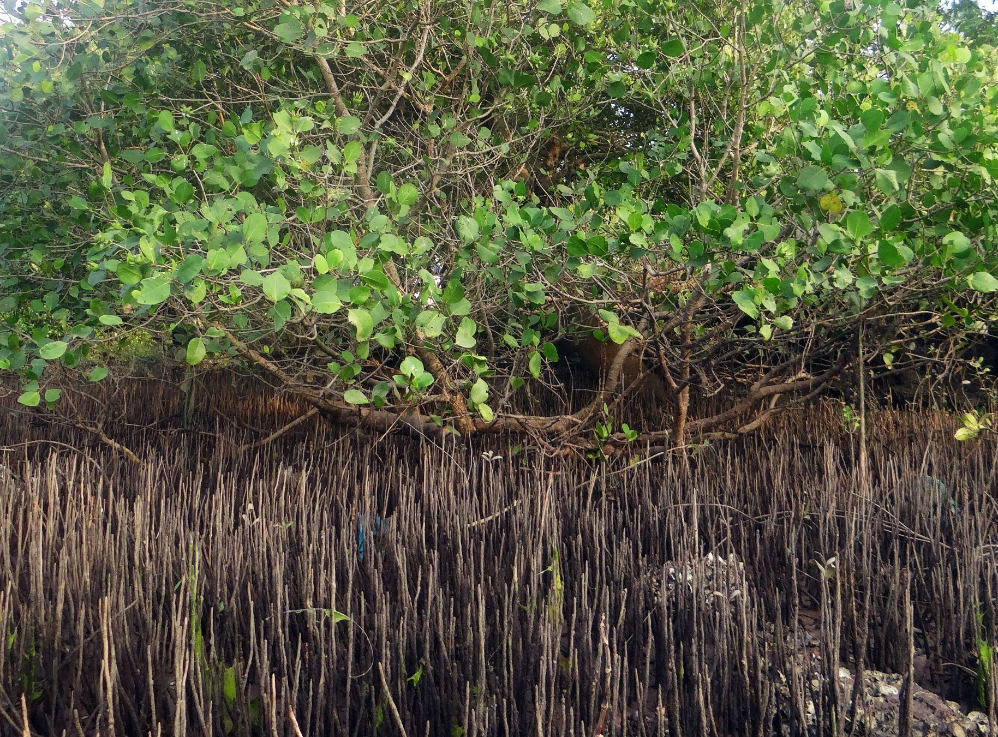
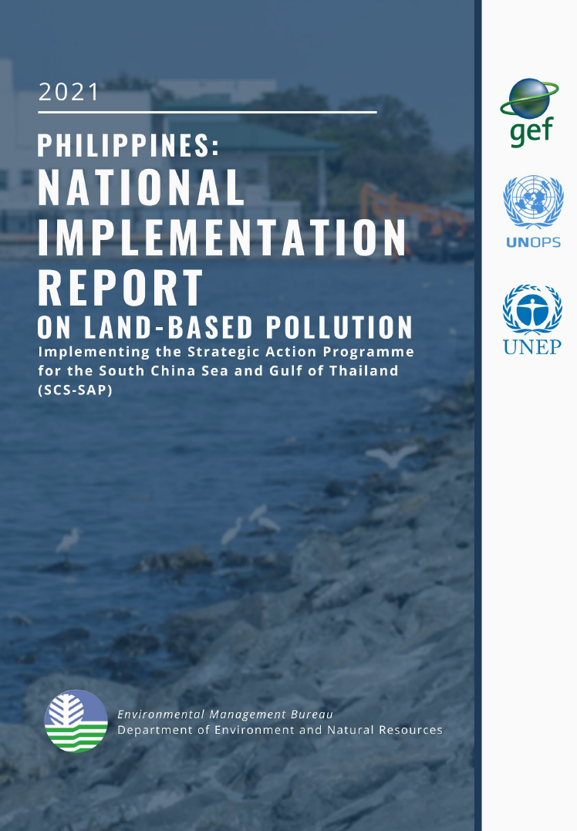
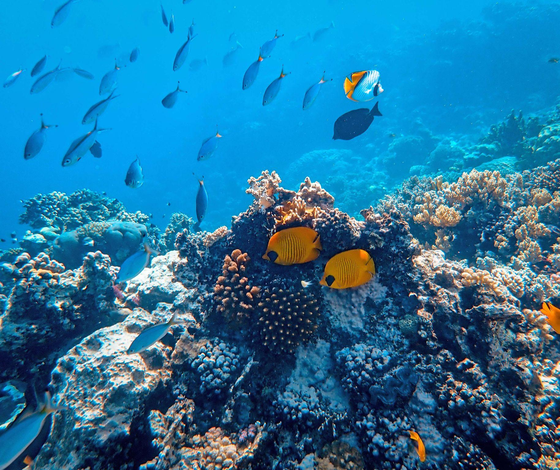
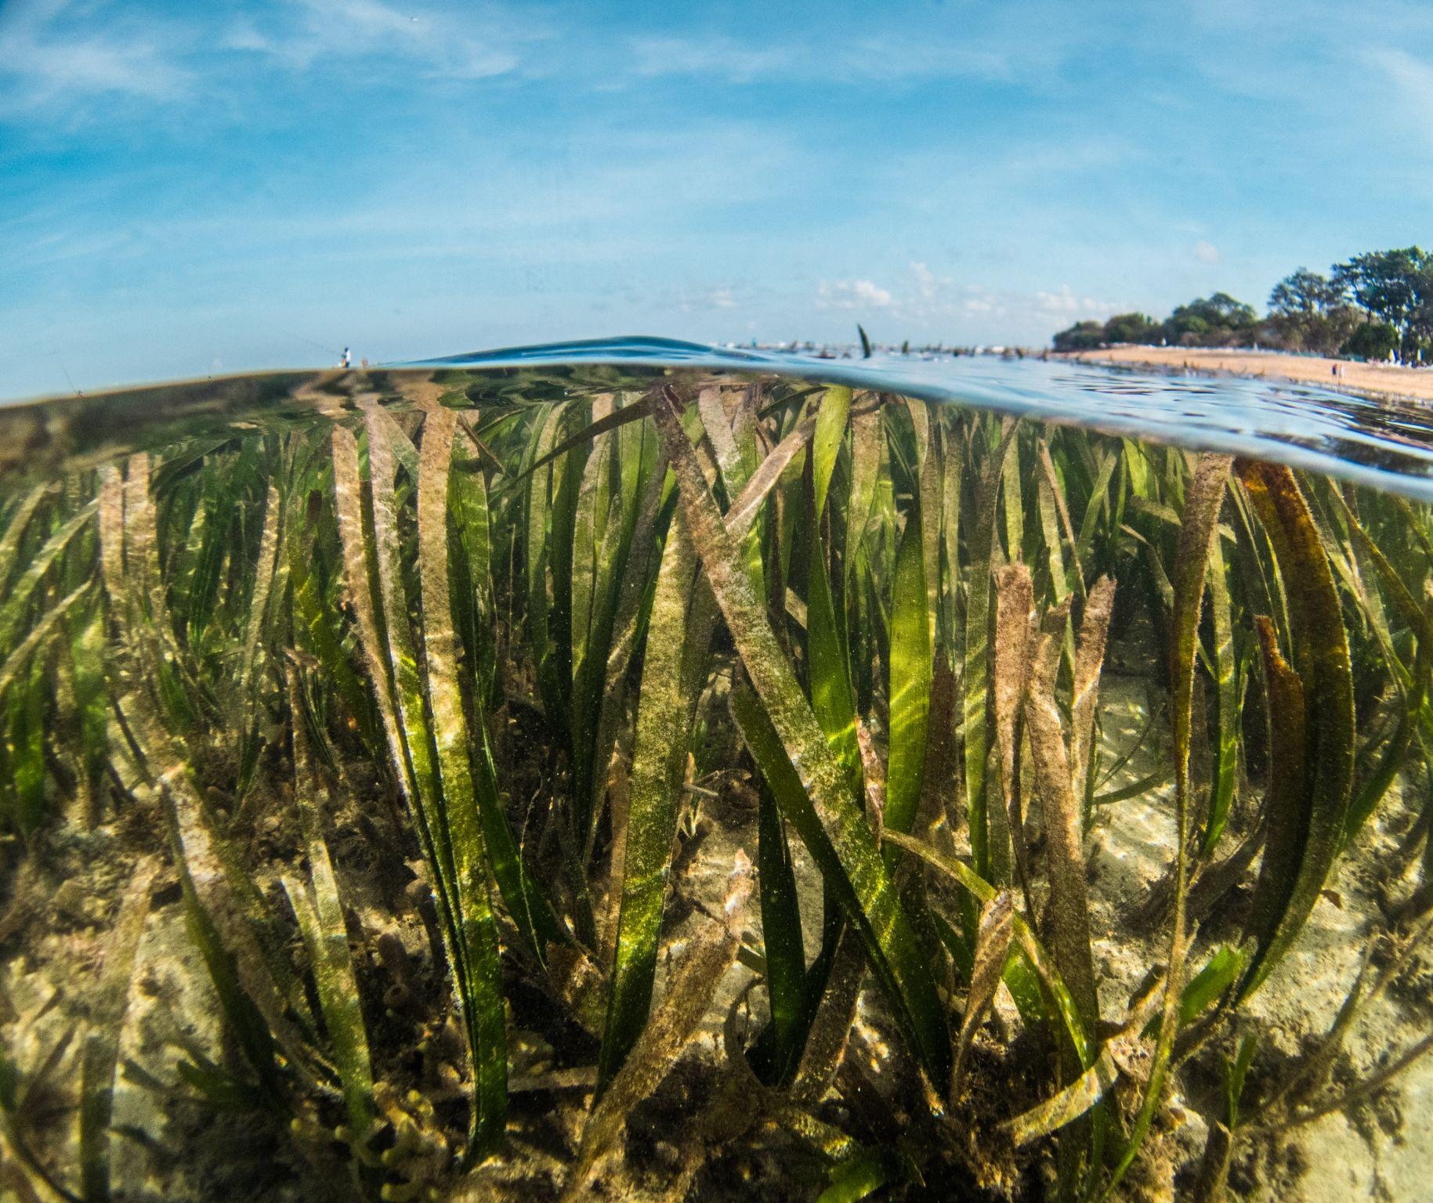
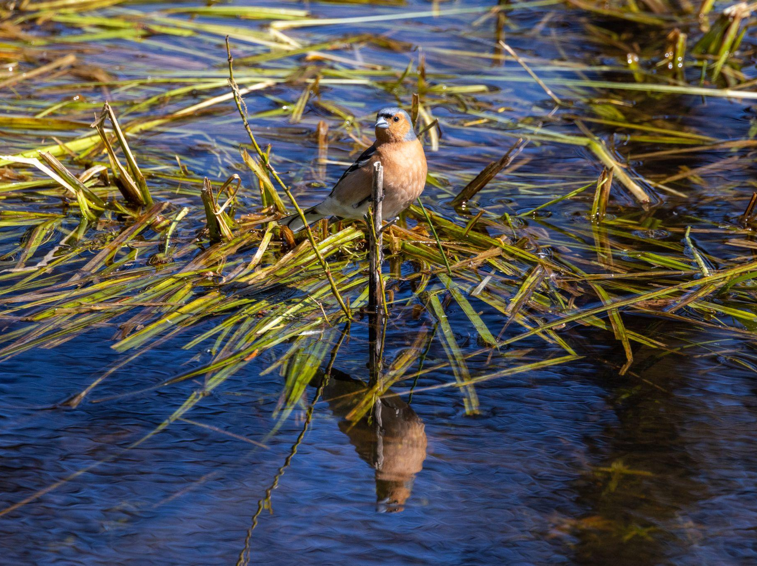
Updates on LbP related activities & achievements for 2023-2024 (following the 1st RWG-LbP meeting)

Slide 4
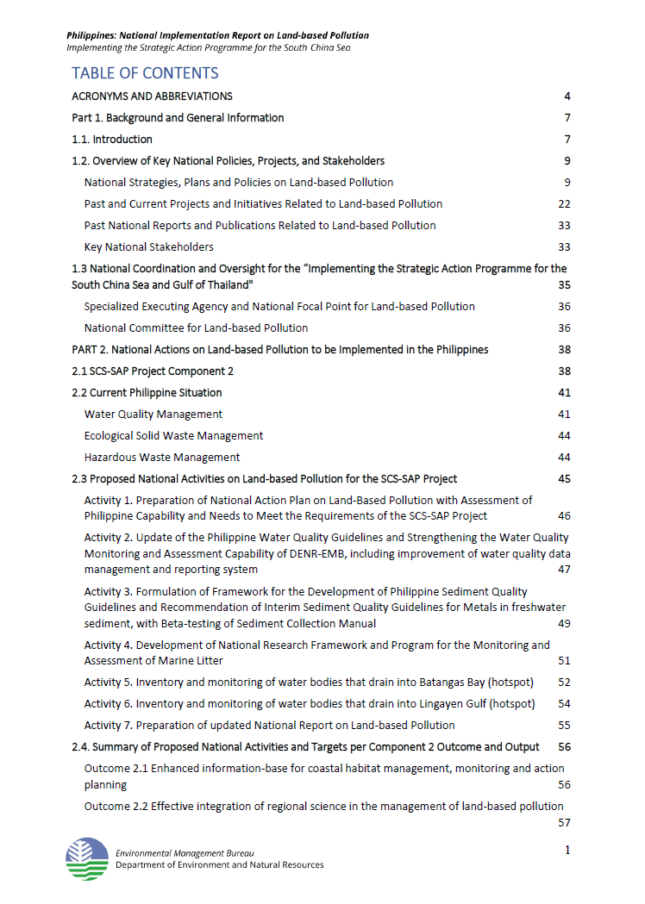
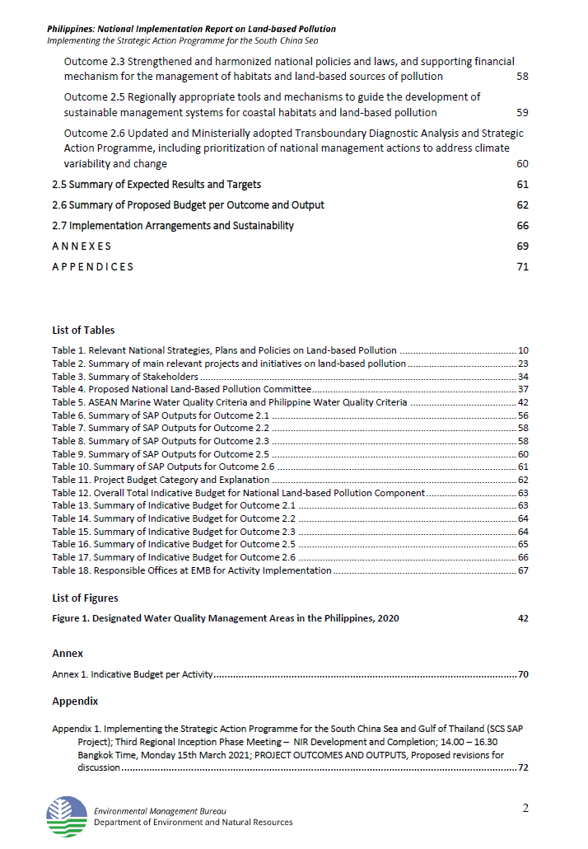
Updates on LbP related activities & achievements for 2023-2024 (following the 1st RWG-LbP meeting)

Slide 5
Legal & institutional matters
(3) Major laws of the Philippines that concern the management of land-based pollution include:
  Clean Water Act (Republic Act [RA] 9275; 2004);
  Ecological Solid Waste Management Act (RA 9003; 2001);
  Toxic Substances and Hazardous and Nuclear Waste Management Act (RA 6969; 1990).
There have been some moves in the Philippine Congress to update these laws, particularly RA 6969, but no concrete steps have happened.

Slide 6
Legal & institutional matters…
Under the Clean Water Act (CWA), the Department of Environment and Natural Resources (DENR), through the Environmental Management Bureau (EMB), is the primary agency responsible for managing and enforcing water quality standards. The DENR's key responsibilities include, among others:
Preparing and implementing the National Water Quality Status Report.
Developing the Integrated Water Quality Management Framework (IWQMF).
Formulating and enforcing action plans for each Water Quality Management Area (WQMA).
Conducting groundwater vulnerability mapping.
Establishing Water Quality Guidelines and General Effluent Standards.
Defining sampling and pollutant analysis procedures and accrediting laboratories.
Classifying water bodies, groundwater sources, and identifying pollution sources.
Conducting information and dissemination campaigns. etc

Slide 7
Legal & institutional matters…
Local Government Units (LGUs) have designated roles in managing water quality within their areas. Their responsibilities include:
Monitoring water quality and responding to emergencies.
Ensuring compliance with the WQMA action plan.
Actively participating in efforts to protect and rehabilitate water quality.
Coordinating with other government agencies, civil society, and concerned sectors to control pollution.
Appropriating land for constructing sewage and septage treatment facilities, as required under Section 7 of RA 9275.
As of 2020, the Philippines has designated 37 WQMAs, plus 24 sub-WQMAs within the Laguna de Bay Basin, each governed by a board composed of representatives from member LGUs, national agencies, NGOs, and the business sector.

Slide 8
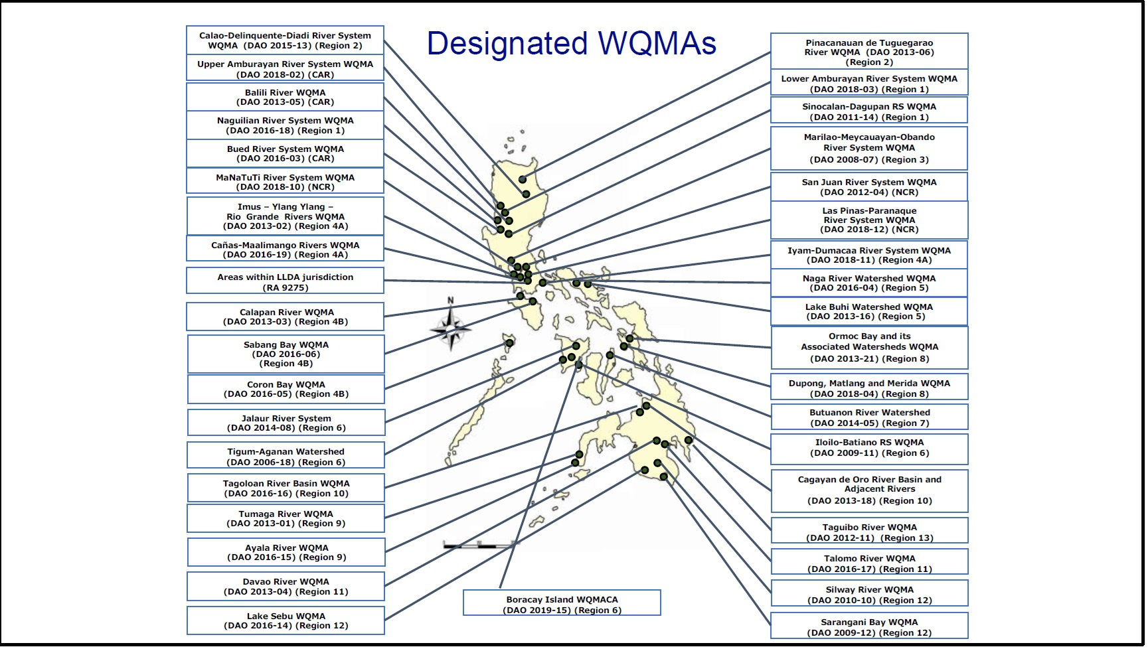
Legal & institutional matters…

Slide 9
Legal & institutional matters…
Under the Ecological Solid Waste Management Act (RA 9003), the Department of Environment and Natural Resources (DENR) has the following specific responsibilities, among others
Policy Development and Oversight: DENR, through the National Solid Waste Management Commission (NSWMC), formulates policies and guidelines for effective waste management.
Technical Assistance: Provides technical assistance and support to LGUs in developing and implementing local waste management plans.
Monitoring and Enforcement: Ensures compliance with waste management standards, penalizes violations, and oversees the closure of open dumpsites.
Waste Database and Reports: Manages a national database on waste generation and disposal, and publishes annual waste status reports.
Research and Development: Supports studies on sustainable waste management practices and technologies.
Public Awareness Campaigns: Conducts information dissemination to educate the public on solid waste management.

Slide 10
Legal & institutional matters…
Under the Ecological Solid Waste Management Act (RA 9003), Local Government Units (LGUs) have specific responsibilities…among others
Local Waste Management Plans: Develops and implements 10-year Solid Waste Management Plans (SWMPs), of which 1,029 cities and municipalities in the Philippines have complied.
Segregation, Collection, and Disposal: Enforces waste segregation at the source and ensures systematic collection and disposal of waste, including recyclable, biodegradable, and residual waste.
Materials Recovery Facilities (MRFs): Establishes MRFs for sorting and processing waste at the barangay or municipal level.
Regulation of Waste Facilities: Ensures the safe and legal operation of disposal facilities and prohibits the establishment of open dumpsites.
Community Engagement: Leads local public awareness campaigns and encourages community participation in waste reduction and recycling efforts.
Coordination and Compliance: Works with other LGUs, DENR, and civil society to align with the national waste management framework and control pollution.
The DENR and LGUs combined efforts aim to reduce land-based pollution, promote waste reduction, and foster sustainable ecological waste management practices across the country.

Slide 11
Legal & institutional matters…
The National Solid Waste Management Commission (NSWMC), under the Office of the Philippine President, oversees RA 9003's implementation, with the DENR-EMB acting as the Commission's Secretariat, providing technical support and ongoing capacity-building assistance to LGUs.
The DENR-EMB developed an NPOA to address marine litter, as the Philippines actively participates in the COBSEA RAP MALI. Marine litter in the Philippines is largely driven by land-based consumption patterns and waste management gaps, with non-biodegradable consumer goods packaging as primary contributors. The NPOA aims to update actions against marine litter, incorporating research, multi-stakeholder engagement, and a broader scope for addressing land-based pollution sources.
LGUs: Primary role in solid waste management; 10-year SWMPs
DENR-EMB: Technical support, Secretariat for NSWMC, capacity-building for LGUs
NSWMC Resolution 1363: directing DENR to ban single-use plastics in government offices
Marine Litter: NPOA targets land-based pollution, outdated marine litter policies

Slide 12
Legal & institutional matters…
Under the Toxic Substances and Hazardous and Nuclear Waste Management Act (RA 6969; 1990)RA, the Department DENR, through the EMB, leads the regulation and control of hazardous waste and toxic chemicals in the Philippines.
The DENR-EMB is responsible for creating and updating guidelines, including the 2013 Revised Procedures for Hazardous Waste Management, and issuing new policies to address emerging waste types, such as Waste Electronic and Electrical Equipment (WEEE).
Amid the COVID-19 pandemic, DENR-EMB adapted its operations, issuing Memorandum Circular 2021-02 to implement remote monitoring protocols across industries, addressing environmental regulations like the Clean Air Act, Clean Water Act, and hazardous waste control.
DENR-EMB faces challenges in updating policies, enhancing training, and upgrading equipment, but it remains committed to supporting initiatives like the SCS-SAP Project to manage land-based pollution.

Slide 13
The Extended Producer Responsibility Act (EPRA) of 2022
The law that amends Republic Act No. 9003, otherwise known as the Ecological Solid Waste Management Act of 2000, to institutionalize the extended producer responsibility on plastic packaging waste.
RA 11898 aims to address the alarming concern of plastic waste in the Philippines by encouraging producers to reduce the amount of plastic they bring into the ecosystem and implement programs aimed to recover waste.
The EPR Act of 2022 is primarily concerned towards plastic packaging waste, ranging from sachets and single use plastics to rigid plastic containers and polystyrene. By the end of 2023, 20% of the plastic generated during the year must be recovered. This target increases by increments of 20% and by 2028 and in the succeeding years, producers are required to recover 80% of their plastic waste produced during the year.
Source: https://emb.gov.ph/

Slide 14
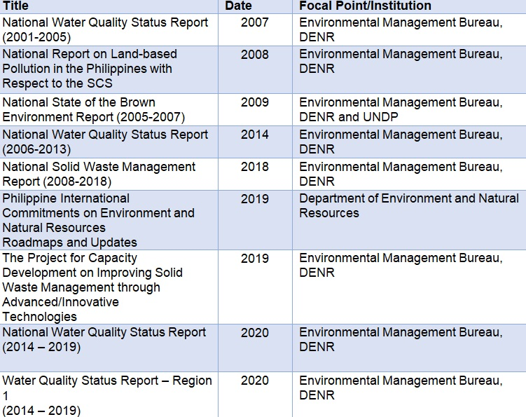
Research and Assessment (Source: EMB-DENR. Philippines NIR on LBL, 2021)

Slide 15
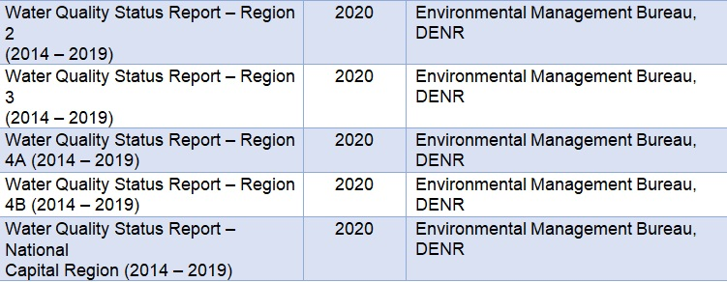
Research and Assessment ((Source: EMB-DENR. Philippines NIR on LBL, 2021)

Slide 16

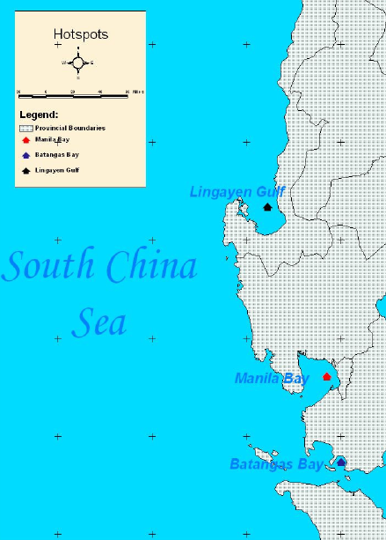
Monitoring status and trends of changes in identified hot spots and monitoring stations
Three (3) hotspots were identified :
  Batangas Bay (Region 4A),
  Lingayen Gulf (Region 1), and
  Manila Bay (National Capital Region [NCR])
Notes:
During a Working Group Meeting for land-based Pollution, 3 hotspots facing the South China Sea were identified. These are the Batangas bay, lingayen gulf, and Manila Bay

Slide 17
Monitoring status and trends of changes in Batangas Bay hotspot

Slide 18
Monitoring status and trends of changes in Batangas Bay hotspot

Slide 19
Status on coordinating national activities and contributing regional activities for 2025-2026
Introduction of specialized executing agency on LBP
To be arranged as soon as the GSA is signed
Outline on National Working Group on LBP (members, organizations)
To be arranged as soon as the GSA is signed
Expert/s to join TDA team
To be identified as soon as the GSA is signed

Slide 20
Challenges and recommendations for implementing LbP activities for 2024-2026
Schedule for signing and implementing new/amended PCA/GSAs
Soon…
Challenges
DENR’s (EMB) non-participation in the implementation; limited access to data, staff, and other assets
Tight time frame
Upcoming elections in May 2025

Slide 21
Challenges and recommendations for implementing LbP activities for 2024-2026
Recommendations
As a matter of priority, conduct courtesy calls and briefings with on-site partners, e.g., PCSD; Palawan Provincial Governor; DENR PENROs, and CENROs; LGUs of Coron, Busuanga, Taytay, and San Vicente; PASU of MSPLS; PNP MG SOU 2
Organize and convene the PSC
Execute Sub-grant Agreement with the Community-Centered Conservation (C3)
Preparation of TORs and hiring of staff and consultants
Conduct on-site Inception workshop (Coron, Palawan)

