Slide 1

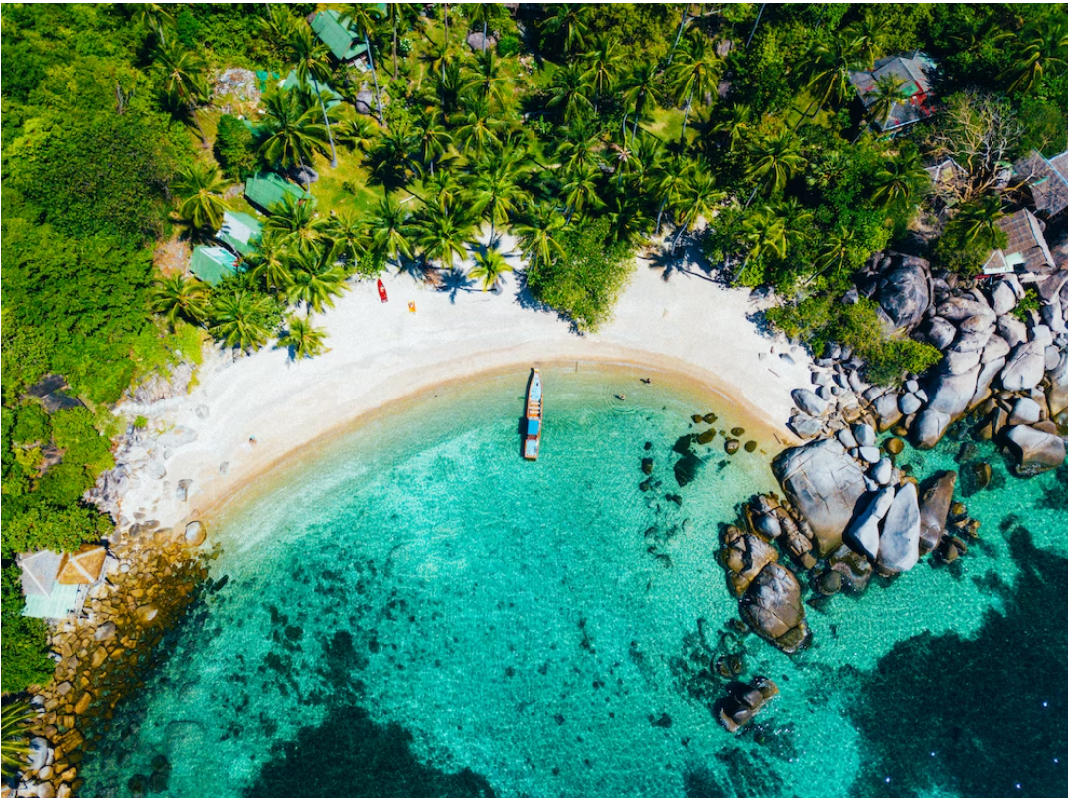



Implementing the Strategic Action Programme for the South China Sea and Gulf of Thailand (SCS SAP) Project
Second Meeting of the Regional Working Group on Land-Based Pollution (RWG-LBP)
11-12 November 2024, Shenzhen, China
Status of Preparation and Implementation of
Land-Based Pollution Activities
INDONESIA

Slide 2
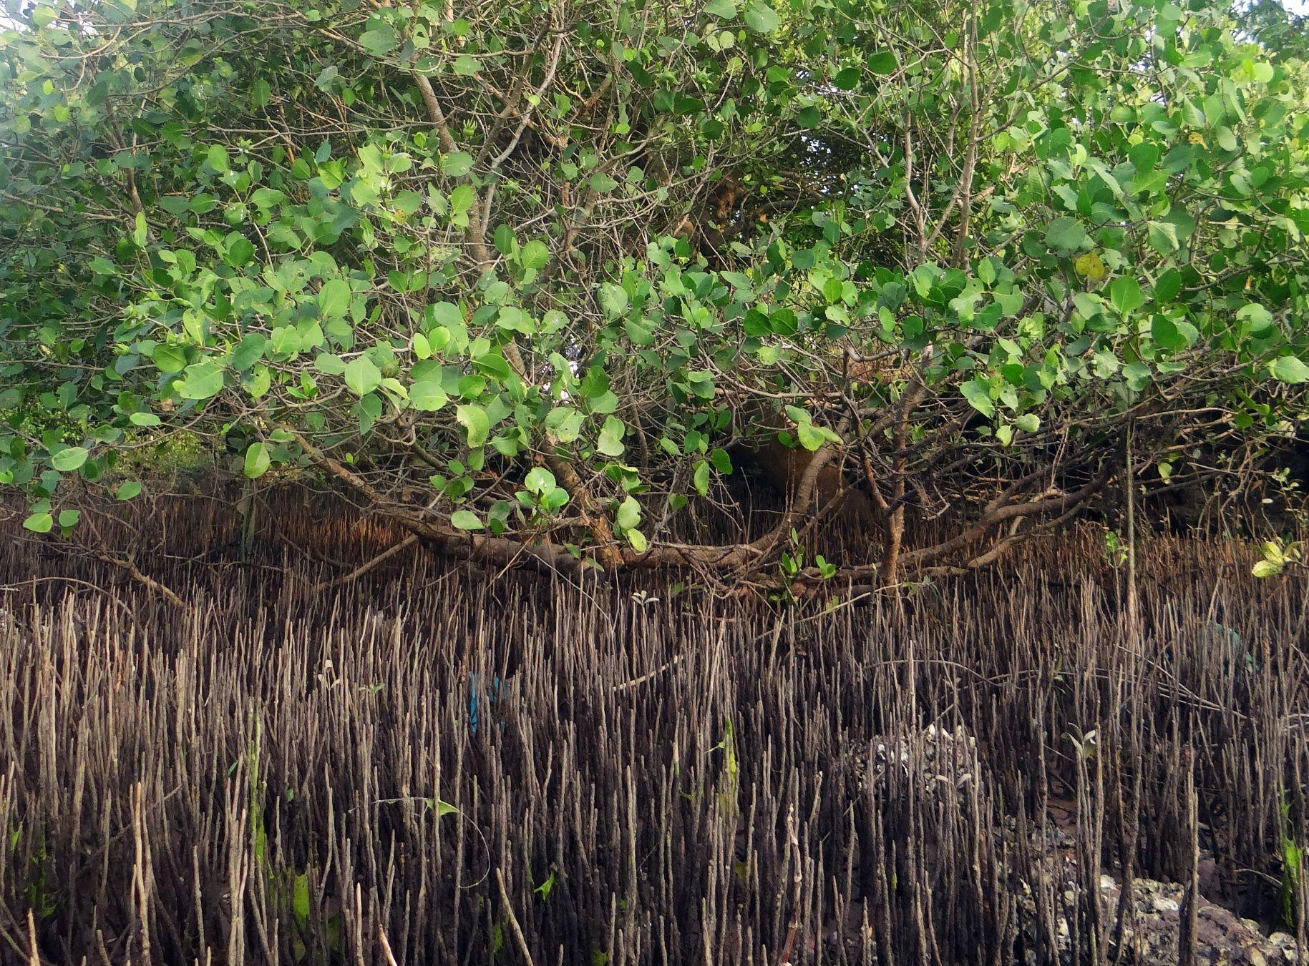
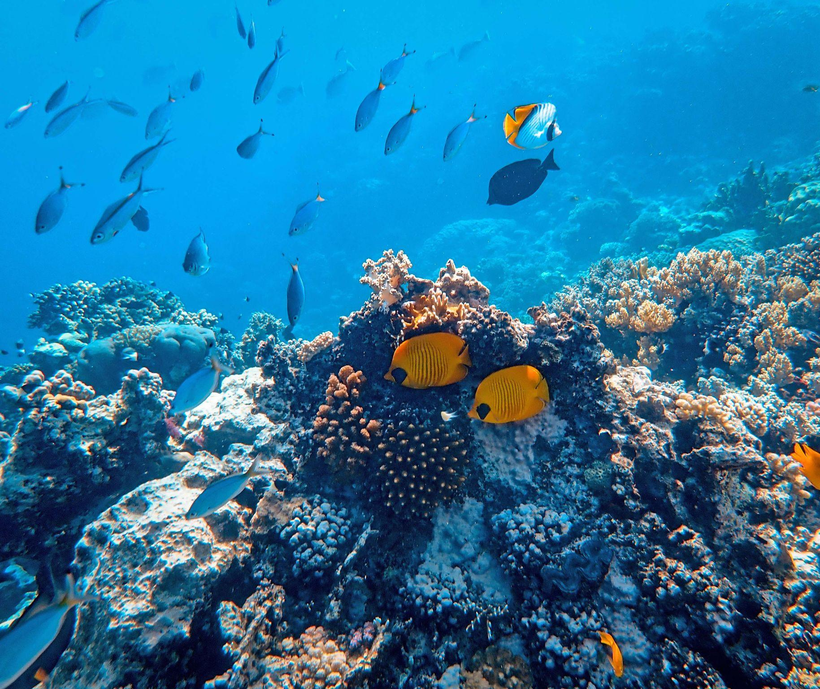
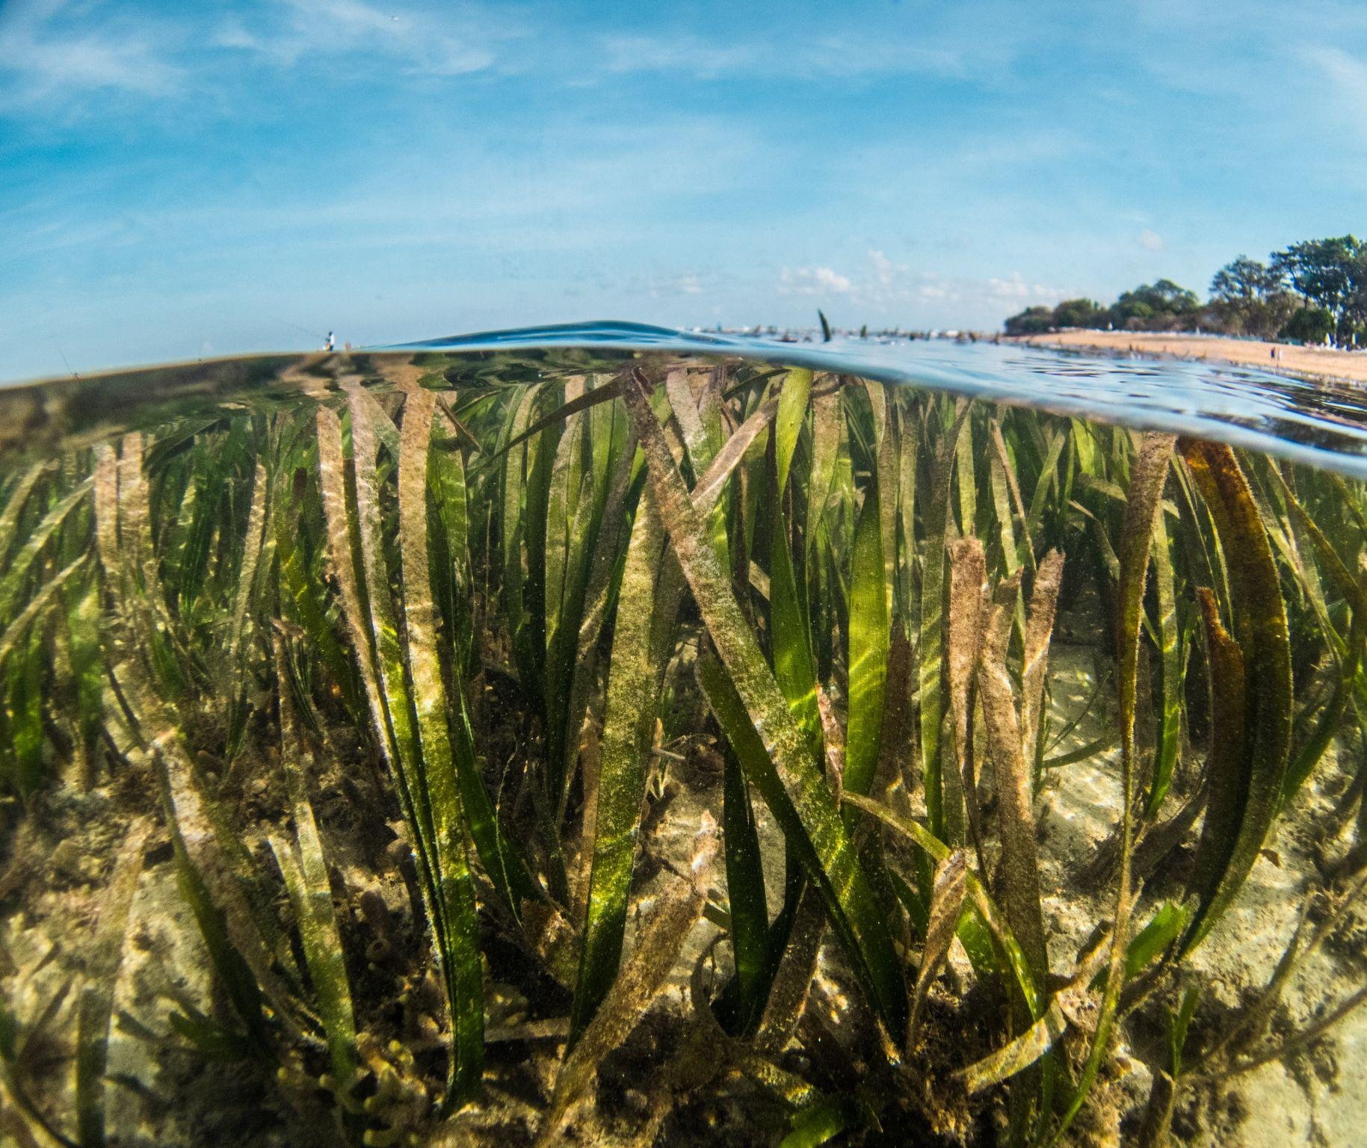
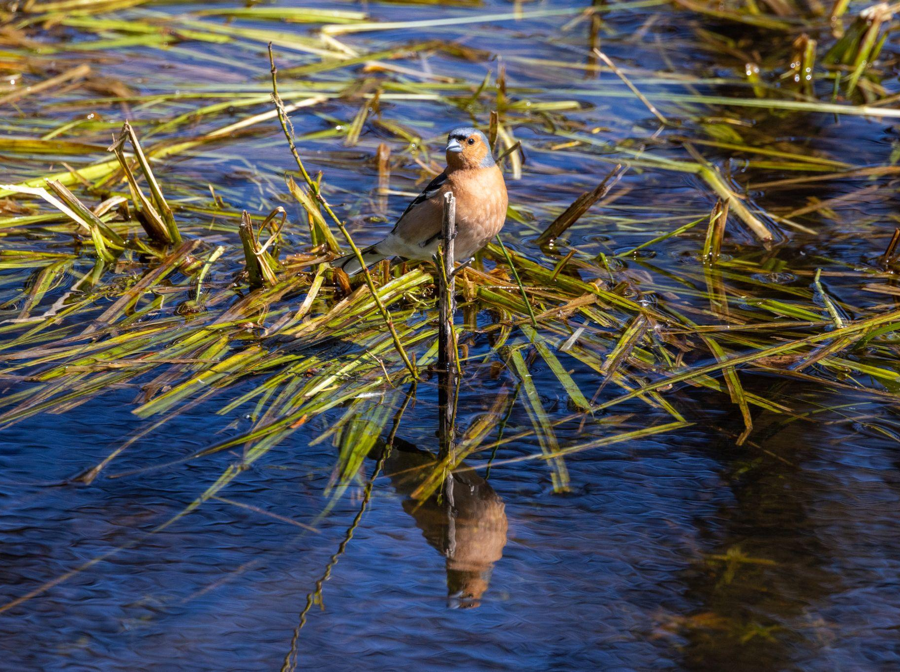
Updates on LbP related activities & achievements for 2023-2024 (following the 1st RWG-LbP meeting)
Legal & institutional matters
Ministry of Environment and Forestry of the Republic of Indonesia
Regulation Of The Minister Of Environment And Forestry Of The Republic Of Indonesia Number 9 Of 2023 Concerning Business Licensing And Government Approval In The Field Of Hazardous And Toxic Waste Management
Minister of Environment and Forestry Regulation No. 4 of 2024, Regarding the Assignment for the Implementation of Peat Restoration Activities for the 2024 Fiscal Year
Minister of Environment and Forestry Regulation Number 14 of 2024, Implementation of Supervision and Administrative Sanctions in the Environmental Sector
Minister of Environment and Forestry Regulation Number 13 of 2024, Implementation of Government Regulation Number 46 of 2016 concerning Procedures for Carrying out Strategic Environmental Assessment
Minister of Environment and Forestry Regulation Number 12 of 2024, Implementation of Nationally Determined Contributions in Handling Climate Change
Minister of Environment and Forestry Regulation Number 11 of 2024, Implementation of the Indonesian National Qualifications Framework in the Sector of Hazardous and Toxic Waste Management
Minister of Environment and Forestry Regulation Number 9 of 2024, Management of Waste Containing Hazardous and Toxic Materials and Waste of Hazardous and Toxic Materials
Minister of Environment and Forestry Regulation Number 27 of 2021, Environmental Quality Index
Minister of Environment and Forestry Regulation Number 13 of 2023 Application of the Indonesian National Qualifications Framework in the Field of Environmental Quality Test Sampling and Environmental Quality Measurement

Slide 3
Updates on LbP related activities & achievements for 2023-2024 (following the 1st RWG-LbP meeting)
Legal & institutional matters
Ministry of Maritime Affairs and Fisheries of the Republic of Indonesia
Decree of the Minister of Maritime Affairs and Fisheries Number 75 of 2024, Producer of Geospatial Data and Thematic Geospatial Information within the Ministry of Maritime Affairs and Fisheries
Decree of the Minister of Maritime Affairs and Fisheries Number 107 of 2023, Water Conservation Area in the Indragiri Hilir Region, Riau Province
Decree of the Minister of Maritime Affairs and Fisheries Number 108 of 2023, Water Conservation Areas in the Ketugar Region and Surrounding Waters as well as Perlang, Bangka Belitung Islands Province
Decree of the Minister of Maritime Affairs and Fisheries Number 1 of 2023, Conservation Area in Waters in the Tuing Region, Bangka Belitung Islands Province
Decree of the Minister of Maritime Affairs and Fisheries Number 185 of 2023, Conservation Areas in the Waters of the Lepar Island and Pongok Island Regions, Bangka Belitung Islands Province
Decree of the Minister of Maritime Affairs and Fisheries Number 107 of 2023, Water Conservation Area in the Indragiri Hilir Region, Riau Province

Slide 4
Updates on LbP related activities & achievements for 2023-2024 (following the 1st RWG-LbP meeting)
Legal & institutional matters
Ministry of Transportation of the Republic of Indonesia
Decree of the Minister of Transportation Number KM 113 of 2024, Determination of shipping lanes, route systems, traffic procedures and ship anchoring areas according to their importance in shipping lanes entering Tanjung Ular Port, Bangka Belitung Province
Decree of the Minister of Transportation Number KM 9 of 2024, Shipping Channels, Route Systems, Traffic Procedures and Ship Docking Areas according to their Importance in the Shipping Routes Entering Tanjung Buton Port, Riau Province
Decree of the Minister of Transportation Number KM 40 of 2023, Determination of Class II Mandatory Guide Waters in Sei Kolak Kijang Waters in the Working Area of ​​the Class III Kijang Harbor Master and Port Authority Office, Riau Islands Province
Provincial Government Decrees
Regulation of the Governor of the Bangka Belitung Islands Number 20 of 2023, Plan for Development of Tourism Development Areas for the Toboali Province and Surrounding Areas
Jambi Province Regional Regulation Number 6 of 2017, Environmental Protection and Management

Slide 5
Updates on LbP related activities & achievements for 2023-2024 (following the 1st RWG-LbP meeting)
Research and Assessment
Ella Yuni Astuti, Ario Damar, Fery Kurniawan. 2023. ANALYSIS OF COASTLINE CHANGES AND ECOLOGICAL RESILIENCE IN TANGERANG COASTAL AREA, BANTEN PROVINCE. J. Ilmu dan Teknologi Kelautan Tropis, 15(3): 283-300. DOI: https://doi.org/10.29244/jitkt.v15i3.42885
Amanah Zakiah, Yonvitner, A. Damar. 2023. TEMPORAL AND SPATIAL DYNAMICS OF PHOSPHATE (PO4-P) AND NITRATE (NO3-N) AS WATER PRODUCTIVITY INDICATORS IN JAKARTA BAY. COJ (Coastal and Ocean Journal) Vol. 7, No. 1, Juni 2023 : 42 – 51
A. Damar, Sigid Haryadi, Isdahartati, Novit Ricardi, Cristine Ingrid Narcise, Dedah Herlina, Tatang Kurniawan, and Rasyad Muhara. 2024. Pollution Loads of the Cipanyairan and Cipalabuan Rivers : Part of the Sukabumi Regency ICM’s Coastal Pollution Management Programs. BIO Web of Conferences 92, 01017 (2024) https://doi.org/10.1051/bioconf/20249201017
Triyoni Purbonegoro, A. Damar, Etty Riani, Nurlisa A. Butet, Muhammad Reza , 12.albus) from downstream area of Cisadane River, Indonesia. Environ Monit Assess (2024) 196:496 https://doi.org/10.1007/s10661-024-12635-w
Fajrin, E.R., A. Damar, Taryono. 2024. Marine Debris Pollution and Its Impact on the Mangrove Ecosystem (Case Study: Karimunjawa Island and Kemujan Island, Indonesia). Journal of Natural Resources and Environmental Management, 1,3: 516-524. http://dx.doi.org/10.29244/jpsl.14.3.516
Apriadi, Tri & Melani, Winny & Zulfikar, Andi & Sabriyati, Deni & Muzammil, Wahyu & Pasisingi, Nuralim. (2024). The presence of harmful algae in the coastal waters of Bintan Island, Riau Islands. Depik. 13. 32-38. 10.13170/depik.13.1.34135.
Hartuti, Maryani & Parwati, Ety & Prayogo, Teguh & Sulma, Sayidah & Ibrahim, Andi & Afgatiani, Pingkan Mayestika & Wijaya, Agung & Kusuma, Fajar & Herdanis, Chatra. (2023). Oil spill distribution analysis using multi sensor satellite data in Batam-Bintan and Karawang waters. 030036. 10.1063/5.0181687.
Nurrachmi, Irvina & Amin, Bintal & Andini, Dilla & Afriansyah, M. & Anadri, Rifqi. (2023). THE DISTRIBUTION AND ABUNDANCE OF TOXIC BENTHIC DINOFLAGELLATES IN MALANG RAPAT COASTAL WATERS OF BINTAN ISLAND, KEPULAUAN RIAU. Asian Journal of Aquatic Sciences. 6. 108-114. 10.31258/ajoas.6.1.108-114.
Zhuhendrik, Zhuhendrik & Kurnianingsih, Fitri & Okparizan, Okparizan. (2023). Impact of Anchoring Management Policy Riau Island Province in Indonesia. International Journal of Social Service and Research. 3. 219-227. 10.46799/ijssr.v3i1.182.

Slide 6
Updates on LbP related activities & achievements for 2023-2024 (following the 1st RWG-LbP meeting)
Research and Assessment
10. Putri, A & Kamila, Salsa. (2023). Overtaking Marine Pollution Issues for Sustainable Eco-Tourism in Mapur Island. IOP Conference Series: Earth and Environmental Science. 1148. 012037. 10.1088/1755-1315/1148/1/012037.
11. Syofyan, Syofirman & Suhaidi, & Purbaningrum, Aulia. (2023). The designation of special area in the Singapore Strait to solve the pollution due to the oil sludge discharge that affects to the coast of Bintan, Indonesia In order to achieve marine and coastal sustainability. BIO Web of Conferences. 70. 10.1051/bioconf/20237002004.
12. Alsaleh, Mohd & A.S., Abdul Rahim. (2024). What are the influence of fishery activities and their implication on marine water pollution? an empirical analysis. Environment, Development and Sustainability. 1-32. 10.1007/s10668-024-05561-x.
13. Winanda, Treza & Amrivo, Viktor & Zulkarnain, Zulkarnain. (2024). The Development Strategy Tourism in Mapur Island Marine Conservation Area Bintan Regency. Journal of Coastal and Ocean Sciences. 5. 39-44. 10.31258/jocos.5.1.39-44.
14. Thahira, Atika & Daulay, Zainul & Ferdi, & Syofyan, Syofirman. (2023). The strategy for the resolution of marine pollution on the northern coast of Bintan Island Indonesia due to sludge oil with the principle of cooperation to realize the sustainable development goals. IOP Conference Series: Earth and Environmental Science. 1148. 012031. 10.1088/1755-1315/1148/1/012031.
15. Nuraini, Lia & Suryadi, Suryadi & Adhayanto, Oksep & Rani, Marnia & Sucipta, Pery & Hidayat, Muhammad. (2023). Application Of The Concept Of Eco Liability In Marine Pollution Due To Ship Accidents In Batam Waters Indonesia. BIO Web of Conferences. 70. 10.1051/bioconf/20237004007.
16. Thahira, Atika & Syofyan, Syofirman & Daulay, Zainul & Ferdi,. (2023). The Outside of Port Limit (OPL) as a new maritime zone to overcome marine pollution due to oil sludge impacting the coast of Bintan, Indonesia to actualise sustainable development. BIO Web of Conferences. 70. 10.1051/bioconf/20237002001.
17. Pranyoto, Pranyoto. (2023). Development of an Integrated Public Policy Model for Combating Marine Pollution. International Journal of Multidisciplinary Research and Analysis. 6. 10.47191/ijmra/v6-i12-47.
18. Amelia, Addela & Putri, Faizah & Widia, & Alkasiyah, & Fabiani, Verry. (2024). SYNTHESIS OF POROUS CARBON MATERIAL PROPYLENE MEDICAL MASK AS ADSORBENT HEAVY METAL IRON (Fe) IN WATER EX-TIN MINING BANGKA BELITUNG. Jurnal Kimia Riset. 9. 1-9. 10.20473/jkr.v9i1.50750.
19. Yusfaddillah, Anita & Saputri, Riski & Edelwis, Tri & Pardi, Hilfi. (2023). Heavy Metal Pollution in Indonesian Waters. BIO Web of Conferences. 79. 04001. 10.1051/bioconf/20237904001.
………

Slide 7
Updates on LbP related activities & achievements for 2023-2024 (following the 1st RWG-LbP meeting)
Monitoring status and trends of changes, specially in the identified hot spots and monitoring stations
Marine Water Quality Index
No | Province | 2019 | 2020 | 2021 | 2022 | 2023
1 | Riau | 74.45 | 71.97 | 77.73 | 83.95 | 74.39
2 | Jambi | 72.2 | 79.58 | 83.58 | 81.67 | 70.69
3 | Sumatera Selatan | 71.58 | 63.75 | 75.53 | 81.03 | 70.37
4 | Kepulauan Bangka Belitung | 67.56 | 70.66 | 82.71 | 85.02 | 82.57
5 | Kepulauan Riau | 81.09 | 69.82 | 75.68 | 85.56 | 81.81
6 | DKI Jakarta | 61.59 | 66.69 | 75.18 | 80.08 | 78.74
Parameter for Water Quality Index | Reasons for Determining Parameters
Total Suspended Solid | Associated with photosynthesis and aesthetics
Dissolved Oxygen | Related to organic pollution, potential danger to biota
Oil and Grease
NH₃-N (Ammonia) | Toxic
PO₄-P (Orthophospat) | Eutrofication potential
No. | Category | Index Range
1. | Very Good | 90 ≤ x ≤ 100
2. | Good | 70 ≤ x < 90
3. | Medium | 50 ≤ x < 70
4. | Bad | 25 ≤ x < 50
5. | Very Bad | 0 ≤ x < 25

Slide 8
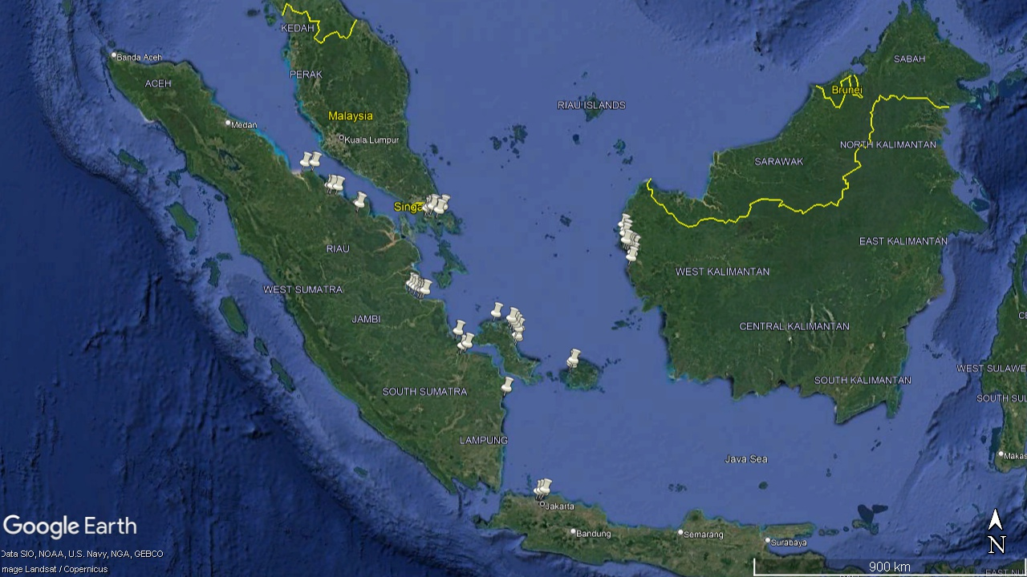
Updates on LbP related activities & achievements for 2023-2024 (following the 1st RWG-LbP meeting)
Monitoring status and trends of changes, specially in identified hot spots and monitoring stations
Marine Water Quality Monitoring Stations

Slide 9
Status on coordinating national activities and contributing regional activities for 2025-2026
Introduction of specialized executing agency on LBP
Specialized Executing Agency for LBP is CCMRS-IPB
Outline on National Working Group on LBP (members, organizations)
DG of Sea Transportation
Ministry of Transportation
DG of Marinee Spatial Management
Ministry of Maritime and Fisheries
Ministry of Environment
National Technical focal Point
DG of Waste Mgt and Hazardoust Waste.
Ministry of Environment
DG of Water Pollution Control
Ministry of Environment
Ministry of Public Works
CCMRS-IPB
Special Executing Agency
Experts
Community Group
Local Governments of the hotspot area

Slide 10
Status on coordinating national activities and contributing regional activities for 2025-2026
Expert/s to join TDA team
National Lead : Mrs. Heni Agustina
Senior Officer on Environmental lmpact Control, MOE
heni.agustina@gmail.com
Team Members
1 . Marine Habitats/Ecosystems: Prof. Dr. Yonvitner, S.Pi., M.Si
Director of Center for Coastal Resources Studies - IPB University
yonvitner75@gmail. com
2. Fish and Fisheries : Dr. M. Riyanto
Researcher, Center for Coastal and Marine Resources Studies - IPB University
mochammadri @apps.ipb.ac.id
3. Pollution - Nutrients, Waste Water, Plastics : Prof. Dr. lr. Ario Damar, M.Si
Researcher, Center for Coastal and Marine Resources Studies - IPB University
adamar@apps.ipb.ac.id
4. Socioeconomics and Livelihoods - Blue Economy, Vulnerabilities to climate change and natural extreme events :
Prof, Dr. lr. Luky Adrianto, M.Sc. Head of lntemational Maritime and Fisheries Research lnstitute (I-MAR), IPB
University lukyadrianto@apps.ipb.ac.id

Slide 11
Challenges and recommendations for implementing LbP activities for 2024-2026
Time schedule for signing and implementing new/amended PCA/GSAs
Waiting for final approval from MOFA
Pending ministerial decision on the appointment of DGs at MOE.
Challenges
Changing in the National Ministerial Format due to new government in Indonesia
delays processes of signing of agreement.
Data spread across govt. institutions, and may not periodically available.
There is a need to increase the role of the community to participate in the prevention of land-based pollution.
Local government financial budget for monitoring seawater quality are limited, therefore data and information at the local level is limited.
Recommendations
Close monitor on the MOU’s finalization process and approval at the Ministry of Foreign Affairs.
Local governments should be able to allocate their own budget for seawater quality monitoring as a basis for decision-making at local level.
Local governments need to improve environmental management in land areas, to prevent impacts on their coastal and marine ecosystems.

