Slide 1





Implementing the Strategic Action Programme for the South China Sea and Gulf of Thailand (SCS SAP) Project
Second Meeting of the Regional Working Group on Land-Based Pollution (RWG-LBP)
11-12 November 2024, Shenzhen, China
Status of Preparation and Implementation of
Land-Based Pollution Activities
[COUNTRY]
Name of LBP Focal Point, Organization

Slide 2
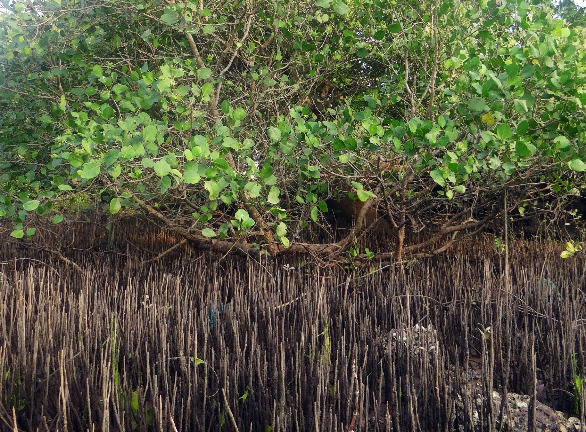

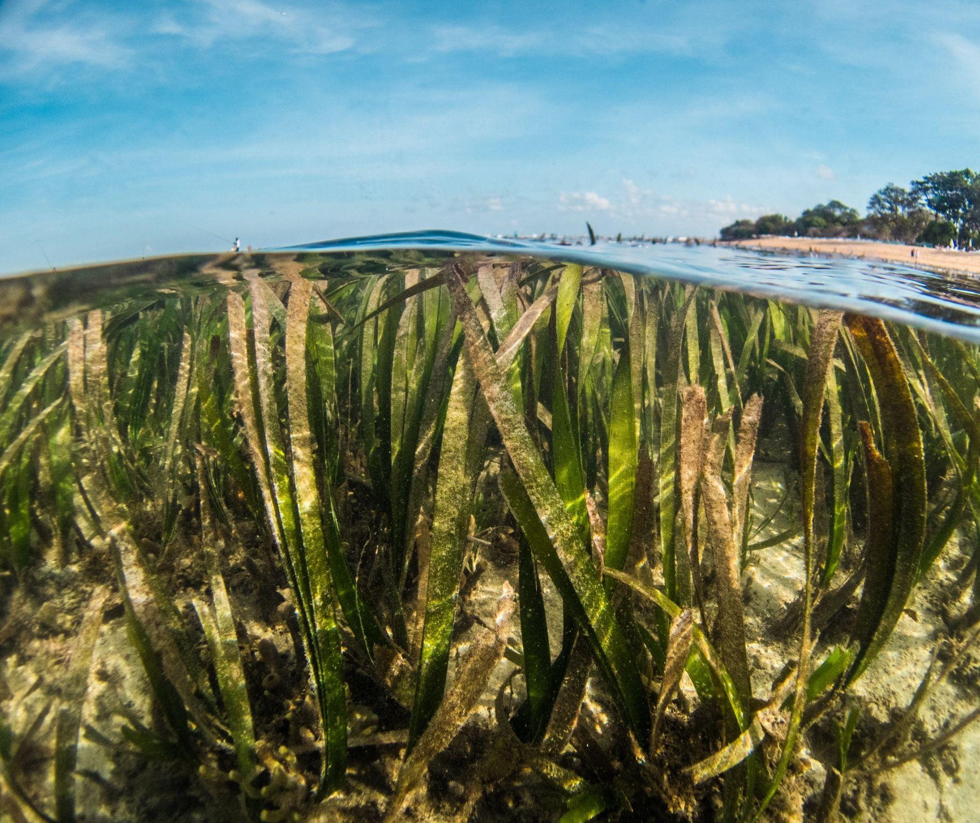
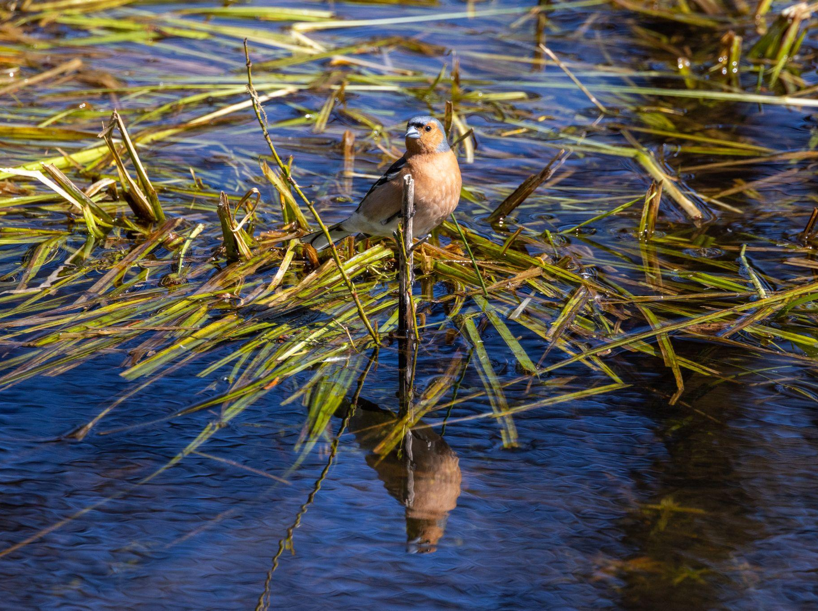
Updates on LbP related activities & achievements for 2023-2024 (following the 1st RWG-LbP meeting)
Legal & institutional matters (new or revised/updated policies, regulation and institutional/financial arrangement…)
Research and Assessment

Slide 3
Updates on LbP related activities & achievements for 2023-2024 (following the 1st RWG-LbP meeting)
Monitoring status and trends of changes, specially in identified hot spots and monitoring stations
Data/Database

Slide 4
Status on coordinating national activities and contributing regional activities for 2025-2026
Introduction of specialized executing agency on LBP
Outline on National Working Group on LBP (members, organizations)
Expert/s to join TDA team

Slide 5
Challenges and recommendations for implementing LbP activities for 2024-2026
Time schedule for signing and implementing new/amended PCA/GSAs
Challenges
Recommendations

