Slide 1
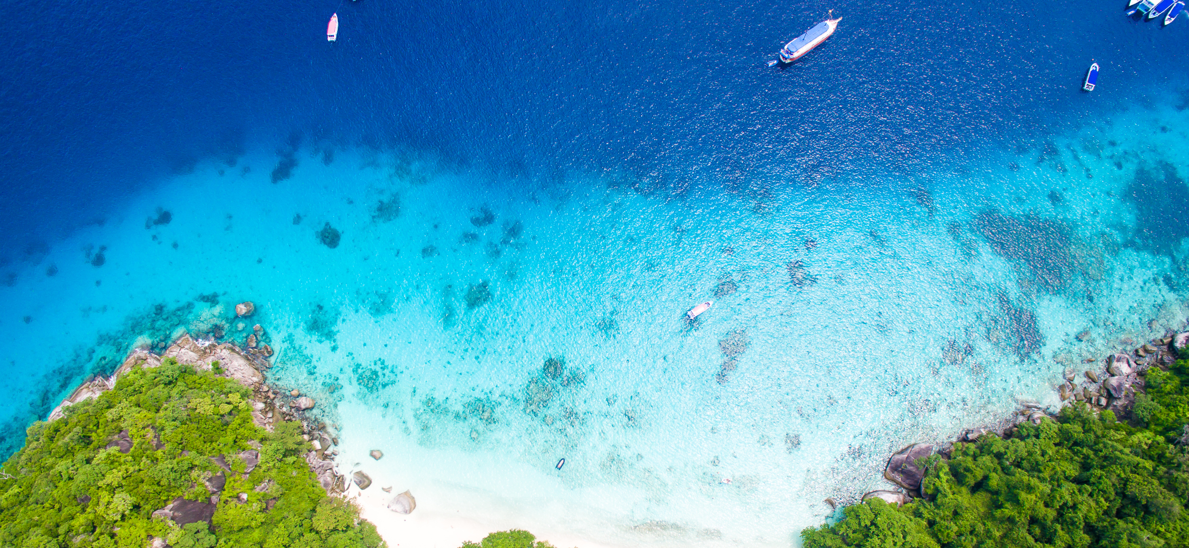


Implementing the Strategic Action Programme for THE SOUTH CHINA SEA AND GULF OF THAILAND (SCS SAP) Project
Second Roundtable of Local Representatives
of the SCS SAP Project
17 September, 2025, Jakarta, Indonesia
Chart on Practices and Lessons Learnt at the Site/local Level
[Bintan and Mapur Seagrass & Indonesia]
[MUIN SINAGA ]

Slide 2

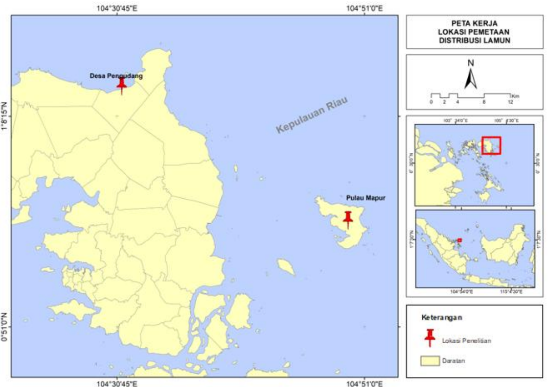
Map indicating site location & habitats (mangroves, coral reefs, seagrasses, coastal wetlands) distribution, if any
About my site
Area of Bintan Regency is 1.318,21 (km2)
Pengudang (Teluk Sebong Disktrict) 285,72 Km2
Mapur (Bintan Pesisir District) 116,11 Km2
Population is about 170.460 Jiwa
Pengudang (Teluk Sebong Disktrict) 19.510 people
Mapur (Bintan Pesisir District) 6.890 people
Specific indigenous feature, Turtle and Dugong
Area (ha) of critical habitats
Seagrass in Pengudang 319,08 hectar
Seagrass in Mapur 375,17 hectar
Main economic activities Fisherman
Threats to coastal habitats
Land clearing and development in main land
Collecting Fish product (shellfish, Gonggong, Cucumber etc)
Environment concerns (pollution, habitat loss and degradation, resource decline…)
Sludge Oil
Seagrass habitat loss and degradation

Slide 3
Highlights of key activities for conservation & sustainable use of coastal habitat and/or fisheries & land-based pollution management (please list maine activities, projects, programs conducted in recent 15 years)
Initiation of a Seagrass Conservation Program integrated with Coral Reef Rehabilitation in 2010, with the proposed area reserved for submission to the Minister of Marine Affairs and Fisheries
Establishment of community groups for coastal ecosystem monitoring, including seagrass bed
Public awareness on the role and function of seagrass for life through the installation of announcement boards and radio advertisements on RRI since 2010
Designation of Regional Conservation Area by the Minister of Marine Affairs and Fisheries of the Republic of Indonesia No. 18 of 2022 (include Seagras)
Optimizing the role of stakeholders in the implementation of Marine Protected Area by establishing a Provincial Technical Unit for Marine Protected Area Management in 2025
Optimizing the Management Plan of the Marine Protected Area that has been prepared

Slide 4
Highlights of key achievements
1/ Establishment and management of Protected Areas (PAs) of all categories (nature reserve, sanctuary, fisheries management, community-based, Ramsar site…)
Designation of Regional Conservation Area by the Minister of Marine Affairs and Fisheries of the Republic of Indonesia No. 18 of 2022 On the Marine Protected Area in the Eastern parts of Bintan Island, Riau Islands Province
Habitat area 138.561,42 (ha) under protection,
new management approach Set up Organization to Manage Conservatioa area]
2/ Approval and implementation of plans for sustainable resources management & use, and land-based pollution management
year of approval 2022, management target Coastal zone , critical habitat area Coral reef 6.120,70 ha and Seagrass bed 2.903,66 ha
3/ Reform of laws/regulations or management approach for ecosystem sustainable use and land-based pollution prevention
[reformed subjects & year in 2022, impacts of reforms: critical habitat area , critical habitat area Coral reef 6.120,70 ha and Seagrass bed 2.903,66 ha

Slide 5
4/ Engagement of related stakeholders
- Goverment, as Regulator and motivator
- Local Community as User
- Academic as Scientific Brief
- Private Sector as Developed Area
5/ Enforcement mechanism and effectiveness
[how enforcement arranged? Evidence in improvement]
  Law enforcement is carried out through mechanisms stipulated in the Decree of the Minister of Marine Affairs and Fisheries, implemented by Marine and Fisheries Resource Law Enforcement, and in collaboration with the community through Community Monitoring Groups
6/ Financial mechanism for sustaining conservation and management
[funding sources, way to mobilize budget, private sector contribution, fee payment]
Funding sources from Central Goverment and Local Goverment
Private Sector with their CSR
NGO and other resources

Slide 6
Lesson learnt (challenges and solution to address challenges)
Management of Regional Marine Protected Areas must involve all stakeholders;
Community assistance is needed for those engaged in the implementation of Regional Marine Protected Area management;
Public awareness among communities around the Regional Marine Protected Areas should be carried out continuously;
Regular monitoring of coastal ecosystems, including seagrass, is necessary to assess the impacts of implemented programs.

