Slide 1
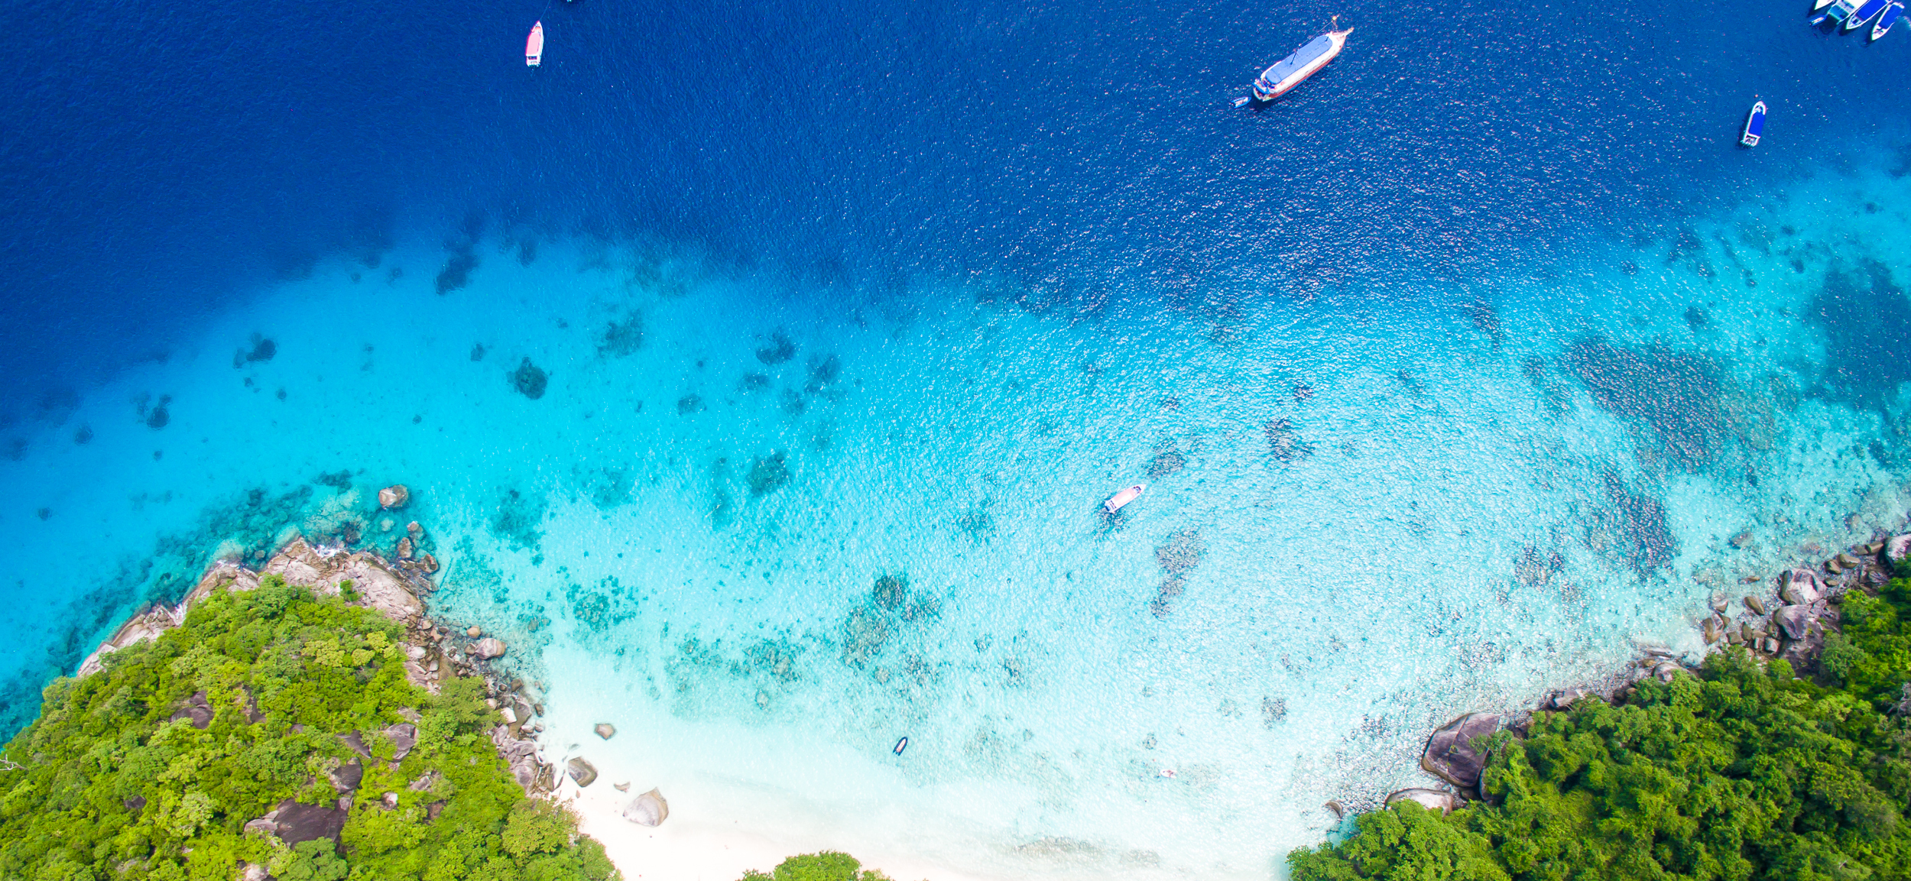


Implementing the Strategic Action Programme for THE SOUTH CHINA SEA AND GULF OF THAILAND (SCS SAP) Project
First Meeting of the Regional Scientific and Technical Committee (RSTC)
of the SCS SAP Project
17-19 October 2022, Bangkok, Thailand
SAP IMPLEMENTATION ACHIEVEMENTS 2008-2021
Thailand
Mr. Ukkrit Satapoomin

Slide 2

Presentation Outline
Introduction
Evaluation of Achievements
Mangroves: SAP Targets and Summary of Achievements
Coral Reefs: SAP Targets and Summary of Achievements
Seagrass: SAP Targets and Summary of Achievements
Wetlands: SAP Targets and Summary of Achievements
Issues and Challenges
Lessons Learned
Recommendations
Conclusions

Slide 3
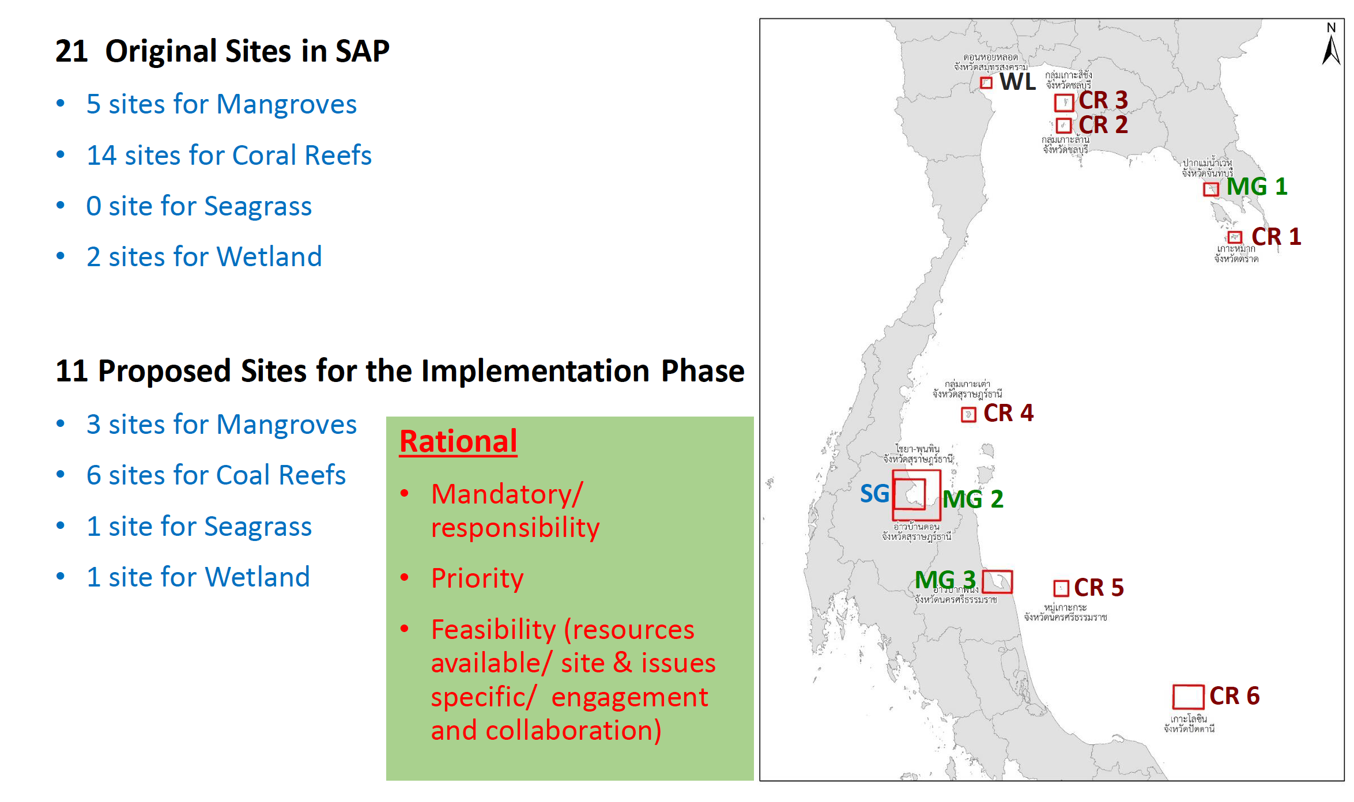
Introduction
Notes:
Present background of country participation and involvement in the projects (past SCS and current SCSSAP) and habitats

Slide 4
Evaluation of Achievements on Mangroves
Regional output | SAP 2008 targets (ha) | SAP target sites and achievements (ha) during 2008-2021
 |  | Trad Province | Thung Kha – Savi Bay | Pak Phanang Bay | Kung Kraben Bay | Welu River Estuary | Total
1.1.1 Declaration of 57,400 ha of mangrove as National Parks and Protected Areas | 1,400 | 6,081 | 2,780 | 3,915 | 588 | - | 8,861
1.1.2 Designation and plans for the management of 166,600 ha of mangrove as non-conversion, sustainable use areas | 1,600 | - | - | - | - | - | -
1.1.3 Reform of laws and regulations for the sustainable use of 602,800 ha of mangrove forest* | 10,000 | 10,852 | 4,338 | 3,915 | 588 | 16,334
1.1.4 Replanting of 21,000 ha of deforested mangrove land | 8,000 | 313 | 269 | 1,223 | 5,204 |  | 7,009
1.1.5 Biodiversity increased for 11,200 ha of mangrove forest via enrichment planting | 3,200 | - | - | - | - | - | -
1.1.6 Monitoring of management effectiveness | 1,600 | - | - | - | - | - | -
Notes:
Present the table to introduce SAP targets on mangroves per regional output and summary of achievements in implementing the SAP targets on mangroves from 2008-2021
Present the estimated funding and source for mangrove activities during 2008-2021 including the implementing agencies and partner
* For 1.1.3, Due to the enforcement of the Promotion of Marine and Coastal Resources Act 2015, all mangrove areas involve in the reform of laws. The figures mean the total area of those sites

Slide 5
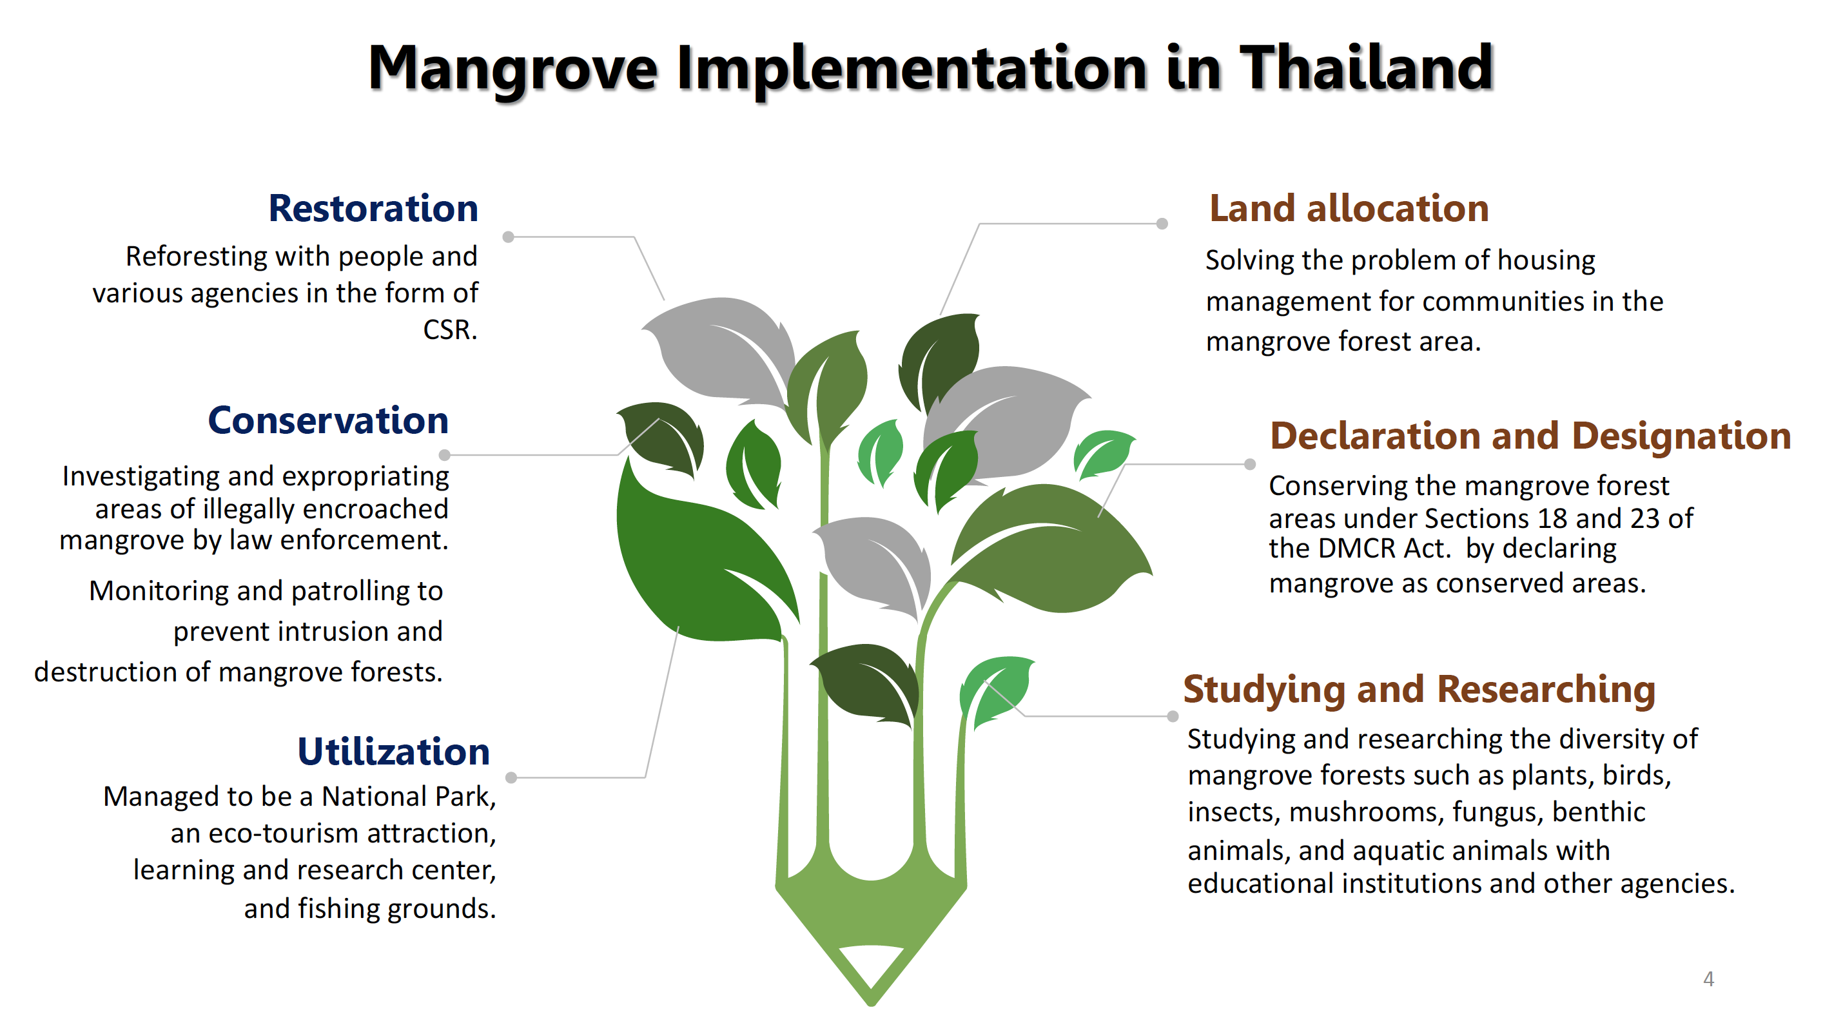

Slide 6
Evaluation of Achievements on Mangroves
Estimated funding (including co-financing) and implementing partners:
Estimated funding: 1.7 Million USD including on-going projects
Implementing partners:
    Dow Chemical Company
    IUCN / Mangrove for the Future
    Prince of Songkhla University
    Mahidol University
    COBSEA
Notes:
Noted that some budgets do note clear cut on habitats, which mean and cover coastal resources and some budgets are ongoing to the current year
Info is based on NIR

Slide 7
Evaluation of Achievements on Coral Reefs
SAP targets for Coral Reefs in Thailand = 72,000 ha / 14 sites
27,490 hectares of coral reefs at 4 sites proclaimed as National Park have sustainably managed through governance structure of the Department of National Park, Wildlife and Plant Conservation
  Mu Koh Chumphon Mu Koh Change
  Mu Koh Ang Thong Mu Koh Samet
10 sites with significant establishment of policies and legal reform
  Act on the Promotion of Marine and Coastal Resources Management A.D 2015
  National Parks Act A.D. 2019
  Promotion of stakeholder engagement in sustainable use and conservation practices/activities
  Application of management approach to address threat and user conflicts e.g. Marine Spatial Planning
Notes:
Present the table to introduce SAP targets on coral reefs per regional output and summary of achievements in implementing the SAP targets on coral reefs from 2008-2021
Present the estimated funding and source for coral reef activities during 2008-2021 including the implementing agencies and partners

Slide 8
Evaluation of Achievements on Coral Reefs
4 sites with establishment of key management tools such as Licensing and Entry permits, Seasonal closers, zoning scheme, and Surveillance and law enforcement (Mu Koh Chumphon, Mu Koh Change, Mu Koh Ang Thong, and Mu Koh Samet)
All 14 sites were included in quadrennial status assessment and monitoring program. The National Policy and Plan Committee on Marine and Coastal Resources Management has approved an annual status assessment and monitoring from 2021 onward.
In addition, DMCR replanted coral fragments over 41.4 ha in 7 sites in 2017-2021
In 2021-2022, DMCR works with 9 diving shops in Koh Tao to replant 23,000 colonies in 2.9 ha
Notes:
Present the table to introduce SAP targets on coral reefs per regional output and summary of achievements in implementing the SAP targets on coral reefs from 2008-2021
Present the estimated funding and source for coral reef activities during 2008-2021 including the implementing agencies and partners
Rehabilitation activities at Koh Tao in 2021-2022, DMCR works with 9 Diving Shops in Koh Tao to replant 23,000 colonies in 2.9 ha

Slide 9
Evaluation of Achievements on Seagrass
No Seagrass site was identified for SAP implementation in Thailand
Below are contribution to regional SAP output:
Regional Output | Thungka Bay | Samui Island | Pha-ngan Island
1.3.1 Twenty seagrass areas totaling 26,036 ha under sustainable management with supporting laws and regulations | 1,337 | 803 | 394
1.3.2 Amended management plans for 7 existing MPAs with significant seagrass areas, to include specific seagrass-related management actions and policy, legal and institutional reforms | 1,337 | - | -
1.3.3 Designation of 7 new Marine Protected Areas focusing on seagrass areas identified in the prioritized listings of the SCS Project | - | 803 | 394
1.3.4 Established mechanism for monitoring seagrass habitat management | 1,337 | 803 | 394
Notes:
Present the table to introduce SAP targets on seagrass per regional output and summary of achievements in implementing the SAP targets on coral reefs from 2008-2021
Present the estimated funding and source for seagrass activities during 2008-2021 including the implementing agencies and partners
------------------------
In the Gulf of Thailand, seagrass beds with an area of about 7,200 ha are under research, monitoring, and management scheme of DMCR. Activities conducted include
seagrass habitat mapping,
status assessment and monitoring of all sites done in every 4 years,
rehabilitation through transplantation technique and carbon sequestration
Routine surveillance and law enforcement on illegal fishing practices (push net and trawling)
Management plans of MPAs were amended e.g. seagrass bed at Thungka Bay within Mu Koh Chumphon National Park (MPA)
Seagrass beds at Samui Island and Pha-ngan Island were designated within the Environmental Protection Area of Surat Thani Province

Slide 10
Evaluation of Achievements on Coastal Wetlands
Regional outputs | Thale Noi non hunting area | Khao Sam Roi Yot National Park | Koh Ra-Prathong | Koh Kra | Don Hoi Lot
1.4.1 Integrated management plans developed and under implementation for at least 2 lagoons (21,818 ha), 10 estuaries (639,418 ha), 5 tidal flats (96,903 ha), 1 peat swamp (45,700 ha) and 1 non-peat swamp (9,808 ha) | 45,700 | 9,808 | 64,200 | 374 | 41,600
1.4.2 Declaration of wetland areas with protection status (i.e. non-hunting area, nature reserves, protected areas, Ramsar Sites) | 45,700 | 9,808 | 19,648 (Ramsar site) | 374 (Ramsar site) | 41,600 (Ramsar Sites)
1.4.3 Adoption of a regional monitoring scheme and its national implementation | - | - | - | - | -
Notes:
Present the table to introduce SAP targets on coastal wetlands per regional output and summary of achievements in implementing the SAP targets on wetlands from 2008-202
Present the estimated funding and source for wetland activities during 2008-2021 including the implementing agencies and partners
------------------------------
Thale Noi Non-hunting area as part of peat swamp with 45,700 ha, and Khao Sam Roi Yot National Park as non-peat swamp (9,808 ha) were the SAP target
These 2 sites have been protected and managed by Department of National Park Wildlife and Plant Conservation (DNP)
Declaration of protection status for priority wetland areas: new Ramsar sites including Koh Ra-Prathong and Koh Kra
Don Hoi Lot is also a Ramsar site and will be implementing site for wetland – effort to manage Don Hoi Lot area from both DMCR and DoF, commiteed to invest 2.4 million US with the aim to
Enhance local participation in sustainable harvesting of razor clams
Provide artificial reefs to rehabilitate spawning groupd for marine species
Support local and provincial regulations for sustainable use of resources
Build on initial efforts by local conservation groups in the area to establish no take zone for Razor Clam

Slide 11
Evaluation of Achievements on Coastal Wetlands
Thale Noi Wildlife Non-Hunting Area – by DNP
  The management and enforcement were adequate
  New management and regulation established by MPA Management Effective Assessment Tool in 2017 by ONEP
  At least 2 participation of communities are
    Netwrok of forest protection volunteer
    DNP volunteer
    Advisory Committee for Thale Noi Non-Hunting Area
Khao Sam Roi Yot National Park – by DNP
  The management and enforcement were adequate
  New management and regulation established by MPA Management Effective Assessment Tool in 2017 by ONEP, and National Park Act 2019
  Mutual agreement between the Park and tourist boat operators
Notes:
Present the table to introduce SAP targets on coastal wetlands per regional output and summary of achievements in implementing the SAP targets on wetlands from 2008-202
Present the estimated funding and source for wetland activities during 2008-2021 including the implementing agencies and partners
------------------------------
Wetlands in Thale Noi Wildlife Non-Hunting Area was responsible by Thale Noi Wildlife Non-Hunting Area, Department of National Park Wildlife and Plant Conservation (DNP) with 97 staff. The management and enforcement were adequate. There new management plan and regulation established at the site by Marine Protected Area Management Effectiveness Assessment Tool (MPA) in 2017 by Office of Natural Resources and Environmental Policy and Planning (ONEP) and WILD ANIMAL CONSERVATION AND PROTECTION ACT, B.E. 2562 (2019) with the Secondary Legislation. At least 3 participation of communities are 1) network of forest protection volunteer. 2) DNP volunteer. and 3) Advisory Committee for Thalay Noi Non-Hunting Area (PAC).
Khao Sam Roi Yot National Park was responsible by Khao Sam Roi Yot National Park, Department of National Park Wildlife and Plant Conservation (DNP) with 98 staff. The management and enforcement were adequate. There new management plan and regulation established at the site by Marine Protected Area Management Effectiveness Assessment Tool (MPA) in 2017 by ONEP and NATIONAL PARKS ACT, B.E. 2562 (2019). There are mutual agreement between Khao Sam Roi Yot National Park and the tourist boat operators such as the group of Thung Sam Roi Yot, Khao Daeng Canal Group, Bang Pu Beach Group, etc., are the community surrounding the National Park.
Don Hoi Lot is also a Ramsar site and will be implementing site for wetland – effort to manage Don Hoi Lot area from both DMCR and DoF, commiteed to invest 2.4 million US with the aim to
Enhance local participation in sustainable harvesting of razor clams
Provide artificial reefs to rehabilitate spawning groupd for marine species
Support local and provincial regulations for sustainable use of resources
Build on initial efforts by local conservation groups in the area to establish no take zone for Razor Clam

Slide 12
Evaluation of Achievements on Coastal Wetlands
Koh Ra-Prathong
  Established under Ramsar Site Management Effectiveness Tracking Tool (R-METT) and MPA
  Enforcement under various laws e.g. Forestry Act, National Reserved Forest Act, and Act Promulgating the land code
Koh Kra
  Established under R-METT and MPA
  DMCR is developing law and regulations to support the Cabinet Resolution Marine Resources Protected Area Announcement
Don Hoit Lot – DMCR and DoF
  local participation in sustainable harvesting of razor clams
  artificial reefs to rehabilitate spawning groud for marine species
  Build on initial efforts by local conservation groups in the area to establish no take zone for razor clam
Notes:
Present the table to introduce SAP targets on coastal wetlands per regional output and summary of achievements in implementing the SAP targets on wetlands from 2008-202
Present the estimated funding and source for wetland activities during 2008-2021 including the implementing agencies and partners
------------------------------
Ko Ra-Prathong has been established under Ramsar site Management Effectiveness Tracking Tool (R-METT) and MPA to be RAMSAR site. Enforcements are under various laws such as Forestry Act B.E. 2484 (1941), National Reserved Forest Act B.E. 2507 (1964) and Act Promulgating the land code B.E. 2497 (1954)
Ko Kra has been established under R-METT and MPA to be RAMSAR site. Department of Marine and Coastal Resources is processing on law and regulation to support the Cabinet Resolution Marine Resources Protected Area Announcement.
Don Hoi Lot is also a Ramsar site and will be implementing site for wetland – effort to manage Don Hoi Lot area from both DMCR and DoF, commiteed to invest 2.4 million US with the aim to
Enhance local participation in sustainable harvesting of razor clams
Provide artificial reefs to rehabilitate spawning groud for marine species
Support local and provincial regulations for sustainable use of resources
Build on initial efforts by local conservation groups in the area to establish no take zone for Razor Clam

Slide 13
Issues and Challenges
Balancing economic use and environmental conservation by providing appropriate income for local communities from a resource base while maintaining the abundance of mangrove areas
Lack of robust governance structure
Sustainable financial mechanism
Lessons Learned
The success of mangrove/coral reef restoration is based on the government policy and the collaboration of local communities, private sector, and other relevant agencies
Enforcing Promotion of Marine and Coastal Resources Act 2015 provides more opportunities for coastal communities and other sectors to participate in habitat conservation.

Slide 14
Recommendations
Establishing mechanism for the monitoring of management, ecological, and socio-economic indicators for all habitats
Partnering with local communities, business, and relevant agencies in the project sites to ensure progress
Focusing on proper management tools and approaches
Ensuring long-term sustainability of actions beyond the project life
Thailand achieved SAP targets in terms of declaration of mangrove area as National Park/Protected area, declration of wetland with protection status, management apporach and tools
However, TH did not focus much on biodiversity increased (for mangrove) and mechanism to monitroing indicators
Way forward: DMCR will execute implementation following the workplan and activities mentioned in the PCA
Conclusions
Notes:
Present recommendations to further the implementation and achievement of the SAP and targets
Present overall summary of achievements in implementing the SAP including funding and implementing agencies and partners
Present ways forward to achieve SAP targets during SCS SAP Project in next 2 years
------------------------------------
RECOMMENDATIONS:
Establishing mechanism for the monitoring of management, ecological, and socio-economic indicators for all habitats
Partnering with local communities, business, and relevant agenceies in the project sites – ensure progress
Focusing more on proper management tools and approaches
Ensuring long-term sustainability of actions beyond project life
CONCLUSION:
Thailand achieved SAP targets in terms of declaration of mangrove area as National Park/Protected area, declration of wetland with protection status, management apporach and tools
Contribute to regional SAP output for seagrass as TH did not have SAP target in previous phase
However, TH did not focus much on biodiversity increased (for mangrove) and mechanism to monitroing indicators
Way forward: DMCR will execute implementation following the workplan and activities mentioned in the PCA

