Slide 1


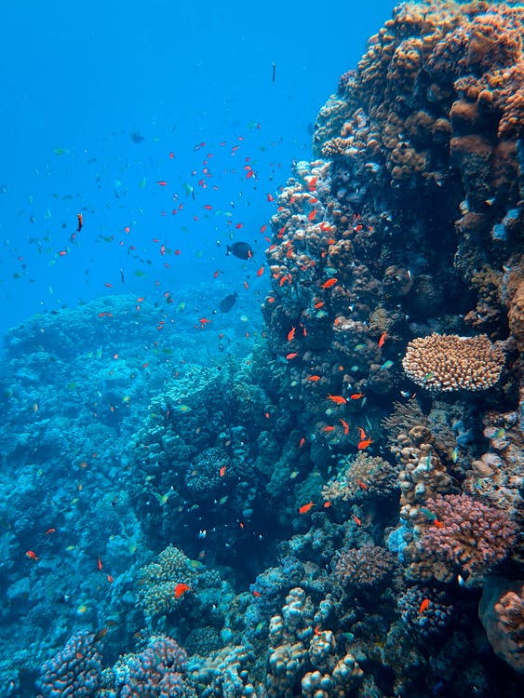
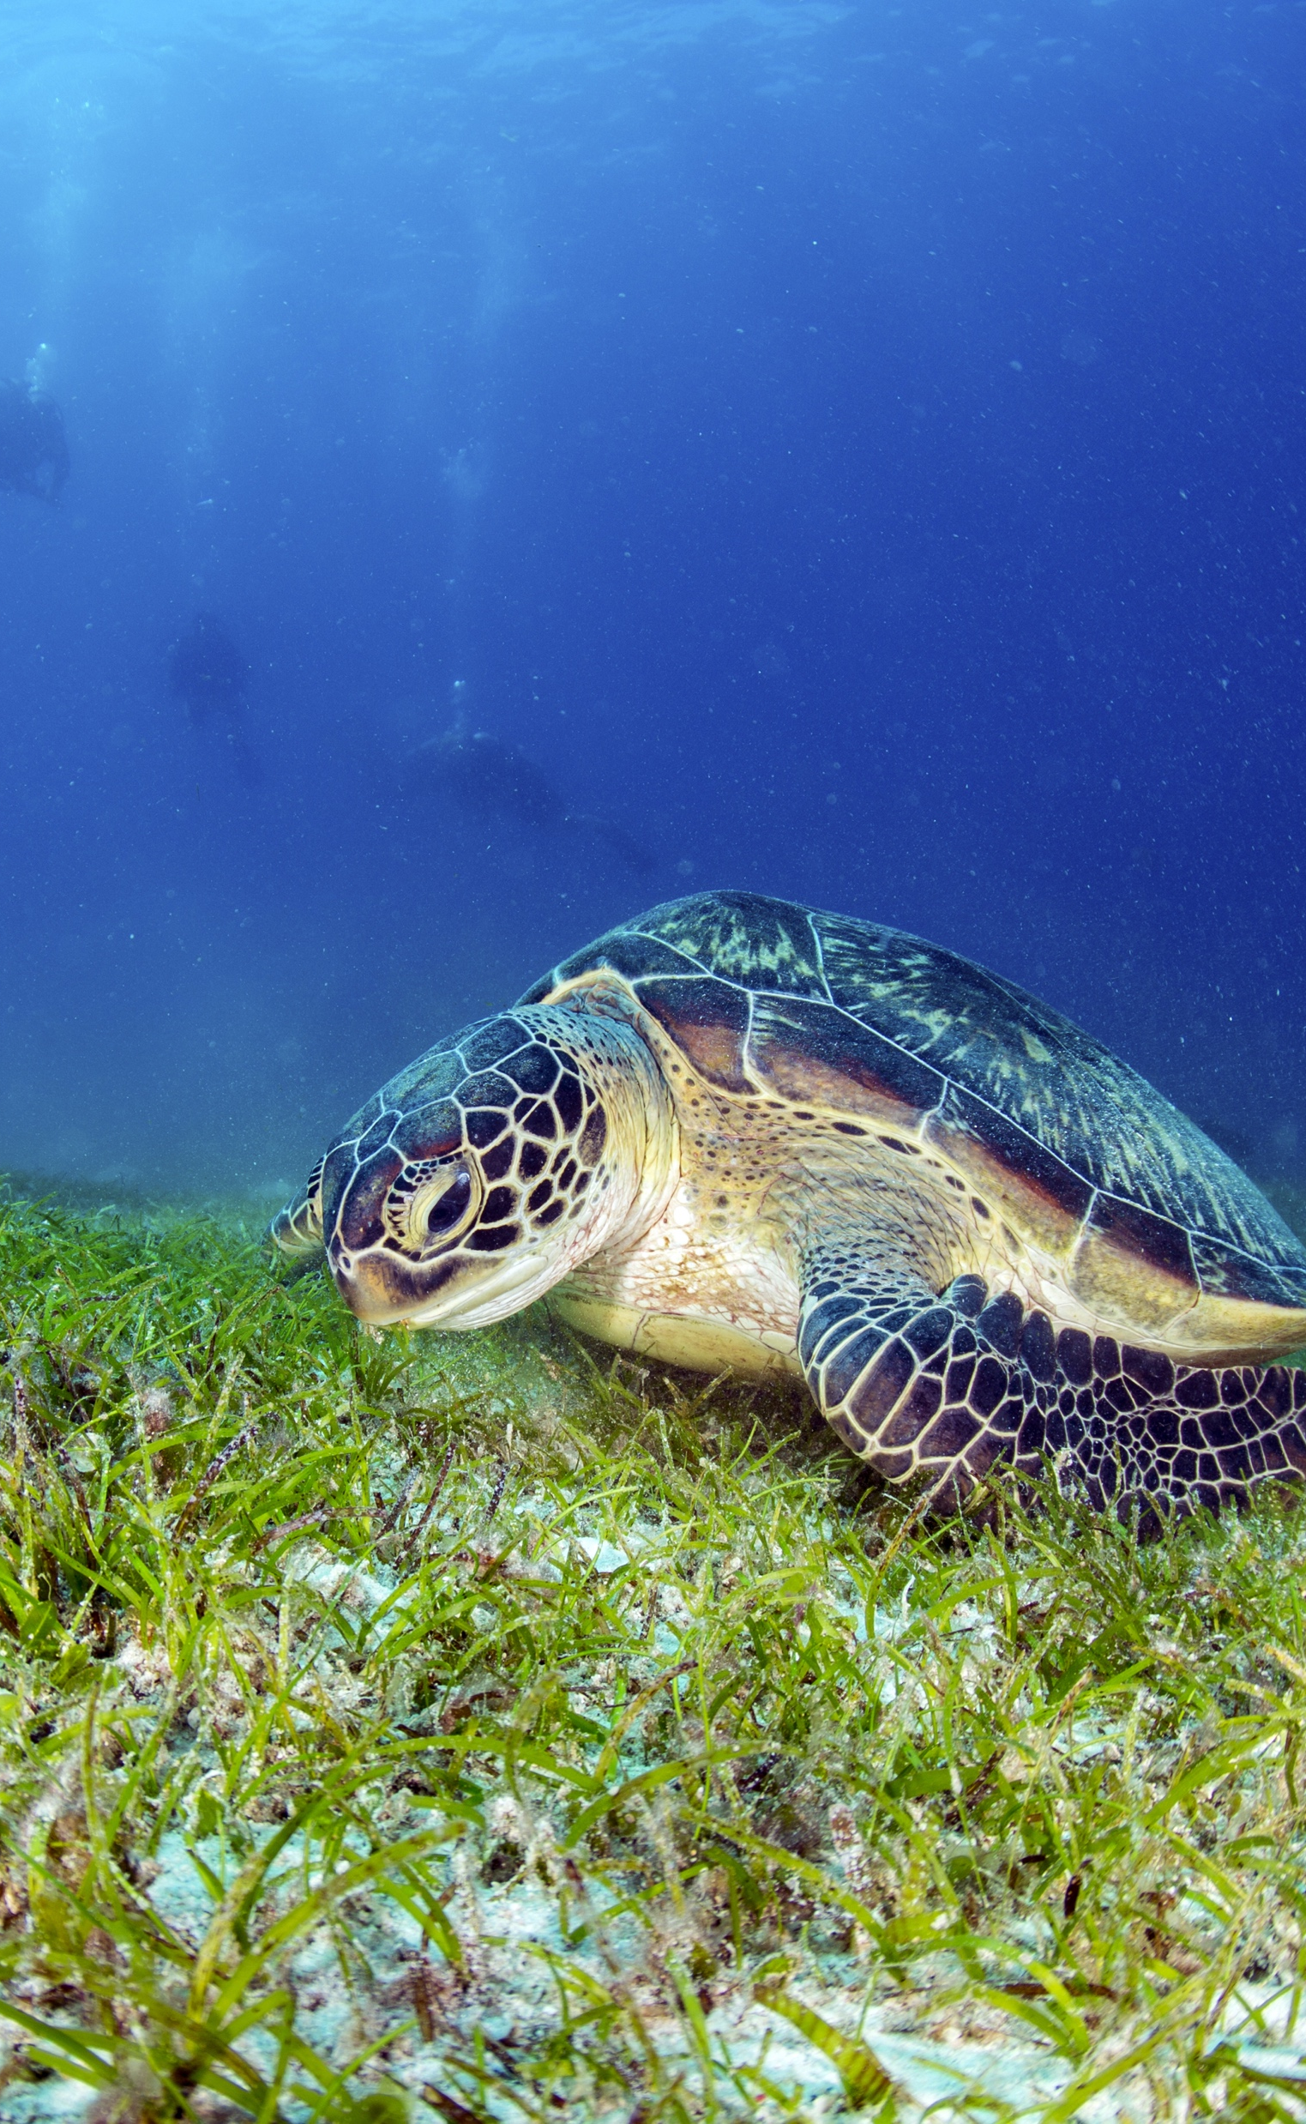
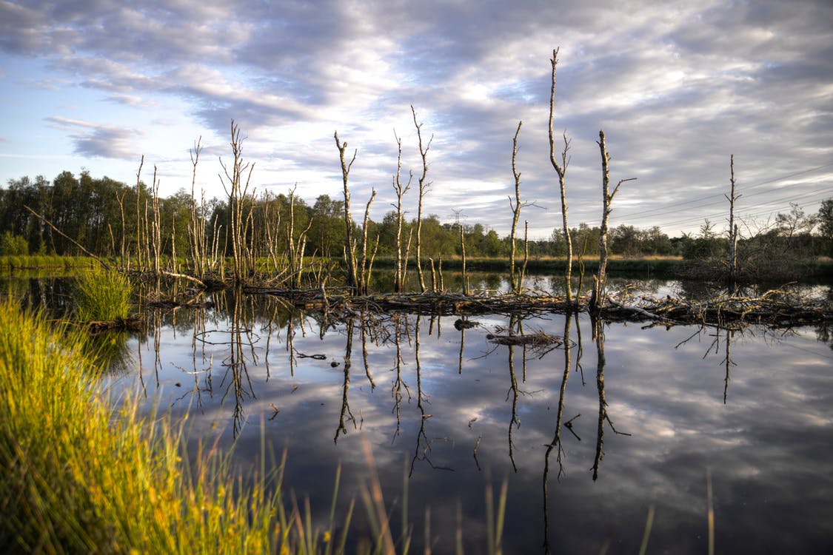
Implementing the Strategic Action Programme for the South China Sea and Gulf of Thailand (SCS SAP Project)
FIRST MEETING OF THE REGIONAL SCIENTIFIC AND TECHNICAL COMMITTEE (RSTC)
OF THE SCS SAP PROJECT
17-19 October 2022, Bangkok, Thailand
REPORT OF ACHIEVEMENTS OF THE FISHERIES REFUGIA PROJECT
[INDONESIA]
[Research Institute for Fisheries Enhancement]

Slide 2
Presentation Outline
Introduction
Key Achievements
Issues and Challenges
Recommendations
Implementing the Strategic Action Programme for the South China Sea and Gulf of Thailand (SCS SAP Project)

Slide 3
Introduction
Background
The South China Sea: support fisheries in Southeast Asian Countries
Intense fishing pressures
Unsustainable fishing methods
Declining critical habitats for the life cycles of most aquatic species
Objective: ‘to operate and expand the network of fisheries refugia in the South China Sea and the Gulf of Thailand for the improved management of fisheries and critical marine habitats linkages in order to achieve the medium and longer-term goals of the fisheries component of the Strategic Action Programme for the South China Sea.
Implementing the Strategic Action Programme for the South China Sea and Gulf of Thailand (SCS SAP Project)

Slide 4
Introduction
SAP targets:
build the resilience of Southeast Asian fisheries to the effects of high and increasing levels of fishing effort;
improve the understanding among stakeholders, of the ecosystem and fishery linkages as a basis for integrated fisheries and ecosystem/habitat management;
build the capacity of fisheries departments/ministries to engage in meaningful dialogue with the environment sector regarding the improvement of fisheries and management of interactions between fisheries and critical marine habitats
Implementing the Strategic Action Programme for the South China Sea and Gulf of Thailand (SCS SAP Project)

Slide 5
Introduction
Project sites in Indonesia;
Implementing the Strategic Action Programme for the South China Sea and Gulf of Thailand (SCS SAP Project)

Slide 6
Introduction
Agency for Marine Fisheries Research and Human Resources (AMFRHR)-Ministry of Marine and Fisheries Affair (MMAF)
(National Lead Agency)
National structures
National Fisheries Refugia Committee (NFRC)
Chair : Secretary of AMFRHR
Members : Leader of relevant Institutions
National Scientific and Technical Committee (NSTC)
Chair : Director of Research Center of Fisheries
Members : Leader of relevant Institutions
SITEBASED MANAGEMENT BOARD
Secretariat :
National Focal Point (NFP): Head of Research Institute for Fish Enhancement
National Scientific & Technical Focal Point (NSTFP) :
Implementing the Strategic Action Programme for the South China Sea and Gulf of Thailand (SCS SAP Project)

Slide 7
Key Achievementsg
 | Padang Tikar, Teluk Batang & Delta Pawan District (West KalimantanProvince ) | Bangka District /Bangka Belitung Province
Target species | Banana shrimp (Penaeus merguiensis) | Squid (Uroteuthis chinensis)
Estimated refugia size | 409.432 Ha
Target habitat | Mangrove | Coral reef, sea grass
Engagement of local stakeholders | Local fishing community in Padang Tikar, Dusun Besar and Delta Pawan (West Kalimantan Province) Fishery product collector, trader, exporter; Marined & Fishery Agency of West Kalimantan Province, Fishery Agency of Kubu Raya District; Fishery Agency of Kayong District; DG of Capture Fisheries; DG of Marine Spatial Planning; Local University in West Kalimantan | Local fishing community in Bangka ; Fishery product collector, trader and exporter Marine & Fishery Agency of Bangka Belitung Province; Fishery Agency of Bangka District; DG of Capture Fisheries; DG of Marine Spatial; University of Bangka Belitung;
Management Mechanism | MMAF: DG of Capture Fisheries (Directorate Fish Resource Management),related to the management of fish resources and regulation of fishing. MMAF: DG of Marine Spatial Planning related to the use of marine space for particular purposes. The Government of West Kalimantan Province Province as the authority for the management of areas and the management of fish resources under the authority of the local government. Community based management | MMAF: DG of Capture Fisheries (Directorate Fish Resource Management),related to the management of fish resources and regulation of fishing. MMAF: DG of Marine Spatial Planning related to the use of marine space for particular purposes. The Government of Bangka Belitung Province as the authority for the management of areas and the management of fish resources under the authority of the local government. Community based management
Implementing the Strategic Action Programme for the South China Sea and Gulf of Thailand (SCS SAP Project)

Slide 8
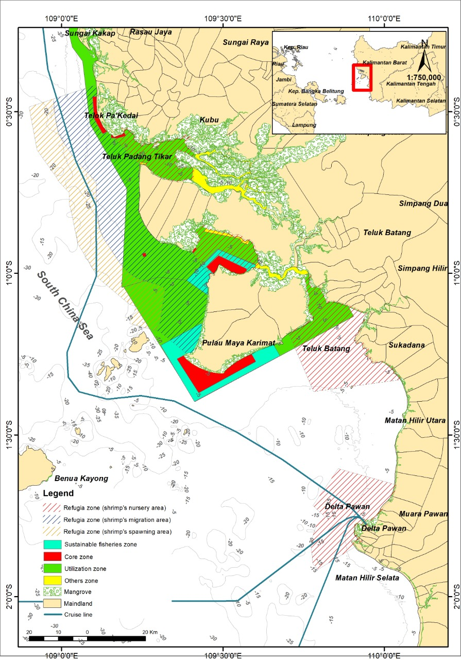
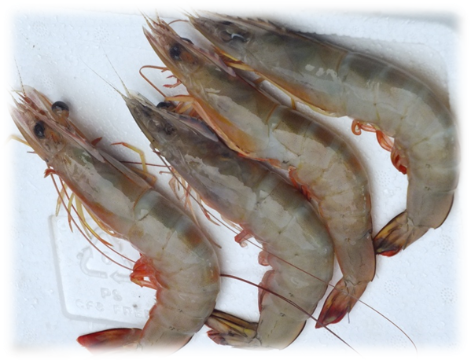
Key Achievements
Proposed Refugia for Penaeid Shrimp (Penaeus merguiensis) in Padang Tikar, Teluk Batang & Delta Pawan District (West KalimantanProvince )
Target species: Banana shrimp (Penaeus merguiensis
Proposed refugia size: 409.432 Ha
Target Habitat : Mangrove
Engagement of local stakeholders: Local fishing community in Padang Tikar, Dusun Besar and Delta Pawan (West Kalimantan Province) Fishery product collector, trader, exporter; Marined & Fishery Agency of West Kalimantan Province, Fishery Agency of Kubu Raya District; Fishery Agency of Kayong District; DG of Capture Fisheries; DG of Marine Spatial Planning; Local University in West Kalimantan
Implementing the Strategic Action Programme for the South China Sea and Gulf of Thailand (SCS SAP Project)

Slide 9
Key Achievements
Proposed Refugia for Penaeid Shrimp (Penaeus merguiensis) in Padang Tikar, Teluk Batang & Delta Pawan District (West KalimantanProvince )
Management Mechanism :
DG of Capture Fisheries (Directorate Fish Resource Management), related to the management of fish resources and regulation of fishing.
DG of Marine Spatial Planning related to the use of marine space for particular purposes.
The Government of West Kalimantan Province Province as the authority for the management of areas and the management of fish resources under the authority of the local government.
Proposed Fishing control through,
Reduction of 20% of existing operational shrimp fishing gears (bottom trawl and trammel net)
Relocate passive shrimp fishing gears
Implementation of the closed fishing season in November and December

Slide 10
Key Achievements
Proposed Refugia for Penaeid Shrimp (Penaeus merguiensis) in Padang Tikar, Teluk Batang & Delta Pawan District (West KalimantanProvince )
Management Mechanism :
e)Propose shrimp habitat management through rehabilitation of mangrove forests, enhancing public awareness regarding the non-destructive fishing method, protection of shrimp habitat,
f) regulating marine spatial utilization permits include:
rearrangement permits for fishermen with passive fishing gears (including the local community), based on Government Regulation No 21/2021 regarding the Implementation of marine spatial planning.
Propose marine spatial planning activities approval in accordance with the Minister of Marine Affairs and Fisheries Decree Number 28/2021
g) Propose monitoring activity for assigned fisheries refugia areas which may be conducted every 3 (three) years accompanied by an evaluation every 6 (six) years since the settlement of the regulation.
Implementing the Strategic Action Programme for the South China Sea and Gulf of Thailand (SCS SAP Project)

Slide 11
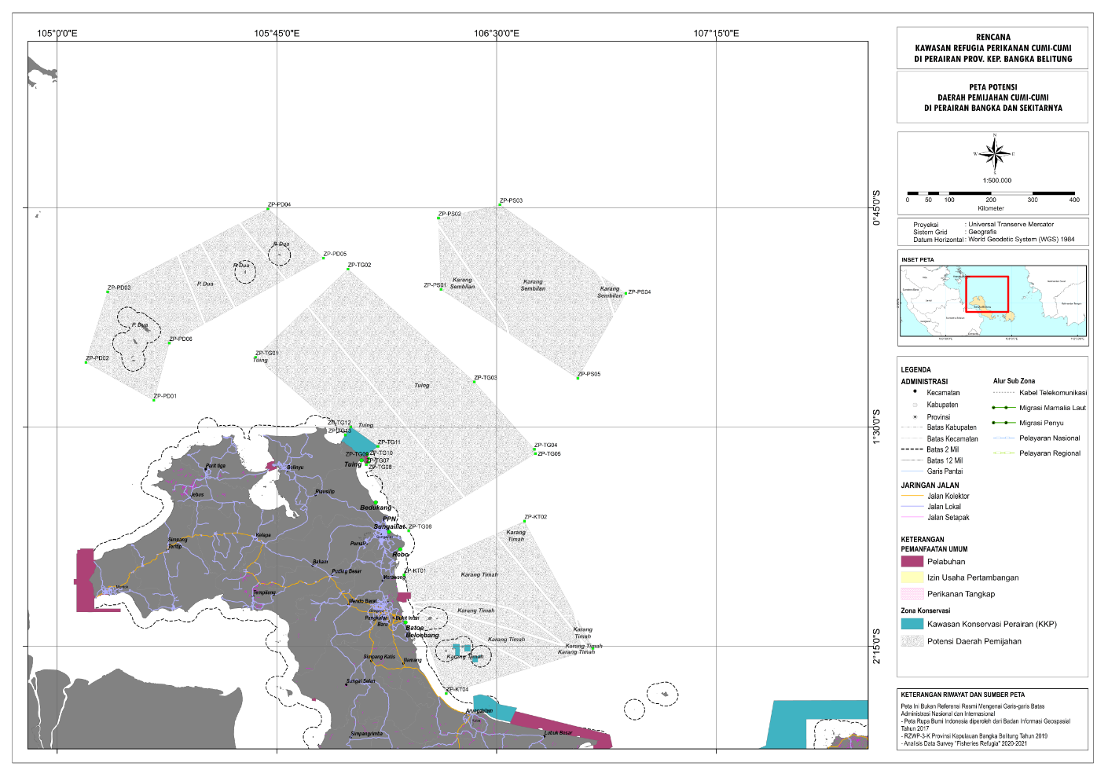
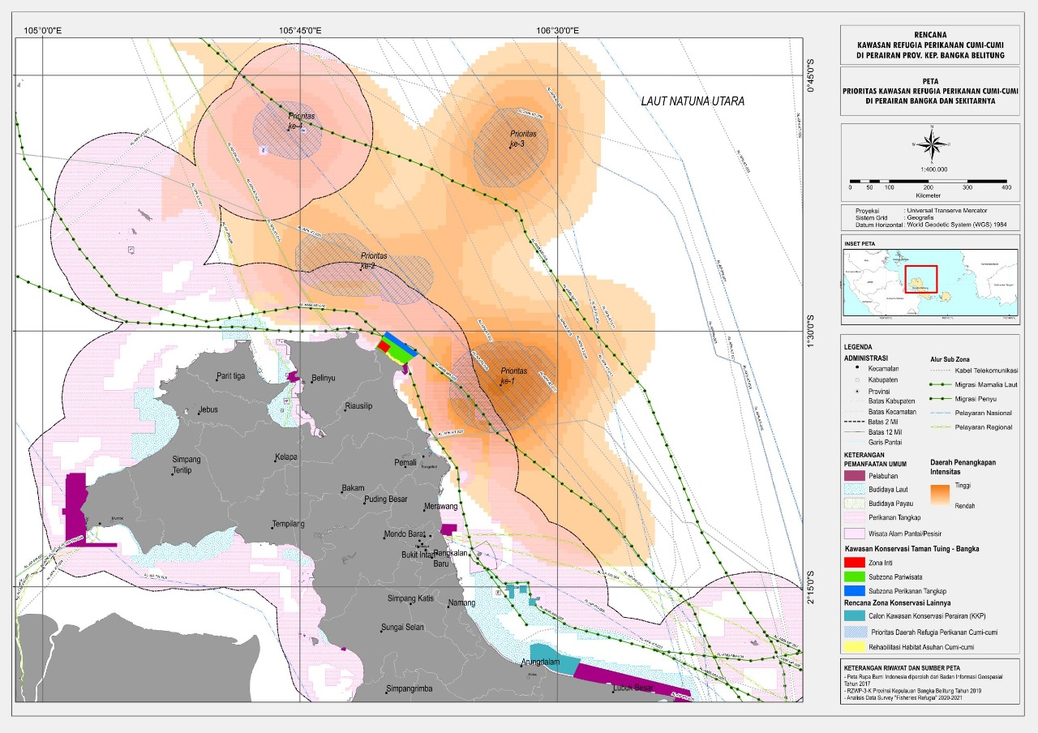
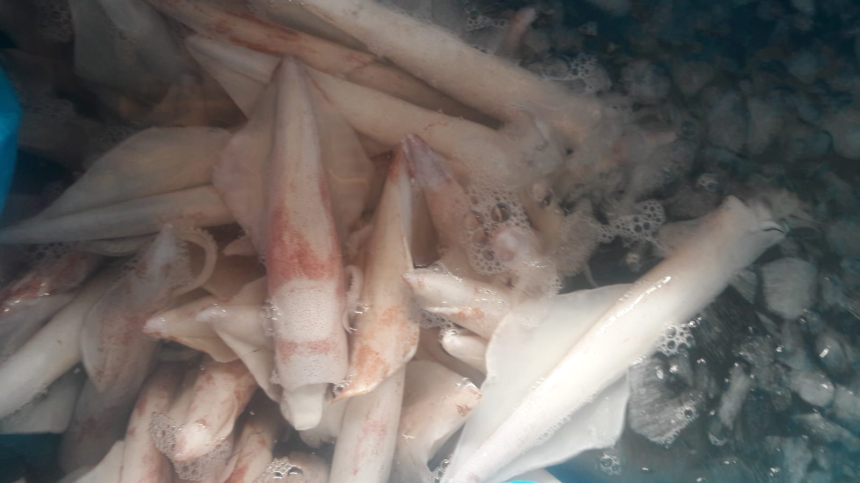
Key Achievements
Proposed Refugia for Squid (Uroteuthis chinensis)
.
Target species: Squid (Uroteuthis chinensis)
Proposed refugia size: 468,828.32 Ha
Target Habitat : Coral reef, sea grass
Engagement of local stakeholders: Local fishing community in Bangka ; Fishery product collector, trader and exporter Marine & Fishery Agency of Bangka Belitung Province; Fishery Agency of Bangka District; DG of Capture Fisheries; DG of Marine Spatial; University of Bangka Belitung;

Slide 12
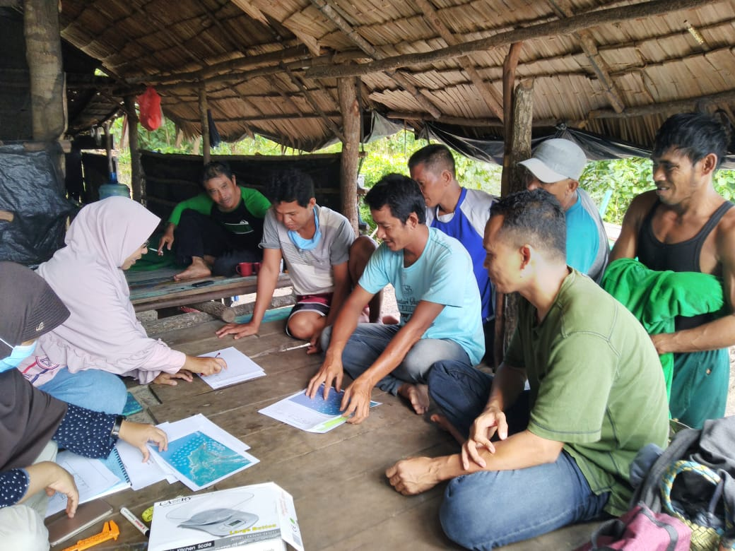
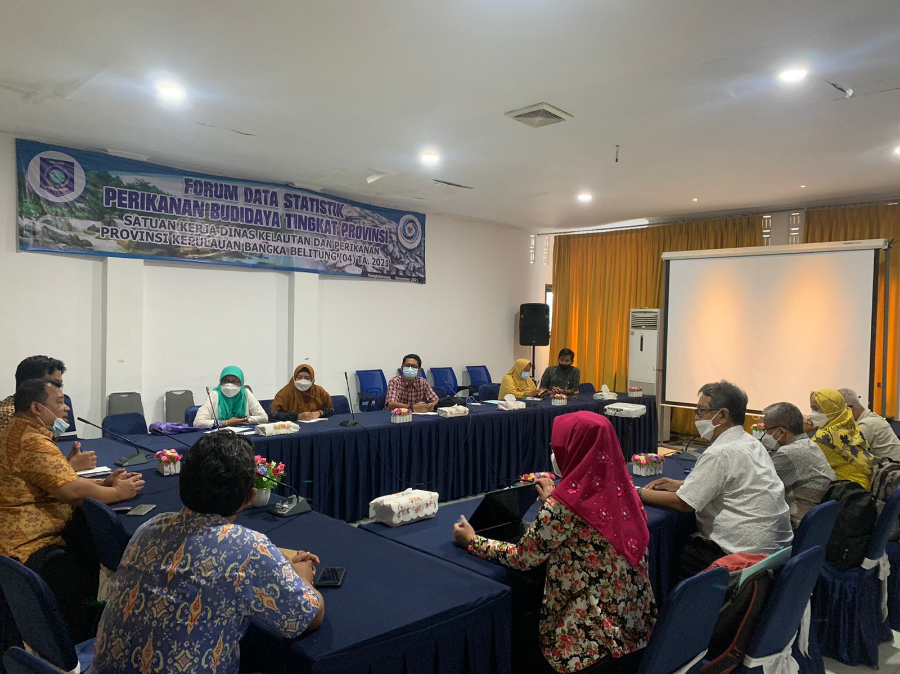
Key Achievements
Proposed Refugia for Squid (Uroteuthis chinensis)
.
Management Mechanism :
Broody squid fishing management through an open-closed fishing mechanism from April to June and October to November was implemented in the designated spawning area.
Regulate squid juvenile fishing by limiting operational lift net and squid juveniles fishing areas as well as prohibit the lift net operation in the designated nursery area.
Conduct coastal habitat rehabilitation through physical (hard structure) and biological (mangrove planting) engineering to trap the sediment.
Encourage the establishment of policy regulations on the use of squid resources at the local level based on independent local wisdom.

Slide 13
Issues and Challenges
Limited information on critical habitat linkage for fish stock
Lack of understanding of the fisheries refugia concept;
Community perception and acceptance;
The COVID-19 pandemic
Changes in the structure and leader of the institution/agency implemented the project
Implementing the Strategic Action Programme for the South China Sea and Gulf of Thailand (SCS SAP Project)

Slide 14
Recommendations
.
Coastal habitat and fisheries management integration: joint activities on policy & legal aspects review and management plans;
Sharing information on identified root causes of the problems and priorities for intervention;
Join activities on rehabilitation and enhancement of critical habitats in the refugia site.
Implementing the Strategic Action Programme for the South China Sea and Gulf of Thailand (SCS SAP Project)

Slide 15
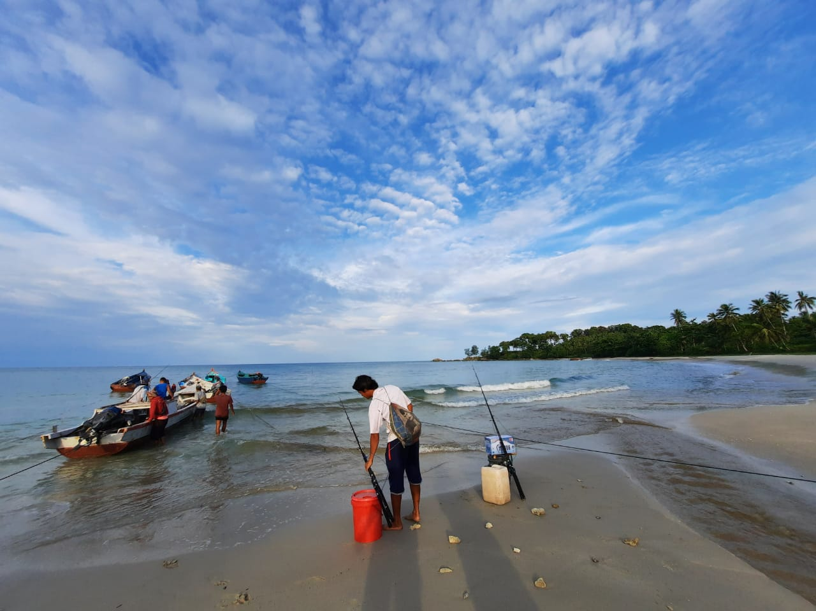
Thank you

