Slide 1
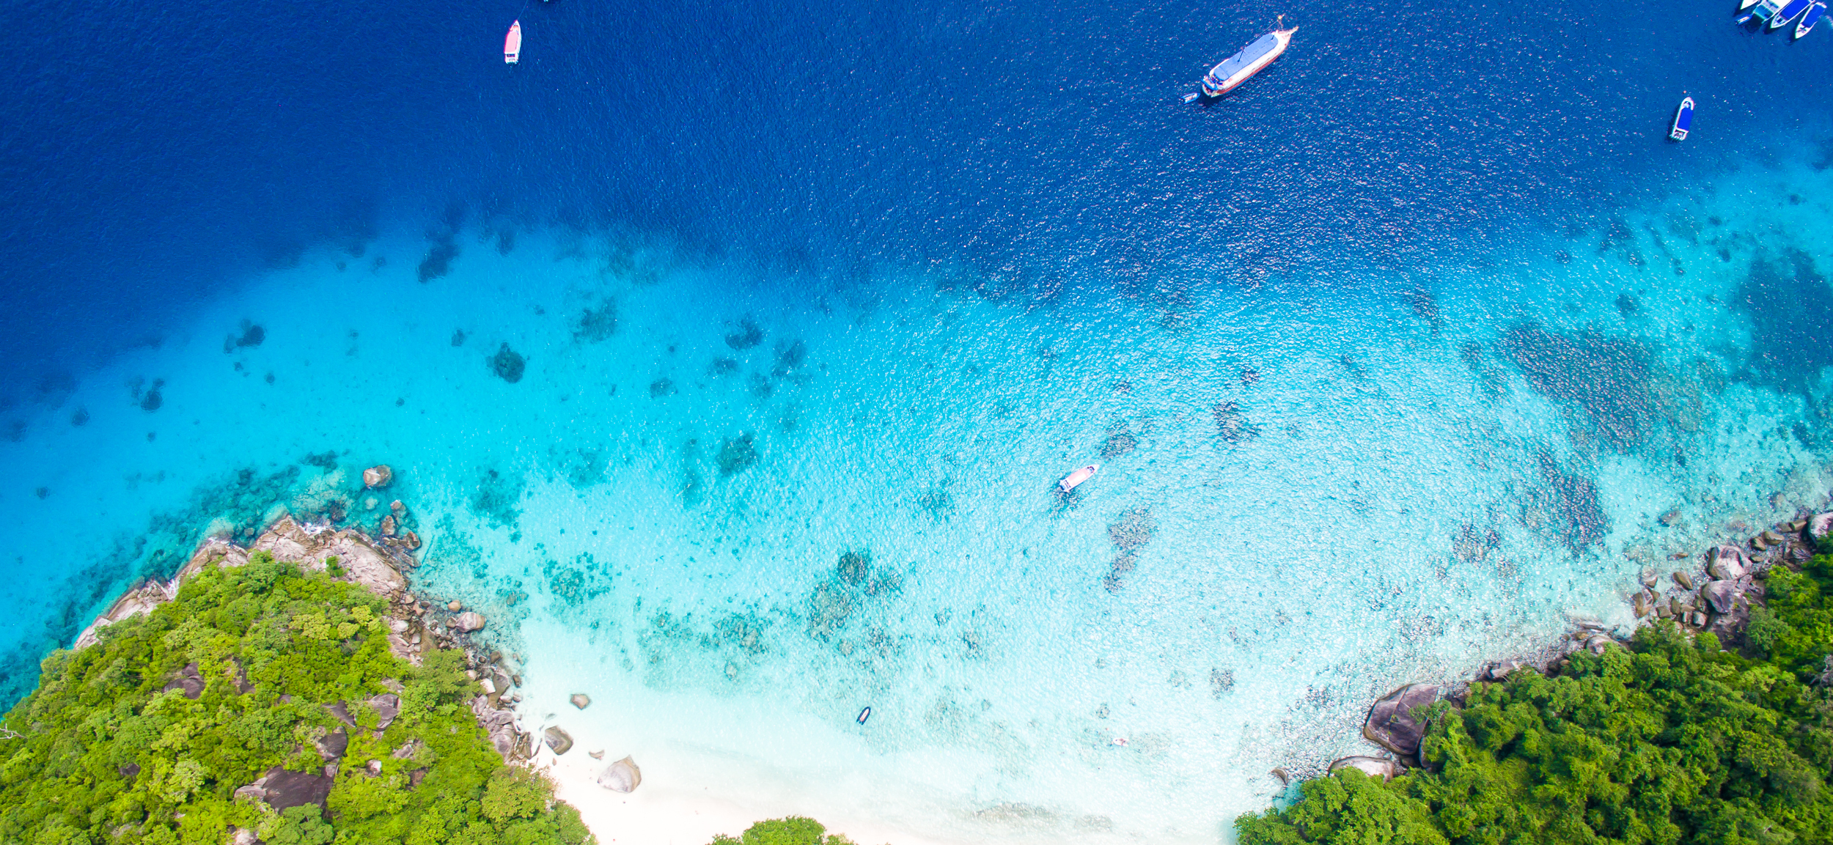


Implementing the Strategic Action Programme for THE SOUTH CHINA SEA AND GULF OF THAILAND (SCS SAP) Project
First Meeting of the Regional Scientific and Technical Committee (RSTC)
of the SCS SAP Project
17-19 October 2022, Bangkok, Thailand
SAP IMPLEMENTATION ACHIEVEMENTS 2008-2021
Vietnam
[Vietnam Agency of Sea and Islands (VASI)]

Slide 2

Presentation Outline
Introduction
Evaluation of Achievements
Mangroves: SAP Targets and Summary of Achievements
Coral Reefs: SAP Targets and Summary of Achievements
Seagrass: SAP Targets and Summary of Achievements
Wetlands: SAP Targets and Summary of Achievements
Issues and Challenges
Lessons Learned
Recommendations
Conclusions

Slide 3
Introduction
United Nations Environment Programme (UNEP) implemented Regional Project “Reversing Environmental Degradation Trends in the South China Sea and Gulf of Thailand” (SCS Project) in the period 2002-2008.
In order to implement the Strategic Action Programme (SAP), at the regional level, the Global Environment Facility (GEF) adopted on November 03, 2016 the project entitled “Implementing the Strategic Action Programme for the South China Sea and Gulf of Thailand (SCS SAP Project)”
Vietnam have developed the National Action Plan (NAPs) for habitat and land-based pollution management during the course of the SCS Project and have conducted a series of activities in implementing the SAP and NAPs on mangroves, coral reefs, seagrass and coastal wetlands since 2008

Slide 4
Evaluation of Achievements on Mangroves
- The Strategic Action Programme targets for mangroves in Vietnam focus on: improving the management of mangrove areas utilized for the sustainable use of non-mangrove resources. This will be achieved via the development and implementation of sustainable use management plans for 50,000 ha of mangroves, as well as the reform of laws and regulations for the sustainable use of mangrove areas in Vietnam.
- The Strategic Action Programme targets also focus on increasing the area of mangrove designated as a National Park or assigned Protected Area status by 30,000 ha. It will also result in the replanting of 8,000 ha of deforested mangrove land and the enrichment planting of a further 2,000 ha of mangrove to increase biodiversity. Priority areas for management include Tien Yen, Xuan Thuy, Can Gio and Ca Mau
Summary of the SAP targets for mangroves and achievements during 2008-2021 in Vietnam
Regional output | SAP 2008 targets (ha) | Tien Yen | Xuan Thuy | Can Gio | Ca Mau | Total
1.1.1 Declaration of 57,400 ha of mangrove as National Parks and Protected Areas | 30,000 | 1,608 | 7,100 | 32,589 | 52,378 | 93.675
1.1.2 Designation and plans for the management of 166,600 ha of mangrove as non-conversion, sustainable use areas | 0* | 1,800 |  | 7,100 |  | 8,900
1.1.3 Reform of laws and regulations for the sustainable use of 602,800 ha of mangrove forest | 50,000 | 1,800 | 7,100 | 32,589 | 52,378 | 93,675
1.1.4 Replanting of 21,000 ha of deforested mangrove land | 8,000 | 800 | 125 | 2000 | 5000 | 7,925
1.1.5 Biodiversity increased for 11,200 ha of mangrove forest via enrichment planting | 2,000 | 400 | 3000 | 4000 | 3000 | 10,400
1.1.6 Monitoring of management effectiveness | N/A

Slide 5
* No target in ha indicated for each site, total targets = managed in 2008 (2,270ha) + added for management (3,300ha)
** Area (ha) under sustainable management with sufficient capacity, approach reformed, tools applied and stress reduced
Evaluation of Achievements on Coral Reefs
Status in 2008 indicated that 5 sites among 9 priority sites in Vietnam were under management with medium management effectiveness. The targeted coral reef area to be added for management through SAP implementation was 3,300 ha, bringing the total area across the nine sites under management to 5,570 ha. The implementation of the Strategic Action Programme also aims to increase the management effectiveness across all nine sites from non-existing and/or medium to high
Summary of the SAP targets for coral reefs and achievements during 2008-2021 in Vietnam
 | Managed in 2008 | SAP target area (ha)* | Total area (ha) ** managed until 2021 | Capacity (high, medium, low) | Management approach (ha) | Management tools (ha) | Moni-toring (ha)
Cu Lao Cham | 100 |  | 356 | High | 67.2 | 288.8 | X
Nha Trang bay | 100 |  | 754 | Low |  | 754 | X
Con Dao | 1,000 |  | 914 | High |  | 914 | X
Phu Quoc | 0 |  | 290 | Medium |  | 290 | X
Ninh Hai | 1,070 |  | 1.303 | High |  | 1.303 | X
Ca Na bay | 0 |  | 506 | Low |  | 506 | X
Ha Long - Cat Ba | N/A |  | 74 | Medium |  | 74 | NA
Hai Van - Son Tra | 0
Bach Long Vi | 0 |  | 1,578 | Low |  | 1,578 | NA
Total | 2,270 | 5,570 | 5,776 |  |  | 5.776

Slide 6
Evaluation of Achievements on Seagrass
The Strategic Action Programme targets four seagrass sites and would result in an increase in seagrass area under management by 5,050 ha. The four sites are located at the Phu Quoc archipelago; Con Dao Islands; Thuy Trieu; and Tam Giang
Regional Output | SAP target (ha) | Phu Quoc | Con Dao | Thuy Trieu | Tam Giang | Total
1.3.1 Twenty seagrass areas totaling 26,036 ha under sustainable management with supporting laws and regulations | 5,050 | 6,925 | 200 |  | 2,071 | 9,196
1.3.2 Amended management plans for 7 existing MPAs with significant seagrass areas, to include specific seagrass-related management actions and policy, legal and institutional reforms |  |  | 200 |  |  | 200
1.3.3 Designation of 7 new Marine Protected Areas focusing on seagrass areas identified in the prioritized listings of the SCS Project |  | 6,825 |  |  | 2,071 | 8,916
1.3.4 Established mechanism for monitoring seagrass habitat management

Slide 7
Evaluation of Achievements on Coastal Wetlands
The Strategic Action Programme implementation in Vietnam would result in the adoption and implementation of management plans for: 2 coastal lagoons – Tam giang-Cauhai (21,600 ha) and Thi Nai (5,000 ha); 3 estuaries – Balat (26,397 ha), Tien River Estuary (100,691) and Dong Nai River Estuary (49,711 ha); and 1 tidal mudflat at Ca Mau Southwest Tidal Flat (60,711 ha). This includes the declaration of wetland areas with protection status and needed management reforms, and adoption of a regional estuary monitoring scheme for national implementation
Summary of achievements on wetland management (ha) in implementing the SAP target at priority sites during 2008-2021 in Vietnam
Regional outputs | Tam Giang – Cau Hai | Ba Lat Estuary | Dong Nai Estuary | Ca Mau Tidal Flat | Phu My (Kien Giang)
Integrated management plans developed and under implementation for at least 2 lagoons (21,818 ha), 10 estuaries (639,418 ha), 5 tidal flats (96,903 ha), 1 peat swamp (45,700 ha) and 1 non-peat swamp (9,808 ha) | TBD |  | TBD | TBD
Declaration of wetland areas with protection status (i.e. non-hunting area, nature reserves, protected areas, Ramsar Sites) |  | TBD | TBD | TBB | TBD
Adoption of a regional monitoring scheme and its national implementation
TBD: to be determind

Slide 8
Funding and source, implementing agencies and partners.
Funding for the regional outputs is lack, mainly from the state budget, some tasks called for investment projects from NGOs, used the budget in the government's afforestation programs.
Vietnam government has made adjustments in policies such as approval of planning of the system of marine protected areas, establishment National Park, offer of recognition World Biosphere Reserves, Ramsar Site, …
Agencies and partners: central and local government, some universities and research institutes, NGOs, …

Slide 9
Issues and Challenges
In the period of 2008-2021, the implementation of the project's objectives is mainly in the form of integration with existing programs of central and local government. Therefore, the results achieved are not synchronous and incomplete at all activities. There are activities that achieve good results, exceed SAP's goals, but there are activities that cannot be implemented or the results are not as expected.
The challenge between economic development and coservation marine and wetland ecosystem. Challange to coastal people’s livelihoods and ecosystem conservation. Challenges posed by climate Change in Vietnam and global.
Lessons Learned
First, the role of government of development guidelines, policies and objectives with the concurrence and support of development partners.
Second, ensure reciprocal resources. Ensuring timely and appropriate reciprocal resources is a demonstration of the Government's high efforts and responsibility in the development cooperation partnership.
Third, the support of international organizations such as UNDP, UNEP, GEF, GIZ... and the companionship of the Vietnamese government
Fourth, the participatory role of local governments and communities where coastal wetland ecosystems, mangroves, coral reefs and seagrasses are located.
Fifth, The participation of specialized Scientists related to marine and coastal ecosystems.
Sixth, a natianl master plan is needed for conservation and developments of wetland ecosystems, mangroves, coral reef and seagrasses.

Slide 10
Recommendations
Remove difficulties in the way of organizing the implementation of project coordination activities and expand the participation of the parties.
Improve the quality of international cooperation.
Strengthen dialogue between the project parties
Increase funding for SCS SAP Project implementation

Slide 11
Conclusions
Department of Science, Technology and International Cooperation (DSTIC) under VASI is coordinating with the United Nations Project Implementation Office (UNOPS) to develop and finalize the Agreement on Cooperation in Project Implementation in Viet Nam.
Funding for activities in Vietnam is 641,662 USD for 5 activities under Component 1 of the Project including coral ecosystems, seagrass, mangroves and wetlands and joint coordination of the project.
Implementing agencies and partners: Hanoi University of Science (HUS) under Vietnam National University (VNU); Institute of Oceanography & Southern Institute of Ecology - under Vietnam Academy of Science and Technology and VASI. Mr. Nguyen The Chinh, Programme Management Specialist-National Coordinator, SCS SAP Project

