Slide 1

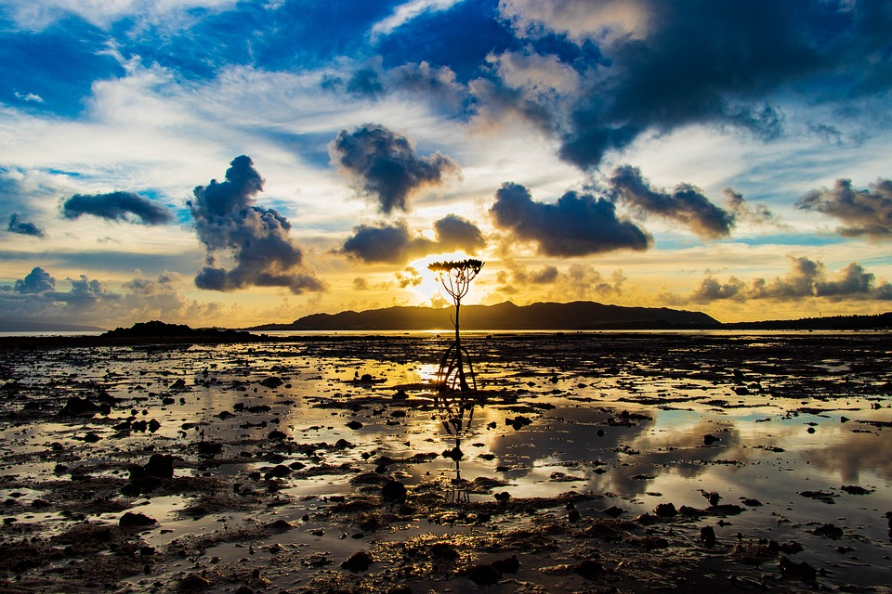
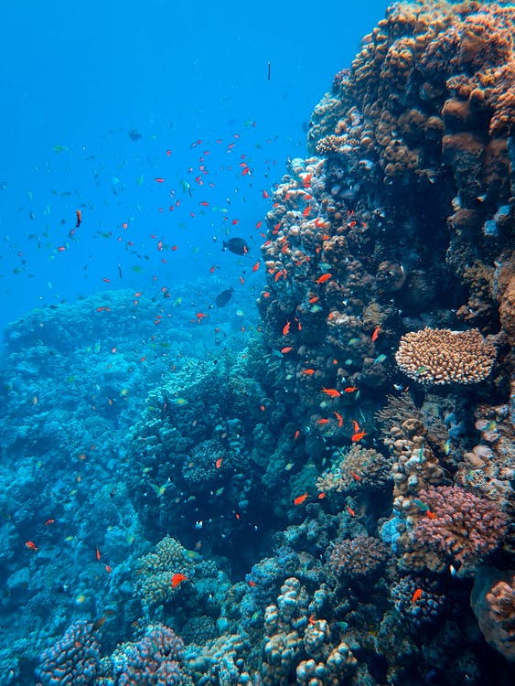
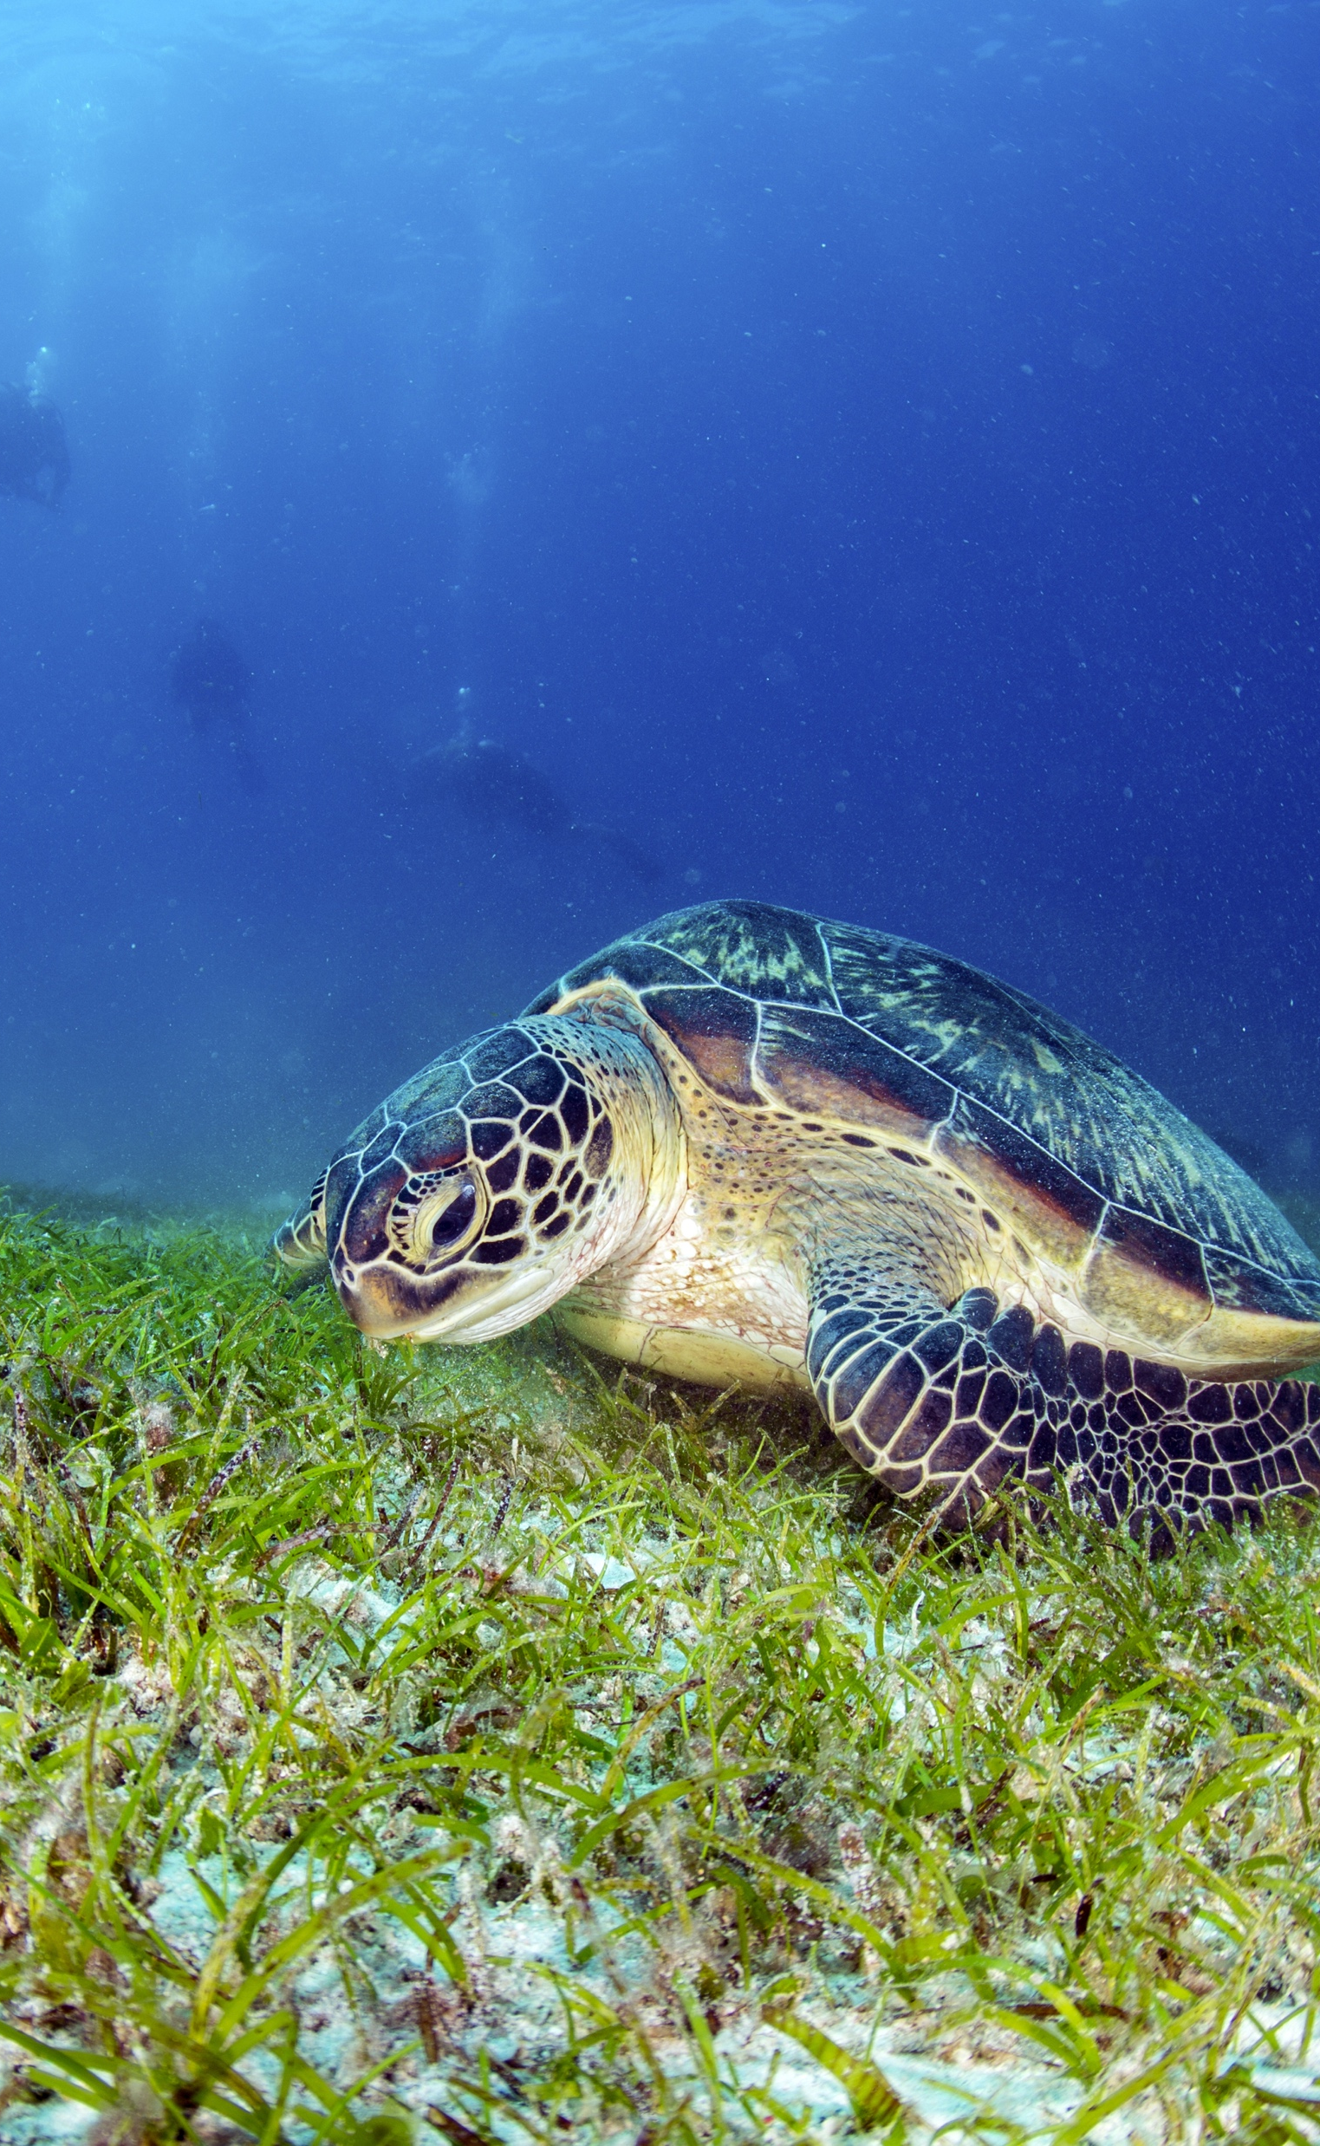
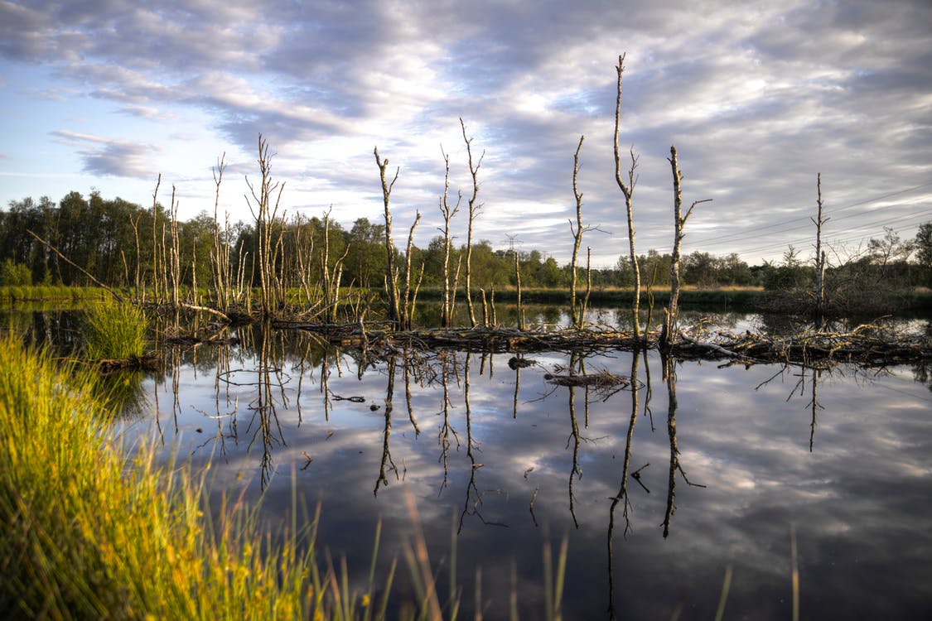
Implementing the Strategic Action Programme for the South China Sea and Gulf of Thailand (SCS SAP Project)
FIRST MEETING OF THE REGIONAL SCIENTIFIC AND TECHNICAL COMMITTEE (RSTC)
OF THE SCS SAP PROJECT
17-19 October 2022, Bangkok, Thailand
REPORT OF ACHIEVEMENTS OF THE FISHERIES REFUGIA PROJECT
[VIET NAM]
[Directorate of Fisheires]

Slide 2
Presentation Outline
Introduction
Key Achievements
Issues and Challenges
Recommendations
Implementing the Strategic Action Programme for the South China Sea and Gulf of Thailand (SCS SAP Project)

Slide 3
Introduction
Viet Nam is situated in the tropical monsoon area of South East Asia. It has a coastline of 3260 km and an exclusive economic zone (EEZ) of more than 1 million km2.
Vietnamese waters have many bays, lagoons, and estuaries, including Ha Long Bay, Bai Tu Long Bay, and Tam Giang lagoon, and over 150,000 ha of mangroves. There is high potential for the development of capture fisheries, marine aquaculture, and other economic sectors, including transportation and tourism.
Vietnam's marine and coastal resources are under increasing pressure and are increasingly being significantly degraded.
Implementing the Strategic Action Programme for the South China Sea and Gulf of Thailand (SCS SAP Project)

Slide 4
Introduction
To ensure the sustainable development of the fisheries sector in particular and the marine economy in general, the Government of Vietnam has issued it. and legal documents such as the Fisheries Law 2017, the Fisheries Sector Development Strategy 2021-2030, with a vision to 2045 (Decision 339/QD-TTg); Decision 742/QD-TTg approving the master plan on the system of marine protected areas of Vietnam until 2020 in order to protect and conserve aquatic resources and marine ecological environment.
Implementing the Strategic Action Programme for the South China Sea and Gulf of Thailand (SCS SAP Project)

Slide 5
Introduction
According to the Fisheries Law 2017, the protection of aquatic resources mainly focuses on the protection of endangered, precious and rare species, economic and indigenous species.
At the local level, the survey to identify resource protection areas is of interest to be implemented and mainly focuses on economic and indigenous objects.
A total of 72 marine fisheries protection zones are planned in the period 2021-2030 nationwide, with a total area of ​​about 1,416,547 hectares, equivalent to about 1.5% of the natural area of ​​Vietnam's sea area. male
Implementing the Strategic Action Programme for the South China Sea and Gulf of Thailand (SCS SAP Project)

Slide 6
Introduction
The establishment and operation of an area to maintain and protect fishery resources in Vietnam is a way of harmoniously combining fisheries management, biodiversity and blue economic development.
Quang Ninh (14 sites), Thua Thien Hue (22 sites), Binh Thuan (4 sites) are the first provinces of Vietnam to establish aquatic resource protection zones to protect areas of high importance for aquatic resources and biodiversity.
Implementing the Strategic Action Programme for the South China Sea and Gulf of Thailand (SCS SAP Project)

Slide 7
Introduction - National structures, executing agencies and national focal points, its roles and functions.
The highest government agency responsible for the administration, development, and management of Viet Nam’s fisheries is the Ministry of Agriculture and Rural Development (MARD). The Directorate of Fisheries (D-FISH) advises and assists the Minister of Agriculture and Rural Development in state management and implementation of state management tasks related to fisheries, in managing and leading the public service activities within the management scope of the Directorate
At the local level, Vietnam has 28 coastal provinces corresponding to 28 sub-departments of fisheries. This department assists the local authority (People’s Committee) in the administration and development of fisheries. Normally, the department has subordinate networks at the district and community level in important areas for fisheries.
Implementing the Strategic Action Programme for the South China Sea and Gulf of Thailand (SCS SAP Project)

Slide 8
Project goal and objective
The longer-term goals of national-level activities of the project in Vietnam are to:
Build the resilience of fish stocks of transboundary significance to the effects of high and increasing levels of fishing effort,
Improve the understanding amongst stakeholders, including fisher folk, scientists, policymakers, and fisheries managers, of ecosystem and fishery linkages, as a basis for integrated fisheries and ecosystem/habitat management,
Build the capacity of fisheries departments to engage in meaningful dialogue with the environment sector regarding the improvement of fisheries and management of interactions between fisheries and critical marine habitats
Implementing the Strategic Action Programme for the South China Sea and Gulf of Thailand (SCS SAP Project)

Slide 9
Project goal and objective
The specific objectives are to:
By 2022, to have established a national system of two fisheries refugia (Hàm Thuận Nam – La Gi – Binh Thuan and Phu Quoc – Kien Giang) for the management of priority, transboundary, fish stocks and endangered species;
By 2022, to have prepared and implemented fisheries management systems in priority refugia based on, and consistent with, the ASEAN SEAFDEC Regional Guidelines for Responsible Fisheries in Southeast Asia.
Implementing the Strategic Action Programme for the South China Sea and Gulf of Thailand (SCS SAP Project)

Slide 10
Refugia site 1 - Coastal area of Lagi – Binh Thuan
73,900 ha
Target species in this project: scallops (Anadara antiquata line)
Ranges, boundaries and coordinates:
V54a (10° 43' 37"N, 108° 00' 30"E)
V54b (10° 36' 09"N, 108° 05' 09"E)
V54c (10° 26' 39"N, 107° 48' 50"E)
V54d (10° 37' 42"N, 107° 41' 40"E)
Parties involved: Directorate of Fisheries (D-Fish), Department of Agriculture and Rural Development, Sub-department of Fisheries, local authorities and local people in 3 communes (Thuan Quy, Tan Thanh, Tan Thuan).
Implementing the Strategic Action Programme for the South China Sea and Gulf of Thailand (SCS SAP Project)

Slide 11
Refugia site 2 - Eastern coastal area of Phu Quoc – Kien Giang
32,860 ha
Target species in this project: Blue Swimming Crab (portunus pelagicus)
Ranges, boundaries and coordinates:
V72a (10° 22' 02"N, 104° 04' 43"E)
V72b (10° 21' 57"N, 104° 13' 01"E)
V72c (10° 04' 05"N, 104° 13' 01"E)
V72d (10° 02' 37"N, 104° 04' 04"E)
Parties involved: Drectorate of Fisheires (D-Fish), Department of Agriculture and Rural Development, Sub-department of Fisheires, local authorities and local people
Implementing the Strategic Action Programme for the South China Sea and Gulf of Thailand (SCS SAP Project)

Slide 12
Issues and Challenges
Due to the impact of the Covid-19 epidemic along with regulations on distance, contact and movement restrictions, many project activities were interrupted because of continuous outbreaks. Activities such as investigate, training... are delayed compared to the original plan.
The project lasts until 2022, which means that the Vietnamese side needs to adjust the project document. During the process of waiting for approval of the Adjustment Decision, the project's activities as well as the project's finance are temporarily suspended. This greatly affects the progress, SAP targets, achievements and results of the project
Implementing the Strategic Action Programme for the South China Sea and Gulf of Thailand (SCS SAP Project)

Slide 13
Recommendations
Support Vietnam to implement components and achieve project results in the last months of 2022.
Sharing experiences during the implementation of project components.
Implementing the Strategic Action Programme for the South China Sea and Gulf of Thailand (SCS SAP Project)

Slide 14
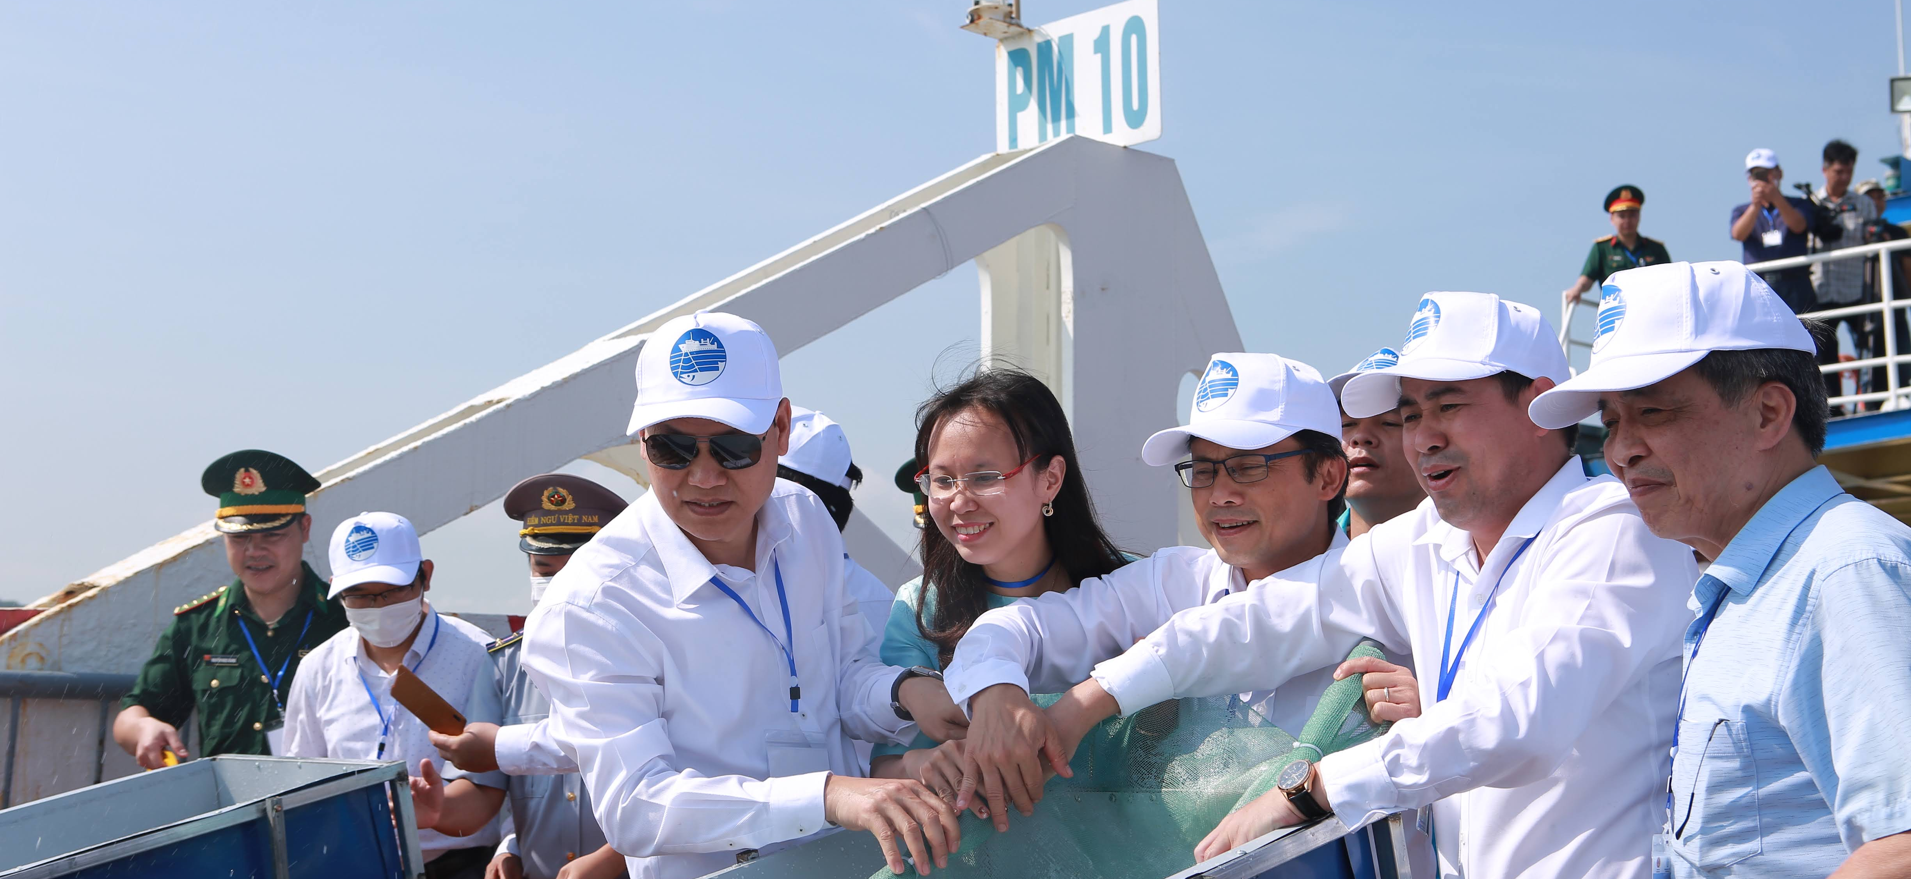
Thanks for your attention!
Implementing the Strategic Action Programme for the South China Sea and Gulf of Thailand (SCS SAP Project)

