Slide 1


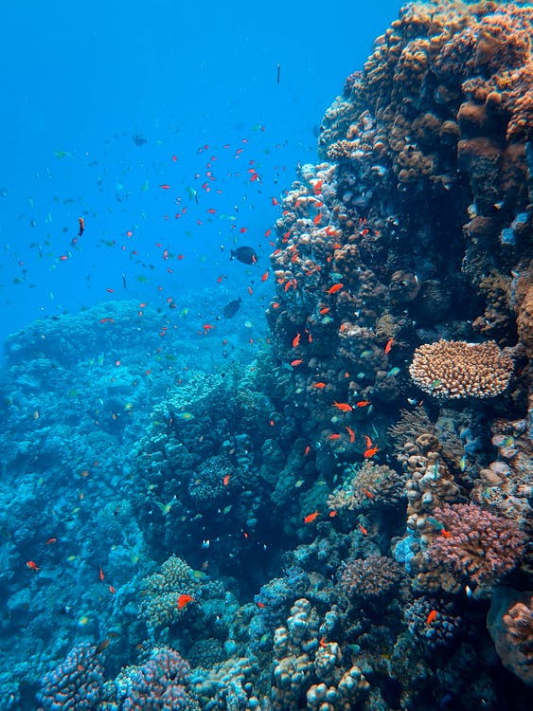
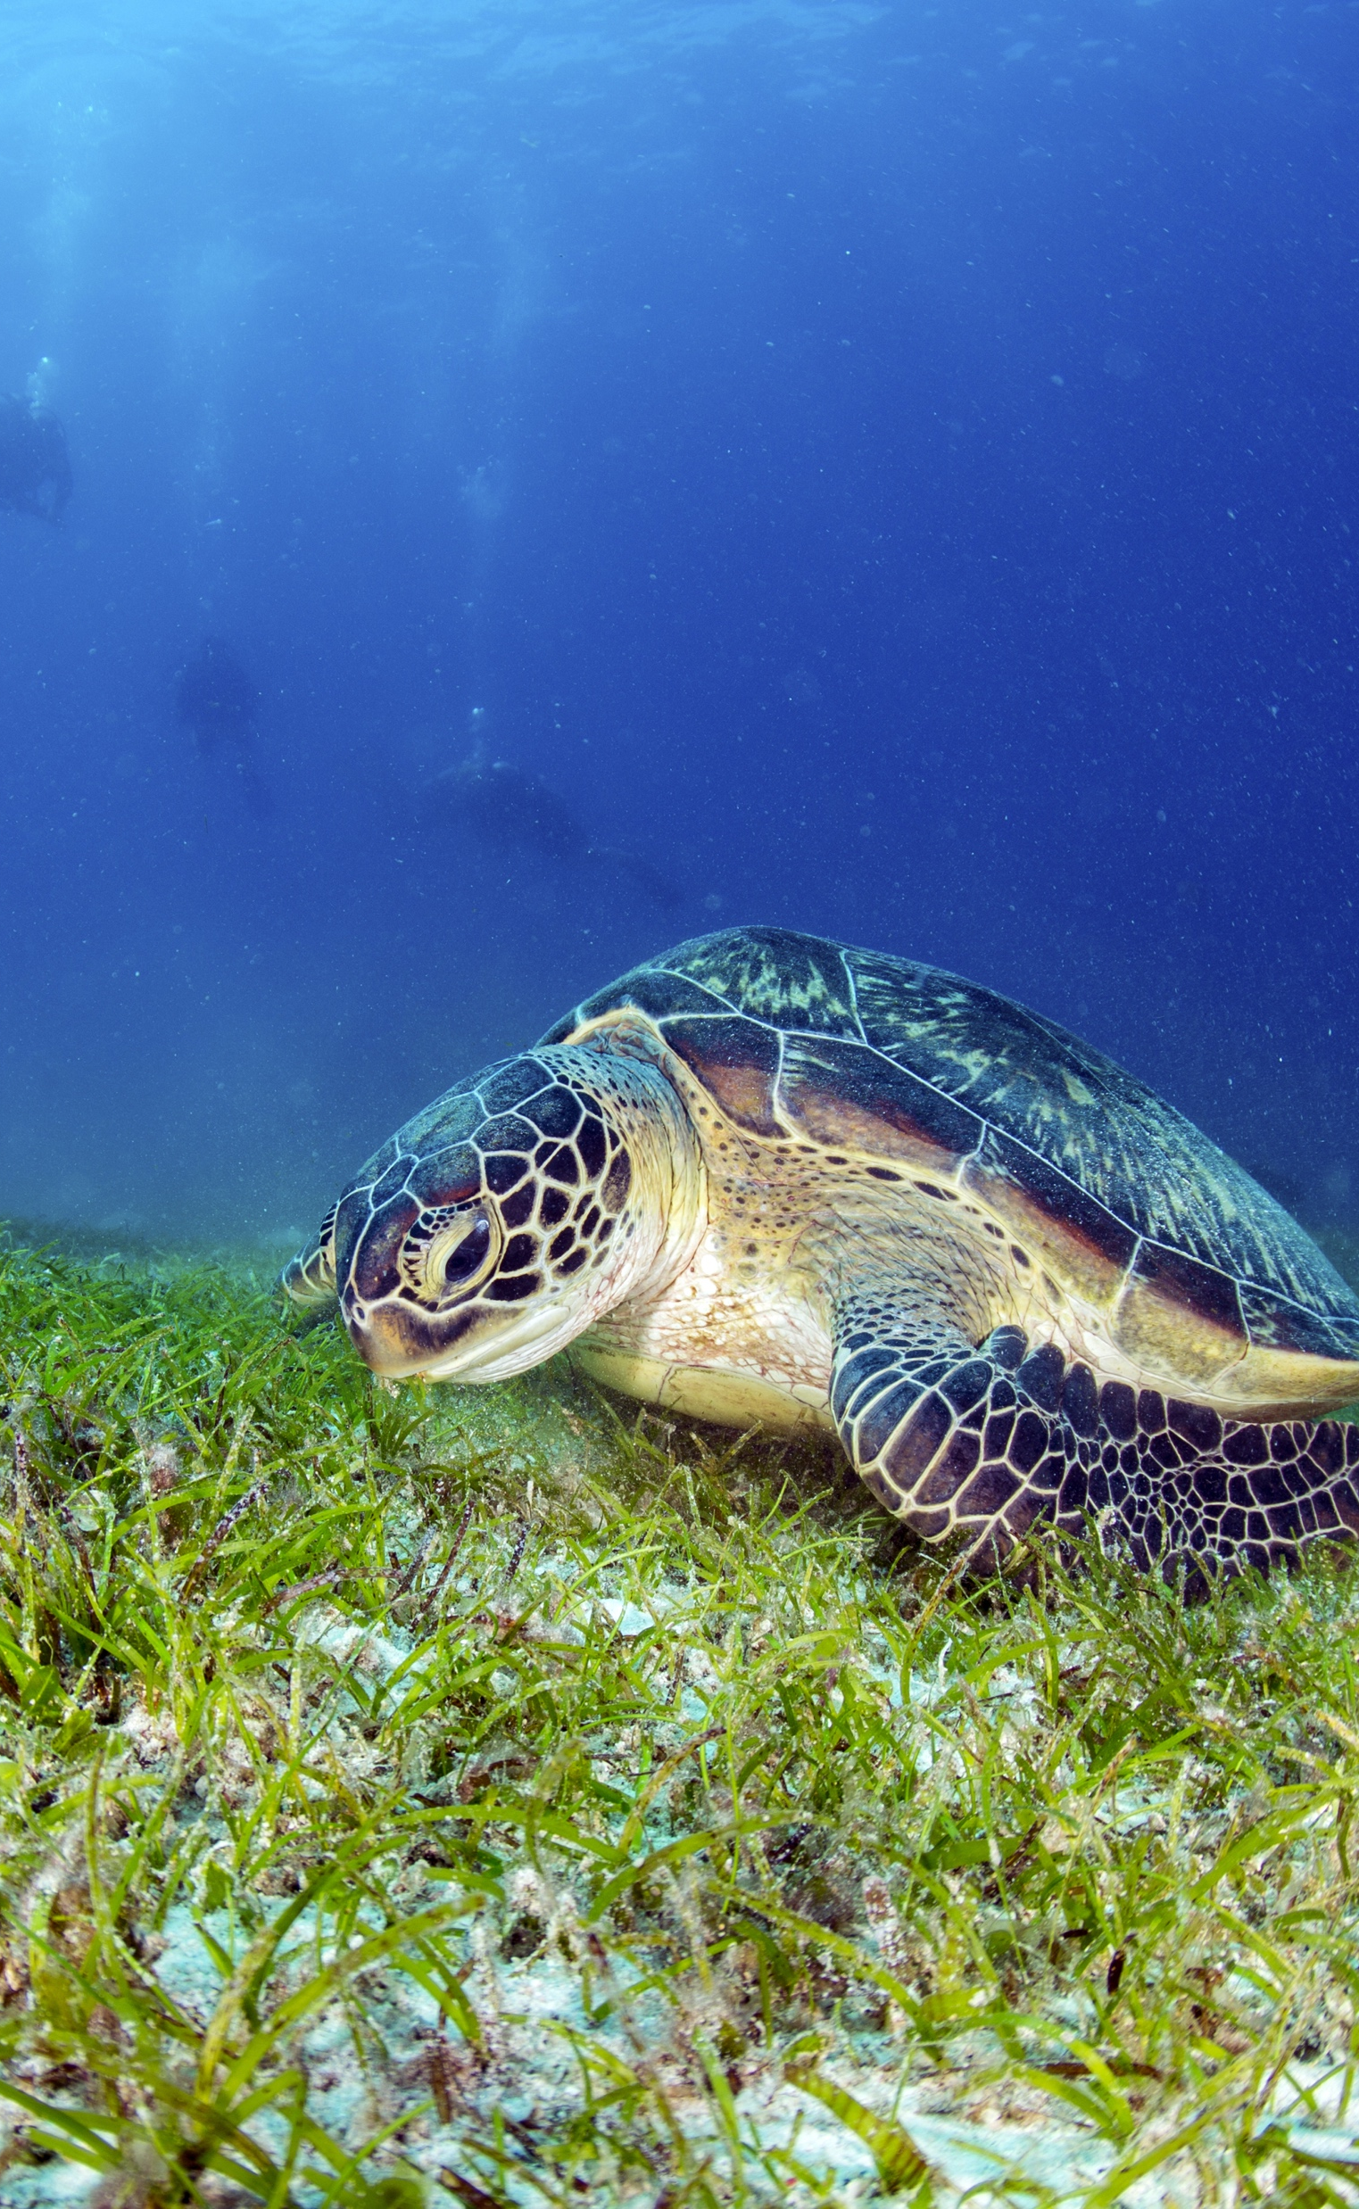
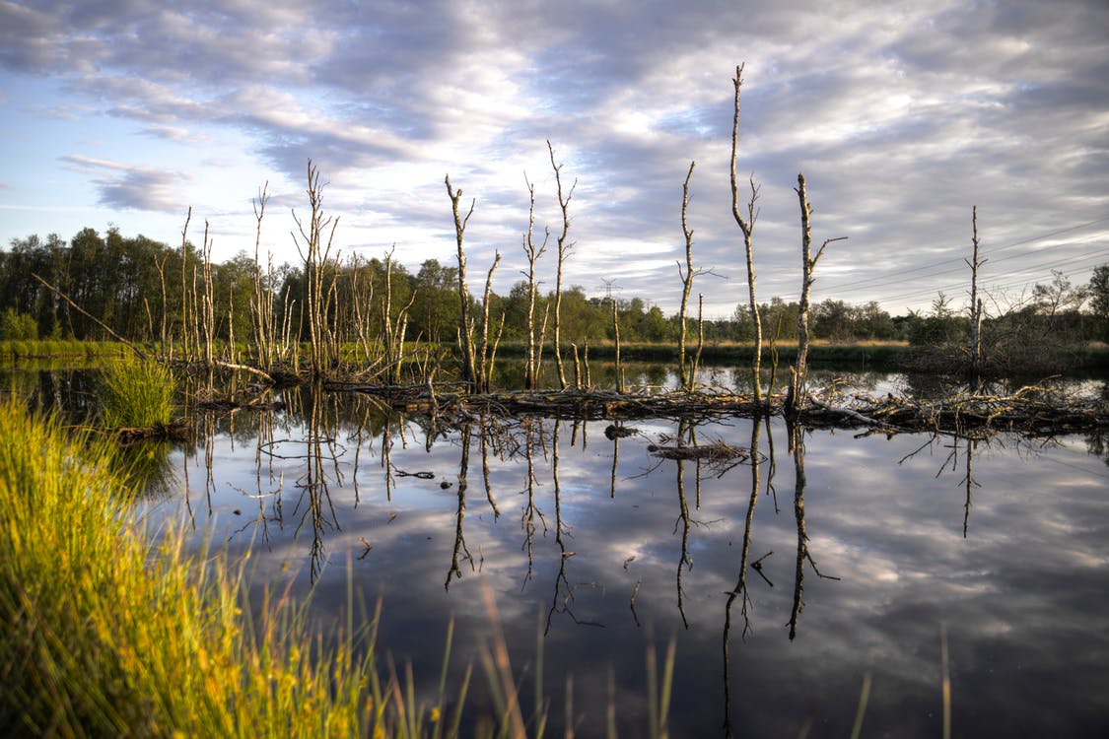
Implementing the Strategic Action Programme for the South China Sea and Gulf of Thailand (SCS SAP Project)
FIRST MEETING OF THE REGIONAL SCIENTIFIC AND TECHNICAL COMMITTEE (RSTC)
OF THE SCS SAP PROJECT
17-19 October 2022, Bangkok, Thailand
REPORT OF ACHIEVEMENTS OF THE FISHERIES REFUGIA PROJECT
[THAILAND]
[Department of Fisheries]

Slide 2
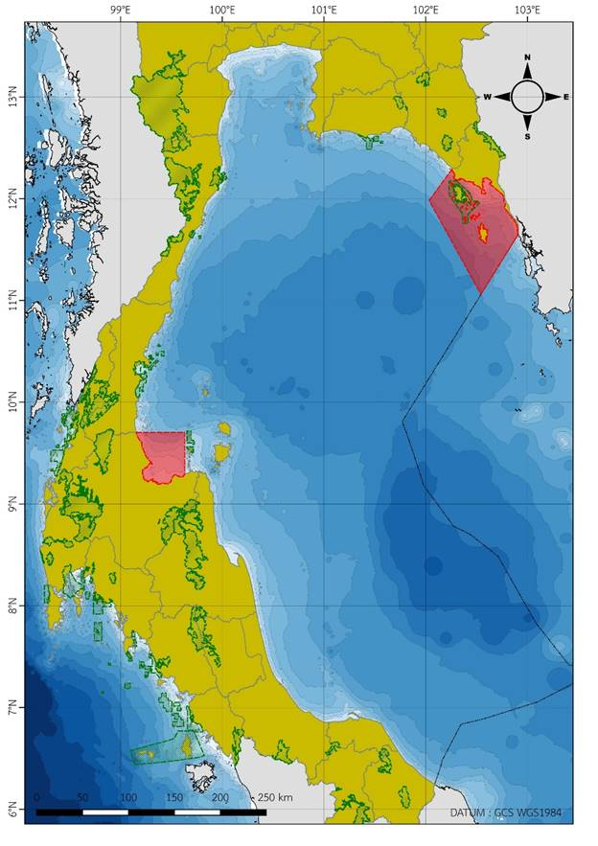
Introduction
Thailand is one of the six countries participating in Fisheries Refugia Project.
There are two sites of Fisheries Refugia established in Thailand: Trat and Surat Thani Sites.
National structure for project implementation is composed of:
Thailand’s National Fisheries Refugia Committee
Thailand’s National Scientific and Technical Committee
Site-based Fisheries Refugia Management Board in Trat Province
Site-based Fisheries Refugia Management Board in Surat Thani Province
Implementing the Strategic Action Programme for the South China Sea and Gulf of Thailand (SCS SAP Project)

Slide 3
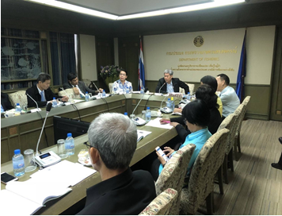
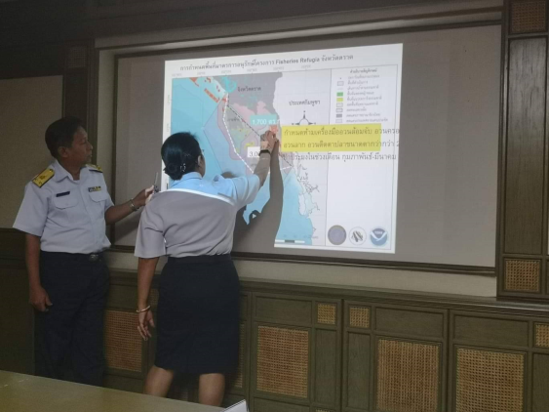
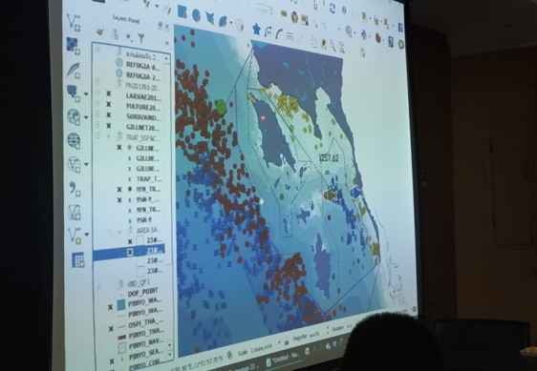
Introduction
Executing agency for Thailand is the Department of Fisheries, responsible for:
Overall responsibility for the execution of the national-level activities of the Fisheries Refugia Project
National focal point for Thailand is the senior technical officer of Marine Fisheries Research and Development Division, Department of Fisheries, responsible for:
Main point of contact with SEAFDEC, UNEP, National Fisheries Refugia Committee, National Scientific and Technical Committee , and site based management boards
Implementing the Strategic Action Programme for the South China Sea and Gulf of Thailand (SCS SAP Project)

Slide 4
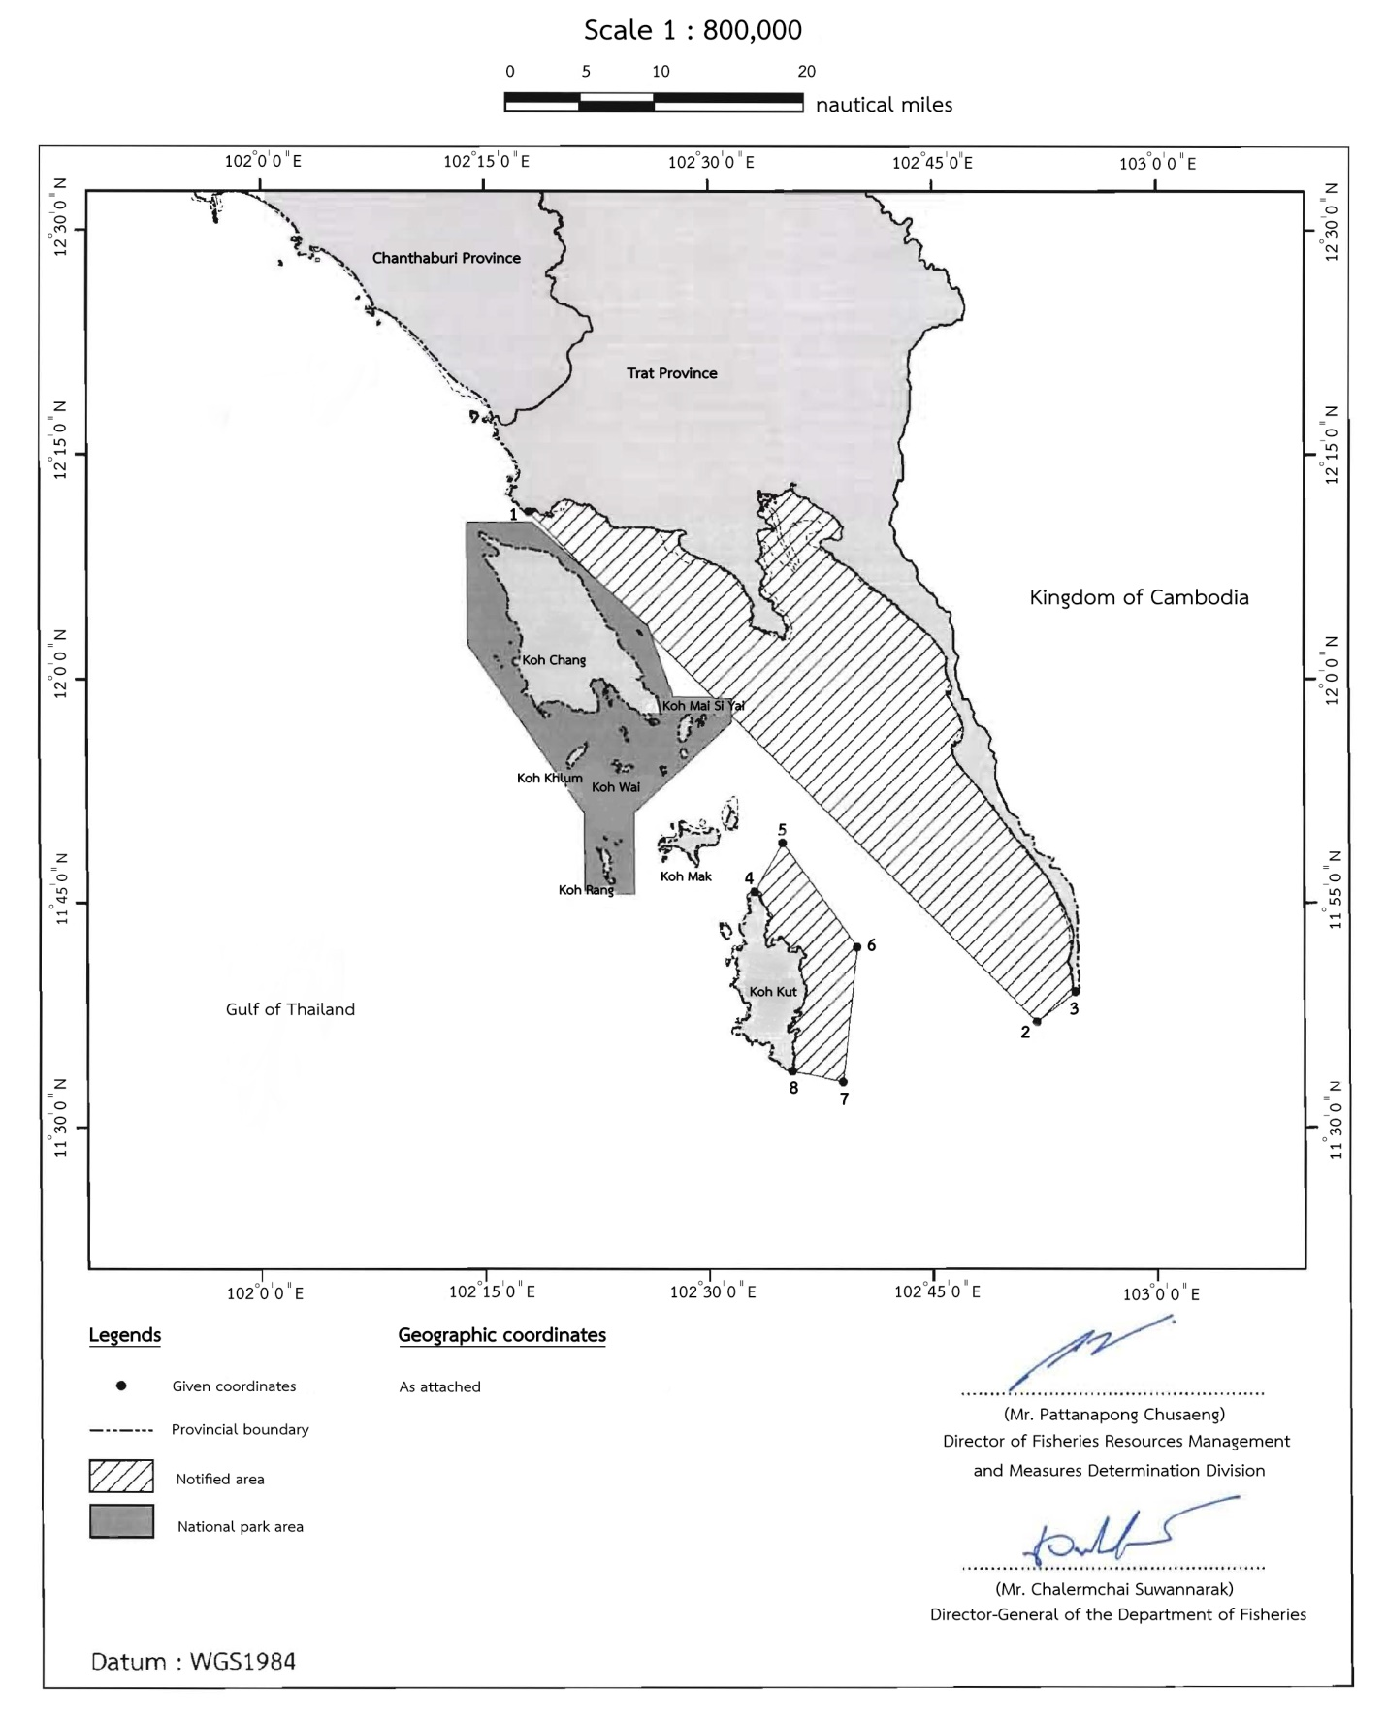
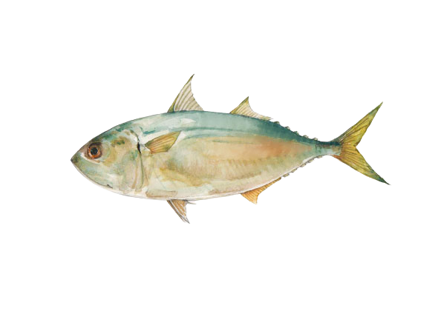
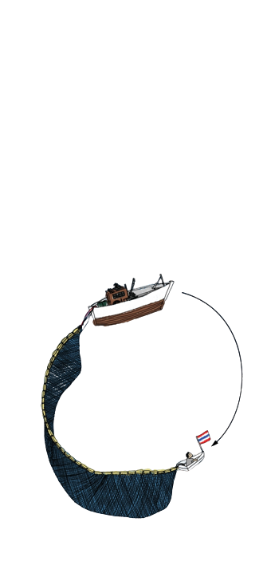
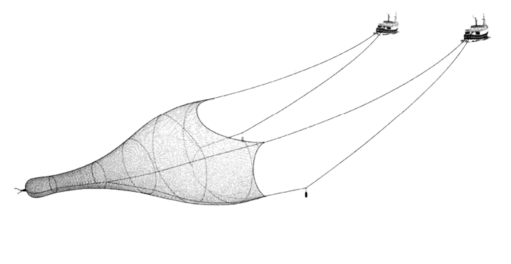
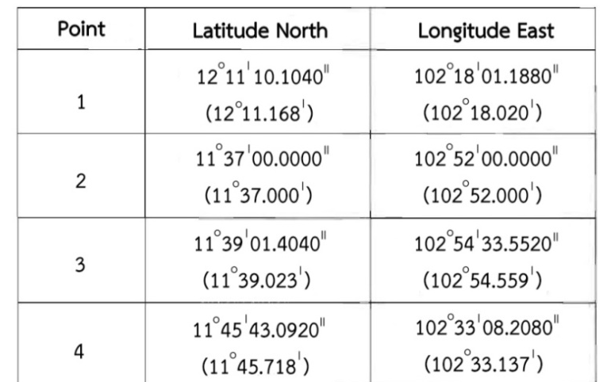


Fisheries Refugia Site 1 : Trat
Location: Off Trat Province
Target Species: Short mackerel
(Rastrelliger brachysoma)
Area : 154,600 ha Marine Habitat Linkage : Coral Reef, Mangrove, Seagrass
Status: Approved
Fishing Closure Period: 1 January to 29 February
Management Measures:
In the period from 1 January to 29 February every year, no person shall fish in fisheries refugia area in Trat Province by the following fishing gears:
(1) Purse seines fitted to motor vessels; and
(2) Pair trawls fitted to motor vessels.

Slide 5
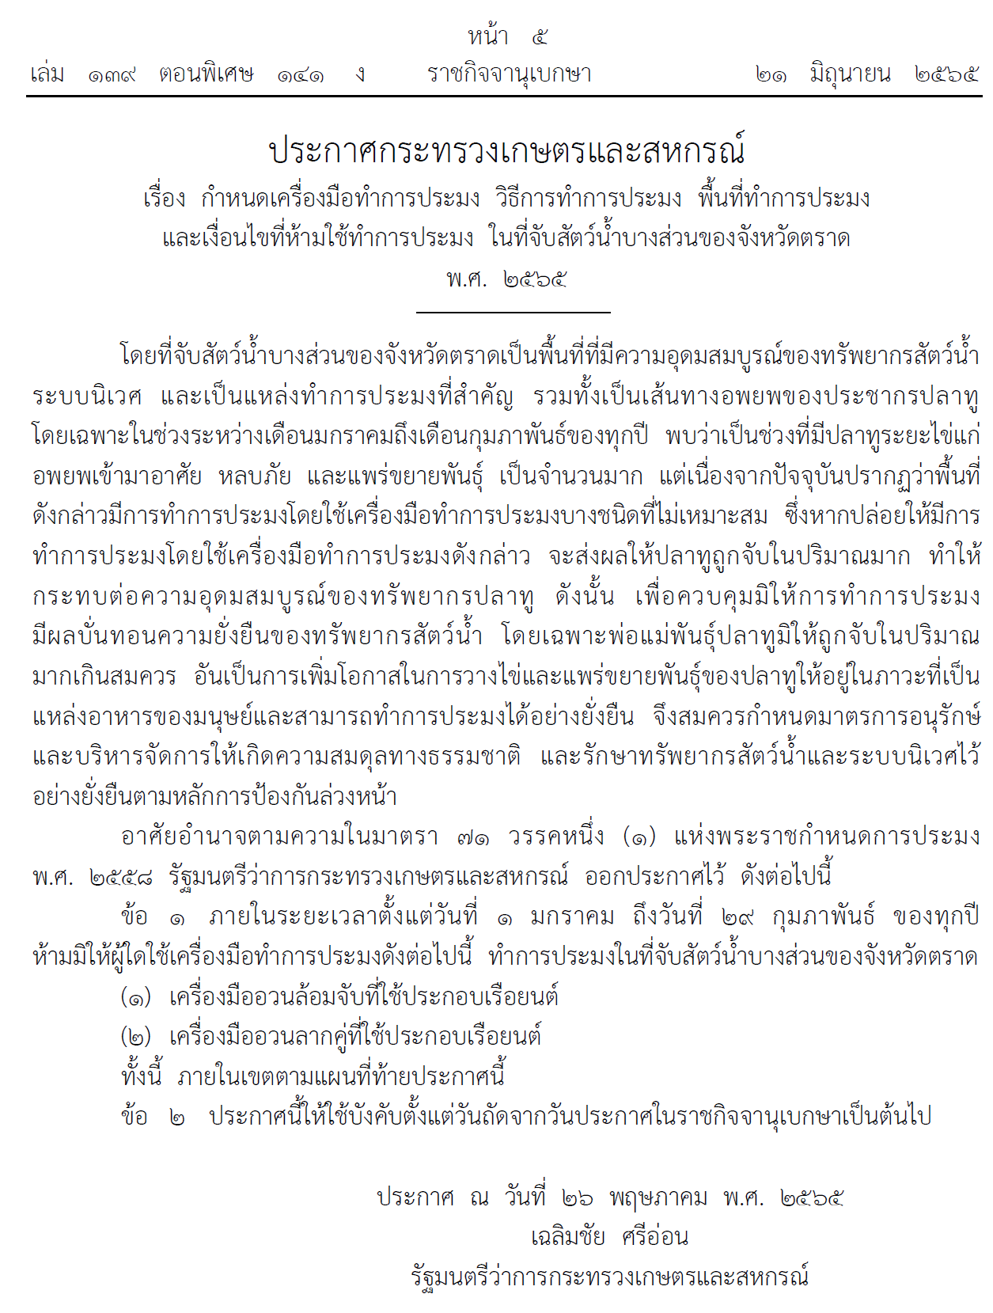
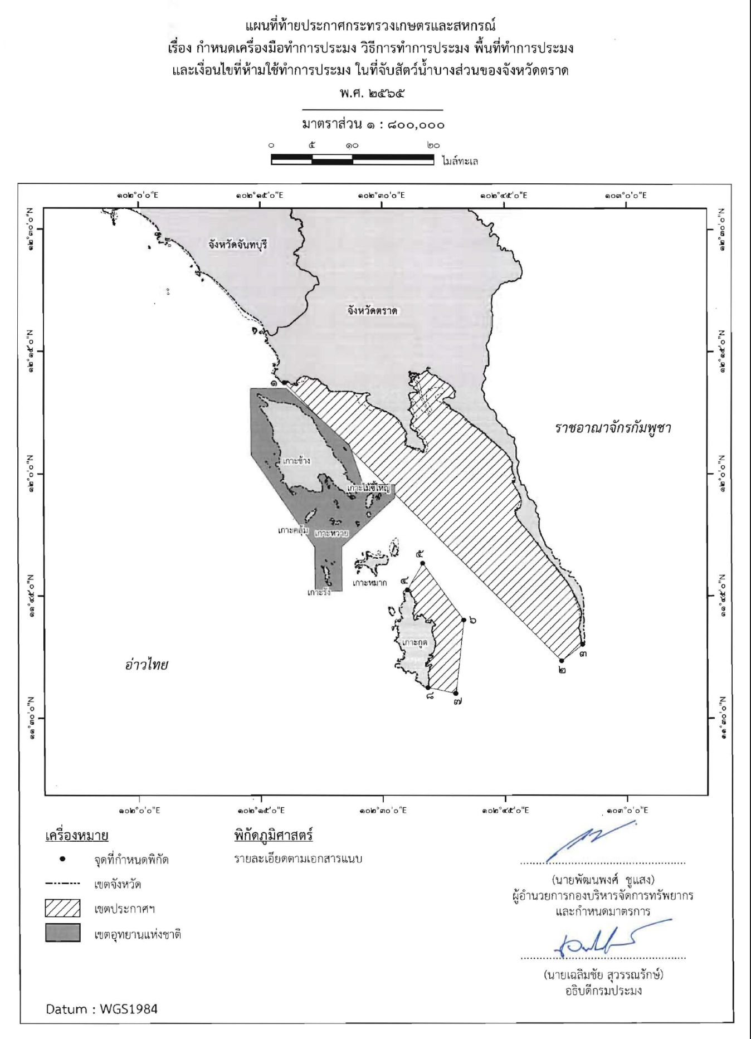
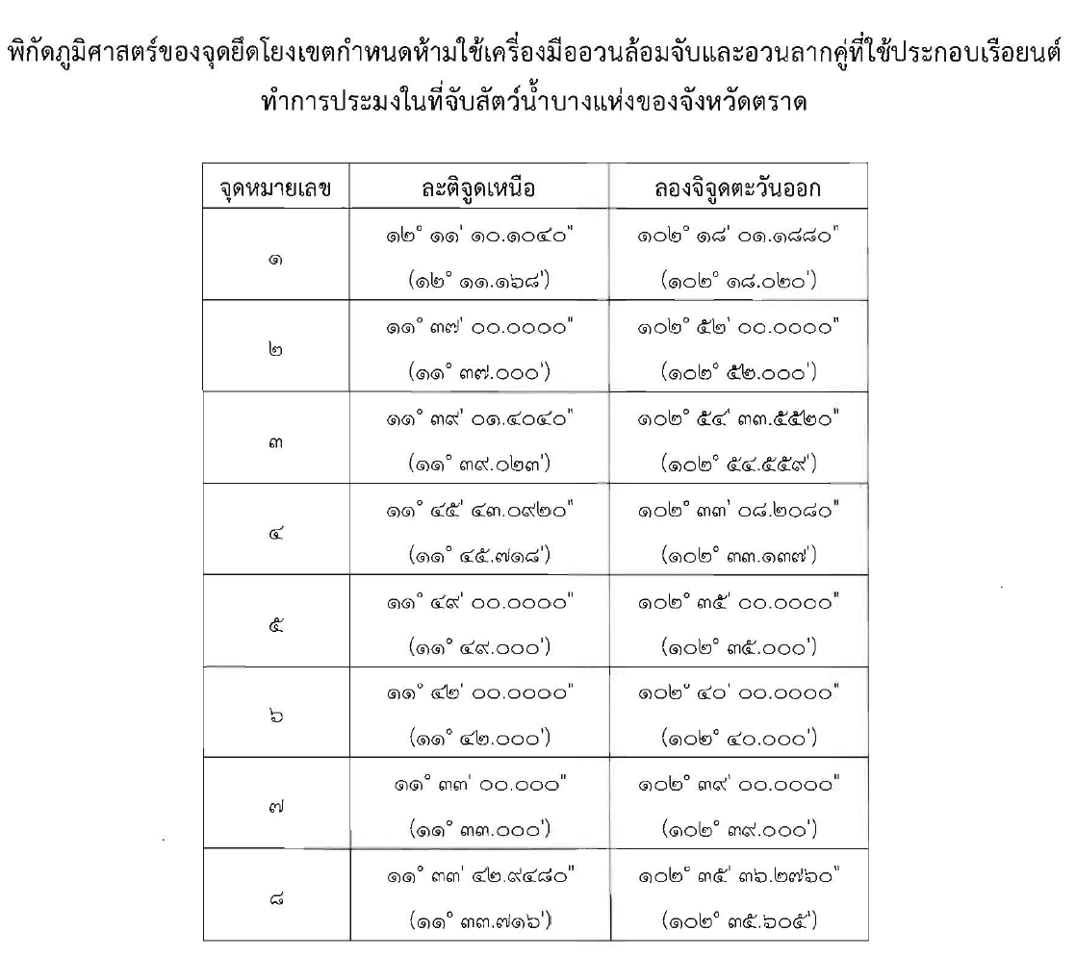
Notification of Ministry of Agriculture and Cooperatives
Re: Prescribing Fishing Gears, Fishing Methods, Fishing Areas, and Conditions Prohibited from Fishing
in Some Parts of the Fishing Ground in Trat Province
B.E. 2565 (2022)

Slide 6
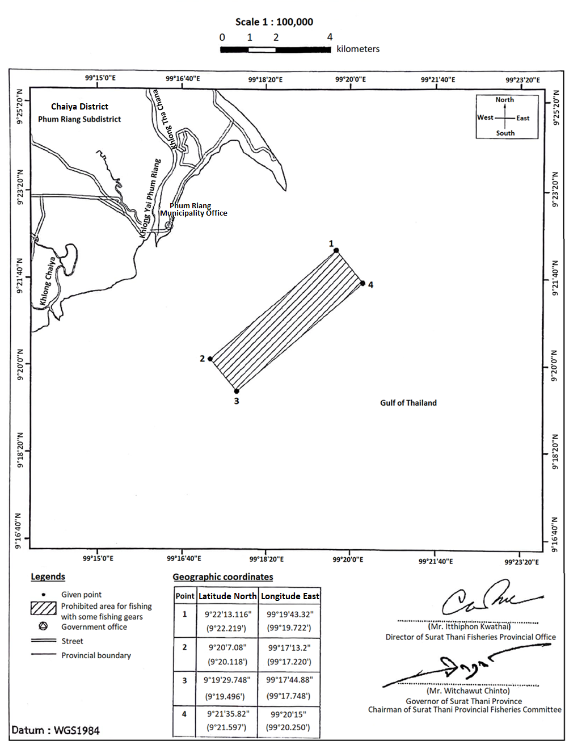
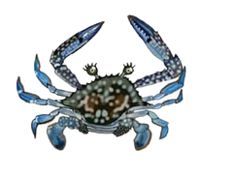
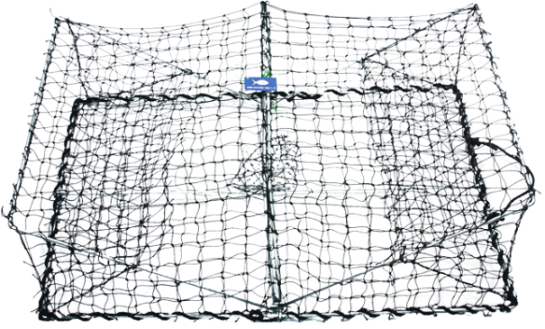
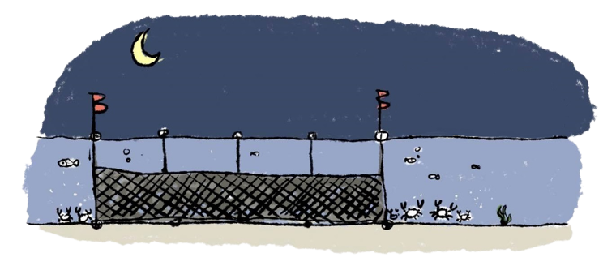
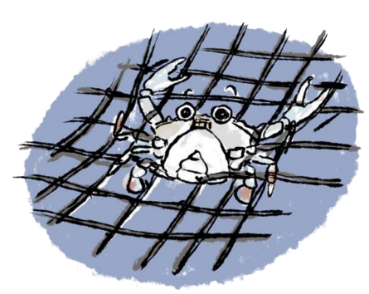
Fisheries Refugia Site 2 : Surat Thani
Location: Around Koh Sed in Ban Don Bay of Surat Thani Province
Target Species: Blue swimming crab
(Portunus pelagicus)
Area : 900 ha Marine Habitat Linkage : Seagrass and Mangrove
Status: Approved
Fishing Closure Period: All year
Management Measures:
No person shall fish in fisheries refugia area at Koh Sed off Surat Thani Province by the following fishing gears:
(1) Crab traps; and
(2) Crab gill nets of a mesh size less than 3 inches.
2

Slide 7
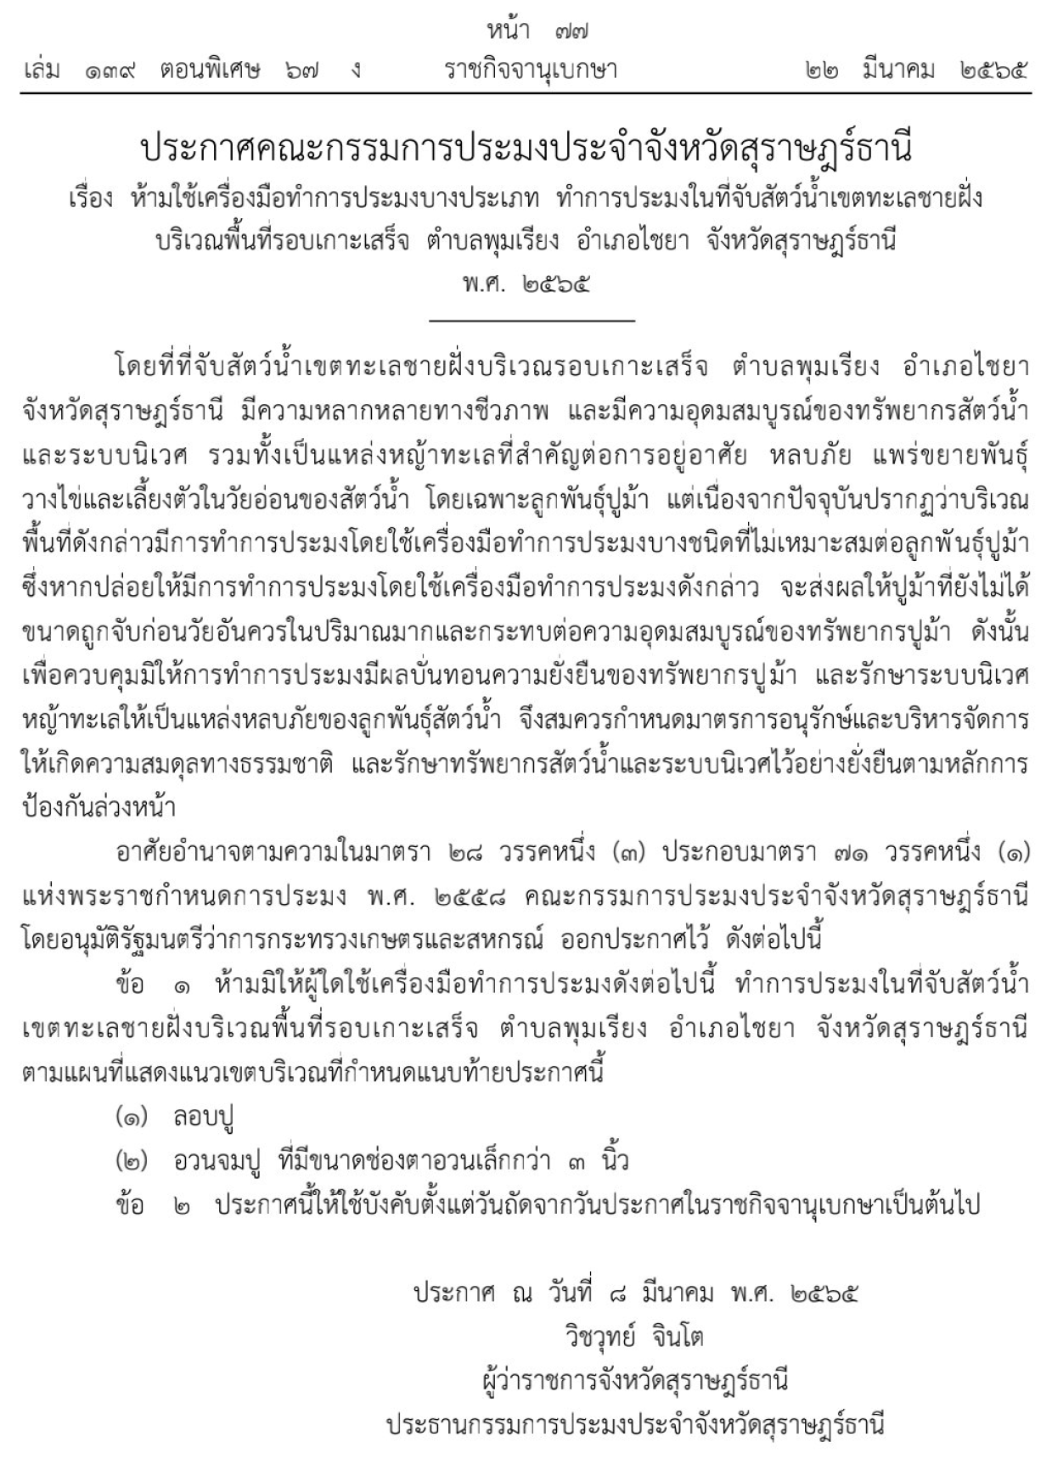
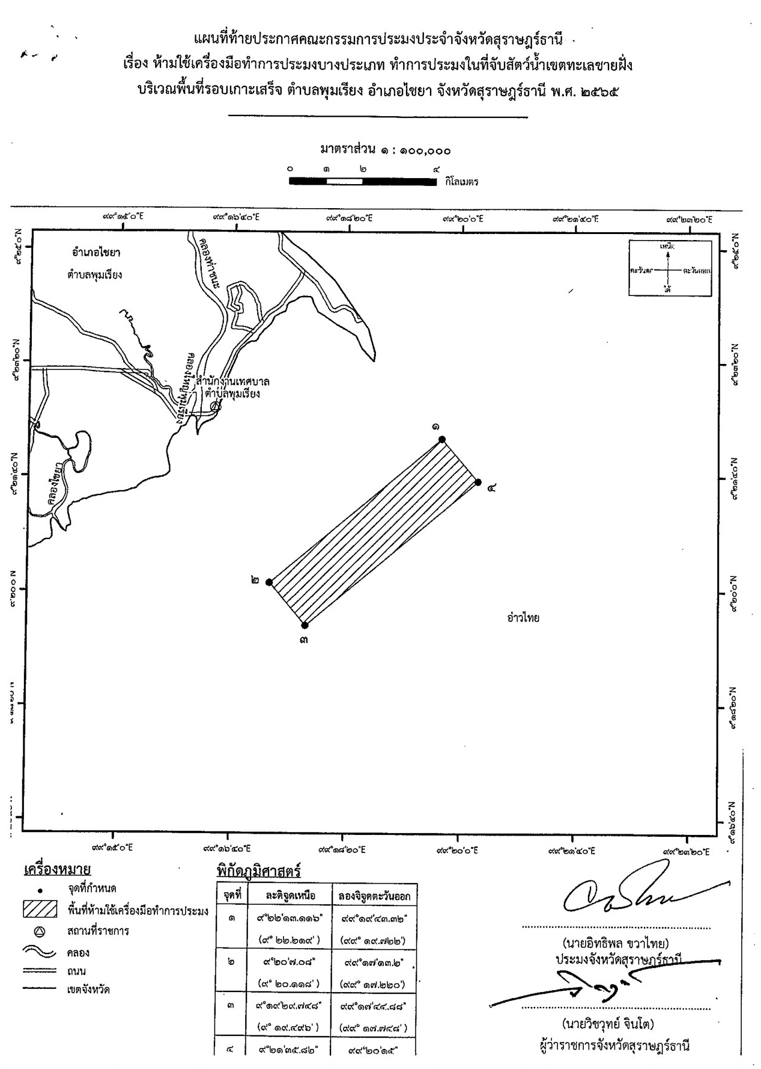
Notification of Surat Thani Provincial Fisheries Committee
Re: Prohibition of Some Fishing Gears Fishing in the Fishing Ground within the Coastal Seas
around the Area of Koh Sed, Phum Riang Subdistrict, Chaiya District, Surat Thani Province
B.E. 2565 (2022)

Slide 8
Engagement of stakeholders for Project Implementation
Department of Fisheries
Department of Marine and Coastal Resources
Department of National Parks, Wildlife and Plant Conservation
Department of Local Administration
Department of Provincial Administration
Navy
Universities
Geo-Informatics and space Technology Development (GISDA)
Local Fishing Community Organizations in the provinces
Small-scale Fishing Groups in the provinces
Fisheries Association of Thailand
Fisheries Association in the provinces
Thai Frozen Food Association
Food Processing Enterprises
Representatives of commercial and small-scale fishers
Representatives of aquaculture farmers
Seafood venders
NGOs - Sustainable Development Foundation
- Forest and Sea for Life Foundation
Implementing the Strategic Action Programme for the South China Sea and Gulf of Thailand (SCS SAP Project)

Slide 9
Issues and Challenges
Achievements
There was a disagreement on management planning regarding the restriction of gill net fishing during the critical period in Trat Fisheries Refugia Site.
Additional technical data collection for catch composition of gill net fishing in Trat Site was undertaken by Fisheries Research Center and the findings were considered by National Scientific and Technical Committee, resulted in technical-based solution of measurement measures at Trat Site.
There was a lack of technical information focusing on the critical area (Koh Sed), including ecosystem and abundance of the priority species (blue swimming crab) in their young stages.
Subcontract was done with academe in the area for surveys of ecosystem and abundance of blue swimming crab in their critical area;
The findings were considered by National Scientific and Technical Committee, and site-based fisheries refugia management board in Surat Thani Province;
Such the technical information was presented as the key component for management planning consideration at on-site stakeholder consultations.
Implementing the Strategic Action Programme for the South China Sea and Gulf of Thailand (SCS SAP Project)

Slide 10
Recommendations
Monitoring and assessment of fisheries refugia and its habitat linkages at sites should be subsequently integrated with SCS SAP Project for the most effective collaboration and evaluation
Assessment of the status of fisheries and habitat at fisheries refugia sites should be included as the sub-project in each relating habitat component of SCS SAP Project
Department of Fisheries and Department of Marine and Coastal Resources should closely cooperated in the action on integrated management of fisheries and ecosystem/habitat in critical areas along the coastal seas of the country
Implementing the Strategic Action Programme for the South China Sea and Gulf of Thailand (SCS SAP Project)

Slide 11
Thank you

