Slide 1


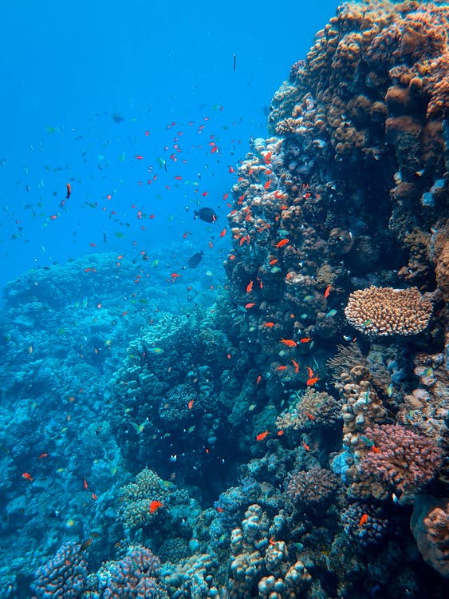
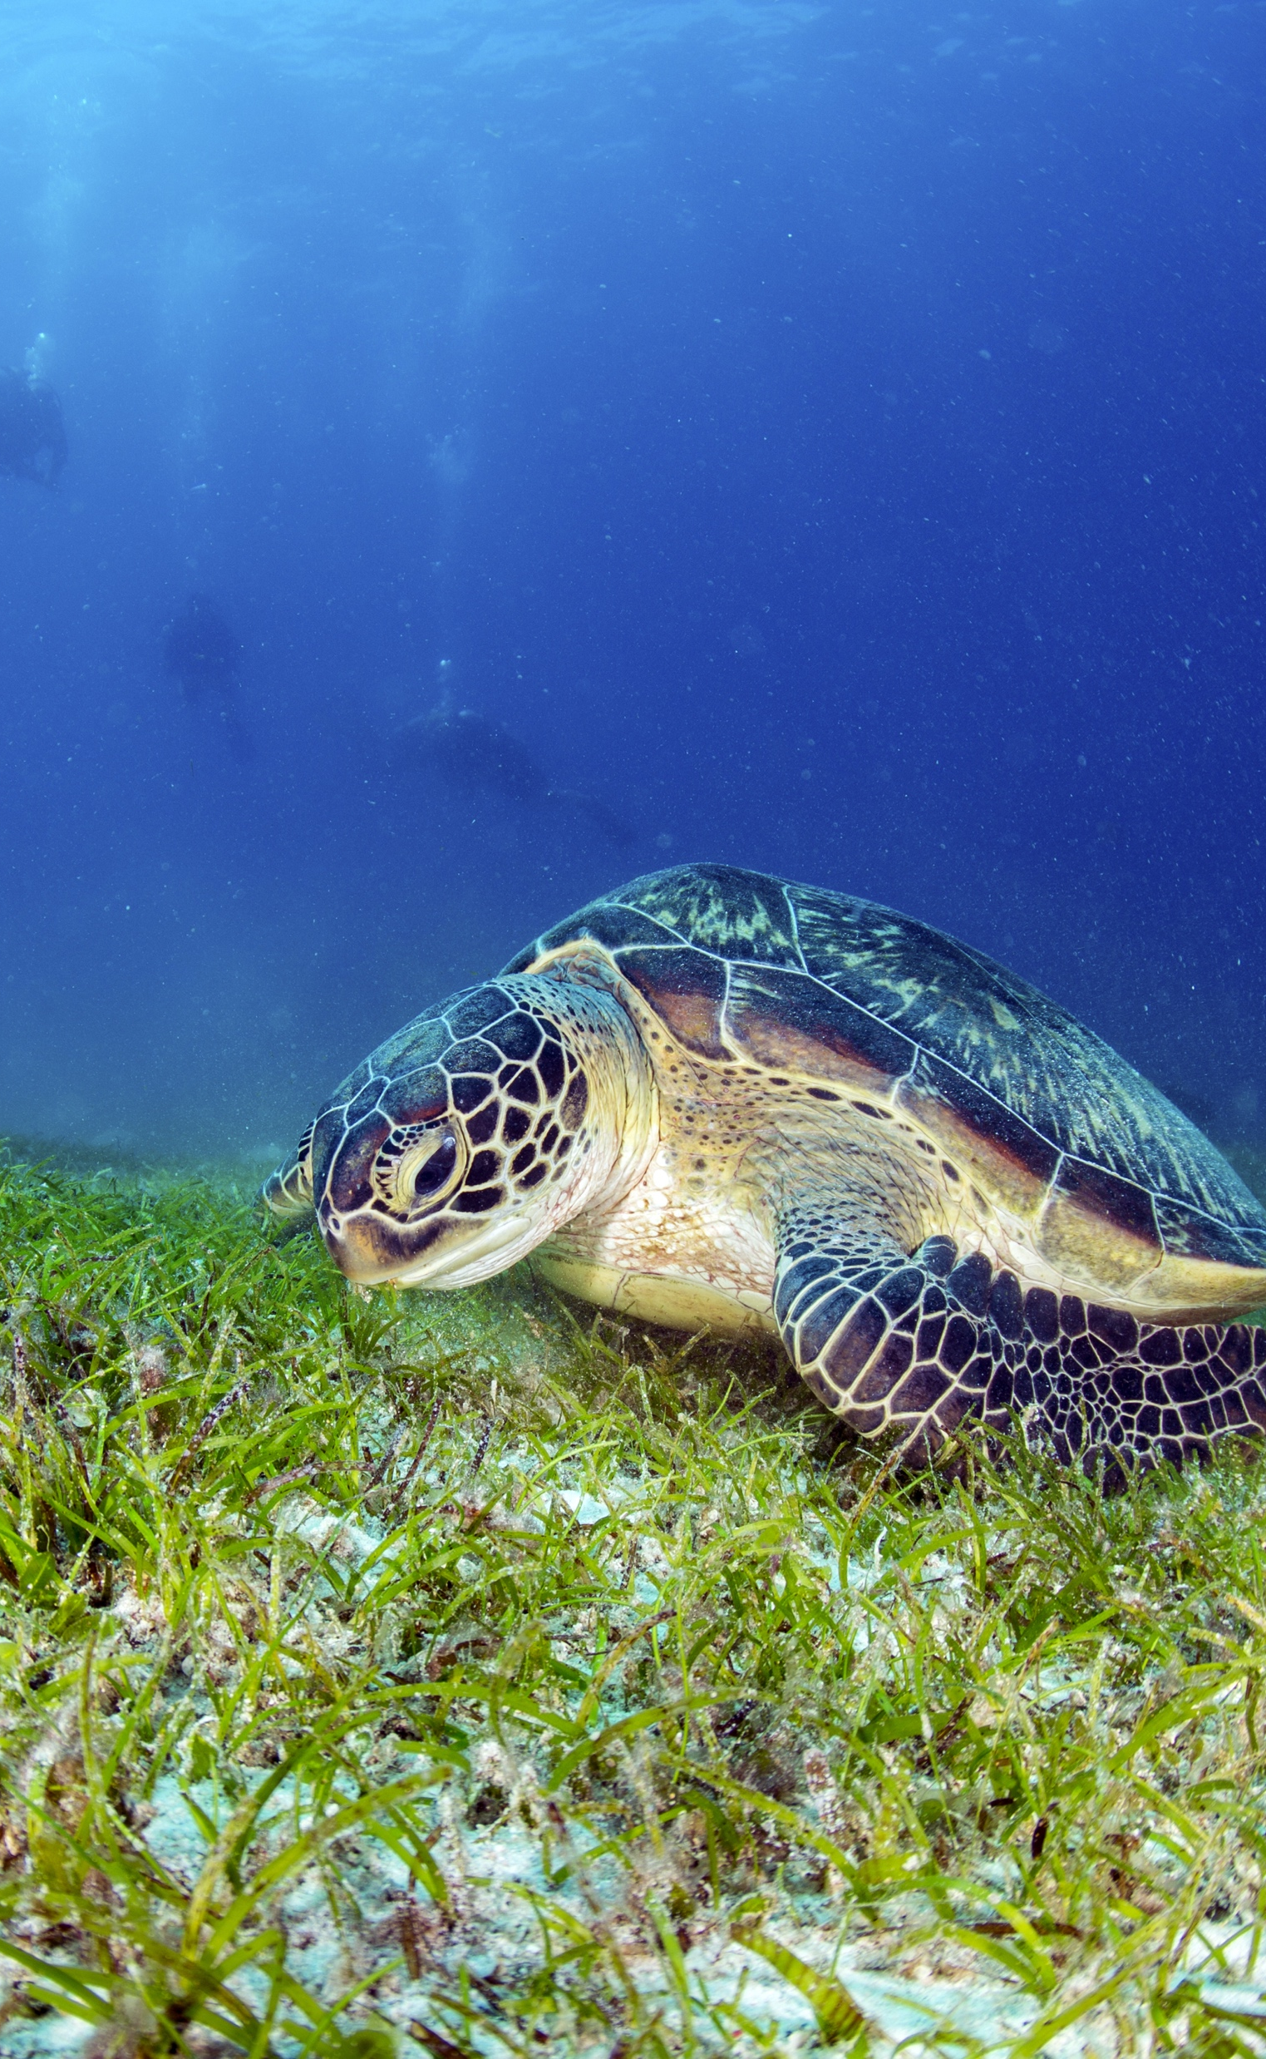
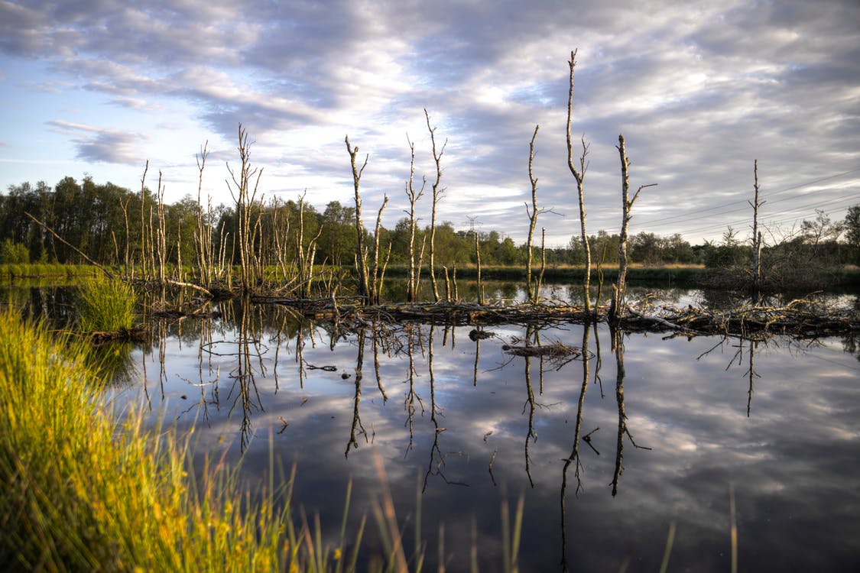
Implementing the Strategic Action Programme for the South China Sea and Gulf of Thailand (SCS SAP Project)
FIRST MEETING OF THE REGIONAL SCIENTIFIC AND TECHNICAL COMMITTEE (RSTC)
OF THE SCS SAP PROJECT
17-19 October 2022, Bangkok, Thailand
REPORT OF ACHIEVEMENTS OF THE FISHERIES REFUGIA PROJECT
[MALAYSIA]
[Department of Fisheries Malaysia (DOFM)]

Slide 2
Introduction
Refugia – the concept
Fishery management focusing on protecting the population of selected fisheries species in a particular fishing area for sustainable fishery.
Purpose of refugia
  For conservation purpose
  Protect the organisms and ecosystem against anthropogenic related damage and climate change (Loarie et al., 2008).
Different from marine parks
  Restriction is only temporary – depends on season/life stages of targeted species
  Protect population and preserve balance of the ecosystem of the selected area.
Important criteria for establishing an area of refugia should contain;
  There is a importance species in that area
  Critical habitat of species live in certain stages of their life cycle
  Circulation of ocean currents that play an important role in the spread of larvae
  Ecologically important area
Implementing the Strategic Action Programme for the South China Sea and Gulf of Thailand (SCS SAP Project)

Slide 3
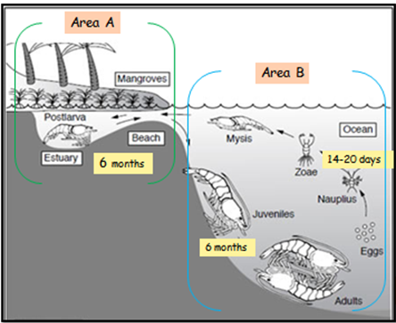
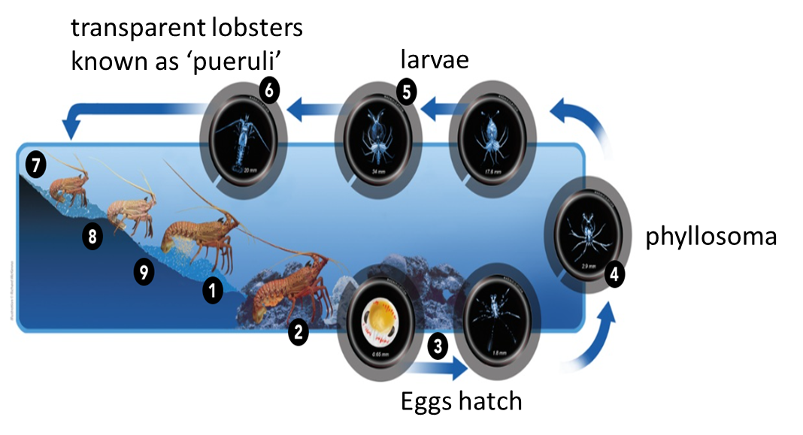
Introduction
The delineation of the Lobster & Tiger prawn refugia area, shall be based on the critical habitats in the both species life-cycle
Penaeus monodon life cycle
Panulirus polyphagus life cycle
Implementing the Strategic Action Programme for the South China Sea and Gulf of Thailand (SCS SAP Project)

Slide 4
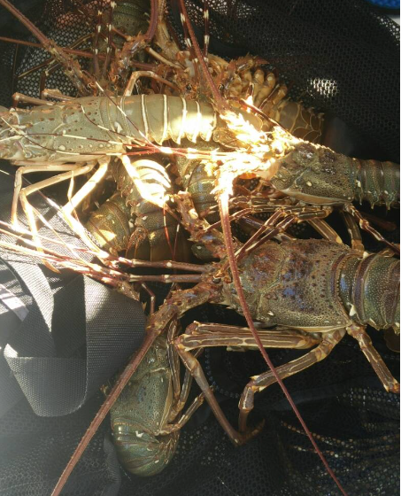
Lobster Refugia
Tanjung Leman Johor
Implementing the Strategic Action Programme for the South China Sea and Gulf of Thailand (SCS SAP Project)

Slide 5
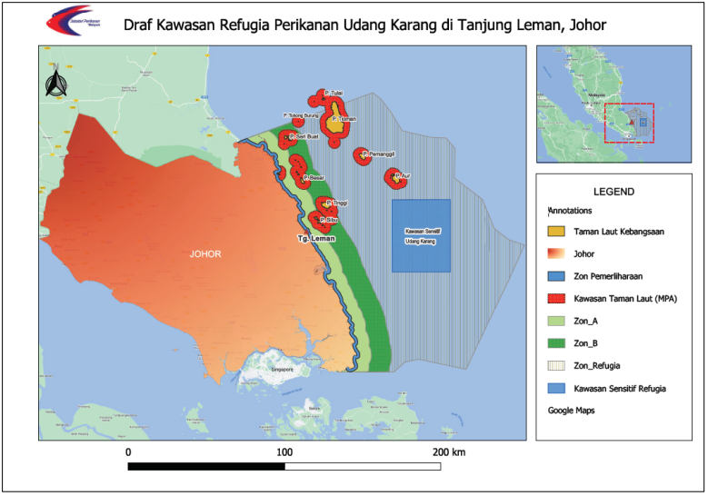
Key Achievements
Proposed Refugia for Lobster area
Sensitive Refugia Area= 1,717 km2
Position of Latitude Longitude sensitive Refugia area
  Point 1 N 1° 55.000’ E 104° 30.000’
  Point 2 N 2° 20.000’ E 104° 30.000’
  Point 3 N 1° 55.000’ E 104° 50.000’
  Point 4 N 2° 20.000’ E 104° 50.000
Closed 15 Dec-Feb (Following year)
Habitat: Seagrass (706 Ha) and corals
Implementing the Strategic Action Programme for the South China Sea and Gulf of Thailand (SCS SAP Project)

Slide 6
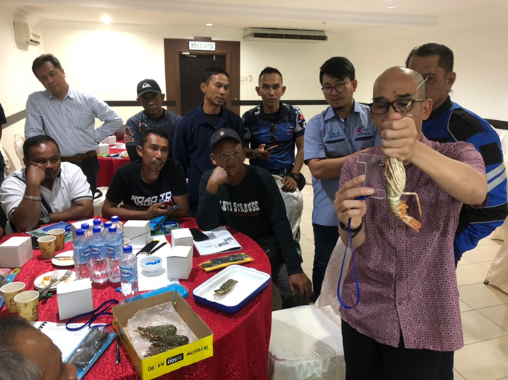
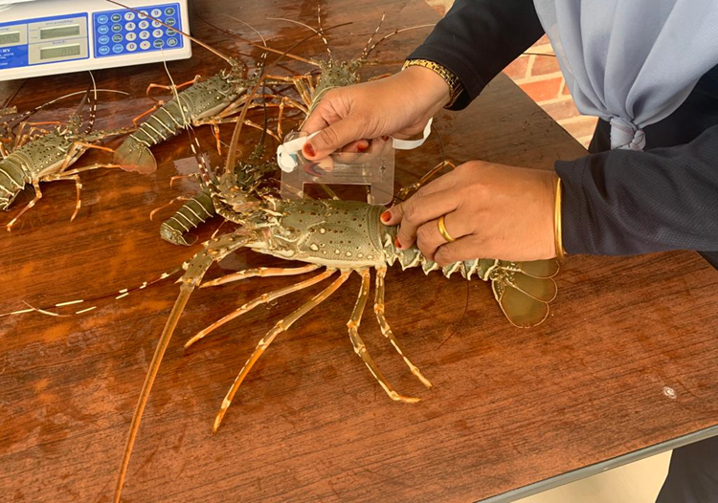
Stakeholder engagements/consultations for Lobster Refugia
  2017- Consultation with the artisanal fishermen from East Coast of Johor
  2018-Consultation with the trawlers fishermen from Endau dan Sedili and
  2018-Refugia Project Consultation with various stakeholders
  2018-Consultation with the fishers from Pahang and Johor
  2019-Consultation with the fishers from Pahang and Johor
  2021- Engagement session with trawlers
  2022- Preparation on Management Plant for Lobster Refugia with consultant
  2022- Stakeholder Engagement for Lobster species in Johor
Tanjung Leman Local Refugia Communities
  Mersing and Rompin District Fisheries
  Mersing and Rompin Fisheries Association
  Fisheries Development Authority District of Mersing
  Mersing Land and District Office
  Trawler Vessel Owner Association
  Local Enforcement Agency
  Fisheries Ecosystem Community of Tg Leman
  Johor State National Park Director
Implementing the Strategic Action Programme for the South China Sea and Gulf of Thailand (SCS SAP Project)

Slide 7
Resources Conservation Strategies of Lobster Refugia in Tanjung Leman, Johor
Habitat conservation and preservation of Lobster in the refugia area
Build and setting an artificial reefs as a new habitat for lobster
Prohibition catch of gravid lobster with eggs and minimum size CL (<6.5 cm)
Declaration of the closure of the fishing season in sensitive refugia areas
Introducing joint management inter agencies and stakeholders
Implementing the Strategic Action Programme for the South China Sea and Gulf of Thailand (SCS SAP Project)

Slide 8
Issues and Challenges
In the beginning, unclear/lack of information about the implementation of refugia and its roles
Compliance with “no-take” rule during specific refugia closed season period
  East Johor traditional fisher
  Trawl net operators and fishes (commercial)
  Island inhabitants/tourism operators
How to achieve
  Stakeholder consultation
  Public awareness
Implementing the Strategic Action Programme for the South China Sea and Gulf of Thailand (SCS SAP Project)

Slide 9
Recommendation
  Deploy artificial reef for new habitats: post larvae, juvenile, sub adult lobster and adult lobster
  To deter operation of bottom trawler within refugia area
  Establishment off – harvesting seasons: December - February
  Revision of harvesting size: males was 6.58-8.18 cm CL; females was 6.75-7.58 cm CL
Implementing the Strategic Action Programme for the South China Sea and Gulf of Thailand (SCS SAP Project)

Slide 10
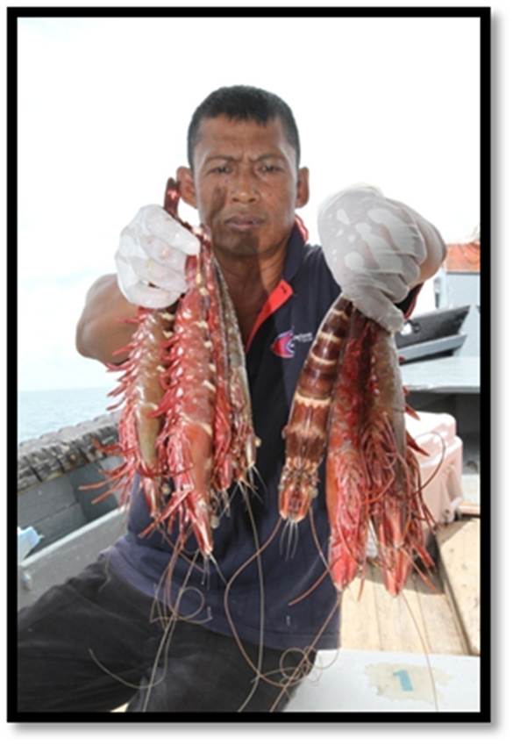
Tiger Prawn Refugia
Kuala Baram Sarawak
Implementing the Strategic Action Programme for the South China Sea and Gulf of Thailand (SCS SAP Project)

Slide 11
Objectives of tiger prawn refugia management
The management tiger prawn refugia plan aims to achieve the following objectives:
To develop a sustainable plan for a long term protection of tiger prawn population at Kuala Baram fishing site.
To identify ways for optimal utilisation of tiger prawn resource.
To ensure ecological integrity of fisheries refugia is maintained.
To generate a plan and strategy to reduce conflict and create awareness among stakeholders.
Implementing the Strategic Action Programme for the South China Sea and Gulf of Thailand (SCS SAP Project)

Slide 12
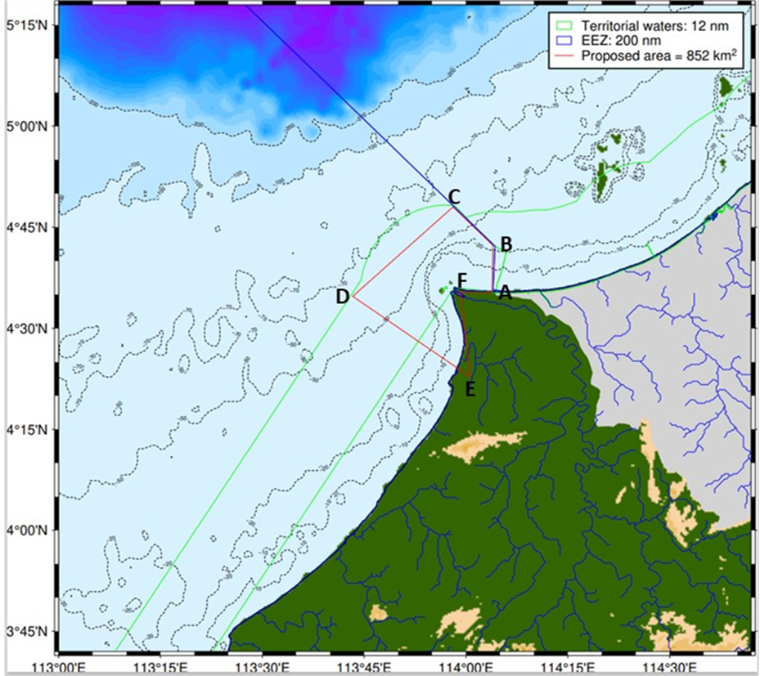
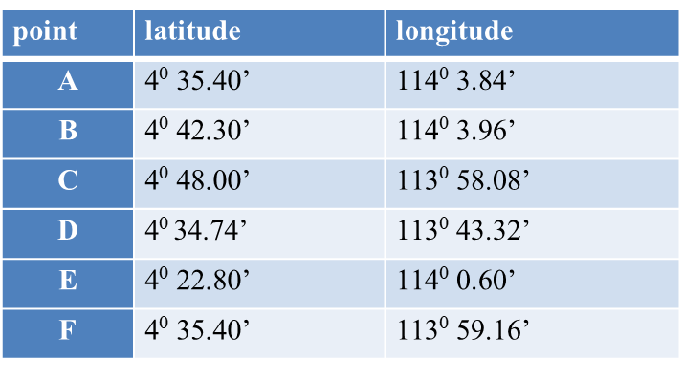
Proposed Refugia for Tiger Prawn area in Kuala Baram Sarawak
Total area of approximately 852km²
in Kuala Baram, Miri, Sarawak
The boundary of the refugia starts from the position latitude N4⁰ 35.40’ longitude E114⁰ 3.84’ at the point A where the EEZ boundary for Malaysia and Brunei starts.
It then heads to the sea with points B and C along the EEZ boundary.
Points C and D are under 12NM territorial water line. Point E is at Marina Bay, Miri.
The land area encompassed from point E to point F includes the 3 rivers: Sungei Miri, Sungei Lutong and Sungei Pasu.
The ending position latitude N4⁰ 35.40’ longitude E113⁰ 59.16’ (point F) is at Kuala Baram river mouth.
Implementing the Strategic Action Programme for the South China Sea and Gulf of Thailand (SCS SAP Project)

Slide 13
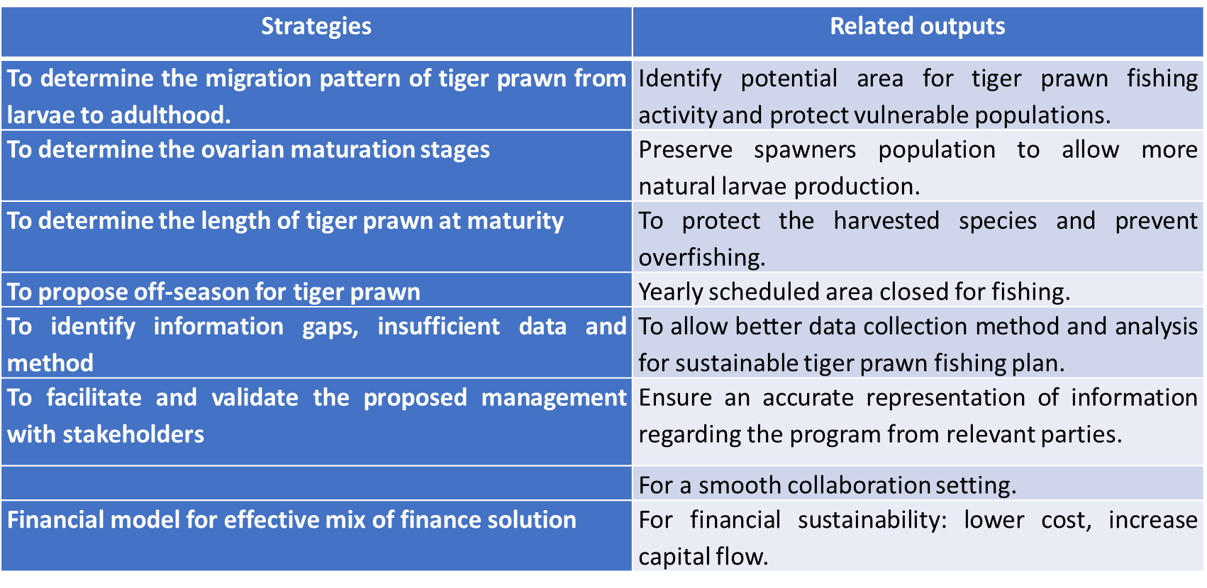
Strategies of tiger prawn refugia establishment
Implementing the Strategic Action Programme for the South China Sea and Gulf of Thailand (SCS SAP Project)

Slide 14
Stakeholder engagements/consultations for Tiger Prawn
2017-Stakeholder Consultation Council on Action Plan and Fisheries Management for the Kuala Baram Tiger Prawn Refugia
2018-REFUGIA Fisheries Project Consultation Program with fishers
2018-Engagement Session on the Management of the Proposed Establishment of Tiger Prawn Refugia with Stakeholders
2021-Consultation Session for the Establishment of Tiger Prawn Refugia with Zone A, Zone B and Zone C7 Ship Owners in Miri and Bintulu
2021-Engagement Session on the Management of the Proposed Establishment of Tiger Prawn Refugia with Stakeholders
2022- Preparation on Management Plant for Lobster Refugia with consultant
Kuala Baram Local Refugia Communities
  Sarawak Region 3 Fisheries Office, Miri
  Sarawak Fishing Vessel Owner Association, Miri
  District Fisheries Association
  Fisheries Development Authority District of Miri
  Miri Land and District Office
  Malaysia Maritime Enforcement Agency (MMEA)
  Petroleum National (PETRONAS)
  Fisheries Ecosystem Community of Kuala Baram
Implementing the Strategic Action Programme for the South China Sea and Gulf of Thailand (SCS SAP Project)

Slide 15
Issues and Challenges
In the beginning, unclear/lack of information about the implementation of refugia and its roles
Level of awareness/understanding the benefit of tiger prawn refugia
  Fishermen
Usage conflicts-overlap of refugia areas, more development to expand Kuala Baram to a larger shipping port
  Miri port authority
How to achieve
  Explanation and consultation by DoF
  Meeting and discussion with Miri port (win-win situation)
Implementing the Strategic Action Programme for the South China Sea and Gulf of Thailand (SCS SAP Project)

Slide 16
Findings From Recent Workshop with Main Stakeholder (DoF)
Proposed close season:
  Starts this coming August – October 2022 as an awareness program
  Official closure will be implemented after the approval from DG of Fisheries under Fisheries Act 1985
  This closure will be included in the license regulation
  This closure are only meant for trawl net and trammel net
Proposed catch and release season:
  February – April
  For all fishing gears
  For Miri and Bintulu waters
Implementing the Strategic Action Programme for the South China Sea and Gulf of Thailand (SCS SAP Project)

