Slide 1

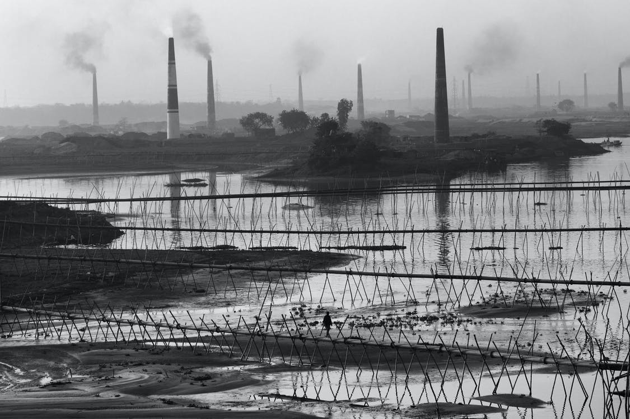
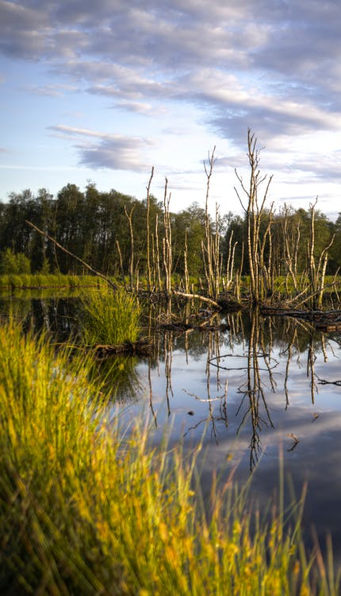
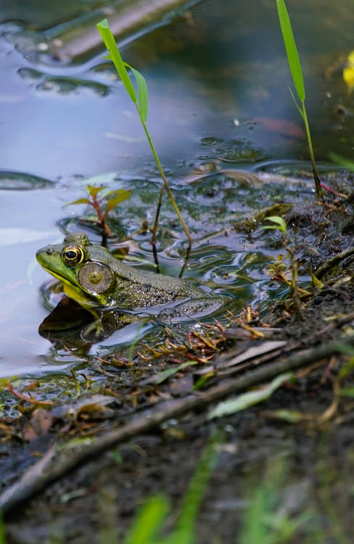

Implementing the Strategic Action Programme for the South China Sea and Gulf of Thailand (SCS SAP Project)
FIRST MEETING OF THE REGIONAL SCIENTIFIC AND TECHNICAL COMMITTEE (RSTC) OF THE SCS SAP PROJECT
17-19 October 2022, Bangkok, Thailand
Report of the Regional Working Group
on Wetlands
Notes:
1 https://www.pexels.com/photo/gray-scale-photo-of-metal-fence-3680457/
2 https://www.pexels.com/photo/clouds-countryside-dawn-dusk-445190/
3 https://www.pexels.com/photo/green-frog-on-the-water-8432966/
4 https://www.pexels.com/photo/river-valley-between-green-mountains-4906447/

Slide 2

RWG Wetland
Introduction
Key Discussions and Agreements
Issues and Challenges
Recommendations and Next Steps
Implementing the Strategic Action Programme for the South China Sea and Gulf of Thailand (SCS SAP Project)

Slide 3
RWG-Wetlands: Roles and Functions
For coordinating the work of the National Wetland Committees established in each of the participating countries
For ensuring effective implementation of project activities undertaken in the context of the achievement of the wetland management targets of the project
To provide a mechanism for exchange of information and experience of wetland management activities in each country
Implementing the Strategic Action Programme for the South China Sea and Gulf of Thailand (SCS SAP Project)

Slide 4
RWG-Wetlands: the first meeting
7 December 2021 with the objectives:
To present and discuss the SAP targets for wetlands and selected sites
To present the info on the status of SAP implementation between 2008-2020
To present the compiled info on the national revision to targets and sites, building upon recent ongoing projects, initiatives and best practices; and
To discuss executing arrangement and workplan for 2021-2022
Implementing the Strategic Action Programme for the South China Sea and Gulf of Thailand (SCS SAP Project)
Notes:
Objective of the meeting:
- To present and discuss the SAP targets for wetlands, and selected sites;
- To present the compiled information provided on the status of SAP implementation between 2008-2020, which will be further developed into a
publication in 2022;
- To present the compiled information on the national revisions to targets and sites, building upon recent and ongoing projects, initiatives and best practices; and
- To discuss executing arrangement and workplans for 2021-2022.

Slide 5
RWG-Wetlands: Designated officers
Election of a Chairperson, Vice-Chair, and Rapporteur:
Chair: Mr. Anson Tagtag, National Focal Point for Wetlands in the Philippines
Vice-Chair: Mrs. Sumana Kajonwattanakul, National Focal Point for Wetlands in Thailand
No Rapporteur elected since the meeting was online and being recorded
RWG members: Mr. Hong Chamnan from Cambodia
Mr. Yu Yunjun from China
Mr. Eko Budi Priyanto from Indonesia
Implementing the Strategic Action Programme for the South China Sea and Gulf of Thailand (SCS SAP Project)

Slide 6
Key Discussions and Agreements
Consideration of the Terms of Reference of the RWG
  Agreed on 10 responsibilities as ToR including
  Provide direction and strategic guidance to national committees on integrated coastal wetland management; and
  Develop annual workplans and provide periodic progress report to the RSTC committee
Review the SAP targets for wetland focal area
  Outcome 1.4 The integrated management of 783,900 ha of coastal wetland at 19 sites
SAP Evaluation at the national level during 2008-2020
  it was based on submitted National Implementing Reports (NIRs) from Cambodia, Philippines, and Thailand
Implementing the Strategic Action Programme for the South China Sea and Gulf of Thailand (SCS SAP Project)
Notes:
The RWG members agreed on 10 responsibilities as ToR inlcuding
Provide direction and strategic guidance to national committees on integrated coastal wetland management; and
Develop annual workplans and provide periodic progress report to the RSTC committee
We reviewed the SAP targets for wetlands that was developed and adopted in 2008. The detail of the targets to achieve Outcome 1.4 on the integrated management of 783,900 ha of coastal wetland was presented including the expected target sites and areas from each country. A total of 19 priority sites from six participating countries were identified in the SAP.
SAP Evaluation at the national level during 2008-2020 – the evaluation was based on submitted National Implementing Reports (NIRs) from Cambodia, Phillippines, and Thailand. No info from China, Indonesia, and Vietnam

Slide 7
Key Discussions and Agreements (2)
SAP Evaluation at the national level during 2008-2020 (cont.)
  the evaluation helps adjust targets and outputs
  to be publication in 2022 and important to submit to GEF Sec
  activities through other initiatives/projects can be reported and included as co-financing
Review and revision of SAP target at the national level
  to be finalized when all NIRs completed.
  concerns on inconsistent approach in designing activities
  activities lead to the achievement of the outcomes and outputs
  should address the gaps and needs in baselines
  long-term sustainability of actions beyond project life
Implementing the Strategic Action Programme for the South China Sea and Gulf of Thailand (SCS SAP Project)
Notes:
The evaluation can help adjust targets and outputs at the national level and will be developed into publication in 2022. This is important report to submit to GEF Secreatriat. Activities has been done through other initiatives and projects in relation to wetland management can be reported and included as co-financing
For Review and revision of SAP target at the nationa level – it will be finalized when all NIRs are completed. there are concerns on inconsistent approach in the development of activities between
each country. The development of activities should lead to the achievement of the outcomes and outputs, using the logical framework approach. The activities should also address the gaps and needs identified in the national reports and baselines, and would results to the long term sustainability of actions and activities beyond project life. The regional working group was encouraged to inform the project team of any challenges and additional project support needed by the group.

Slide 8
Key Discussions and Agreements (3)
National presentations on SAP implementation and future planning (including best practice)
  Cambodia: Koh Kapik Ramsar Site (12,000 ha)
  China: site selection was undergoing the consultation process
  Indonesia: Semilang Sector of the national park (267,592 ha)
  Philippines: Maragodon River Estuary
  Malampaya Sound Proacted Landscape and Seascape Estuary
  Manila Bay Tidal Flats (total 97,545 ha)
  Thailand: Don Hoi Lot (41,600 ha)
Implementing the Strategic Action Programme for the South China Sea and Gulf of Thailand (SCS SAP Project)

Slide 9
Key Discussions and Agreements (4)
The Ramsar Convention has 3 core provision:
Designation and management of wetland of international importance;
Wise use of all wetlands; and
Collaboration among countries on transboundary matters
Definition of the Convention includes mangroves, coral reefs and seagrass beds – applicable to other habitats and WGs
RWG-W were requested to work with other WGs to get all resources that are available e.g., guidelines, tools and best practices including joint capacity building and training
Implementing the Strategic Action Programme for the South China Sea and Gulf of Thailand (SCS SAP Project)
Notes:
The meeting had expert from the Ramsar Convention on Wetlands presnted that
RAMSAR CONVENTION has 3 core provision:
Designation and management of wetlands of international importance;
Wise use of all wetlands; and
Coolaboration among countries on transboundary matters
The definition of wetlands was also highlighted, which according to the definition of the convention, includes mangroves, coral reefs and seagrass beds, which is an important
point to consider. As such, the convention is equally applicable to other habitats and working groups under the project.
As the definition of wetlands covers all the working groups under the porject, RWG-W members were requested to work with other working groups to get all resources that are available in terms of guidelines, tool and best pracitces, including having joint capacity building and training to combine resources.

Slide 10
Issues and Challenges
Issues to address:
Harmonization between national activities proposed by the different working group – e.g., linkage with mangrove.
Not much on the sustainability of the management plan developed – ensuring the sustainability of the plan
The role of local stakeholders and local communities
Sustainable financing scheme
Data monitoring and information gathering
Implementing the Strategic Action Programme for the South China Sea and Gulf of Thailand (SCS SAP Project)
Notes:
Important issues that are good to address here are:
1. The harmonization between national activities proposed by the different working groups particularly activities that are related and have linkages such as the
mangroves activities.
2. Significant progress in the development and implementation of wetland management plans was also noted but not much on the sustainability of the management plans
developed. Members were requested to focus not only on the development and implementation of management plans but also ensuring the sustainability of the plans.
3. the role of local stakeholders and local communities
4. sustainable financing schemes,
5. data monitoring and information gathering

Slide 11
Issues and Challenges (2)
Challenges in evaluation and development
Difficulties to provide data for SAP Evaluation
  Rough estimates
  estimated value of target areas
Development of NIRs – identification of areas and lack of data on the identified specific wetland type
  review reports from other projects
  provide comments on the submitted NIRs
Implementing the Strategic Action Programme for the South China Sea and Gulf of Thailand (SCS SAP Project)
Notes:
In terms of challenges especially for SAP evaluation and activities development, countries have difficulties to provide data for SAP evaluation – both in terms of (a) terms and definitions, and (b) availability of data on the sites and targets. Suggestion was to use rough estimates and the use of estimated value of target areas for SAP evaluation.
A challenge raised in the development of NIRs is the identification of areas and lack of data on the identified specific wetland type, which was eventually addressed through consultations and review of
reports from other projects and initiatives. As to the support needed, the project was requested to provide their comments on the submitted NIR, and see what further assistance is needed to improve the NIR.

Slide 12
Issues and Challenges (3)
Challenges in implementation:
Lack of management capacity
Human and natural treats e.g., encroachment, wildlife hunting/poaching, illegal logging, and forest fires
Weak enforcement of policies e.g., easement regulation and foreshore policies – resulting in development activities
Weak consideration of biodiversity concerns
Sedimentation and pollution from land-based activities, mining, and dredging activities
Reduced water retention capacity of estuaries and other aquatics ecosystem
Implementing the Strategic Action Programme for the South China Sea and Gulf of Thailand (SCS SAP Project)
Notes:
In implementation, the challenges identified were
the lack of management capacity
human and natural threats such as encroachment, wildlife hunting/poaching, illegal logging and forest fires.
- Weak enforcement of policies such as easement regulations and foreshore policies resulting to lack of or premature issuances of certifications to uncontrolled
reclamation projects and other development activities;
Weak consideration of biodiversity concerns in the environmental impact system of development projects along intertidal wetlands;
Sedimentation and pollution from land-based activities and mining and dredging activities; and
Reduced water retention capacity of estuaries and other aquatic ecosystems resulting to an increased retention time of sediments and pollutants in its system.

Slide 13
Recommendations and Next Steps
Establish national wetland committees/working groups
Establish the National Technical Working Group (NTWG) with all habitat focal points and conduct first meeting to ensure synergies between habitats
Establish the Inter-Ministerial Committee (IMC) and conduct the first meeting to confirm workplan and budget
Provide best practice on wetland management/restoration (2008-2021)
Data and monitoring workshop – to coordinate the regional and national activities on data management and monitoring
Implementing the Strategic Action Programme for the South China Sea and Gulf of Thailand (SCS SAP Project)
Notes:
- Establish national wetland committees/working groups and share workplan of meetings. It is recommended to include Fisheries Refugia Project and experts as well as key wetland initiatives
and projects.
- Establish the National Technical Working Group (NTWG) with all habitat focal points and conduct first meeting to ensure synergies between habitats.
- Establish the Inter-Ministerial Committee (IMC) and conduct the first meeting to confirm workplan and budget of NIRs.
- Provide best practices on wetland management/restoration (2008-2021)
- Data and monitoring workshop to coordinate the regional and national activities on data management and monitoring. The date to be confirmed with the support of a regional
consultant.

Slide 14
Recommendations and Next Steps (2)
2nd RWG-W meeting to present and discuss:
  Methodology for revising the National Wetland Reports
  Progress in the execution of activities
  Monitoring and data management and indicators
  Any revision to work plans and budget; and
  Compiling best practices
  The plan is to organize the meeting twice a year (online and face-to-face)
Implementing the Strategic Action Programme for the South China Sea and Gulf of Thailand (SCS SAP Project)
Notes:
2nd RWG-W meeting to present and discuss:
Methodology for revising the National Wetland Reports
Progress in the execution of activities
Monitoring and data management and indicators
Any revision to work plans and budget; and
Compiling best practices
The plan is to organize the meeting twice a year (online and face-to-face)

Slide 15
Recommendations and Next Steps (3)
Start the process of developing the the revision of TDA including key impacts on wetlands, and consider these impacts and new issues such as climate change
Compilation of wetland resources from regional and global level
Launch of the Small Grant Program in 2022, following the good practices done in the first project – the review and approval of projects will be the responsibility of the NTWG and IMC.
Implementing the Strategic Action Programme for the South China Sea and Gulf of Thailand (SCS SAP Project)
Notes:
Recommendations also include:
- Start the process of developing the revision of TDA including key impacts on wetlands and consider these impacts and new issues such as climate change.
- Compilation of wetland resources from regional and global level.
- Launch of the Small Grants Program in 2022, following the good practices done in the first project. This will be coordinated at the regional level. A call for proposals from NGOs and
CBOs will be launched and shared with the countries. The review and approval of projects will be the responsibility of the NTWG and IMC.

