Slide 1

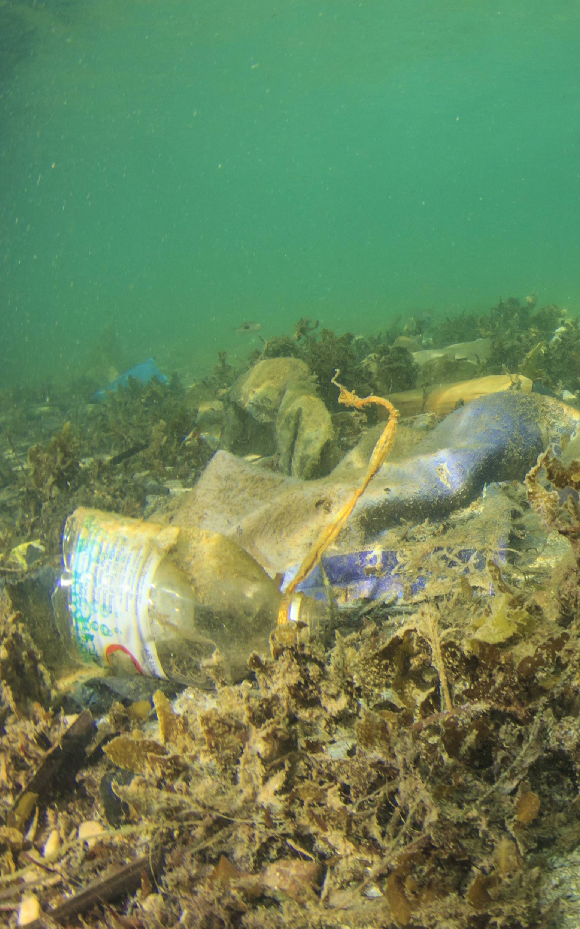
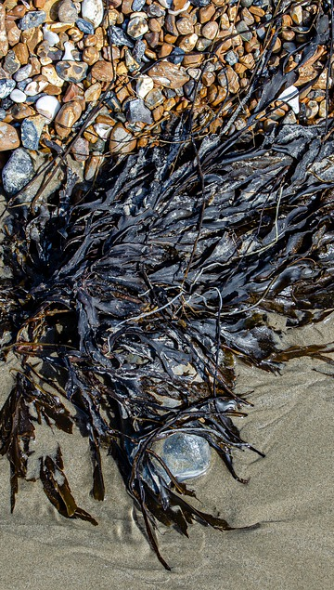
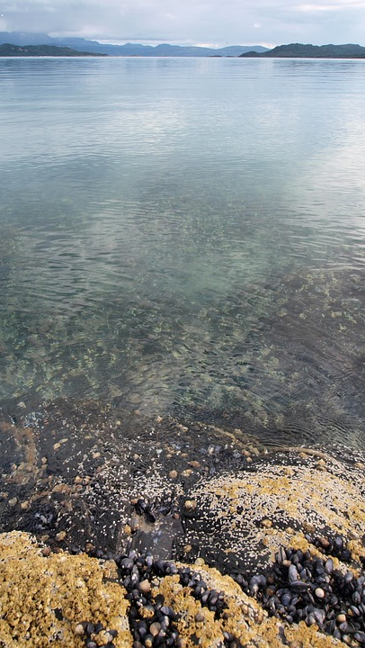
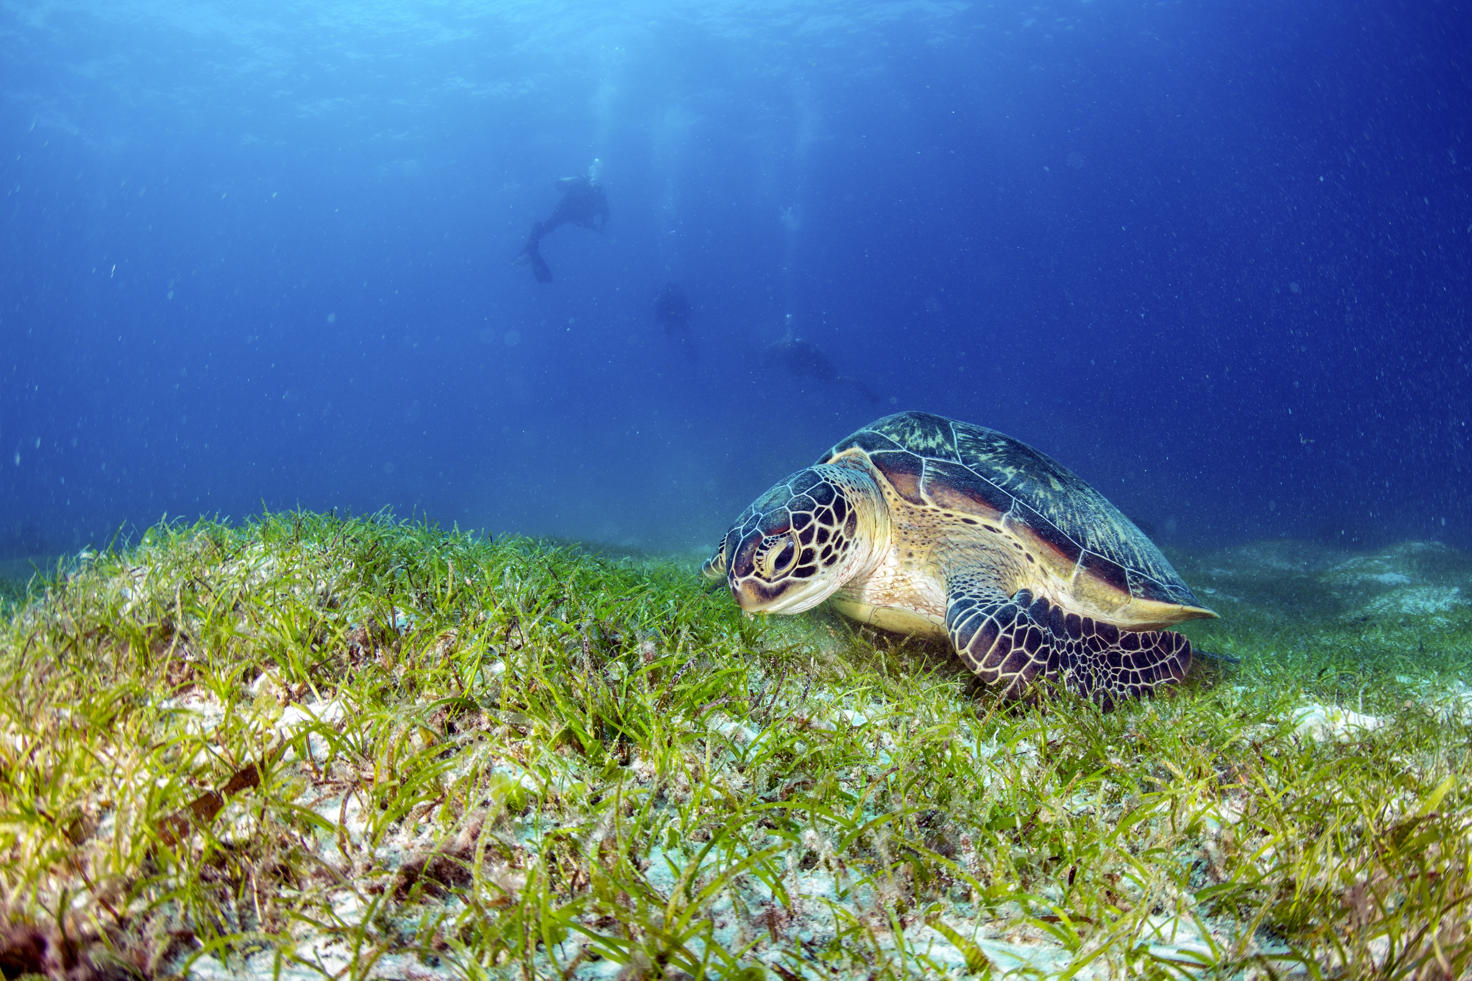
Implementing the Strategic Action Programme for the South China Sea and Gulf of Thailand (SCS SAP Project)
FIRST MEETING OF THE REGIONAL SCIENTIFIC AND TECHNICAL COMMITTEE (RSTC) OF THE SCS SAP PROJECT
17-19 October 2022, Bangkok, Thailand
Report of the Regional Working Group
on Seagrass

Slide 2
Presentation Outline
Introduction
Key Discussions and Agreements
Issues and Challenges
Recommendations and Next Steps
Implementing the Strategic Action Programme for the South China Sea and Gulf of Thailand (SCS SAP Project)

Slide 3
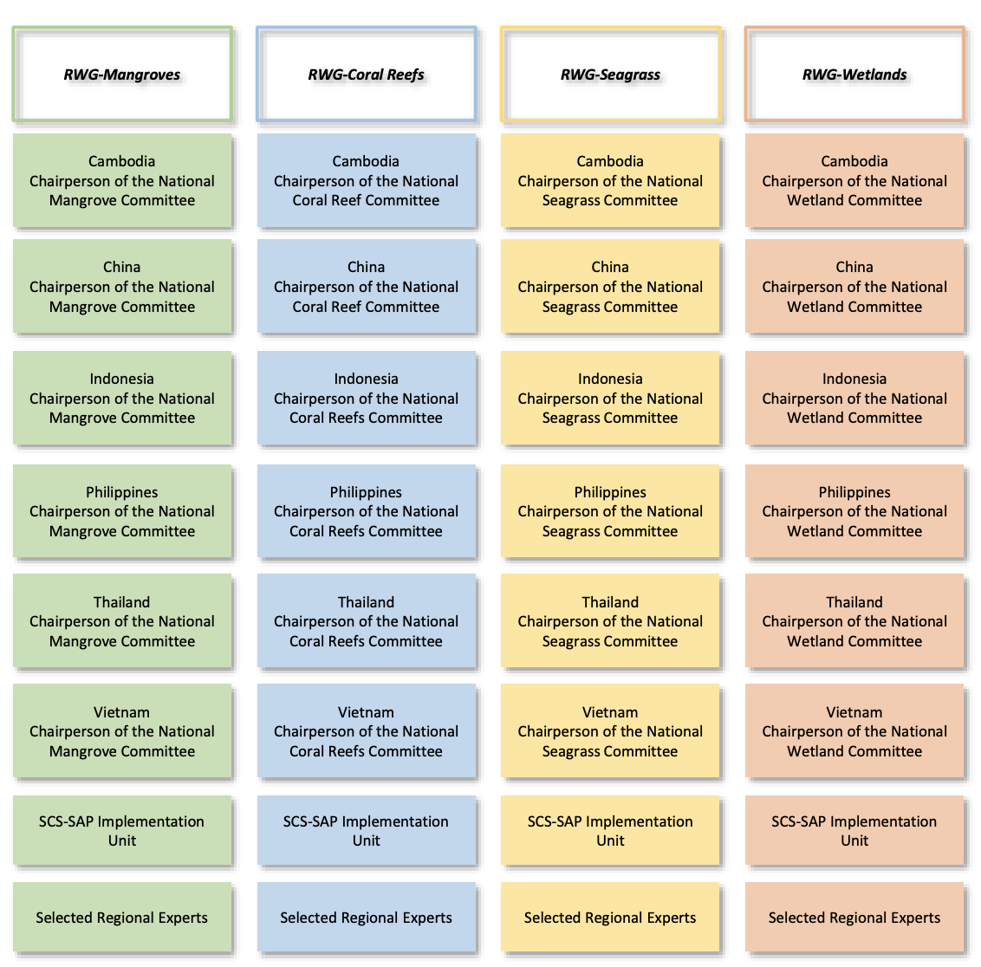
Introduction
Objectives of first RWG meeting
Present and discuss the SAP targets for seagrass, and selected sites;
present the compiled information provided on the status of SAP implementation between 2008-2020, which will be further developed into a publication in 2022;
present the compiled information extracted on the NIRs including best practices,
next steps and recommendations from the participants
Implementing the Strategic Action Programme for the South China Sea and Gulf of Thailand (SCS SAP Project)
Notes:
The priority objective of the meeting was to revitalize the working group which would be the essential technical team to monitor and lead all the activities on the habitat management and restoration, development and revision of national reports, TDA and SAP, and to ensure the execution of activities at the national level.

Slide 4
TERMS OF REFERNCE OF THE REGIONAL WORKING GROUP ON SEAGRASS (RWG-SG)
RWG-SG shall:
Coordinating the work of the National Seagrass Committees/Working Groups established in each of the participating countries;
Ensure effective implementation of project activities undertaken in the context of the achievement of the seagrass management targets of the project;
Provide a mechanism for exchange of information and experience of seagrass management activities in each country;
Assume overall responsibility for the timely execution of project activities in support of the achievement of the abovementioned targets;
Update, in close collaboration with the National Seagrass Committees/Working Groups, the regional seagrass meta-database and GIS, including meta-data on biodiversity and the results of seagrass research pertaining to this project.
Implementing the Strategic Action Programme for the South China Sea and Gulf of Thailand (SCS SAP Project)

Slide 5
TERMS OF REFERNCE OF THE REGIONAL WORKING GROUP ON SEAGRASS (RWG-SG)
RWG-SG shall:
Develop, in close collaboration with the National Seagrass Committees/Working Groups, public awareness and information materials concerning the national and regional importance of such ecosystems;
Develop guidelines regarding best practices for sustainable seagrass management for adoption and application at national level in participating countries;
Prepare a regional review of national experiences in seagrass restoration with a view to developing widely applicable guidelines concerning best practices in seagrass restoration and rehabilitation;
Review and evaluate, at the regional level, progress in implementation of the seagrass activities of the project, and provide guidance for improvement when necessary; and
Develop annual workplans and provide periodic progress reports to the Regional Scientific and Technical Committee.
Implementing the Strategic Action Programme for the South China Sea and Gulf of Thailand (SCS SAP Project)

Slide 6
Designated Officers and Members
Officers
Mr. Datu Tungko Saikol, Focal Point for Seagrass in the Philippines and Mr. Tri Edi Kuriandewa, Focal Point for Seagrass in Indonesia were elected as Chairperson and Vice-Chairperson, respectively.
Members:
The RWG-SG of the SCS SAP Project shall consist of the Chairpersons of the National Seagrass Committees/Working Groups together with one member of the SCS SAP Project Coordination Unit and selected regional experts.
Implementing the Strategic Action Programme for the South China Sea and Gulf of Thailand (SCS SAP Project)

Slide 7
Key Discussions and Agreements
Review of SAP Targets for Seagrass Focal Area
  The SAP targets for seagrass focused on Outcome 1.3 on the conservation and sustainable use of 26,036 ha of seagrass areas in the six participating countries, to be achieved through four regional outputs;
  A total of 20 priority sites were identified in the SAP excluding Thailand with no site proposed
SAP Evaluation at the National Level During 2008-2020
  Based on the country presentations, there have been significant achievements in implementing the SAP at national and site levels. In terms of SAP targets, the methodology in updating the national seagrass report will be discussed in the next meeting, which will provide more quantitative data.
Implementing the Strategic Action Programme for the South China Sea and Gulf of Thailand (SCS SAP Project)

Slide 8
Key Discussions and Agreements
Review and Revision of SAP Targets at the National Level
  As to the progress of the NIRs, Cambodia, Philippines and Thailand are well advanced with sites and targets, draft activities, workplans and budget. These countries were supported by UNOPS in terms of funding and consultancy support.
  China is under preparation with site visits and information gathering completed.
  Indonesia is under preparation with SEAs already identified to work on the NIRs.
  Viet Nam is still under preparation.
  The RWG-SG needs to review and design actions that lead to the achievement of the outcomes and outputs, addresses the gaps and needs identified in the national reports and baselines, and long term sustainability of actions and activities beyond project life. The RWG-SG was encouraged to inform the PCU of any additional project support needed by the group.
Implementing the Strategic Action Programme for the South China Sea and Gulf of Thailand (SCS SAP Project)

Slide 9
Key Discussions and Agreements
National Presentation on SAP Implementation and Future Planning
  Most notable are the consideration of the Fisheries Refugia project in the selection of sites and encouraged participants to coordinate closely with the Fisheries Refugia project as some activities and challenges are related and covered by the Fisheries Refugia project
  Another is the establishment of Marine Protected Areas in the last decade, which would be interesting to know the broader picture of each MPAs.
  Also noted in the presentations are issues on land-use, sand mining, shipping, pollution and fishing and tourism activities, which should be considered in the national implementation reports.
  The project is going to revise and update the national reports which would contribute to the updating of the SAP. It is important to know how much has changed in the last decade in terms of the pressures and threats on seagrass.
Implementing the Strategic Action Programme for the South China Sea and Gulf of Thailand (SCS SAP Project)
Notes:
National Seagrass Focal Points and representatives from Cambodia, China, Indonesia, Philippines and Thailand presented key achievement in SAP implementation between 2008-2021 including the current status of consultations towards the revision of national targets and sites and NIRs. There was no representative from Viet Nam.

Slide 10
Key Discussions and Agreements
National Presentation on SAP Implementation and Future Planning
Best Practices in Seagrass Management
  Dr. Tuan introduced a document which is a compilation of good practices and lessons learned, focusing on: 1) Reducing habitat degradation and loss, 2) Integrated management of habitat and land-based pollution management, and 3) Transboundary management and regional cooperation.
  It was noted from the country presentations that many seagrass areas are now covered by MPAs or under some form of management
  The RWG-SG members were encouraged to go through the document and see the gaps and work together to gather and synthesize information from the presentations and other sources on the achievements and best practices of the seagrass focal area in the last decade
  Dr. Hart Hart also introduced the small grant programs to the meeting under this agenda item. The plan is for
  IMC and NTWG to become the mechanism to review and select the proposal to be implemented. Regarding the allocation, the budget is about 30,000 to 40,000 USD per project. A coordinator will be recruited to coordinate and develop the mechanism and call for proposal based on the SAP
Notes:
National Seagrass Focal Points and representatives from Cambodia, China, Indonesia, Philippines and Thailand presented key achievement in SAP implementation between 2008-2021 including the current status of consultations towards the revision of national targets and sites and NIRs. There was no representative from Viet Nam.

Slide 11
Key Discussions and Agreements
Execution Arrangement and National Work Plans
  The Project Coordination Unit will:
    Share NIR guidance documents that was used on the 15 March 2021 meeting for the
    finalization of the NIR including the national reports and national action plans produced in the first phase of the project.
    Revise the RWG-SG TOR based on comments provided. Then share the revised version with track change by 10 December 2021 for final comments, to be received by 24 December 2021. Then adopt the document via silent procedure.
    Draft the meeting report by 17 December 2021, after all the meetings have been conducted.
Notes:
National Seagrass Focal Points and representatives from Cambodia, China, Indonesia, Philippines and Thailand presented key achievement in SAP implementation between 2008-2021 including the current status of consultations towards the revision of national targets and sites and NIRs. There was no representative from Viet Nam.

Slide 12
Key Discussions and Agreements
Execution Arrangement and National Work Plans
  At national level, the RWG-SG members are requested to:
    Adopt the RWG-SG TORs by 24 December 2021 via silent procedure
    Submit pending Seagrass NIRs by 17 December 2021, taking note of the need for more time for consultation and information gathering, and the need to provide the key indicative information needed for the cooperation agreement and signing
    Confirmation/reconfirmation of the Seagrass focal point (chairs of Seagrass committee/working group) by 17 December 2021 as some of the countries have not yet nominated their seagrass focal points.
    Complete the RWG-SG.1/4 (SAP Evaluation 2008-2020) document and discuss at national seagrass committees/working groups by 31 December 2021.
    Complete the RWG-SG.1/5 (SAP Implementation 2021-2023) document and discuss at national seagrass committees/working groups by 31 December 2021.
Notes:
National Seagrass Focal Points and representatives from Cambodia, China, Indonesia, Philippines and Thailand presented key achievement in SAP implementation between 2008-2021 including the current status of consultations towards the revision of national targets and sites and NIRs. There was no representative from Viet Nam.

Slide 13
Issues and Concern
Limited time to gather data and the unavailability of data and information of some sites which are necessary to complete the national implementation reports and evaluation document;
Review the key impacts on seagrass and consider these impacts and new issues such as climate change.
Implementing the Strategic Action Programme for the South China Sea and Gulf of Thailand (SCS SAP Project)

Slide 14
Recommendations and Next Steps
January 2022: Signing of legal agreements (PCAs) between UNOPS and SAP Specialized Executing Agency (SEA)
February 2022: First Regional Scientific and Technical Committee (RSTC) Meeting, back to back with workshop/training on best-practices, tools and guidelines
April 2022: Second RWG-SG Meeting, planned to be organized twice a year (online and face to face), to present and discuss the 1) Methodology for revising the National Seagrass reports, 2) Progress in the execution of activities, 3) Monitoring and data management and indicators, 4) Any revision to work plans and budget, and 5) Compiling best-practices
June 2022: Second Steering Committee Meeting
Implementing the Strategic Action Programme for the South China Sea and Gulf of Thailand (SCS SAP Project)

