Slide 1

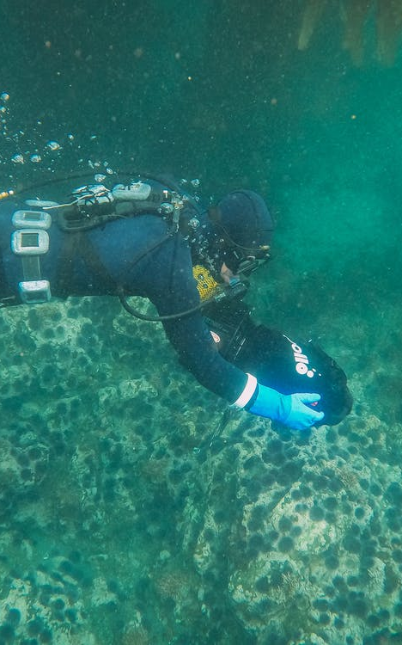
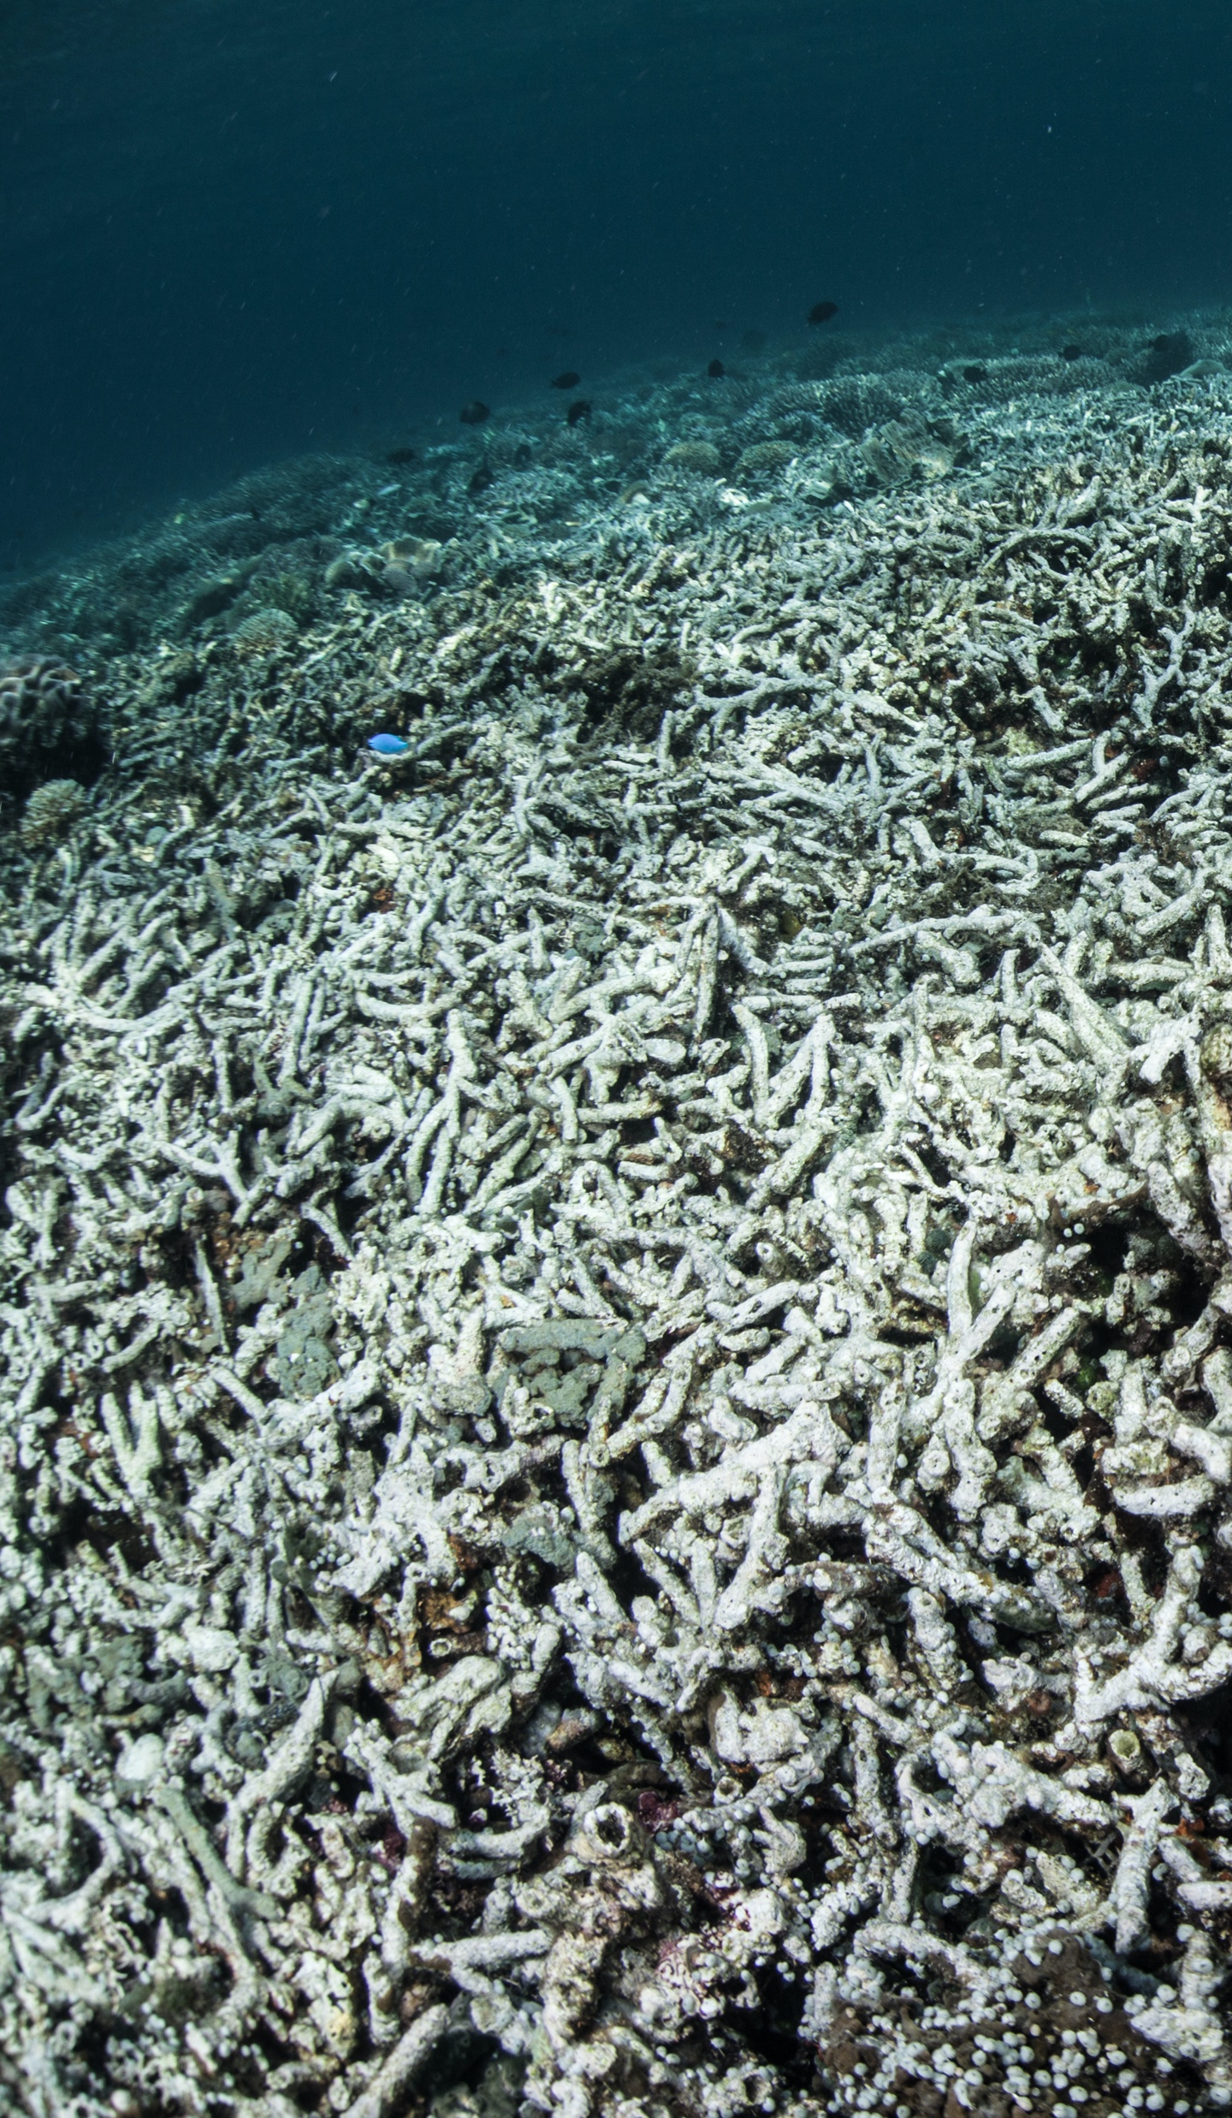
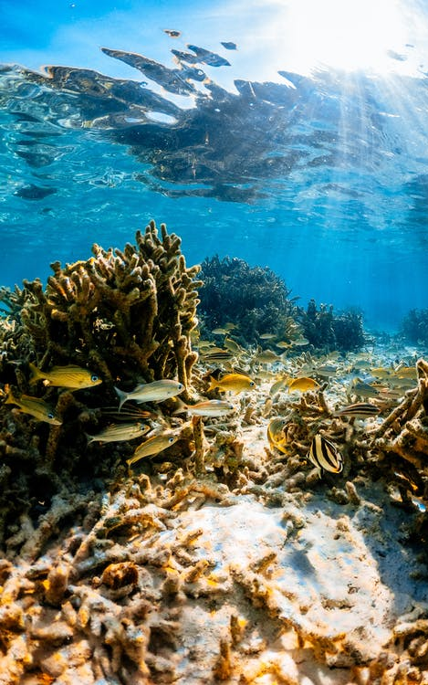
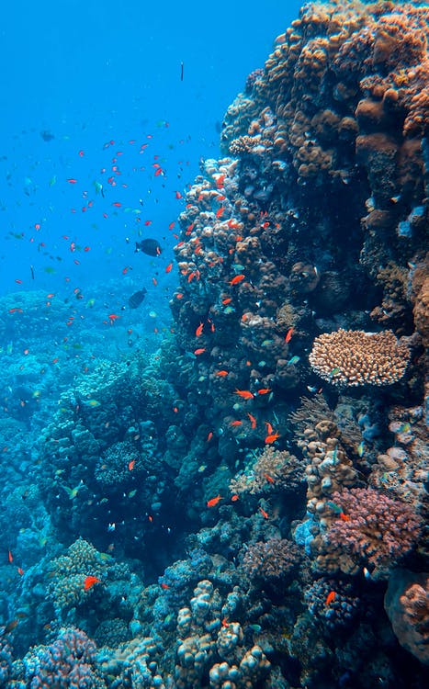
Implementing the Strategic Action Programme for the South China Sea and Gulf of Thailand (SCS SAP Project)
FIRST MEETING OF THE REGIONAL SCIENTIFIC AND TECHNICAL COMMITTEE (RSTC)
OF THE SCS SAP PROJECT
17-19 October 2022, Bangkok, Thailand
Report of the Regional Working Group
on Coral Reefs
Notes:
stock
https://www.pexels.com/photo/man-in-black-and-yellow-diving-suit-under-water-8849656/
https://www.pexels.com/photo/undersea-landscape-of-coral-reef-9762762/
https://www.pexels.com/photo/photo-of-fishes-near-coral-reef-3163599/

Slide 2

RWG-Coral Reefs
Introduction
Key Discussions and Agreements
Issues and Challenges
Recommendations and Next Steps
Implementing the Strategic Action Programme for the South China Sea and Gulf of Thailand (SCS SAP Project)

Slide 3
RWG-Coral Reefs: Roles and Functions
For coordinating the work of the National Coral Reef Committees established in each of the participating countries
For ensuring effective implementation of project activities undertaken in the context of the achievement of the coral reef management targets of the project
To provide a mechanism for exchange of information and experience of coral reef management activities in each country
Implementing the Strategic Action Programme for the South China Sea and Gulf of Thailand (SCS SAP Project)

Slide 4
RWG-Coral Reefs: the first meeting
2 December 2021 with the objectives:
To present and discuss the SAP targets for coral reefs and selected sites
To present the info on the status of SAP implementation between 2008-2020
To present the compiled info on the national revision to targets and sites, building upon recent ongoing projects, initiatives and best practices; and
To discuss executing arrangement and workplan for 2021-2022
Implementing the Strategic Action Programme for the South China Sea and Gulf of Thailand (SCS SAP Project)
Notes:
The first regional working group meeting was conducted on 2 December 2021
Objective of the meeting:
- To present and discuss the SAP targets for coral reefs, and selected sites;
- To present the compiled information provided on the status of SAP implementation between 2008-2020, which will be further developed into a
publication in 2022;
- To present the compiled information on the national revisions to targets and sites, building upon recent and ongoing projects, initiatives and best practices; and
- To discuss executing arrangement and workplans for 2021-2022.

Slide 5
RWG-Coral Reefs: designated officers
Election of a Chairperson, Vice-Chair, and Rapporteur:
Chair: Mr. Ukkrit Satapoomin, National Focal Point for Coral Reefs in Thailand
Vice-Chair: Mr. Yon Yonvitner, National Focal Point for Coral Reefs in Indonesia
No Rapporteur elected since the meeting was online and being recorded
RWG members: Mr. SUM Dara from Cambodia
Mr. Datu Tungko M. Saikol from Philippines
Implementing the Strategic Action Programme for the South China Sea and Gulf of Thailand (SCS SAP Project)

Slide 6
Key Discussions and Agreements
Consideration of the Terms of Reference of the RWG
  Agreed on 10 responsibilities as ToR including
  Provide direction and strategic guidance to national committees on sustainable management of coral reefs; and
  Develop annual workplans and provide periodic progress report to the RSTC committee
Review the SAP targets for coral reefs focal area
  Outcome 1.2 The sustainable management of 110,430 ha of coral reef, 46 sites
  Concerns on numbers of sites due to available budget
  SAP evaluation document could help in the revision and justification of new targets
Implementing the Strategic Action Programme for the South China Sea and Gulf of Thailand (SCS SAP Project)
Notes:
The RWG members agreed on 10 responsibilities as ToR inlcuding
Provide direction and strategic guidance to national committees on sustainable management of coral reef; and
Develop annual workplans and provide periodic progress report to the RSTC committee
We reviewed the SAP targets for coral reefs that were developed and adopted in 2008. The detail of the targets to achieve Outcome 1.2 on the sustainable management of 110,430 ha of coral reefs was presented including the expected target sites and areas from each country. A total of 46 priority sites from six participating countries were identified in the SAP.
There were concerns on numbers of sites and areas due to available budget; however, SAP evaluation document and the recommendation provided could help in the revision and justification of new targets, also need to consider and ensure the long-term sustainability of the activities.

Slide 7
Key Discussions and Agreements (2)
SAP evaluation at the national level during 2008 - 2020
  Provided evidence on proactive contribution of the participating countries
  Calculated co-financing contribution and provided updated baseline for developing relevant activities
  Based on submitted NIRs from Cambodia, Philippines, and Thailand
Review and revision of SAP targets at national level
  China is not participating since they have no SAP targets for CRs
  concerns on inconsistent approach in designing activities
  activities lead to the achievement of the outcomes and outputs
  should address the gaps and needs in baselines
  long-term sustainability of actions beyond project life
Implementing the Strategic Action Programme for the South China Sea and Gulf of Thailand (SCS SAP Project)
Notes:
SAP Evaluation at the national level during 2008-2020 was to provide evidence on proactive contribution of the participating countries. Based on the evaluation, countries can calculate their co-financing contribution as well as provide updated baseline for developing relevant activities. the evaluation was based on submitted National Implementing Reports (NIRs) from Cambodia, Phillippines, and Thailand.
Review and revision of SAP target at national level
China is not participating as they have no SAP target for CR
there are concerns on inconsistent approach in the development of activities between each country. The development of activities should lead to the achievement of the outcomes and outputs, using the logical framework approach. The activities should also address the gaps and needs identified in the national reports and baselines, and would results to the long term sustainability of actions and activities beyond project life. The regional working group was encouraged to inform the project team of any challenges and additional project support needed by the group.

Slide 8
Key Discussions and Agreements (3)
National presentation on SAP implementation
  Cambodia
    7 sites were proposed under the SAP (2,808 ha)
    Reduced to 3 sites: Koh Kong, Kong Rong, and Koh Tonsay
    Building management capacity / improving management tools
  Indonesia
    10 sites were proposed under the SAP
    Reduced to 7 sites: Karimata straits, Bintan, Natuna, Batam, Senayang Lingga, Anambas and Bangka
    Profiling of coral reef ecosystems / rehabilitation
    Increased capacity of managers and communities
Implementing the Strategic Action Programme for the South China Sea and Gulf of Thailand (SCS SAP Project)

Slide 9
Key Discussions and Agreements (4)
National presentation on SAP implementation (cont)
  Philippines
    Original 9 sites, reduced to 4 sites:
Masinloc, Zambales El Nido, Palawan
Bolinao/Lingayen Gulf Maricaban Strait, Batangas
    Integration and streamlining of different management plans
    Comprehensive Land Use Plan for a ridge to reef appraoch
  Thailand
    Original 14 sites, reduced to 6 sites: Lan and Phai, Si Change, Koh Kra, Koh Losin, Koh Tao and Kho Mak
    Establish law enforcement measures to minimize the impact from marine tourism industry and coastal development
    Establish utilization and conservation zones
Implementing the Strategic Action Programme for the South China Sea and Gulf of Thailand (SCS SAP Project)

Slide 10
Best Practices
Good participation of local fisheries communities and tourism sector (KH)
Integration of traditional wisdom in development of coral reef management plan (ID)
Community-based management system (ID)
Establishment of protected area covering coral reefs (PH)
Sustainable financing mechanism in the form of user’s fee (PH)
Use of in-situ coral nurseries, using mesh net – provide stability for coral growth and reduce impacts of sedimentation (SG)
Integration of scientific data into policy and adaptation practices (TH - Mu Koh Chang)
Implementing the Strategic Action Programme for the South China Sea and Gulf of Thailand (SCS SAP Project)

Slide 11
Issues and Challenges
Impacts of IUU fishing to coral reef / unsustainable fishing practices
Marine pollution e.g.
  marine debris and plastic
  oil spill
  sediment transport from land-based pollution
  deteriorating water quality
Encroachment and unregulated development activities due to tourism
Climate change
Outbreak of Crown-of-Thorn Seastar
Lack of robust governance structure
Lack of sustainable financial mechanism
Implementing the Strategic Action Programme for the South China Sea and Gulf of Thailand (SCS SAP Project)

Slide 12
Recommendations and Next Steps
Establish national coral reef committees/working groups
Establish the National Technical Working Group (NTWG) with all habitat focal points and conduct first meeting to ensure synergies between habitats
Establish the Inter-Ministerial Committee (IMC) and conduct the first meeting to confirm workplan and budget
Provide best practice on coral reef management/restoration (2008-2021) – cooperated with UN Decade Incubator Coral Reef Group
Implementing the Strategic Action Programme for the South China Sea and Gulf of Thailand (SCS SAP Project)

Slide 13
Recommendations and Next Steps (2)
2nd RWG-CR meeting to present and discuss:
  Methodology for revising the National Coral Reef Reports
  Progress in the execution of activities
  Monitoring and data management and indicators
  Any revision to work plans and budget; and
  Compiling best practices
  The plan is to organize the meetings twice a year (online and face-to-face)
Implementing the Strategic Action Programme for the South China Sea and Gulf of Thailand (SCS SAP Project)

Slide 14
Recommendations and Next Steps (3)
Review the key impacts on coral reefs and consider these impacts and new issues such as climate change and marine debris
Compilation of coral reef resources from regional and global level
Launch of the Small Grant Program in 2022 for NGOs and community organizations to implement community-based projects/ activities. The IMC and NTWG will lead the review and approval of application
Implementing the Strategic Action Programme for the South China Sea and Gulf of Thailand (SCS SAP Project)

