Slide 1


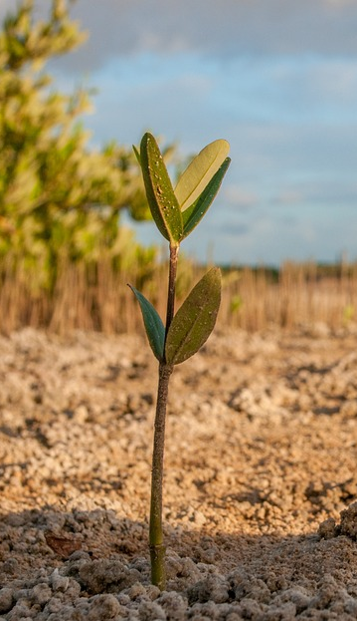
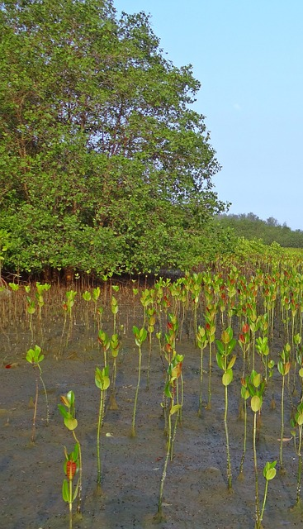
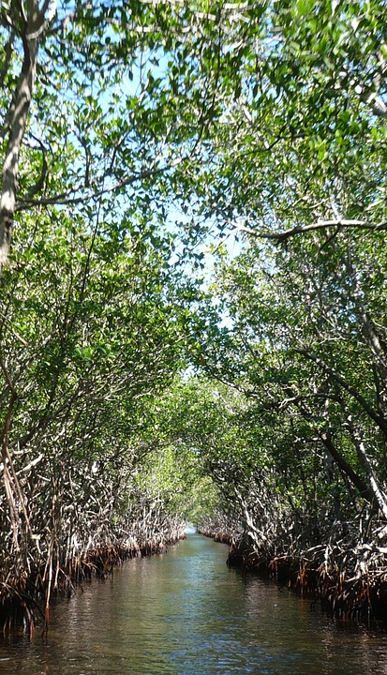
Implementing the Strategic Action Programme for the South China Sea and Gulf of Thailand (SCS SAP Project)
FIRST MEETING OF THE REGIONAL SCIENTIFIC AND TECHNICAL COMMITTEE (RSTC)
OF THE SCS SAP PROJECT
17-19 October 2022, Bangkok, Thailand
Report of the Regional Working Group on Mangroves

Slide 2

Presentation Outline
Introduction
Key Discussions and Agreements
Issues and Challenges
Recommendations and Next Steps
Implementing the Strategic Action Programme for the South China Sea and Gulf of Thailand (SCS SAP Project)

Slide 3
Introduction
Present the background of the RWG-Mangroves in terms of structure (organogram), roles and functions (per TOR), date and objectives of first RWG meeting, designated officers - Chair, Vice-Chair and Rapporteur, and RWG members (per meeting report)
Implementing the Strategic Action Programme for the South China Sea and Gulf of Thailand (SCS SAP Project)

Slide 4
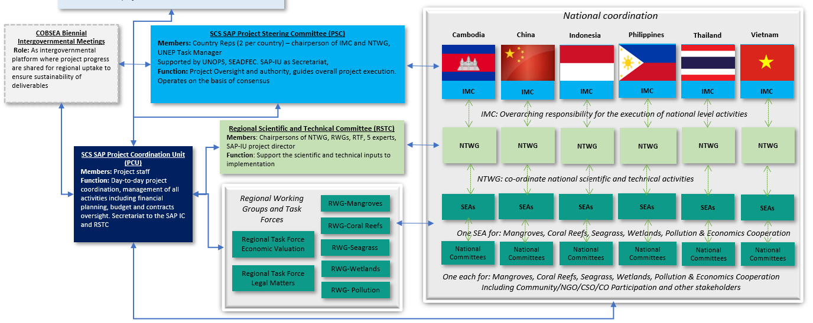
Introduction
RWG-M organogram
Implementing the Strategic Action Programme for the South China Sea and Gulf of Thailand (SCS SAP Project)

Slide 5
Introduction
RWG-M has the responsibility
--ensuring effective implementation of project activities undertaken in the context of the achievement of the mangrove management targets of the project;
--providing a mechanism for exchange of information and experience of mangrove management activities in each country.
Implementing the Strategic Action Programme for the South China Sea and Gulf of Thailand (SCS SAP Project)

Slide 6
Introduction
TOR of the RWG-M, Main function:
Provide direction, and strategic guidance to the National Mangrove Committees
Update, in close collaboration with the National Mangrove Committees, the regional mangrove metadatabase and GIS,
Develop, in close collaboration with the National Mangrove Committees, public awareness and information materials;
Receive, and review reports, data and information from the National Mangrove Committees and compile the regional syntheses;
Develop guidelines regarding best practices for sustainable mangrove management for adoption and application at national level in participating countries;
Prepare a regional review of national experiences in mangrove restoration with a view to developing widely applicable guidelines concerning best practices in mangrove restoration and rehabilitation;
Implementing the Strategic Action Programme for the South China Sea and Gulf of Thailand (SCS SAP Project)

Slide 7
Introduction
The objectives of this First Meeting of the Regional Working Group on Mangroves include:
Present and discuss the SAP targets for mangroves, and selected sites
Present the compiled information provided on the status of SAP implementation between 2008-2020, which will be further developed into a publication in 2022
Present the compiled information on the national revisions to targets and sites, building upon recent and ongoing projects, initiatives and best practices;
Discuss executing arrangement and workplans for 2021-202;
Implementing the Strategic Action Programme for the South China Sea and Gulf of Thailand (SCS SAP Project)

Slide 8
Introduction
First RWG meeting：Teleconference, 1 December 2021
Designated officers:
Chair: Mr. Yu Yunjun, Representative of China.
Vice-Chair: Mr. Nyoto Santoso, Focal Point for Mangrove in Indonesia.
Rapporteur: No.
RWG members: The membership of the RWG-M was formally established at the first meeting of the Working Group.
The RWG-M of the SCS SAP Project consist of the Chairpersons of the National Mangrove Committees together with one member of the SCS SAP Project Coordination Unit and selected regional experts.
Implementing the Strategic Action Programme for the South China Sea and Gulf of Thailand (SCS SAP Project)

Slide 9
Key Discussions and Agreements
Present the key discussions and agreements made per meeting agenda
Terms of Reference for the Regional Working Group on Mangroves, consider, amend and adopt the Terms of Reference.
Review the SAP targets for mangrove focal area. The Secretariat presented the SAP targets on mangroves and the objectives and outputs of the SCS SAP project
Evaluation of SAP Implementations of the Mangrove Focal Area During 2008-2021. The Secretariat introduced document on the format of evaluation.
Implementing the Strategic Action Programme for the South China Sea and Gulf of Thailand (SCS SAP Project)

Slide 10
Key Discussions and Agreements
4. Reviews and revision of SAP targets at the national level. The Secretariat introduced the document on plans for implementing the SAP for mangrove focal area at the national level during 2021 – 2023
5. National Presentations on SAP implementation and future planning. National Mangrove Focal Points presented key achievement in SAP implementation between 2008-2021 and the revision of national targets and sites and NIRs.
6. Execution arrangement and national work plans. The Secretariat presented the follow up actions as discussed and agreed.
Implementing the Strategic Action Programme for the South China Sea and Gulf of Thailand (SCS SAP Project)

Slide 11
Issues and Challenges
Present the issues and challenges encountered in the implementation of the SCS SAP Project, SAP targets and achievements
Alternative livelihoods;
Mechanism for financial sustainability；
Lack of public awareness on the importance of the mangrove forests at local level;
Enhancing capacity on mangrove management and conservation at local level.
Absence of harmonized institutional data on the extent and cover of mangrove areas.
Implementing the Strategic Action Programme for the South China Sea and Gulf of Thailand (SCS SAP Project)

Slide 12
Recommendations and Next Steps
Present the recommendations:
1. Request what additional support PCU can provide, identify capacity and training needs
2. To review what are the key impacts to mangroves, and consider new issues such as plastics and climate change.
3. PCU to compile mangrove resources from regional and global level, including UNEP and WCMC’s work on mangroves
4. Small Grants Program to be launched in 2022, to include mangrove restoration. NTWG & IMC to review application
Implementing the Strategic Action Programme for the South China Sea and Gulf of Thailand (SCS SAP Project)

Slide 13
Recommendations and Next Steps
Next steps for 2022:
1. Legal agreements (PCA’s) to be signed with each SEA
2. workshop/training on best-practices, tools and guidelines
3. Second RWG-M to discuss:
1) Revision of National Mangrove reports and
2) Progress in execution of activities
3) Monitoring and data management and
4) Any revision to workplans/budget as needed
5) Compiling best-practices
Implementing the Strategic Action Programme for the South China Sea and Gulf of Thailand (SCS SAP Project)

