Slide 1
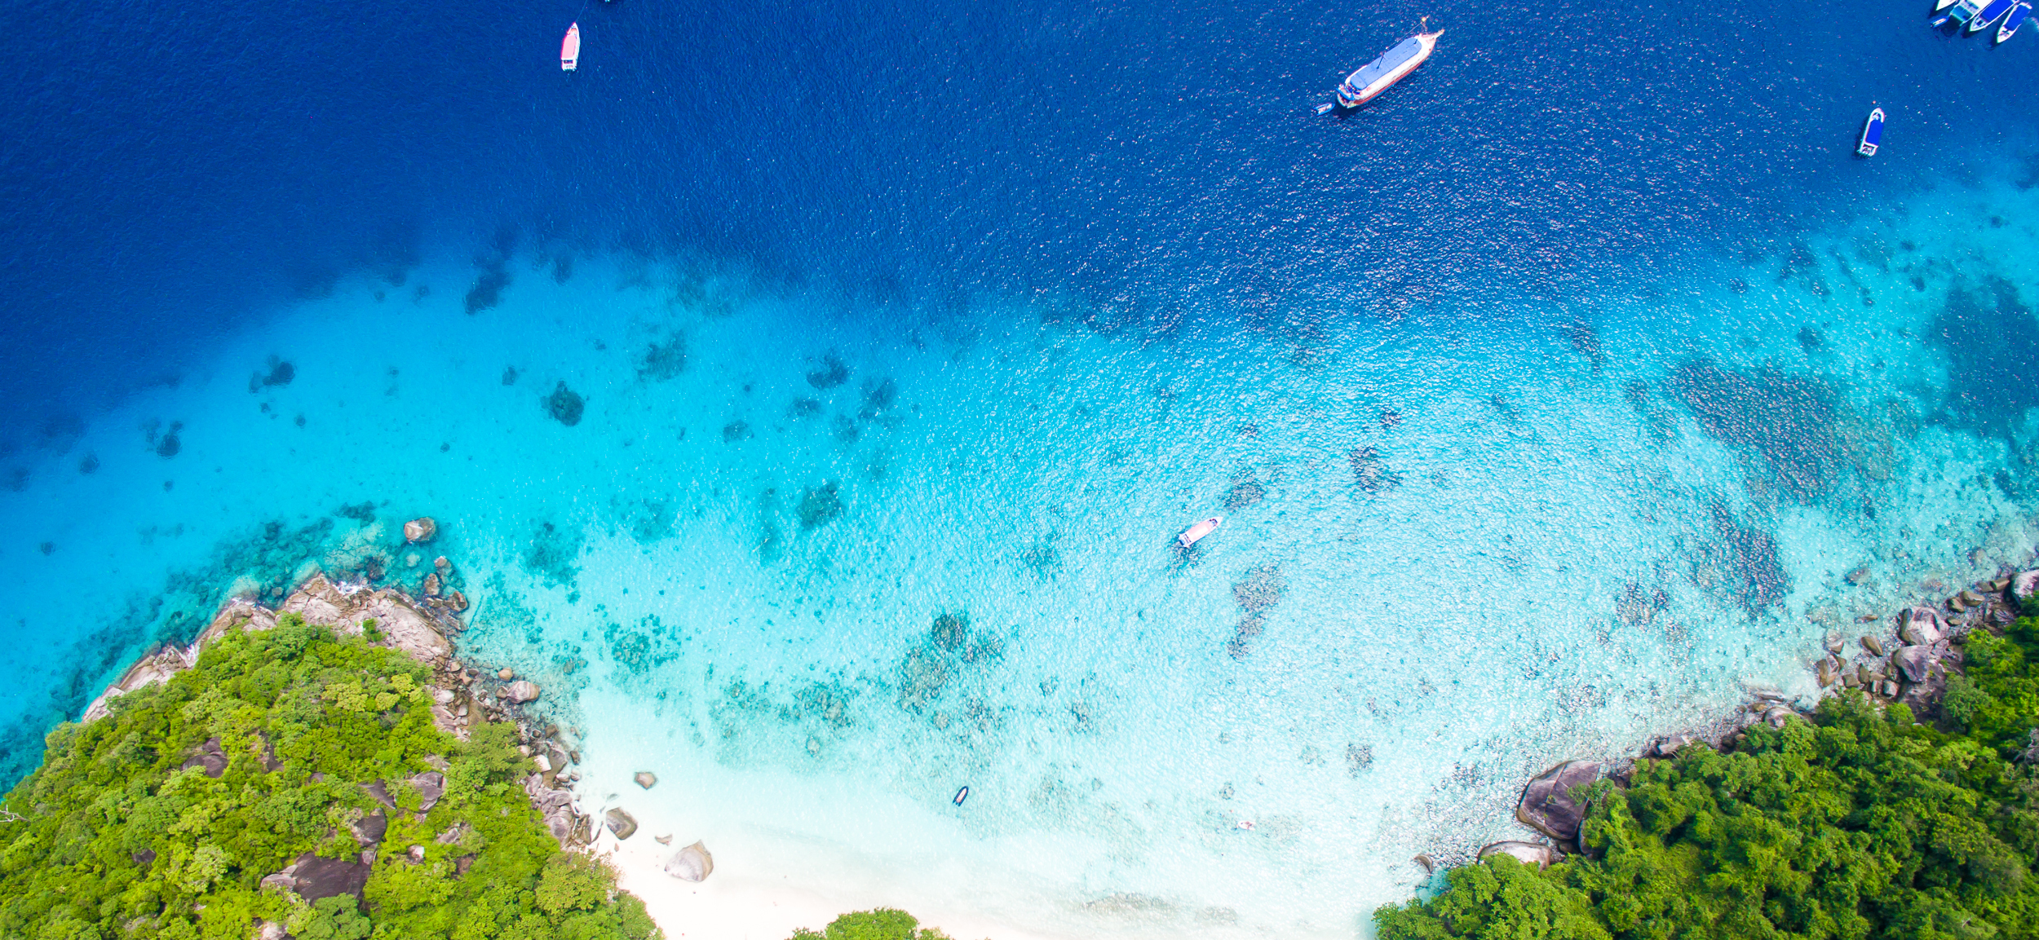


Implementing the Strategic Action Programme for THE SOUTH CHINA SEA AND GULF OF THAILAND (SCS SAP) Project
First Meeting of the Regional Scientific and Technical Committee (RSTC)
of the SCS SAP Project
17-19 October 2022, Bangkok, Thailand
SAP IMPLEMENTATION ACHIEVEMENTS 2008-2021
China
South China Institute of Environmental Sciences, MEE

Slide 2

Presentation Outline
Introduction
Evaluation of Achievements
Mangroves: SAP Targets and Summary of Achievements
Coral Reefs: SAP Targets and Summary of Achievements
Seagrass beds: SAP Targets and Summary of Achievements
Wetlands: SAP Targets and Summary of Achievements
Issues and Challenges
Lessons Learned
Recommendations
Conclusions

Slide 3
Introduction
Present background of country participation and involvement in the projects (past SCS and current SCSSAP) and habitats
China participated in projects of mangrove, seagrass, and wetland.
South China Institute of Environmental Sciences was the leading SEA
Protection of Coral Reefs will be briefly introduced in the meeting.
5 sites of mangroves, 5 sites of seagrass, 4 sites of wetland

Slide 4
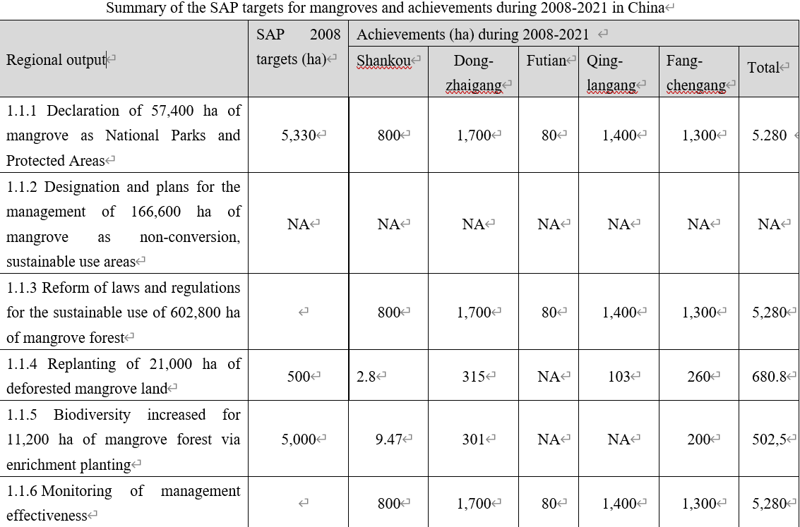
Evaluation of Achievements on Mangroves

Slide 5
Evaluation of Achievements on Mangroves
Present the estimated funding and source for mangrove activities during 2008-2021 including the implementing agencies and partners
Estimated funding: N.A.
Source:
1) The marine ecological conservation and restoration Funds (original Blue Bays Programme launched in 2016), funded by Ministry of Finance
2) The Wetland Conservation and Restoration Funds, funded by Ministry of Finance
3) Ecological compensation funds (provided by Companies)
4) Local Authorities
Implementing agencies and partners：
1) Ministry of Natural Resources, and local natural resources agencies
2) Ministry of Ecology and Environment, and local environment agencies
3) National Forestry and Grassland Administration, and local forestry agencies
4) Local Authorities such as provincial governments
5) Natural Reserve Agencies

Slide 6
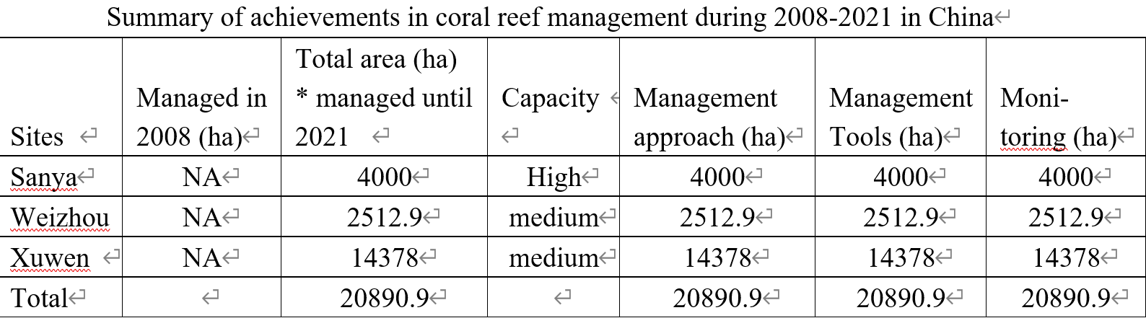
Evaluation of Achievements on Coral Reefs

Slide 7
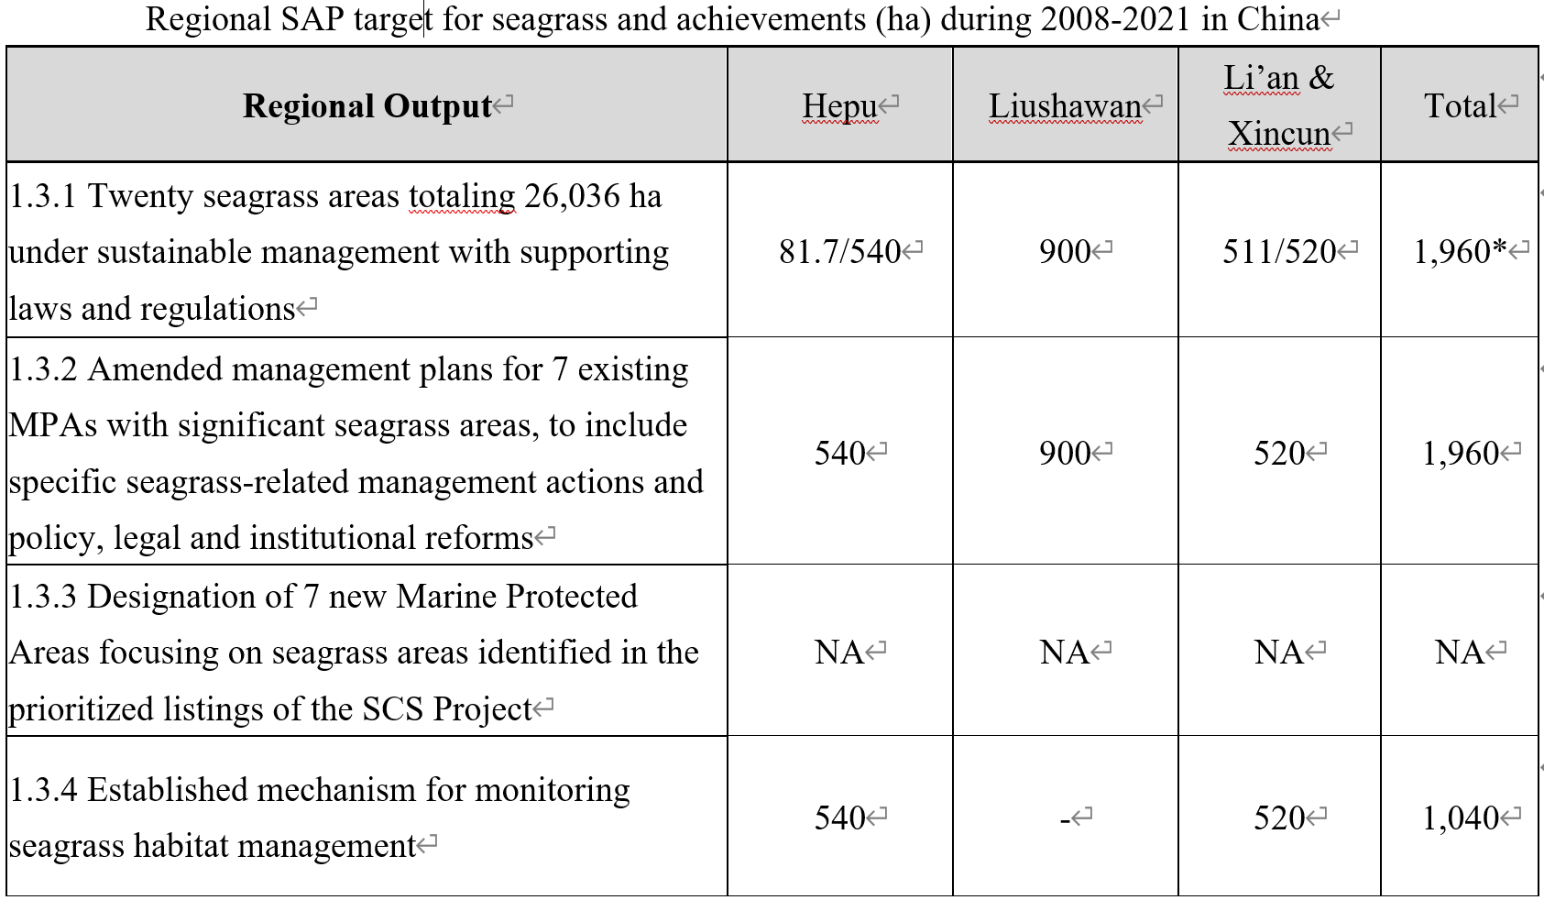
Evaluation of Achievements on Seagrass

Slide 8
Evaluation of Achievements on Seagrass
Present the estimated funding and source for seagrass activities during 2008-2021 including the implementing agencies and partners
Estimated funding: N.A.
Source:
1) The marine ecological conservation and restoration Funds (original Blue Bays Programme launched in 2016), funded by Ministry of Finance
2) The Wetland Conservation and Restoration Funds, funded by Ministry of Finance
3) Ecological compensation funds Funds, provided by Companies
4) Local Authorities
Implementing agencies and partners：
1) Ministry of Natural Resources, and local natural resources agencies
2) Ministry of Ecology and Environment, and local environment agencies
3) National Forestry and Grassland Administration, and local forestry agencies
4) Local Authorities such as provincial governments
5) Natural Reserve Agencies

Slide 9
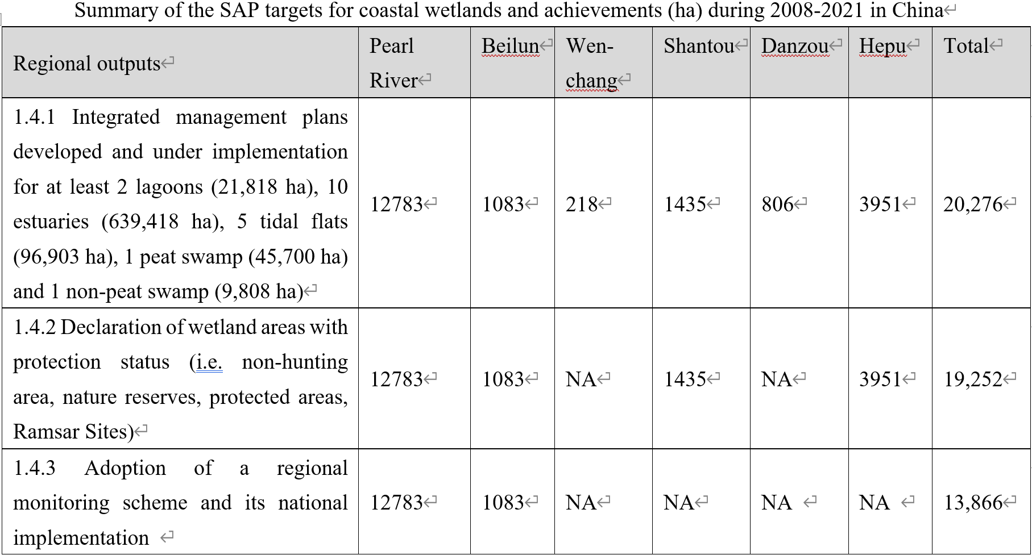
Evaluation of Achievements on Coastal Wetlands

Slide 10
Evaluation of Achievements on Wetland
Present the estimated funding and source for wetland activities during 2008-2021 including the implementing agencies and partners
Estimated funding: N.A.
Source:
1) The marine ecological conservation and restoration Funds (original Blue Bays Programme launched in 2016), funded by Ministry of Finance
2) The Wetland Conservation and Restoration Funds, funded by Ministry of Finance
3) Ecological compensation funds Funds, provided by Companies
4) Local Authorities
Implementing agencies and partners：
1) Ministry of Natural Resources, and local natural resources agencies
2) Ministry of Ecology and Environment, and local environment agencies
3) National Forestry and Grassland Administration, and local forestry agencies
4) Local Authorities such as provincial governments
5) Natural Reserve Agencies

Slide 11
Issues and Challenges
Present the issues and challenges encountered in implementing the SAP and achieving its targets including actions taken to address it
Alternative livelihoods;
Mechanism for financial sustainability；
Lack of public awareness on the importance of the coastal habitats at local level;
Enhancing capacity on coastal management and conservation at local level;
Integrated management of sites faces challenges;
Emerging problems and hot issues.

Slide 12
Lessons Learned
Present the lessons learned in implementing the SAP and achieving its targets
Firstly, completed governance reform of the organizational structure of ecological environment and natural resources: China unveiled a state-level institutional reform of government structure in 2018.
Secondly, improved law and regulation system in coastal protection and restoration.
Thirdly, goals and tasks of the SAP were integrated into national policy framework and action plans for coastal habitat conservation and restoration.
Fourthly, established the financing mechanisms to support conservation and restoration of coastal habitats.

Slide 13
Recommendations
Present recommendations to further the implementation and achievement of the SAP and targets.
Exploration of approaches to Alternative livelihoods;
Exploration of building Mechanism for financial sustainability；
Strengthening capacity building and public involvement including scientific research and public education
Exchange of best practice of coastal habitats management.
Request PCU to provision of the technical support to coastal habitat management, e.g. exchange of best practice.
Ensure synergies among mangroves, coral reef, seagrass and wetland, especially for ecological connectivity among them.

Slide 14
Conclusions
Present overall summary of achievements in implementing the SAP including funding and implementing agencies and partners
Mangroves: many activities in SAP target sites was implemented, the area of mangroves grow constantly, and the mangrove ecosystem in site was healthy.
Seagrass: many activities in SAP target sites was implemented, Seagrass bed ecosystems of SAP target sites were in a healthy state.
Wetland: many activities in SAP target sites was implemented, the wetland ecosystem was rehabilitated, biodiversity of the sites increased.
Fund Source: Ministry of Finance, Local Authorities, and Companies
Implementing agencies and partners：
1) Ministry of Natural Resources, Ministry of Ecology and Environment, National Forestry and Grassland Administration
2) Local Authorities such as provincial governments
3) Natural Reserve Agencies

Slide 15
Conclusions
Present ways forward to achieve SAP targets during SCS SAP Project in next 2 years
Legal agreements (PCA’s) to be signed
Implementation of the activities as the Annex of PCA
Combination with national and provincial action plan for coastal habitat conservation and restoration
Strengthening capacity building and public involvement including scientific research and public education

Slide 16
Thank you very much
yuyunjun@scies.org

