Slide 1



Implementing the Strategic Action Programme for THE SOUTH CHINA SEA AND GULF OF THAILAND (SCS SAP) Project
Second Meeting of the Regional Working Groups on Coral Reefs and Seagrass Beds
of the SCS SAP Project
11-12 August 2025, Iloilo, Philippines
Report on National Activities to Implement the SCS SAP Project
(for the period January 2022 – July 2025)
Thailand
Director of the Marine Resources Conservation Division
Director of the Marine and Coastal Resources Research and Development Institute

Slide 2
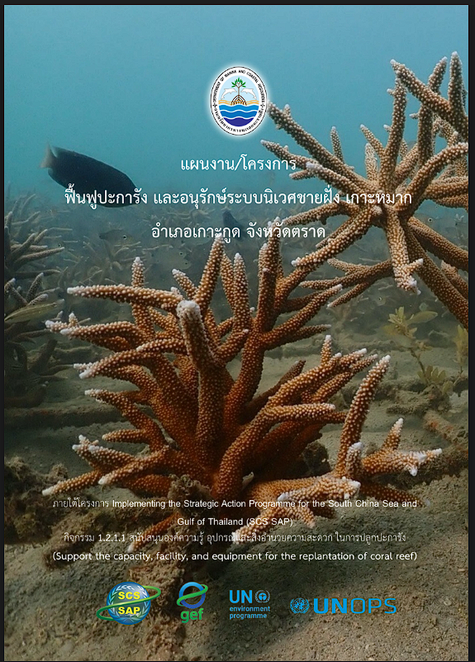

Presentation Outline
Introduction
Highlights of key achievements in Implementing the SAP on CRs & SGs during 2022 – July 2025
Summary on status of monitoring related CRs & SGs
Availability of data and information at the sites on CRs & SGs
Issues and Challenges
Lessons learned
Recommendations & Conclusions

Slide 3
Introduction
 | Coral Reefs (CR) | Seagrass Beds (SG)
Date of PCA signature | 29 October 2021
Executing body and national focal point | Executing Body: Marine Resources Conservation Division, DMCR National Focal Point: Director of the Marine Resources Conservation Division | Executing Body: Marine and Coastal Resources Research and Development Institute, DMCR National Focal Point: Director of the Marine and Coastal Resources Research and Development Institute
Date of national working group establishment and meetings | Established: 11 April 2024 Meeting: 14 November 2024
Sites | 6 sites: Koh Si Chang, Koh Lan, Koh Tao, Koh Mak, Koh Kra, Koh Losin | 1 site: Bandon Bay
Co-finance project/activities related | 165,315.87 USD (in-kind)
Members of TDA/SAP national team on ecosystem | 1. Associate Professor Dr. Thamasak Yeemin

Slide 4
Highlights of key achievements in Implementing the SAP on CRs & SGs during 2022 – July 2025
1. Newly established or upgraded Protected Areas (PAs) of all categories (nature reserve, sanctuary, fisheries management, Ramsar)
Activity | Site 1: Bandon Bay (Seagrass) | Site 1: Koh Si Chang | Site 2: Koh Lan
Name of PA | Conserved Areas under DMCR | Currently undergoing the process of being declared a Marine Protected Area (MPA) under Section 22 of the DMCR Act. | Integration with ONEP: Aligned with environmental PA designations Draft zoning plan: Applied to select uses (e.g., sea-walker tours)
Date of establishment/upgrading
PA management plan status | In progress | In progress | Done, implemented by ONEP
Approved by | - | - | Minister of Natural Resources and Environment
Total area of PA (ha) | ~6,700 | ~700 | ~900
Area (ha) of CRs protected | NA | ~700 | ~900
Area (ha) of SGs protected | ~6,700 | NA | NA
Report of capacity assessment (yes/no) | Yes | Yes | Yes
Training course (on what?) | Seagrass monitoring, law enforcement | Coral management, zoning, patrol | Coral management, zoning, patrol
Consultation (date/no. participants) | 2023–24 / 60+ | 2023–24 / 40+ | 2023–24 / 50+
Zoning regulation (yes/no) | Yes | Yes | Yes
Type of enforcement | DMCR/Community Watch & LMMA | DMCR/Community | DMCR/Community

Slide 5
1. Newly established or upgraded Protected Areas (PAs) of all categories (nature reserve, sanctuary, fisheries management, Ramsar site)
Activity | Site 3: Koh Tao | Site 4: Koh Mak | Site 5: Koh Kra | Site 6: Koh Losin
Name of PA | In the process of official declaration as a Marine Protected Area (MPA) under Article 22 of the DMCR Act. | In the process of official declaration as a Marine Protected Area (MPA) under Article 20 of the DMCR Act. | Conserved area under Art. 20 DMCR Act. | Conserved area under Art. 20 DMCR Act.
Date of establishment/upgrading |  |  | 28 May 2001 | 31 March 2022
PA management plan (done/in progress) | In progress | In progress | Done, implemented | Done, implemented
Approved by | - | - | Minister of Natural Resources and Environment | Minister of Natural Resources and Environment
Total area of PA (ha) | ~900 | ~1,400 | ~550 | ~1,000
Area (ha) of CRs protected | ~900 | ~1,400 | ~550 | ~1,000
Area (ha) of SGs protected | NA | NA | NA | NA
Report of capacity assessment (yes/no) | Yes | Yes | Yes | Yes
Training course (on what?) | Coral mgmt, monitoring, eco-tourism | Coral mgmt, sustainable tourism | Enforcement, coral mgmt, monitoring | Enforcement, coral mgmt, patrols
Consultation (date/no. participants) | 2023–24 / 50+ | 2023–24 / 45+ | 2023–24 / 30+ | 2023–24 / 30+
Zoning regulation (yes/no) | Yes | Yes | Yes | Yes
Type of enforcement (PA authority/community involvement…) | DMCR/Community | DMCR/Community | DMCR/Community | DMCR/Community

Slide 6
Highlights of key achievements in Implementing the SAP on CRs & SGs during 2022 – July 2025 (cont.)
2. Approval and implementation of plans for sustainable management & use
Activity | Site 1: Bandon Bay (Seagrass) | Site 1: Koh Si Chang (Coral Reef) | Site 2: Koh Lan
Report to review management status (yes/no) | Yes | Yes | Yes
Local consultation (date/no. participants) | 2023–24 / 60+ | 2023–24 / 40+ | 2023–24 / 50+
Date of management plan submitted | 2023 | 2023 | 2023
Area (ha) of CRs managed by the plan | NA | ~700 | ~900
Area (ha) of SGs managed by the plan | ~6,700 | NA | NA
Date of approval | 2024 | 2024 | 2024
Approved by | DMCR, Provincial Committee | DMCR, Provincial Committee | DMCR, Provincial Committee
Zoning regulations (yes/no) | Yes | Yes | Yes
Awareness raising campaign (date/no. participants) | 2023–24 / 250+ (multiple events) | 2023–24 / 150+ (multiple events) | 2023–24 / 200+ (multiple events)
Training course (on what, no. participants) | Seagrass mgmt, monitoring, law enforcement (60+) | Coral mgmt, zoning, patrols (50+) | Coral mgmt, eco-friendly tourism (50+)
Area (ha) of CRs/SGs restoration | ~30 (community-led restoration) | ~5 | ~7
Type of livelihood alternatives | Eco-tourism (seagrass tours), bivalve/clam harvest, value-added processing | Eco-tourism, community patrols, guide services | Eco-tourism, dive shops, guide services
What stakeholders involved | DMCR, provincial gov, fishers, community groups, LMMA committees | DMCR, local gov, tourism operators, fishers, community groups | DMCR, local gov, dive operators, community

Slide 7
2. Approval and implementation of plans for sustainable management & use
Activity | Site 3: Koh Tao | Site 4: Koh Mak | Site 5: Koh Kra | Site 6: Koh Losin
Report to review management status (yes/no) | Yes | Yes | Yes | Yes
Local consultation (date/no. participants) | 2023–24 / 50+ | 2023–24 / 45+ | 2023–24 / 30+ | 2023–24 / 30+
Date of management plan submitted | 2023 | 2023 | 2023 | 2023
Area (ha) of CRs managed by the plan | ~900 | ~1,400 | ~550 | ~1,000
Area (ha) of SGs managed by the plan | NA | NA | NA | NA
Date of approval | 2024 | 2024 | 2024 | 2024
Approved by | DMCR, Provincial Committee | DMCR, Provincial Committee | DMCR, Provincial Committee | DMCR, Provincial Committee
Zoning regulations (yes/no) | Yes | Yes | Yes | Yes
Awareness raising campaign (date/no. participants) | 2023–24 / 200+ (multiple events) | 2023–24 / 180+ (multiple events) | 2023–24 / 80+ (multiple events) | 2023–24 / 80+ (multiple events)
Training course (on what, no. participants) | Coral mgmt, monitoring, eco-tourism (50+) | Coral mgmt, sustainable tourism (40+) | Enforcement, coral mgmt, monitoring (30+) | Enforcement, coral mgmt, patrols (30+)
Area (ha) of CRs/SGs restoration | ~10 | ~8 | ~3 | ~3
Type of livelihood alternatives | Eco-tourism, dive shops, guide services | Eco-tourism, MoU w/ operators, guide services | Community patrols, local enforcement | Community patrols, local enforcement
What stakeholders involved | DMCR, local gov, dive ops, community | DMCR, local gov, dive ops, community | DMCR, local gov, rangers, community | DMCR, local gov, rangers, community

Slide 8
Highlights of key achievements in Implementing the SAP on CRs & SGs during 2022 – July 2025 (cont.)
3. Reform of laws/regulations or management approach for the sustainable
Activity | Site 1: Bandon Bay (Seagrass) | Site 1: Koh Si Chang | Site 2: Koh Lan
Report to review law/regulations or management approach (yes/no)) | Yes | Yes | Yes
Subject to be reformed (new approach, environment protection, ecosystem conservation…) | LMMA | Upgrading PA status, new zoning & MSP, community co-management | Upgraded PA status, new permit & MSP zoning system, eco-tourism integration
Consultation (date/no. participants) | 2023–24 / 60+ | 2023–24 / 40+ | 2023–24 / 50+
Date of disseminating law/regulations or new approach | 2024 | 2024 | 2024
Enacted by | DMCR, Provincial Committee | DMCR, Provincial Committee | DMCR, Provincial Committee
Key activities to improve management (capacity building, awareness raising, enforcement…) | Capacity building for enforcement, zoning demarcation, LMMA training, awareness campaigns | Capacity building, MSP zoning, awareness campaigns, community patrols | Eco-tourism training, MSP zoning & permit system, community patrols, awareness campaigns
Impacts of reformed law/regulations:
Increasing public awareness (much, better/ no change) | Much | Much | Much
Improved enforcement (much, better/no) | Much | Better | Better
Area (ha) of CRs managed effectively | NA | ~700 | ~900
Area (ha) of SGs managed effectively | ~6,700 | NA | NA

Slide 9
3. Reform of laws/regulations or management approach for the sustainable
Activity | Site 3: Koh Tao | Site 4: Koh Mak | Site 5: Koh Kra | Site 6: Koh Losin
Report to review law/regulations or management approach (yes/no)) | Yes | Yes | Yes | Yes
Subject to be reformed (new approach, environment protection, ecosystem conservation…) | Upgrading PA status, new zoning, voluntary permit codes, sustainable tourism | Upgrading PA status, sustainable tourism MoU, new zoning | Upgraded PA status, stricter protection zones, enhanced enforcement | Upgraded PA status, expanded no-take zones, patrol protocols
Consultation (date/no. participants) | 2023–24 / 50+ | 2023–24 / 45+ | 2023–24 / 30+ | 2023–24

Slide 10
Summary on status of monitoring related CRs & SGs in Thailand
Activity | Site 1: Bandon Bay (Seagrass) | Site 1: Koh Si Chang | Site 2: Koh Lan
Methodology training (date/no. participants) | 2023 / 40+ (DMCR, community, LMMA) | 2023 / 25+ (DMCR, local gov, dive ops) | 2023 / 30+ (DMCR, dive ops, local gov)
Indicators & frequency | SG: Coverage, shoot density, water quality Quarterly | CR: Live coral cover, fish, water quality Quarterly | CR: Live coral cover, fish, water quality Quarterly
No. stations | 6 (across SG zones) | 3 (core reef sites) | 4 (core reef sites)
Date of 1st / 2nd monitoring practices | 2023 Q1 / 2023 Q4 | 2023 Q2 / 2024 Q1 | 2023 Q2 / 2024 Q1
Trend of change of CRs and SGs | Improved coverage & health in core LMMA zones | Stable to improved coral cover, some recovery areas | Coral health and fish abundance improving

Slide 11
Summary on status of monitoring related CRs & SGs in Thailand (Cont.)
Activity | Site 3: Koh Tao | Site 4: Koh Mak | Site 5: Koh Kra | Site 6: Koh Losin
Methodology training (date/no. participants) | 2023 / 40+ (DMCR, dive ops, community) | 2023 / 35+ (DMCR, dive ops, local gov) | 2023 / 25+ (DMCR, local rangers) | 2023 / 20+ (DMCR, patrols)
Indicators & frequency | Coral cover, fish, water quality Quarterly | Coral cover, fish, water quality Quarterly | Coral cover, fish, water quality Quarterly | Coral cover, fish, water quality Quarterly
No. stations | 5 | 3 | 2 | 2
Date of 1st / 2nd monitoring practices | 2023 Q2 / 2024 Q1 | 2023 Q2 / 2024 Q1 | 2023 Q2 / 2024 Q1 | 2023 Q2 / 2024 Q1
Trend of change of CRs and SGs | Coral recovery in some zones; stable elsewhere | Coral resilience improving; stress hotspots identified | Stable coral cover; better enforcement | High coral integrity; maintained status

Slide 12
Availability of data and information at the sites on CRs & SGs
CR & SG Data and Information Categories / total parameters | Bandon Bay (SG) | Koh Si Chang (CR) | Koh Lan (CR) | Koh Tao (CR) | Koh Mak (CR) | Koh Kra (CR) | Koh Losin (CR) | Main reasons of data/information unavailability
Geographic information / 5 | 5 | 5 | 5 | 5 | 5 | 5 | 5 | —
Biological information / 16 | 12 | 14 | 14 | 14 | 14 | 13 | 13 | Some taxonomic, fish, mammal data under review/incomplete; partial for molluscs/crustaceans, trends at SG site systemizing
Social – use information / 9 | 8 | 8 | 8 | 8 | 8 | 7 | 7 | Traditional use, ecosystem service valuation ongoing
Stress-pressure information / 7 | 7 | 7 | 7 | 7 | 7 | 7 | 7 | —
Economic valuation / 7 | 2 | 2 | 2 | 2 | 2 | 2 | 2 | Economic/valuation studies ongoing/incomplete at all sites
- All basic geographic, biological, social, and stress information is recently available.
- Main gaps are in advanced biological (e.g., molluscs, crustaceans, some mammals), traditional use/social (ecosystem services), and especially economic valuation (all sites: studies are ongoing or planned).

Slide 13
Issues related to collection, gathering and provision of national data & information on CRs & SGs
Shortages in collecting & managing data:
Economic valuation and advanced biological data remain limited at most sites.
Mechanisms of data management & exchanges in the country:
Centralized DMCR database, but regional data sharing is still limited.
Consideration to monitoring socio-economic indicators:
Medium priority; annual socio-economic surveys ongoing at demonstration sites.
Types of data available but impossible to provide:
Sensitive or confidential data (e.g. enforcement, some economic figures).
Popular techniques used for mapping habitats:
GIS and drone mapping combined with field surveys.
Training needs on remote sensing application for mapping:
Medium to high; advanced analysis skills needed.
Suggestion for developing the regional database:
Standardize indicators and reporting formats for all countries.

Slide 14
Information related to economic valuation, blue carbon, and blue economy
Study/Project | Focus | Year
Coral Reef Tourism/Fisheries Valuation | Economic value of CR tourism & fishery | 2023
Seagrass Management Cost-Benefit | Economic value/benefit of management | 2024
Blue Carbon Assessment | Blue carbon & sequestration potential | 2024–2025
Blue Economy Pilots | Ecosystem service & finance models | Ongoing

Slide 15
Issues and Challenges
Data/capacity gaps, especially advanced biological and economic data
Enforcement and sustainable financing challenges
Pressures: tourism, illegal/destructive fishing, climate change, COT outbreaks
Responses: community enforcement, LMMA pilots, routine monitoring, adaptive management
Lessons Learned
Stakeholder engagement and LMMA/co-management models improve effectiveness
Participatory monitoring and adaptive management build local ownership
Local capacity building is essential for sustainability

Slide 16
Recommendations
Expand LMMA/co-management and community-based management
Invest in advanced monitoring (remote sensing, economic valuation) and training
Strengthen national–regional data linkages and harmonize protocols
Develop sustainable finance mechanisms for long-term SAP implementation
Conclusions & Way Forward
Significant gains in protected area designation, management, and monitoring for coral reefs and seagrass in Thailand
Partnership of DMCR, UNEP, local agencies, and communities is critical
Next steps: Scale up LMMA, address data gaps, mainstream best practices, secure SAP sustainability to 2027

Slide 17
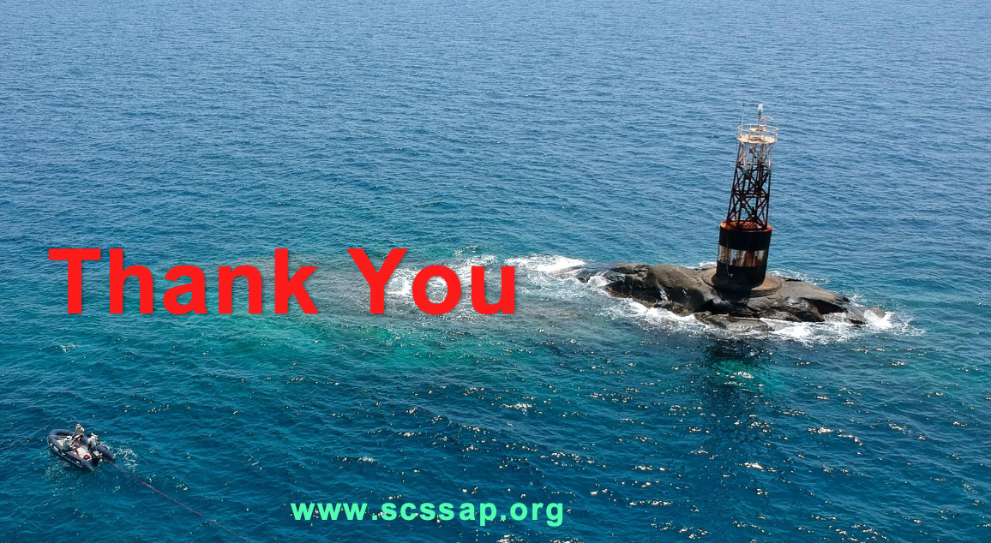
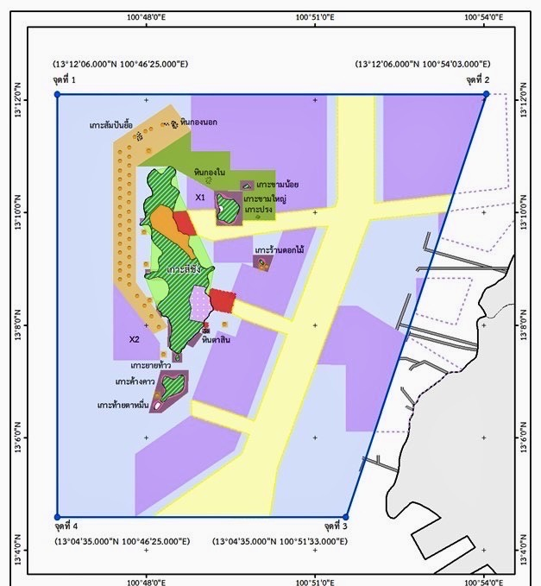
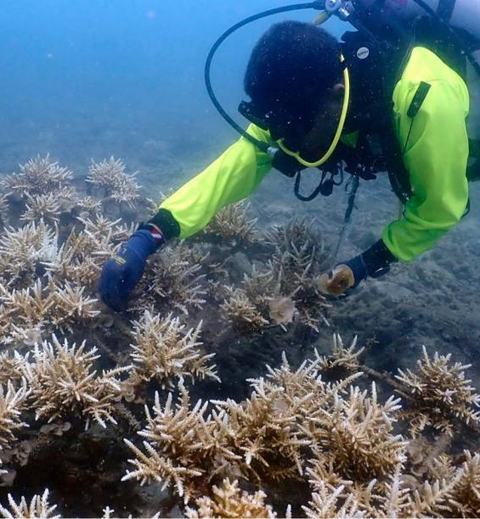
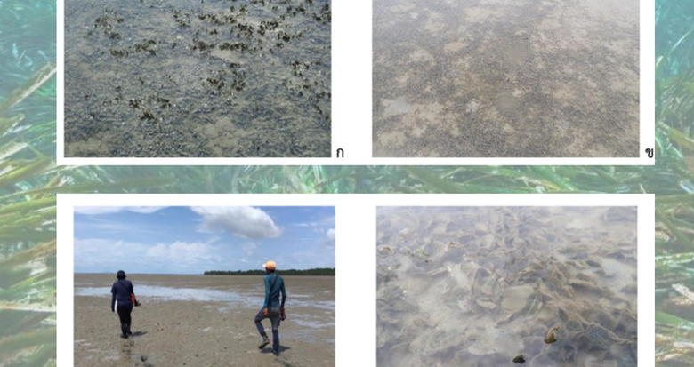
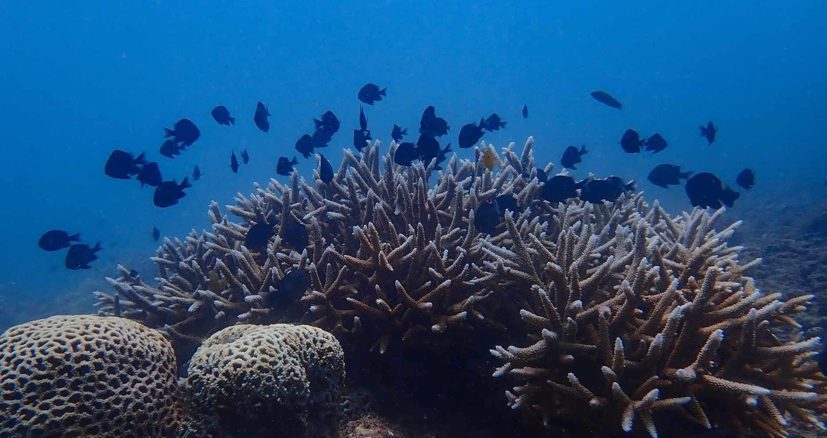
Thank you for your attention.

