Slide 1





Implementing the Strategic Action Programme for the South China Sea and Gulf of Thailand (SCS SAP) Project
Second Meeting of the Regional Scientific and Technical Committee (RSTC)
23-25 July 2024, Bangkok, Thailand
Next Steps and Execution Arrangements

Slide 2
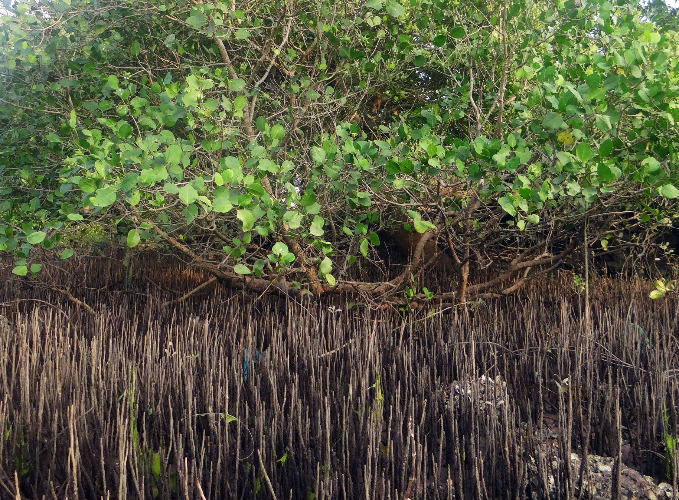

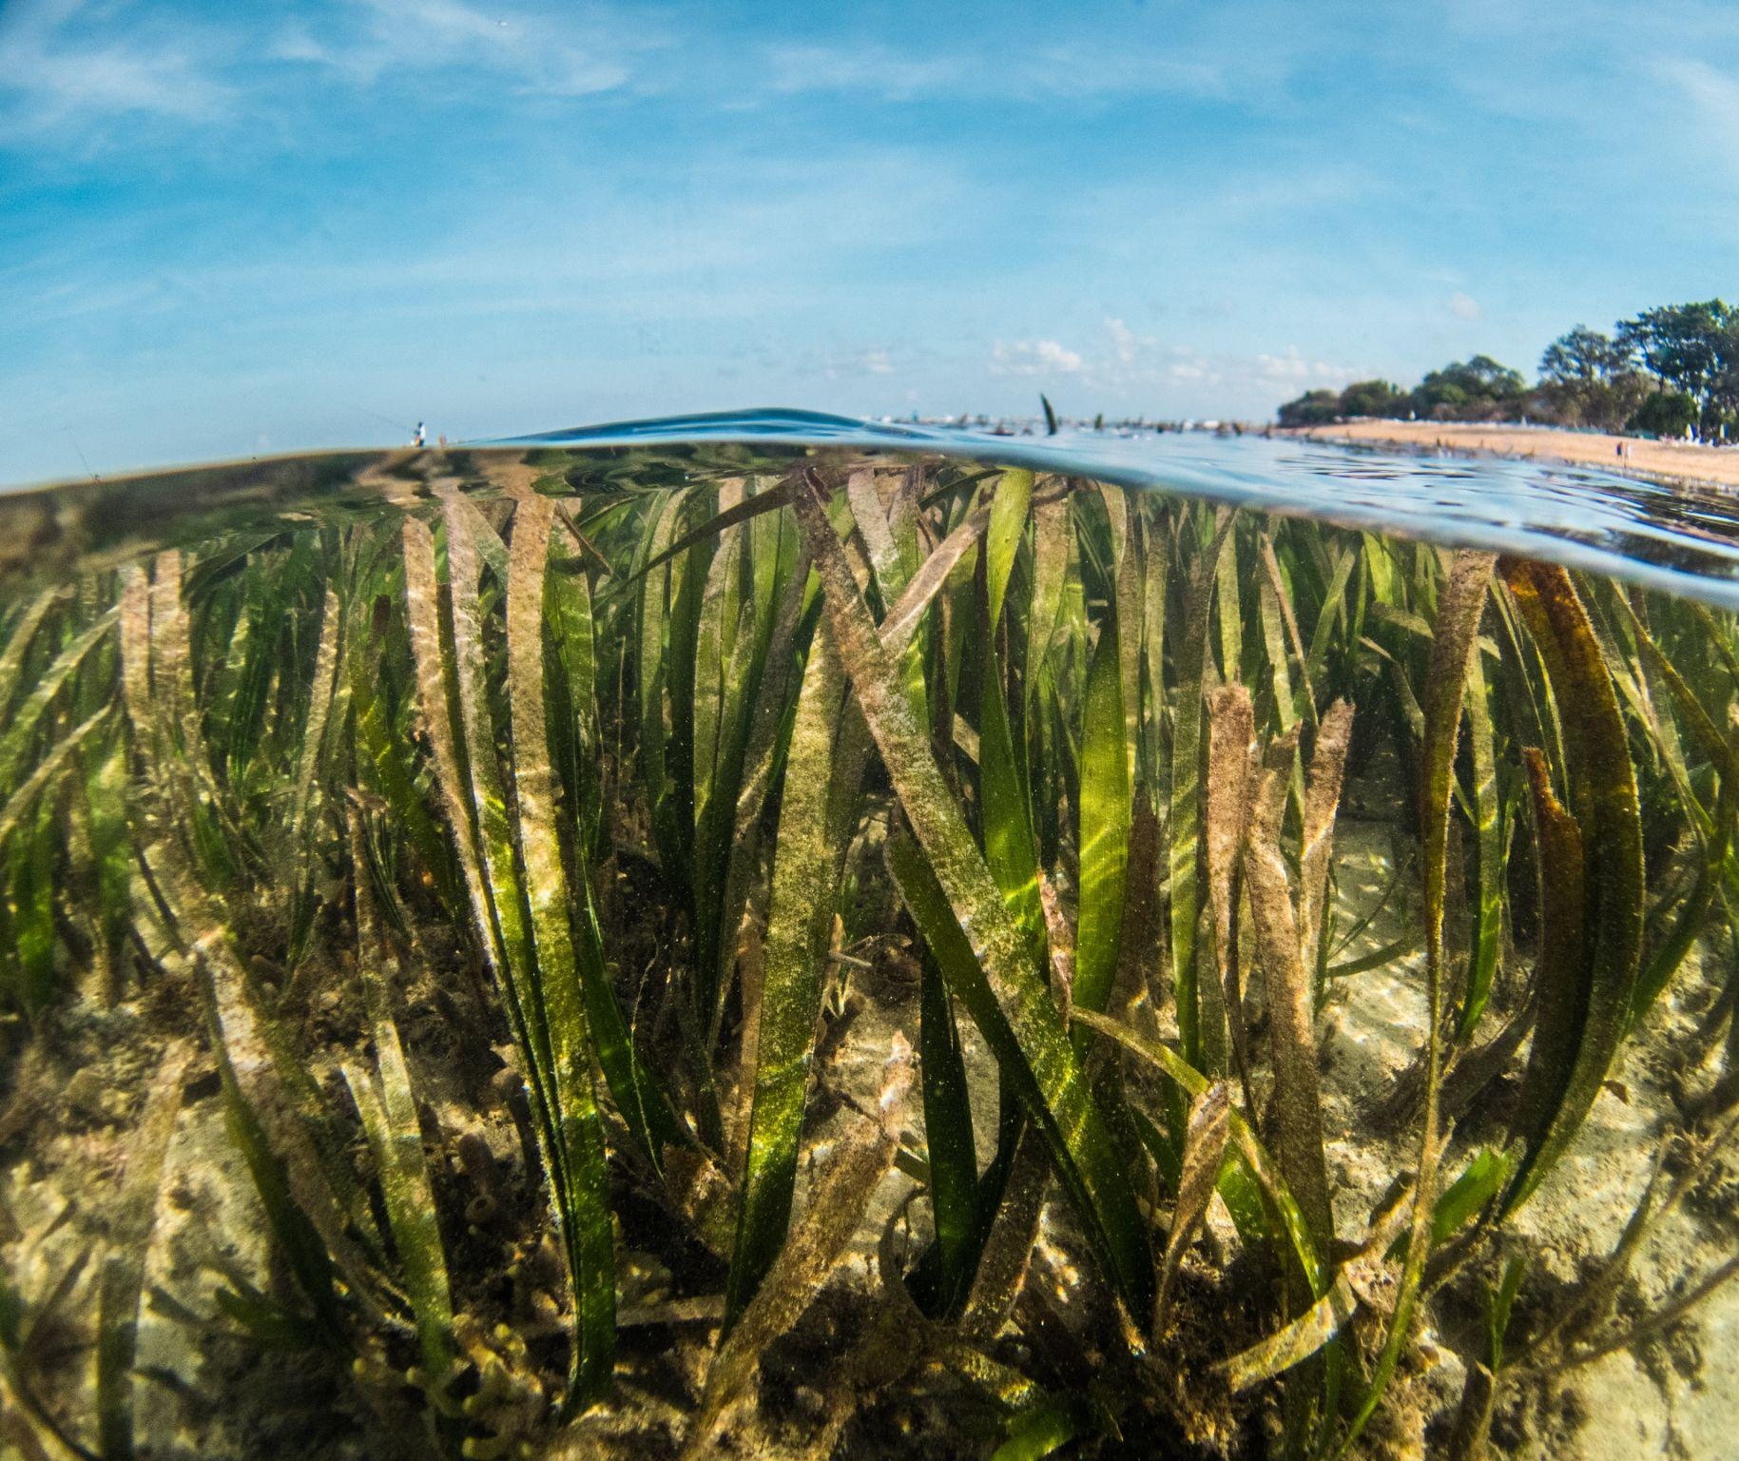
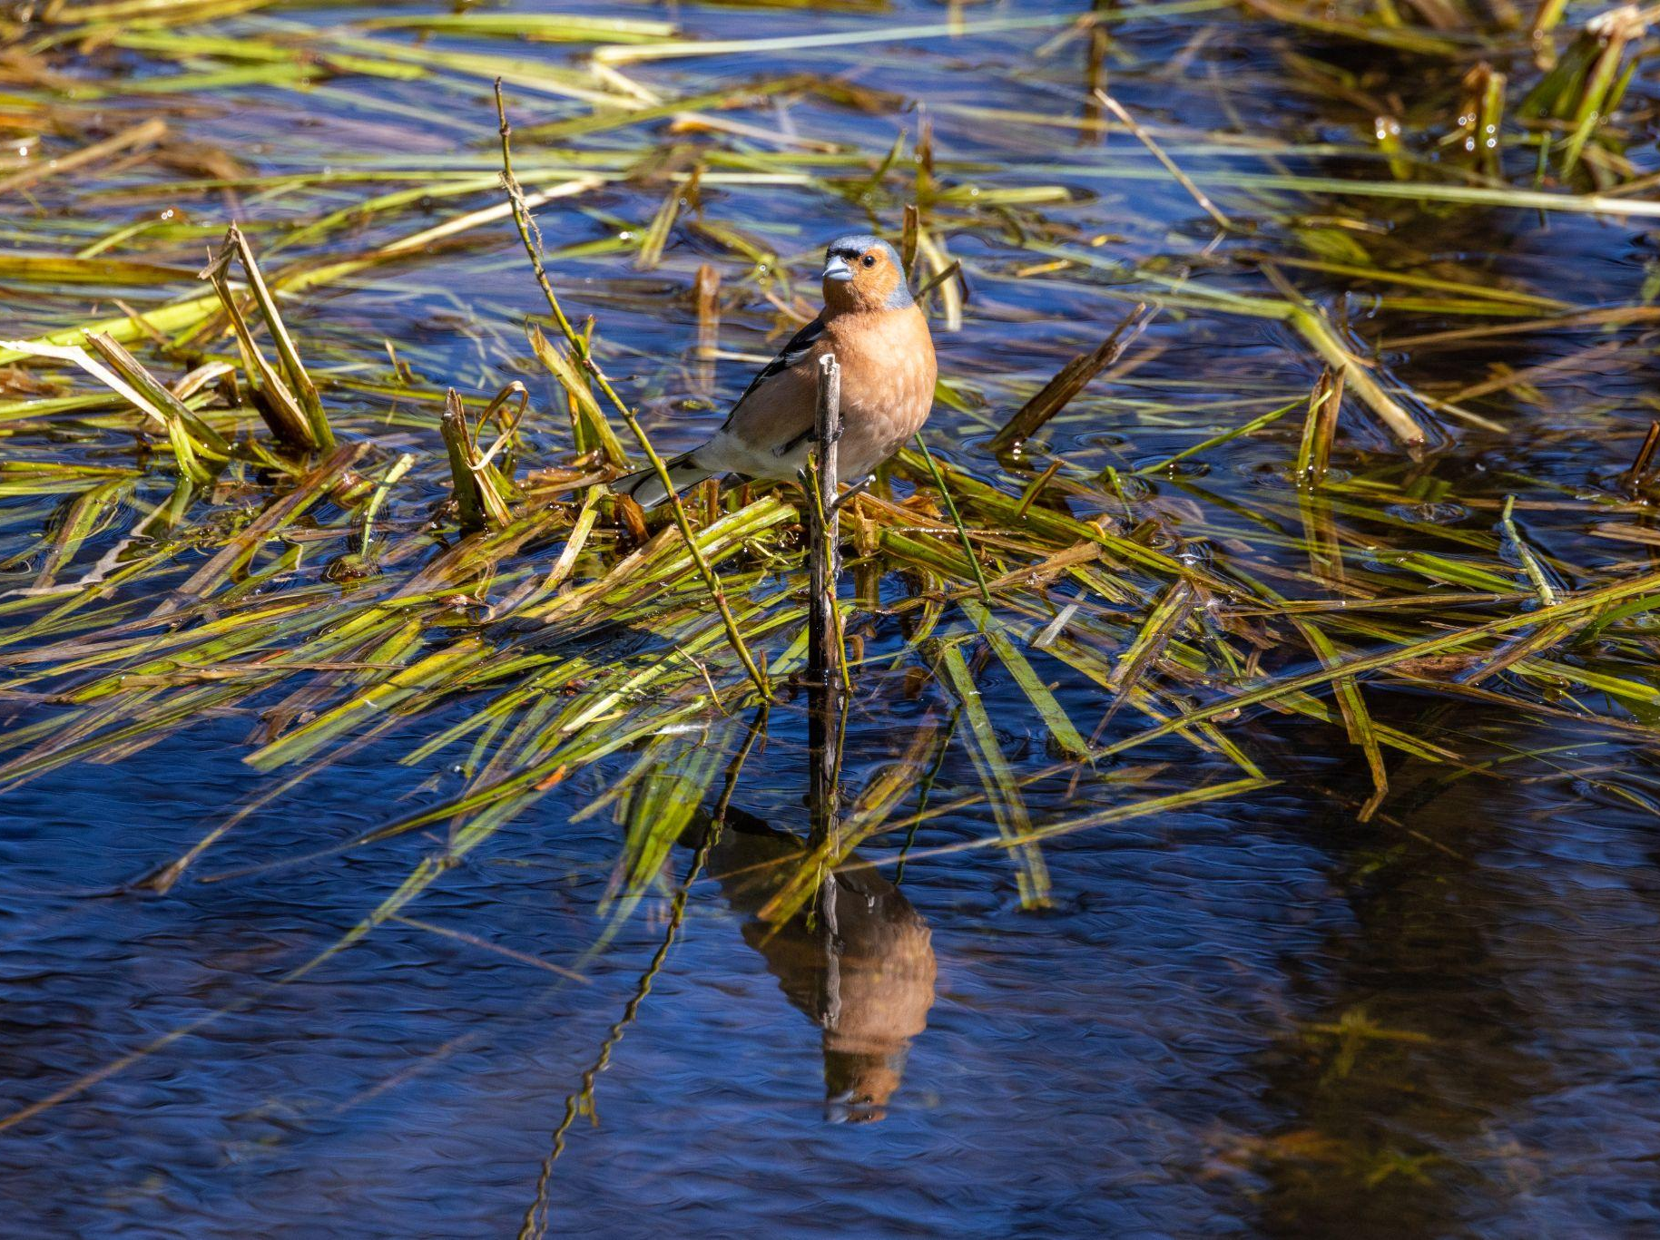
Next Steps and Execution Arrangements
Project implementation and achievement
Document good practices as a result of project implementation
Document impacts of project from site to national level
Document country achievements such as community and stakeholder engagement, private sector involvement, habitat management, etc., and prepare communication materials for the 10th International Water Science Conference (IWC10) in September 2024

Slide 3
Next Steps and Execution Arrangements
TDA/SAP development and updating process
Identify National TDA-SAP Leads and Experts
Develop guidance and template in developing the TDA/SAP to help countries
COBSEA IGM as platform for TDA/SAP endorsement. Inform the COBSEA IGM in October 2024 that the TDA/SAP process has started
Organize preparatory meetings via Zoom:
First Prep Zoom meet to present draft analytical framework with indicators - mid-October 2024
Second Prep Zoom meet to assess national TDA-SAP/ TWG on data assembly and preliminary indicator analysis - mid Dec 2024

Slide 4
Next Steps and Execution Arrangements
TDA/SAP development and updating process
Organize consultation workshops (to coincide with regional meetings):
Workshop 1 – Data assembly and indicator-based assessment methods, Q1 2025
Workshop 2 – Sharing preliminary results, Q2 2025
Workshop 3 – Strategic Action Planning, Q3 2025
Strategic national agenda based on compilation of relevant national action plans updated, Q4 2025
National consultations for the updated SAP, Q4 2025
Synthesized the updated Regional SAP draft, Q1 2026
Reviewed and finalized for COBSEA IGM, Q2 2026

Slide 5
Next Steps and Execution Arrangements
Regional data and knowledge management
SCS SAP Project and COBSEA to collaborate in data and information collection and exchange, specially in the countries not participating in the SCS SAP Project
SCS SAP Project and COBSEA to develop jointly the South China Sea regional knowledge management mechanism - SEA:LEARN (Seas of East Asia: Learning Exchange and Resources Network)
SCS SAP Project to link the information tools developed by the UNEP/GEF Fisheries Refugia Project
SCS SAP Project to engage actively with the GEF IW:LEARN activities and events (publications, bulletins, conferences, etc)

