Slide 1
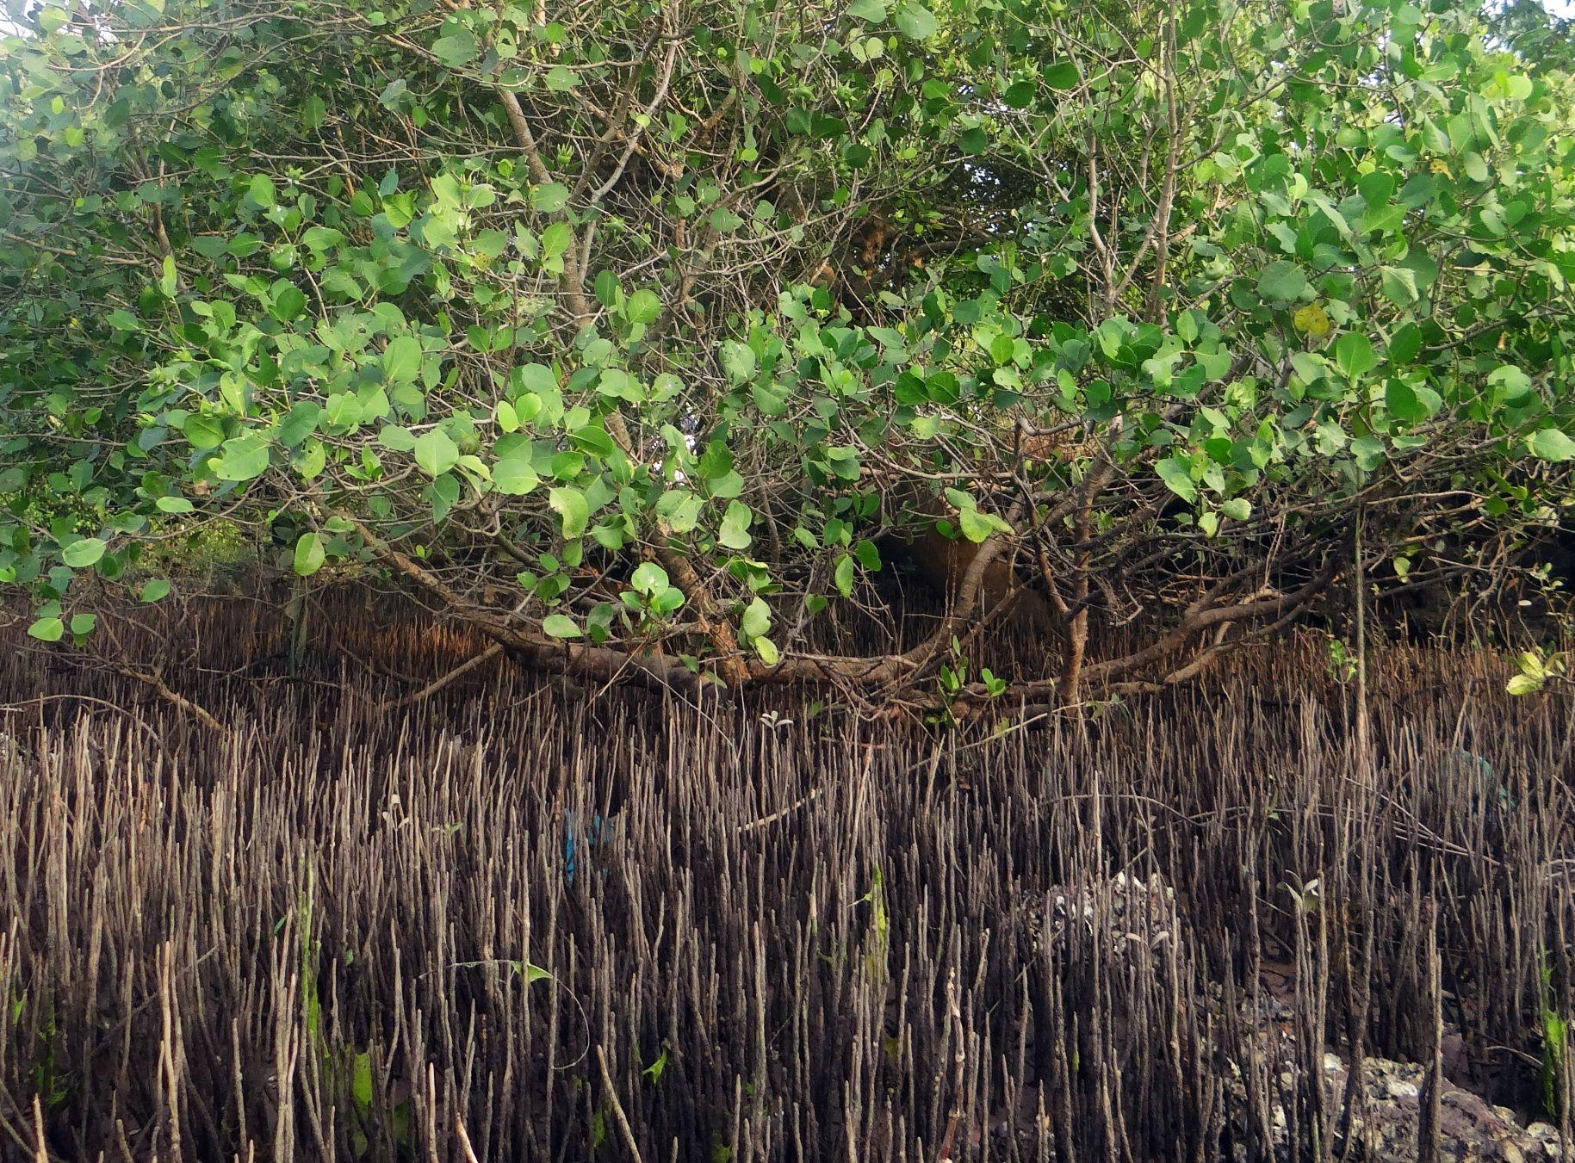

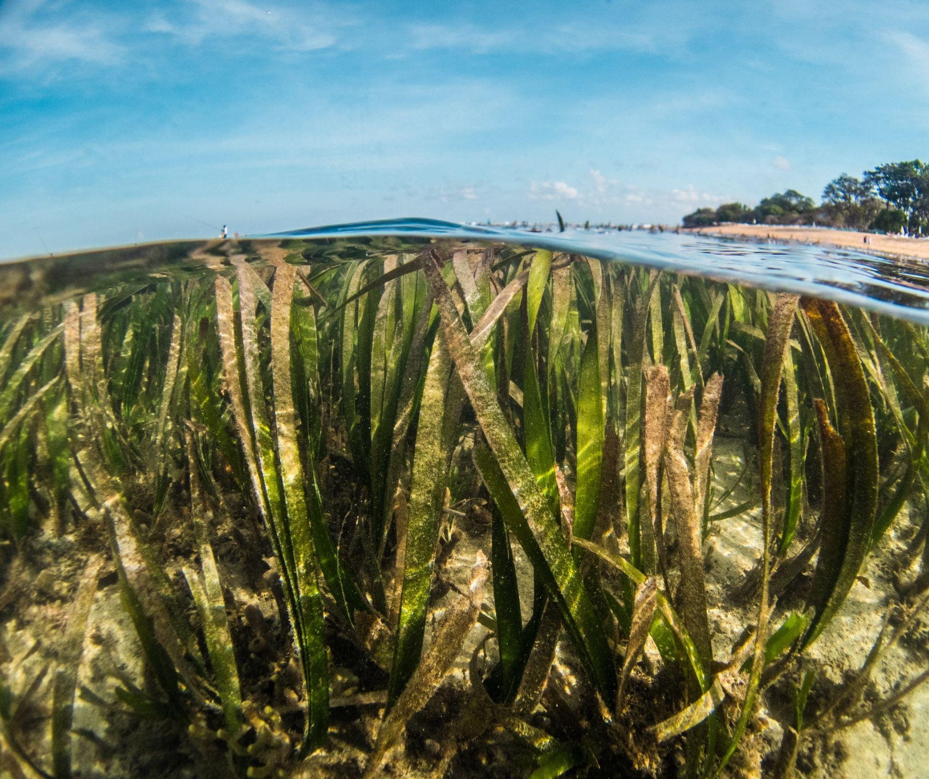

National data & knowledge management systems
Transboundary Diagnostic Analysis & SAP
INDONESIA
Bangkok 24 July 2024

Slide 2
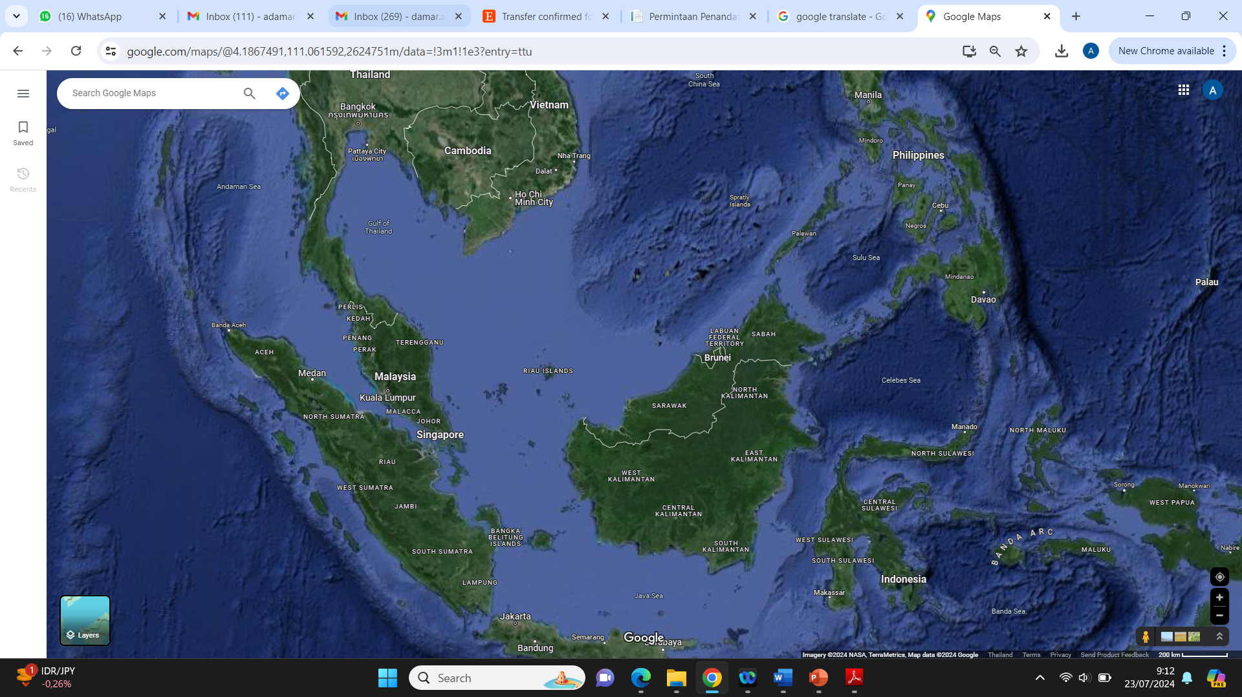
Transboundary Diagnosis Analysis (TDA) and SAP (Agenda 6)
East Monsoon
West/North Monsoon
Transboundary themes
Pollution
Migratory marine mammals & turtle
Migratory Fish
Migratory Bird
Coral Reef
Mangroves
Seagrass
Alien Species

Slide 3
Transboundary Diagnosis Analysis (TDA) and SAP (Agenda 6)
Ecological connectivity
Larvae distribution
Seeds distribution
Food web link
Hydrodynamics
Social connectivity
Cultural
Risk and Threats
Etc.

Slide 4
Transboundary Diagnosis Analysis (TDA) and SAP (Agenda 6)
Management Thematics
1. Coastal and Marine pollution : hydrodynamics, monsoonal systems
2. Migratory marine mammals & turtle : conservation
Migratory fish : yellow fin
Migratory Birds
5. Coastal ecosystems : Coral Reef, Mangroves, Seagrass
6. Alien and invasive species : Ballast water, research

Slide 5
Transboundary Diagnosis Analysis (TDA) and SAP (Agenda 6)
The Analysis
Ecological connectivity
Oceanographic features
Fish distribution
Marine mammals and turtle migration route
Larvae of coral reef distribution
Types of pollution
2. Social connectivity
Cultural connectivity
Risk and threats connectivity
CONNECTIVITY INDEX

Slide 6
Strategic Action Plan (Agenda 6)
INSTITUTIONAL ARRANGEMENT
Lead by National Development Planning Minisry and Respective Ministerial
1. Coastal and Marine pollution : MOEF
2. Migratory marine mammals & turtle : MOMAF
3. Migratory fish : MOMAF
3. Coastal ecosystems : MOMAF and MOEF
Alien and invasive species : MOT, MOMAF
Birds : MOEF

Slide 7
National data and knowledge management systems and tools (Agenda 7)
National data;
National data in Indonesia is spread across various ministries and institutions, so there are various versions of data and maps which are often inaccurate and overlapping.
Since 2016 there has been a presidential regulation issuing "one map policy", and followed in 2019 the government issued "Indonesia one data policy", with this policies the government appointed certain ministries/ institutions that have authority to collect and produce data and maps. for instance is MoEF responsible “one data and map policy” for mangrove (DG-DASHL) and marine litter (DG-PPKL), and MoMAF for coral reefs and seagrass, etc.
These policies aim to enable the government to create national planning and formulate national policy in accordance with existing data and maps.

Slide 8
National data and knowledge management systems and tools (Agenda 7)
BENEFITS
Planning document of national and each administrative area
Development plan of an administrative area
Coastal and marine spatial planning
Conservation and rehabilitation programs proposed
Budgeting allocation
Avoiding overlapping and gap in planning between provinces

Slide 9
National data and knowledge management systems and tools (Agenda 7)
List of systems and tools available and used (past and present):
Tools developed and available :
1. Integrated Coastal Management (ICM) : SOC, SORBM
2. Marine Protected Area (MPA) : EVIKA, MEETS
3. Habitat Restoration and Management (HRM) : RA
4. Climate Change Assessment/Disaster Risk Reduction (CCA/DDR) : CESI

