Slide 1

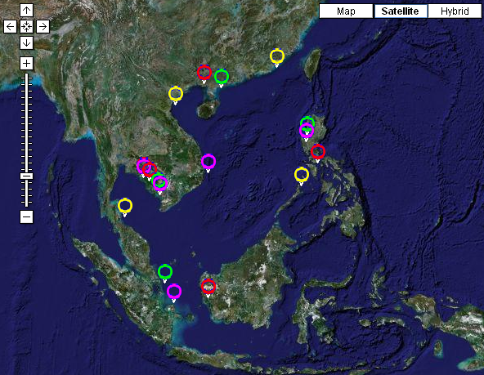
Implementing the Strategic Action Programme for the South China Sea and Gulf of Thailand (SCS SAP Project)
Information tools developed by the SCS Project and mechanism for development of regional knowledge management system of the SCS SAP Project
(Meeting document SCSSAP RSTC 2/6)

Slide 2
Information tools developed by the SCS Project
Development of the South China Sea project website
The Partner Network Contacts Database
Information Pages for each Regional Working Group, Regional Task Force, and Demonstration Site
Electronic Discussion Forums
A Monthly E-Newsletter
The SCS “Blog”
RSS News Feeds
An Online “Helpdesk”

Slide 3
Improving accessibility to information and outputs from the SCS project
South China Sea Document Repository,
Online South China Sea Meta-Database,
Online South China Sea Geographical Information System,
Online Nutrient Carrying Capacity Model for the South China Sea,
Online South China Sea Projects Database,
South China Sea Multi-Media Centre,
Catalogue of South China Sea Public Awareness Materials,
South China Sea Photo Album,
Fisheries Refugia Information Portal,
South China Sea Training Portal, and
South China Sea Project Google Earth Map Files.

Slide 4
Data and information bases of the sites developed by the SCS Project
GIS database based on agreed properties and variables
 | Parameter | Data & Information needed
Geographic information | Co-ordinates | Latitude & Longitude central position of areas, GPS Boundary or number (min 4) of paired co-ordinates for larger areas; end points for linear strips.
 | Area | (Units Km² or Ha)
Physical Environment | Reef type | Fringing (mainland & island), barrier, atoll, patch, other
 |  | Slope Degrees (tangent)
 | Bathymetry | Depth contour
 | Climate | Prevailing wind; sea surface temperature, (seasonal mean, max & min); rainfall mean monthly rainfall (mm)
 | Current pattern | Seasonal current pattern
 | River discharge | Sediment load, quantity of freshwater discharge salinity
Details of properties and variables, Data and Information requirements
Table 1. For Mangrove Site Characterisation.
Table 2. For Coral Reef Site characterisation.

Slide 5
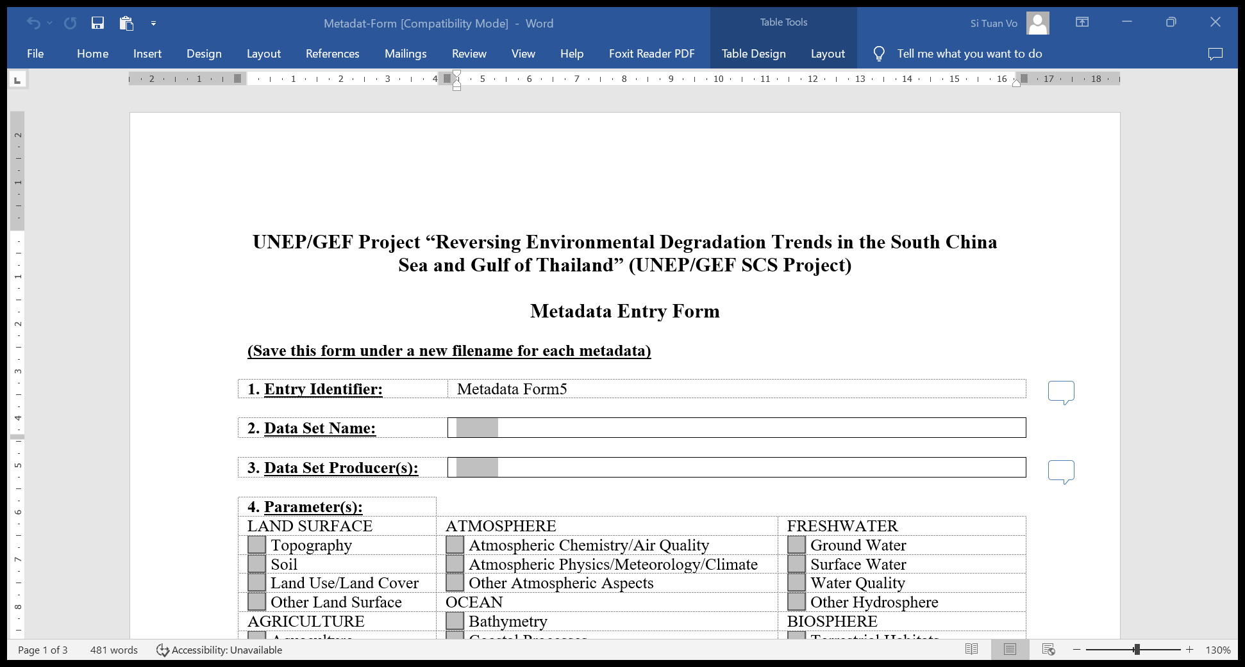
The Online South China Sea Meta-Database
Annex 2. Metadata entry form

Slide 6
Outcomes, outputs and activities of the SCS SAP Project toward the South China Sea knowledge management system
Outcome 2.1 Enhanced information-base for coastal habitat management, monitoring and action planning
Outcome 2.2 Effective integration of regional science in the management of land-based pollution
Outcome 3.4 Revitalization of regional mechanisms for communications, knowledge exchange, and information and data management and sharing

Slide 7
2.1.1. Assessment of existing data and information on coastal habitat in the South China Sea, and review of monitoring and assessment approaches that can support SCS monitoring program, from national, regional and global sources, combined with project-generated data from Component 1
Regional: (1) Develop and establish mechanism for collection and compilation of GIS data, partnerships, approach, and database linked to global databases on habitats; (2) Report on existing databases on coastal ecosystems, including all relevant types of data and information
National: Review status of national monitoring system including innovative technology and approaches; report on data available and main gaps and capacity needs in monitoring, in line with regional and national commitments, the SDG’s and CBD Post 2020 Framework
Execution: Consultancy work with participation of RWGs & Focal Points on habitats
2.1.2 Mechanism for collection and exchange of regional coastal habitat and pollution information and data established
National: Provision of habitat and pollution data following site characterization forms and guidance (focusing on project sites)
Regional: (1) Agreed characterization form and guidance to support national reviews of data and information on pollution; (2) Development of GIS & meta-database; (3) Sharing with partners
Execution: Consultancy work with participation of RWGs & National Focal Points on habitats & LbP

Slide 8
2.1.3 Roles of coastal habitats for blue economy development in the South China Sea, and assessment of data/information needs for the blue economy
Regional: Agreement on key principles for the development of the blue economy in the region, including the role of coastal habitat conservation in the blue economy
National: Review of available data and information related to assessment of role of habitats, including all ecosystem services from coastal habitats/ecosystems (such as climate change adaptation, mitigation)
Execution: Consultancy work with participation of RTF-EV and national EV experts
2.2.1 Updating the current scientific data and information on marine land-based pollution for SCS marine basin
National: Analysis and mapping of each countries monitoring programmes, desk review of national LbP assessment and modelling
Regional: Report on scientific data and information on marine land-based pollution for SCS marine basin and building a regional mechanism for monitoring and reporting on the marine and coastal environment (in partnership with regional organizations
Execution: Consultancy work with information contribution from countries and other exercises

Slide 9
2.2.2 Regional level assessment of sources, flows, and impacts of marine pollution (incl. from coastal aquaculture): Support national surveys using recommended approaches and applying training to establish baselines and inform a regional assessment
Regional: Develop methodology/guidelines on the assessment of sources, flows and impacts of key contaminants and quantification of effluent volumes and contaminant loadings for coastal aquaculture.
National: Provision of data and information for regional assessment
Execution: Consultancy work with participation of RWG & National Focal Points on LbP
2.2.3. Quantification of effluent volumes and contaminant loadings from coastal aquaculture to the SCS marine basin
National: Review of data and information on effluent and contaminant loading from culture operations (plastic, nutrient…) identified as key threat to dominant coastal biomes
Regional: Report on impacts of key contaminants and quantification of effluent volumes and contaminant loadings for coastal aquaculture
Execution: Consultancy work with information contribution from countries and regional reviews by RWG-LbP

Slide 10
2.4.1 Expanded datasets and estimates of economic valuation information on the goods and services of SCS coastal ecosystems
National: Desk reviews on economic valuation conducted in countries
Regional: Report on the methodology and best practices on economic evaluations, updating the Economic Valuation carried out under Phase 1 (2002-2008) to include new data from the region, considering TEEB methodologies, blue economies, and blue carbon.
Execution: Consultancy work with participation of RTF-EV
2.5.1. Online catalogue of best practice management measures and technologies for sustainable use of SCS coastal habitats and land-based pollution management
Regional: Catalogue of best practices accessible online (Linked to outputs 1.5.3, 2.3.1, and 3.1.6)
Execution: Task of communication expert (PCU)
3.4.1 A variety of multi-media information and knowledge products based on SCS SAP implementation communications strategy
Regional: Development of the SCS SAP communication strategy
Execution: Reviewed by the RSTC

Slide 11
3.4.2 Regionally appropriate knowledge tools developed to support decision-making and planning
Regional: Repository of knowledge tools based on national needs accessible online
Execution: Possible partnerships to support the development and initiate contracts and activities.
3.4.3 The SCS project web portal and clearing house mechanism and associated regional databases online, updated and linked to IW-Learn and other GEF Knowledge management systems
Regional: Maintain and update the project web-site https://scssap.org/ and linked to IWLEARN.
Execution: Daily work of communication expert
3.4.4 Active engagement with GEF IW: LEARN [1% of project resources] including participation in IW conferences and 3 experience notes
Regional: Inputs and contributions to the IWLEARN activities
Execution: PCU task

Slide 12
Issues for discussions and decisions by the RSTC
Integration and sustainability
Role of COBSEA national focal points in data and information collection and exchange, specially in the countries not participating in the SCS SAP Project
Linkages with the information tool developed by the UNEP/GEF Fisheries Refugia Project executed by SEAFDEC
Joint development of the South China Sea knowledge management system between COBSEA and the SCS SAP Project
Active engagement with GEF IW:LEARN (publications, conference…)

Slide 13
Data collection and information documentation
Site characterization forms drafted by consultant, adjusted by RWGs on habitats and reviewed by the RSTC
Templates for LbP data and information drafted by consultant, adjusted by RWGs on LbP and reviewed by the RSTC
Guidance for gathering data and information on economic valuation and blue economy drafted by consultant, adjusted by RTF-EV and reviewed by the RSTC
NTFPs ‘s coordination with national working groups on habitats and LbP to gather data and information at site and national levels
Data and information sharing and exchange
Template for metadata drafted by consultants, adjusted by RWGs on habitats and LbP, and reviewed by the RSTC
GIS and Metadata bases developed by the communication expert and uploaded to the website for wide uses
Some data and information (mainly secondary/synthesized materials) shared for TDA development with guidance of the consultant on TDA/SAP
Online catalogue of best practice management measures and technologies for sustainable use of SCS coastal habitats and land-based pollution management

