Slide 1
Proof of concept for integrated Transboundary Diagnostic Assessment:
Landscape – seascape continuum
Draft Schedule

Slide 2
Mapping and assessing landscapes
Scale: Watersheds draining to South China Sea
Variables
Variable | Data source | Quality of data/ Time coverage
1. Population size and density | National Statistics Office | Changes over time
2. Population without sewer connection |  | Changes over time
3. Land use – cropland | National Agriculture Office | Changes over time
4. Land use - pastureland | National Agriculture Office | Changes over time
5. Land use – natural forests | National Forestry Office | Changes over time
6. Land use – urban centers | National Development Office | Changes over time

Slide 3
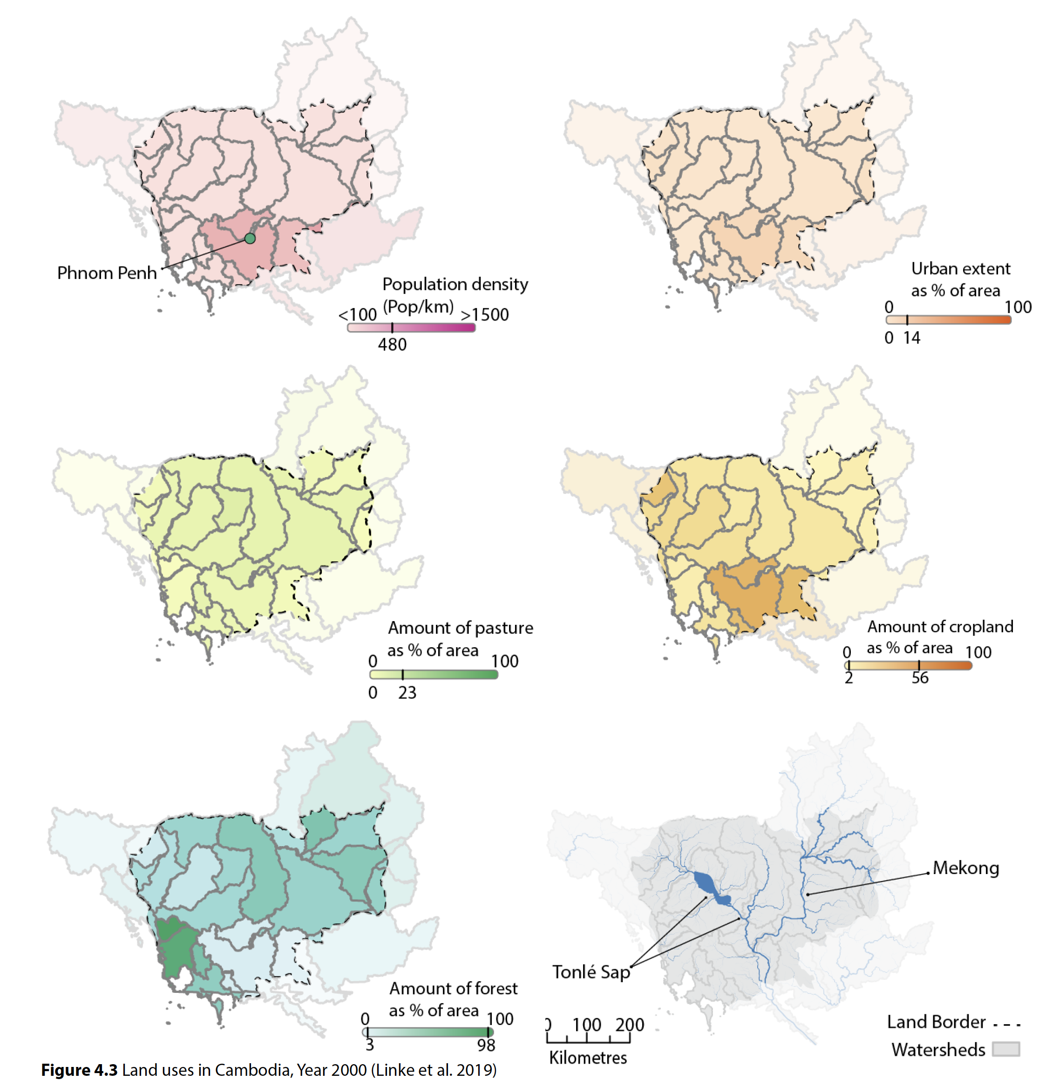
Land use analysis at watershed scale
For Cambodia using data from
Linke et al. 2019 for year 2000.

Slide 4
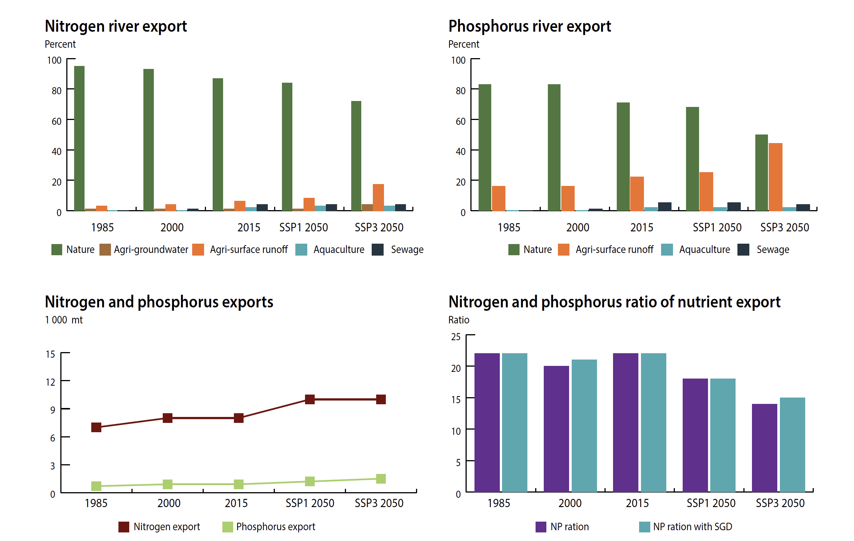
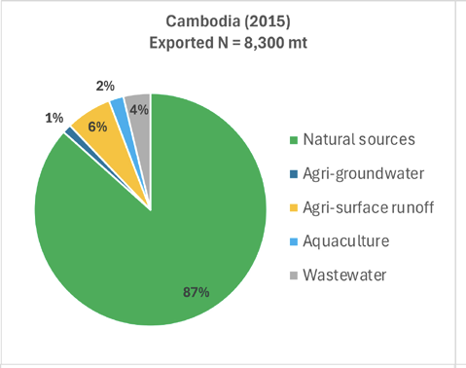
Assessing water quality at river mouth
Water quality monitoring with reference standards
Sources of nutrients using modeled data from Beusen et al 2022

Slide 5
Associated Coastal Habitat Assessments
Mapping of seagrass, corals, mangroves, wetlands
Area/ extent, changes over time
Species diversity, changes over time
Functional group diversity, changes over time
Median sizes of harvestable food fish species over time
Flowering events for seagrasses
Spawning events for corals
Presence/Absence of associated macrofauna
Above ground biomass for mangroves, changes over time
Productivity in kg C/unit area/yr
Area with marine protected status

Slide 6
Assessing coastal water quality
Empirical data: Occurrence of harmful algal blooms, hypoxic events
Computing the Nitrogen or Phosphorus Index of Eutrophication Potential (Garnier et al. 2010)
Coastal water quality standards

Slide 7
Socioeconomic assessment
(jurisdiction approximating watershed scale; gender disaggregated)
No. of fishers, No. of tourist operators, No. of tourist visitors
Median annual income per economic activity
Average/ median family size
No of dependent family members by gender
Poverty level
Protein dependence
Educational attainment, scale
Average/ median longevity
Exposure/Risks to natural disasters (coastal flooding, storms, etc.)

Slide 8
Governance assessment
Subnational/ National pollution reduction policies
Subnational/ National marine protected area policies
Subnational/ National coastal development plans
Subnational/ National fisheries and aquaculture policies
Capacity for environmental monitoring
Capacity for law enforcement
Capacity for environmental education and awareness building

Slide 9
Comparative Assessment of Levels of Risk for
Associated Landscape-Seascape systems
of [COUNTRY] in the South China Sea
Landscape-Seascape systems Of Country-South China Sea | Landscape factors | Water quality at river mouth | Socioeconomic factors | Governance factors | Coastal Habitat Health | Level of Risk
A |  |  |  |  |  | High
B |  |  |  |  |  | Medium
C |  |  |  |  |  | Low
D |  |  |  |  |  | Medium
E |  |  |  |  |  | High

Slide 10
Checklist for Integrated landscape-seascape assessments to underpin National TDAs
WORKSHOP I: Data assembly and Indicator-based Assessment Methods – possibly Q3, coincident with a regional meeting
  Watershed and associated habitat maps
  Assembly of existing and accessible data sets
  Methods to characterize watershed, water (fwater & coastal), associated coastal ecosystems, human wellbeing and livelihoods
  Methods to translate metrics to comparable levels of risk

Slide 11
In parallel
Liana to mine FREE global databases for:
  Modeled nutrient fluxes for model years 2020, 2030, 2050
  Fisheries landed catch
  Burden of disease due to water-related environmental factors
  Tourism
Thematic Consultants
  Published studies on regional governance, economic valuation, fisheries refugia, pollution

Slide 12
Workshop II – Sharing preliminary results
(coinciding with a regional meeting, 2025 Q1)
Sharing preliminary results by National TDA Teams
Sharing preliminary results from global data bases
Sharing preliminary findings from thematic published literature
Preliminary ranking of priority areas of transboundary concern by National TDA Teams
Preliminary identification of STRATEGIC ACTIONS to address priority transboundary concerns by National TDA Teams
Authored publications – finalized by 2025 Q2
  National TDAs
  Thematic TDAs
  Assessment using global databases

Slide 13
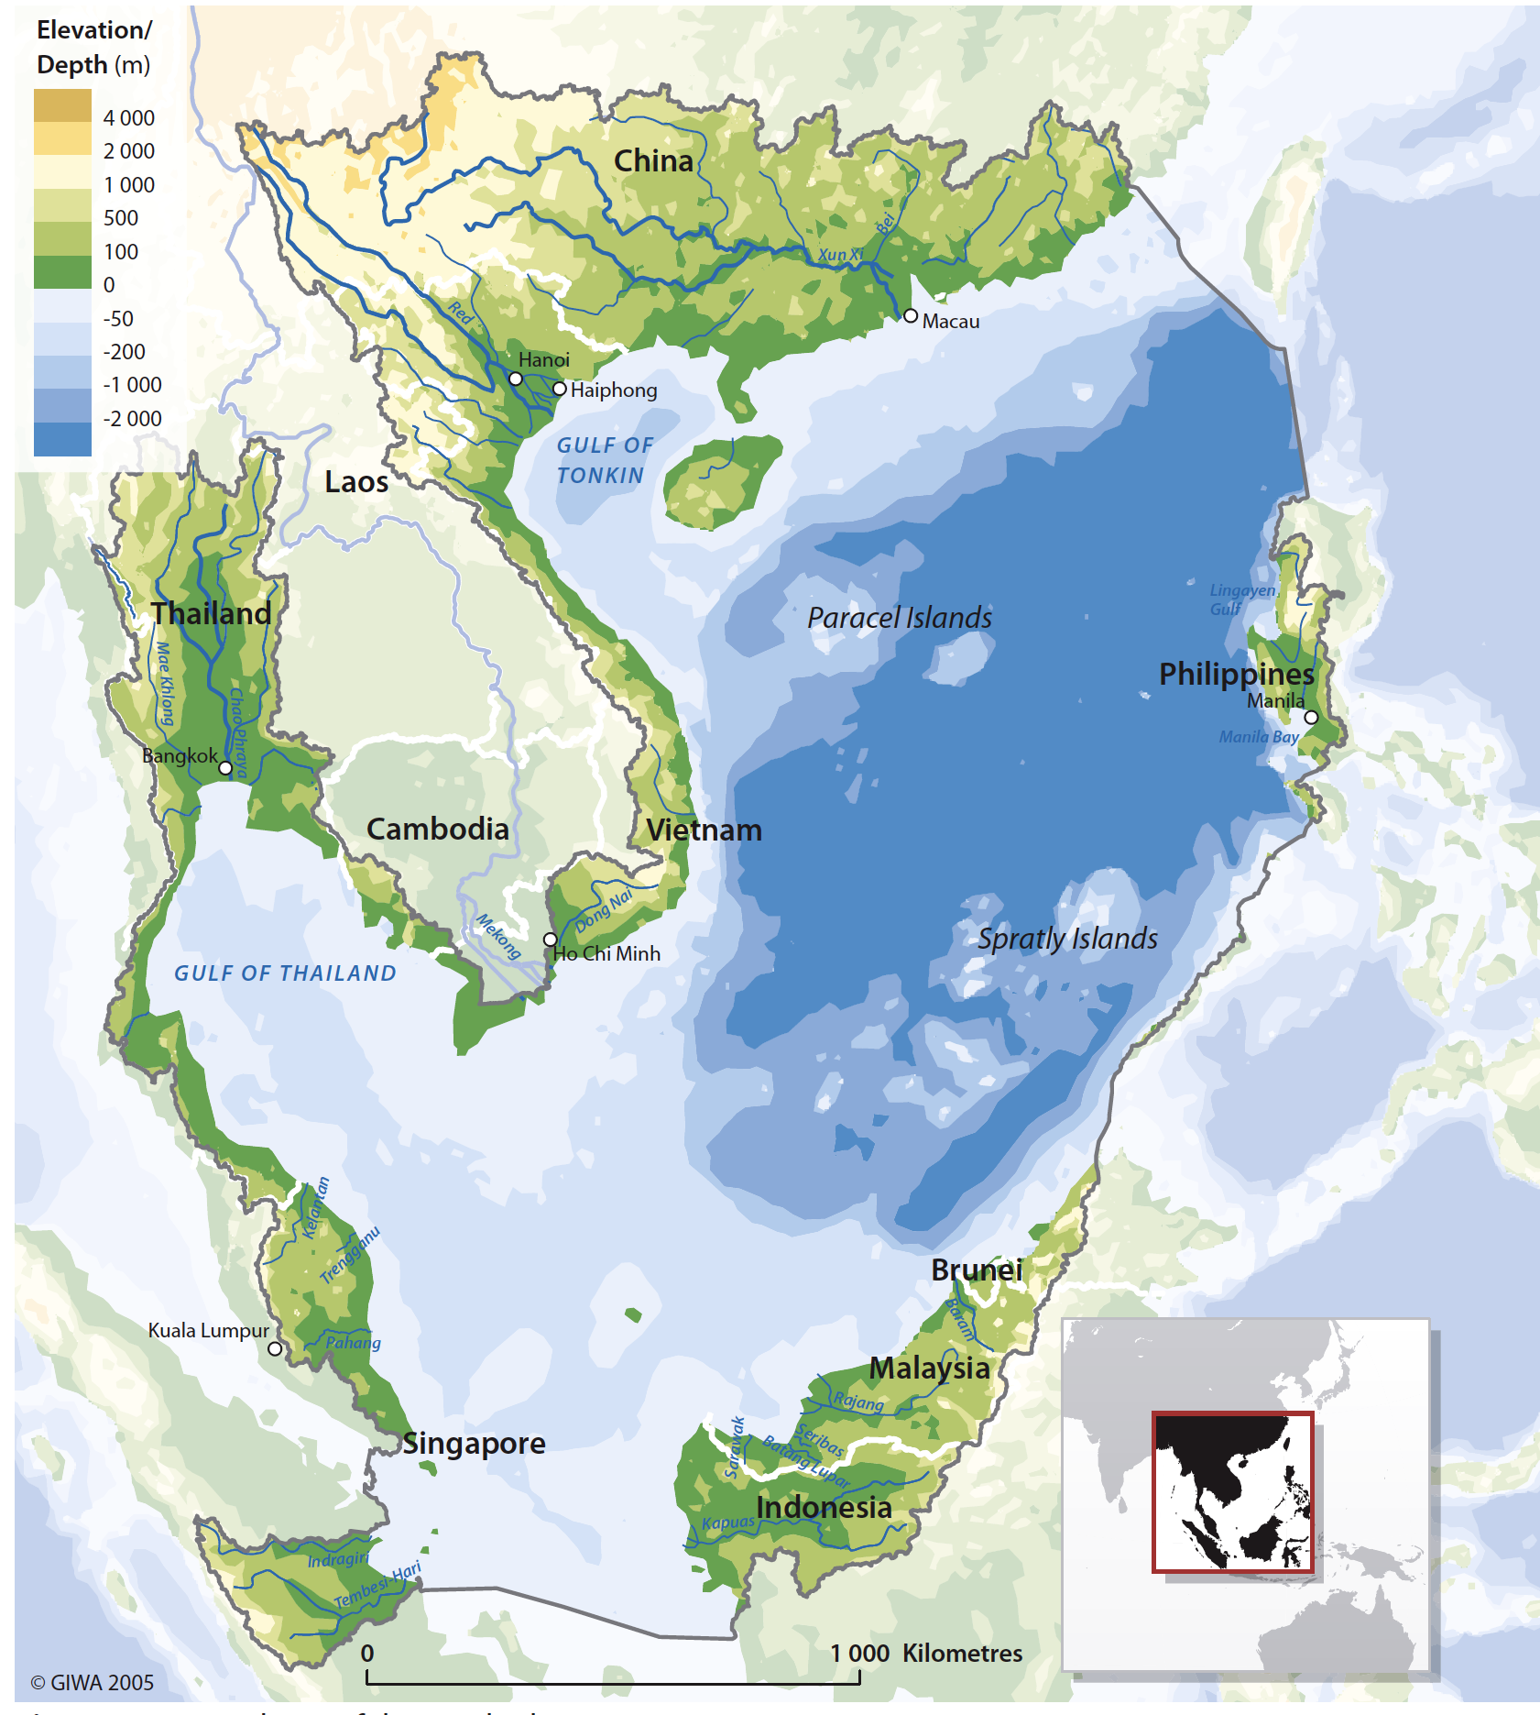
Workshop III – Strategic Action Planning, 2025 Q3
Identified strategic actions by National TDA-SAP Teams
Economic valuation: Costs and benefits of Strategic Actions
PRIORITY strategic actions identified for financial assistance
  GEF
  Public-private partnerships
  Other blended investments
National SAPs finalized 2025 Q4
Synthesized Regional SAP draft 2026 Q1; Reviewed and finalized 2026 Q2

