Slide 1





Implementing the Strategic Action Programme for the South China Sea and Gulf of Thailand (SCS SAP) Project
Second Meeting of the Regional Scientific and Technical Committee (RSTC)
23-25 July 2024, Bangkok, Thailand
Report of Status and Progress of the SCS SAP Project implementation
[NAME OF COUNTRY]
[Name of National Executing Agency]

Slide 2
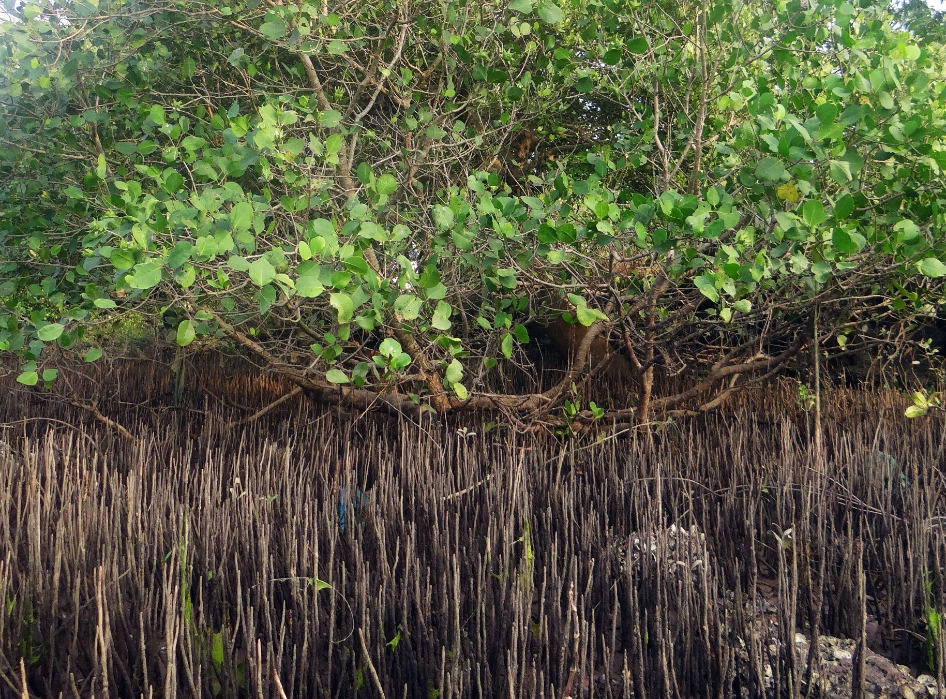



Updated National Coordination Framework
Focal Ministry:
Executing (leading) Agency:
Key Partner Organizations:
National Focal Points
National Technical Focal Point:
Focal Point for mangroves:
Focal Point for coral reefs:
Focal Point for seagrass beds:
Focal Points for LbP:
Focal expert on Economic Valuation

Slide 3
Status of PCA/GSA signature and amendment
Time of signing the first PCA:
Time of signing the amended PCA:
Amendment for all 3 components:
Amendment for only component 1:
If not signed yet, time schedule for signing PCA/GSA:
Challenges resulting in the delay:
Solutions to speed up:

Slide 4
Progress in implementing the signed PCA/GSA
Timing issues (intime, delayed, extended):
List of changed activities and reasons:
Key achievements up to present:
1/
2/
3/
…………………………

Slide 5
Highlights on the country report on achievements in implementing the SAP during 2008-2021
Time of adoption for publication:
Key achievements on management of mangroves, coral reefs, seagrass beds, coastal wetlands and LbP
1/
2/
3/
,,,,,,,,,,,,,,,,,,,,,,,,,,,,,,,,,,,,,,,

Slide 6
Status in documenting good practices
List of good practices documented:
1/
2/
3/
……
Time of finalization and submission for publication:

Slide 7
Participation in the Special Forum on South China Sea and Roundtable
Total participants:
Number of local representatives:
Number of presenters in the forum
Number of talks in the roundtable:
Highlights on networking following the special forum:
1/
2/
3/
,,,,,,,,,,,,,,,,,

Slide 8
Challenges encountered in the implementation of the SCS SAP Project and Recommendations
Present challenges. recommendations and action points.

Slide 9
National data and knowledge management systems and tools (Agenda 6)
List of systems and tools developed (past and present):
1/
2/
3/

